Slide 1
Customize slide two for your PTA and save it as a jpg image file to post on social media or to send in an email to your school community.
Click in the boxes to edit the text:
PTA Name
List reasons why people should support your PTA now more than ever before
Add your Membership Goal in the banner at the top of the thermometer (you can find this goal number in MemberHub on the Unit Data page towards the bottom
Calculate your current Percentage to Goal (Members To Date divided by Membership Goal) and then adjust the thermometer fill by clicking on the RED are, while hovering over the center dot, drag your mouse up to increase the size to fill the thermometer to represent your current percentage %
When finished with your customization – click on FILE and SAVE AS – browse to a location on your device and change the file type to jpg file interchange format. When you click to save, a dialog box will open asking “Which slide do you want to export?” Click the option for just this one or current slide only to save “this slide only.” This will save the slide as an image file for you to use on FaceBook, Instagram, Twitter or in an email blast.
If you need assistance, please email dwelch@nyspta.org in the state office.

Slide 2
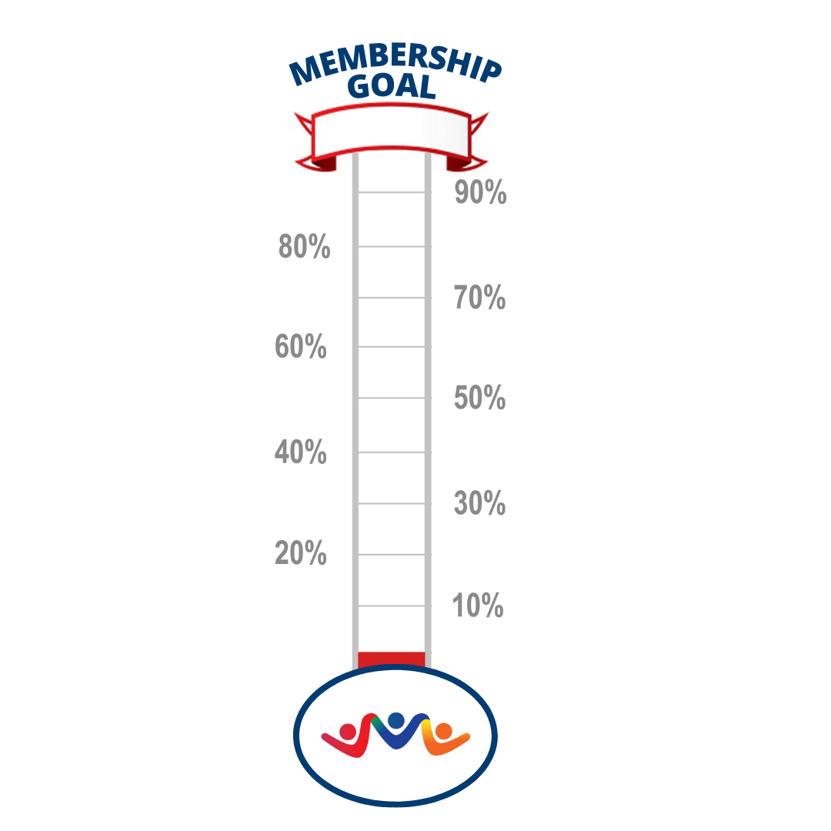
PTA NAME
Add Goal#
Add Reasons to Join here!
List programs and services your PTA provides or other reasons your school parents and others should join PTA.
You can adjust the size of this text block and background color block as needed

