Slide 1
Navigating the Digital World
Mikki Wilson
PTA Connected National Ambassador
Notes:
{Say}
Introduction – Who you are and what you do for NPTA.​​
I am so excited to be here at the New York State PTA Convention to talk about a topic that seems to be on every family’s mind – online safety in our digital world and how National PTA’s PTA Connected Initiative is helping parents and caregivers navigate the challenges that can come from being so connected online.
​ PTA Connected is an initiative focused on providing turn-key programming for PTA leaders to address digital safety, citizenship, wellbeing, access and equity concerns in their school community. All programming from National PTA is designed in a similar manner to provide PTA leaders with as many resources as possible to support you in running programmatic events within your community
{next slide}

Slide 2
Agenda
Why Digital Wellness?
What is PTA Connected?
PTA Connected Programs
Program Highlight – Ready, Tech, Go!
Program Support
Q&A
Notes:
{Say}
Today, we will do a brief overview of why digital wellness is more important than ever, the specific programs within the PTA Connected Initiative, highlight our newest program Ready, Tech, Go!, and see what you can expect from our programmatic resources. At the end, we’ll have time to answer and discuss any questions or thoughts you may have.
{next slide}

Slide 3
Thumbs Up-Down-Sideways
Today have you -
Used a connected device?
Checked email?
Posted on social media?
Checked in with your family?
Do you feel –
Comfortable with the amount of time you spend online?
Comfortable with the amount of time your family spends online?
Prepared to talk to your community about online safety and wellness?
Notes:
{Say}
Within all National PTA programs we provide PTA leaders with everything needed to run not only a successful program, but one that supports active family engagement.
This is an example of the type of ice breaker that is baked into PTA Connected programs to help you do that.
For this activity give please me a Thumbs up if you agree, thumbs down if you disagree or a thumb in the middle if you are unsure about how to answer the following questions.
{Click through and read each of the 4 questions. Pause to have people look around the room. Stop at “Do you feel…”}
{Say}
We have had a lot of very clear answers for this first section. I wonder if we will have some people who are in the middle for this next section.
{Click through the next 3 questions. Read each one. Pause after each to have people look around the room. Stop at the end.}
{Say}
It looks like there are some people in the room who are ready to go and some people who want some more information – PTA Connected is designed to help all of us feel prepared to have important digital conversations and comfortable with our family’s online behavior.
{next slide}

Slide 4
Why Digital Wellness?
Screen Time
Children ages 8-12 spend 5.5 hrs. per day using screens for entertainment.
On average, boys have slightly higher screen time then girls.
Social Media Usage
93% of youth age 14-22 use social media.
In 2019, 41% of teens said they enjoyed social media "a lot"; while in 2021 that figure declined to 34%.
Cyber Bullying
37% of young people ages 12-17 have been bullied online.
60% of young people have witnessed online bullying.
Notes:
{Say}
So, what is digital wellness, and why is it important?
Digital wellness is being aware of how you spend your time online. It includes being mindful of your online presence and footprint; how you interact with social networks, games and apps; the ways you protect your identity; and how you balance your time online within your daily life.
A 2021 survey conducted by Common Sense Media found that children ages 8-12 spend around 5 and half hours a day using screens for entertainment, with boys having slightly higher screen times than girls on average.
A 2018 study by Hopelab and Well Being Trust found that 93% of youth age 14-22 use social media, most daily. Additionally, in 2019, 41% of teens said they enjoyed social media "a lot"; while in 2021 that figure declined to 34%.
And finally
According to 2019 Cyberbullying Data collected by Dr. Justin Patchin, 37% of young people between the ages of 12 and 17 have been bullied online. 30% have had it happen more than once
And according to the Children’s Society, 60% of young people have witnessed online bullying, but most of not intervened.
{next slide}

Slide 5
National PTA Research Found:​
- Concerns of oversharing personal information​
- Cyberbullying​
- Screentime​
- Mental Health​
- Scams​
- Data Privacy
Notes:
{Say}
Although National PTA has had a digital safety program since 2015, over the past several years, the PTA has heard growing concerns from parents about their families online lives. ​
​
In spring 2018, National PTA did direct research via focus groups and a national survey of our members to try to hone in on this, and as you can imagine, parents are concerned about lots of things online including:
oversharing of personal information
Cyberbullying
Screentime
Mental health
Scams
Data privacy
Parents really want a space to connect with one another and their kids around these topics. They want to have technology conversations with their kids but are overwhelmed with information and/or not sure where to start or what information is even reliable. ​

Slide 6
PTA Connected provides you with turn-key programs to support:
Digital Wellness
Online Safety
Data Privacy
Digital Citizenship
Family Tech Rules
Notes:
{Say}
To help, National PTA focused all of PTA’s digital work into one initiative called PTA Connected.
This initiative takes a holistic approach to providing PTAs with programming that addresses online safety and data privacy, wellness, being a good digital citizen - which is a fancy way of saying how you behave online– and helping families establish together what their online values are and what their rules around technology will be.
Thanks to funding provided over the years by Norton, Google, YouTube, Discord, and AT&T, PTAs have been able to host hundreds of PTA Connected events in every state, Puerto Rico and on Military Bases.​
​
{next slide}

Slide 7
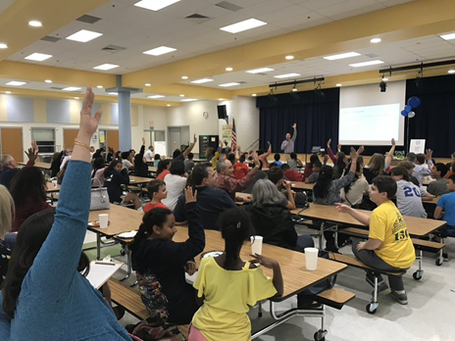
PTA Connected
All PTA Connected programming is designed to empower PTA leaders to create engaging spaces for families to practice skills needed to be safe while exploring and growing online.
Notes:
​Throughout this process, the thing that we kept hearing was that parents really wanted a space to connect with one another and their kids around these topics.
That they want to have conversations with their kids but are overwhelmed with information and not sure where to start or what information is even reliable. ​
​PTA Connected programs are designed to help us move away from a traditional lecture based model and bring digital safety to life. Creating the time for us to work together as families in community, making a safer and better internet for us all to learn and grow.

Slide 8
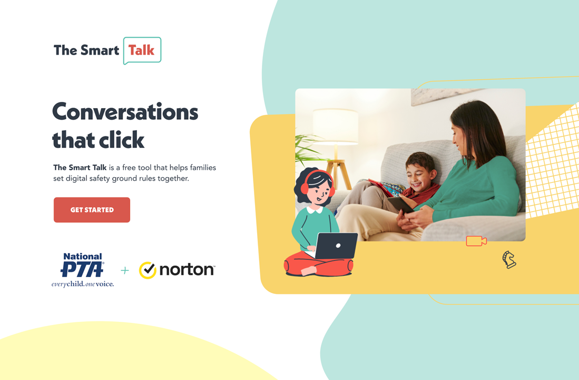

The Smart Talk An Interactive Family Conversation
Goals:
Educate families about the importance of being safe, responsible and smart online.
Facilitate interactive family activities and conversations focused on digital safety.
Teach families how to use the Smart Talk tool.
www.thesmarttalk.org
Notes:
{Say}
All PTA Connected programming is designed to empower PTA leaders to create engaging, interactive spaces for families to put what they are learning into practice, so they feel well prepared as a family to apply the skills needed to be safe while exploring and growing online.
The first PTA Connected program I want to tell you about is The Smart Talk.
National PTA and Norton co-created The Smart Talk in 2015 and completed a major expansion and redesign in 2022. The Smart Talk is a free online tool that helps caregivers and kids ages five to 17 have positive, proactive technology conversations and set healthy digital limits together so families can feel safer and more empowered in their digital lives. Families are guided through four topic areas to create a personalized technology agreement that helps keep everyone on track!
In 2022:
The Smart Talk was updated with tailored age-based content
It is easier to use with improved functionality such as save and return, a unique family account log-in, and education linked throughout
It is available in English and Spanish
We encourage everyone to try out the new Smart Talk tool!
To help provide families prepare for these important conversations, we have created a programmatic event that your PTA can host every year. The goals of these events are to:
Educate families about the importance of being safe, responsible and smart online
Facilitate interactive family activities and conversations focused on digital safety, and
Teach families how to use the Smart Talk tool.
{next slide}

Slide 9
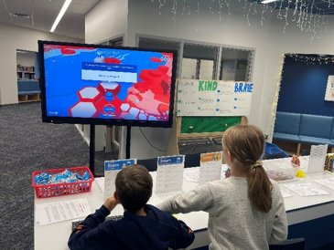


Be Internet Awesome Parent-to-Parent Discussions
Goals:
Learn how to keep families smart, alert, strong, kind and brave online.
Engage with peers to discuss families’ online experiences and solutions.
Explore Google and YouTube family resources.
Notes:
{Say}
A lot of the fear about talking about digital safety is that we think we don’t know enough, that things are always changing, that our kids know more than we do, and we can’t keep up with our digitally savvy kids. ​
Learning the skills to be safe and responsible online are very similar to the skills that we use in our everyday in-person interactions. ​
​
Be Internet Awesome Family Workshops are a time for parents and caregivers will learn what it means to help their families be smart, alert, strong, kind and brave online, engage with their peers to discuss their online experiences and solutions, and explore resources and tools to help them stay on track.​
​
All parents and caregivers who attend these events leave with a handbook that they can use at home to continue the conversation with their kids. ​
{next slide}

Slide 10
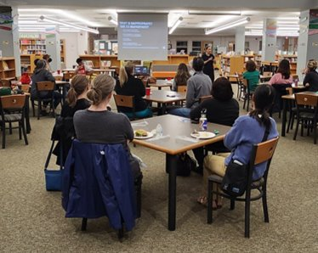

Build Up and Belong For teens and parents/caretakers
Goals:
Explore the use of technology as a communication and relationship tool.
Discuss ways to build belonging and have positive relationships in our digital world.
Notes:
{Say}
National PTA also recognizes that for a lot of children, the internet is where they may be searching for belonging.
National PTA has teamed up with Discord to develop a program that helps facilitate learning and discussion among families with youth 13 years of age and older.
Discussion during Build Up and Belong programs dive into using online platforms safely, responsibly and kindly and increases usage of Discord safety features and practices.
This program focuses on ways to build belonging and have positive relationships online.
{next slide}

Slide 11
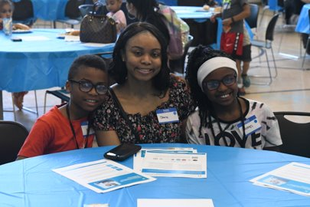

Ready, Tech, Go! Screen Readiness Workshops
Goals:
Help families and caregivers reflect on screen readiness.
Explore tools and resources to help determine screen readiness.
Provide tips and ideas to promote a healthy digital home.
Notes:
{Say}
Now, we wanted to take a bit of time to highlight our newest program- Ready, Tech, Go! supported by AT&T, helps families and caregivers determine their child’s screen readiness.
Ready, Tech, Go! workshops, with education developed by National PTA and resources provided by AT&T and the American Academy of Pediatrics, provide tools and tips to help determine screen readiness and promote a healthy digital home.
{next slide}

Slide 12
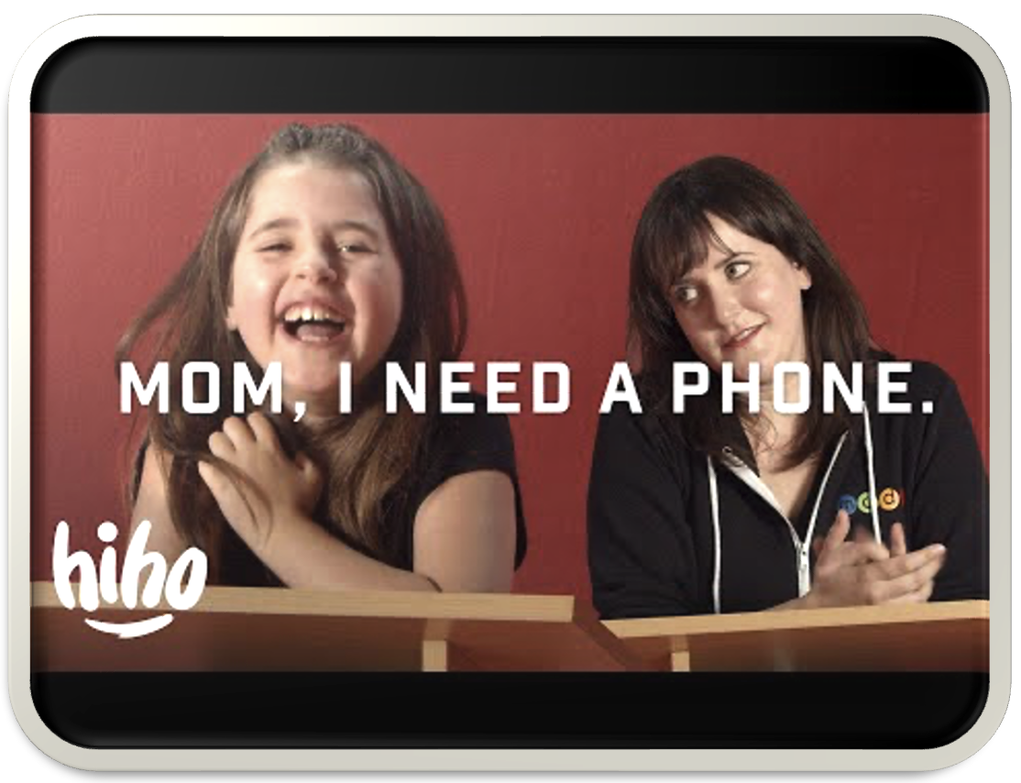
The Great Cellphone Debate Can you relate?
Play
Notes:
SAY: So, let’s take a look at what a PTA Connected program looks like, featuring our newest program- Ready, Tech, Go!
First, let’s start with a short video clip that many of us will probably relate to. It shows a mom and her 8 year old daughter debating whether the daughter will get a phone. In the video, mom and child are actually presenting their viewpoints to a panel who will decide the fate of the great cell phone debate.
[Play the video clip. When you click on the link, the video will open in a new tab.]
Video URL: https://www.youtube.com/clip/UgkxEiiDst5wDaLveLpf3Byzz9-zqslffs1T
Can you relate? Raise your hand if you heard points made by your own kids.
{Participants may raise their hands.}
No matter what talents kids naturally possess, it seems like all kids who want a cell phone suddenly develop a talent for debate. And for many of us, it can be hard to know what to do or how to respond, especially when we’re not sure what’s true.
{Click to next slide}

Slide 13
Truth or Myth?
What does current research say about tween tech use?
Notes:
SAY: Ready, Tech, Go! programming kicks off by walking parents and caregivers through a series of truths and myths around personal device ownership and screentime, similar to those raised in the great cell phone debate.
The biggest argument- “Everyone my age has a phone.”
But is this true? It can be hard for parents to know for sure.
To become a little more clear on some technology use facts, PTA leaders will walk parents through a game of “Truth or Myth.”
These statements, parents may have heard from their kids, friends, neighbors, or the media. So, let’s play a round.
{Click to next slide}

Slide 14


About 80% of eight and nine-year-olds have their own smartphone.
Notes:
SAY: “About 80% of 8- and 9-year-olds have their own smartphone.”
What do you think? Give me a thumbs up if you think this is a fact, and a thumbs down if you think it’s a myth.
{Pause to let participants look at who put their thumbs up or down.}
{Click to next slide}

Slide 15
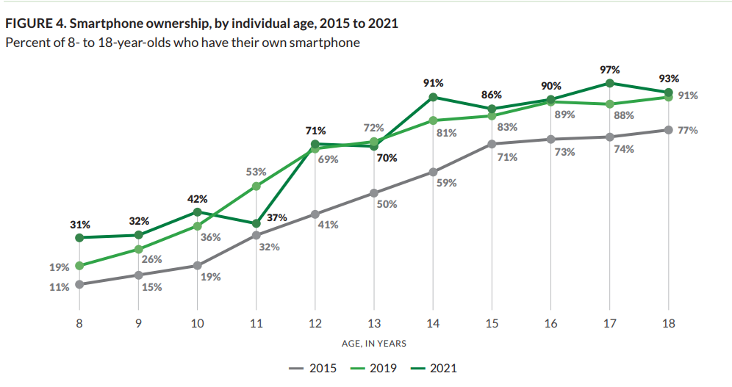
What the Research Says
Common Sense Media. (2022, March). The Common Sense Census: Media Use by Tweens and Teens, 2021.
Notes:
SAY: This statement is FALSE.
A 2021 survey conducted by Common Sense Media found that only 31% of 8-year-olds and 32% of 9-year-olds have their own smartphones. This number is up from 19% in 2019.
According to the same survey, 71% of 12-year-olds and 91% of 14-year-olds have their own smartphones.
{Click to next slide}

Slide 16
Screen Readiness
What does “screen ready” really mean?
Notes:
Say: Now, I mentioned screen readiness, which is what Ready, Tech, Go! is all about. So, let’s talk about readiness. Regardless of whether everyone else their age has a phone or how most kids spend their time with screens, the question that is on every parent’s mind is…
Is my child ready?
{Click to next slide}

Slide 17
Screen Readiness ≠ Age
Varies from family to family
Situations, motivation and need
Personalities, interests and family values
Varies from child to child
Developmental maturity, responsibility and accountability
Different types of screen activities
Clear boundaries vs. free exploration
Active vs. passive use
Notes:
Say: For many families there isn't a clear-cut answer to this question, which is where Ready, Tech, Go! steps in.
Ready, Tech, Go! explores how readiness is not about age, but about a child’s developmental maturity and their family or caregiver’s values. It’s also about the steps adults can take to help their child develop a healthy relationship with technology.
{Pause for a few moments to give participants time to reflect.}
{Click to next slide}

Slide 18
Parent/Caregiver Readiness
Am I ready to establish rules and reinforce them consistently?
Am I willing to have open communication and ongoing dialogue with my child about their digital life?
Am I willing to use tools and resources to help me be an effective digital parent?
Notes:
Say: Parent readiness also plays an important role when creating a healthy digital environment. Ready, Tech, Go! prompts key discussion questions for parents and caregivers to consider. In other words, the whole family must be screen-ready, not just the child.
{Click to next slide}

Slide 19
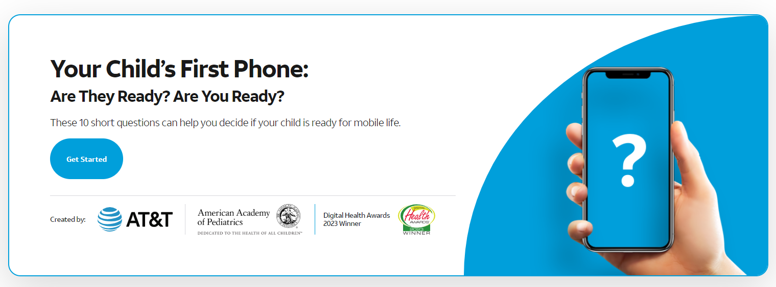
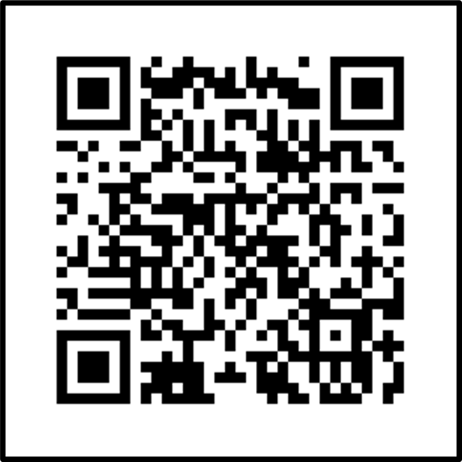
PhoneReady Quiz
Notes:
Say: The featured tool provided through Ready, Tech, Go! is the PhoneReady Quiz.
This quiz, developed by AT&T in collaboration with pediatricians from the American Academy of Pediatrics, helps parents reflect on different aspects of phone readiness. Participants who take the quiz answer 10 questions then receive a readiness score to help them decide what’s right for their family.
You may scan the QR code shown here to access the PhoneReady Quiz today!

Slide 20
PhoneReady Quiz
Motivation
Accountability
Responsibility
Maturity
Notes:
SAY:
The items on this quiz help us reflect on four main questions related to readiness.
Motivation: Why does your child NEED a phone?
Responsibility: Is your child ready for the responsibilities that come with having a phone?
Maturity: Is your child developmentally mature enough to manage their experiences with a phone?
Accountability: Are YOU ready to lead the charge and help your child develop a healthy relationship with technology?
{Click to next slide}

Slide 21
Learn from Each Other
How Ready, Tech, Go! supports peer-to-peer learning.
Notes:
Say: Digital parenting can be a tough job, and sometimes the best ideas come from other parents going through the same things.
Since each parent and caregiver has valuable input and experiences, Ready, Tech, Go! takes allows participants the opportunity to exchange thoughts with one another.
{Click to next slide}

Slide 22

Group Talk
Choose one or more questions to discuss with your partner(s).
When your child asks to use new or more technology, what goes through your mind? How do you decide what to tell them?
How do you communicate technology and screen expectations to your children?
What steps do you take to help your child use technology safely and responsibly?
Where do you turn for information and advice on digital-aged parenting?
Notes:
SAY: Participants are split into groups, and given conversation started like the ones seen on the screen. Groups have 7 minutes to discuss questions such as:
What steps do you take to help your child use technology safely and responsibly?
And, where do you turn for information and advice on digital-aged parenting?
{Click to next slide}

Slide 23
Tips and Resources for Healthy Digital Habits
How can we support healthy digital habits at home?
Notes:
SAY: Lastly, Ready, Tech, Go! provides tips and resources for building healthy digital habits that apply no matter where children are in their screen readiness journey. Let’s look at a few!
{Click to next slide}

Slide 24
Create Digital Expectations As a Family
TIP 1
Invite all family members (especially kids) to help make the rules; encourage everyone to voice their opinion.
Talk about consequences; ask kids what seems fair if the rules are broken. It’s helpful to have a plan before you need it.
Display the rules and revisit them regularly.
Adults can model healthy digital behaviors by following the rules too.
Notes:
SAY: For example, when parents/caregivers ask kids to participate in making the rules, they have more buy-in, and are more likely to follow them. Kids can also share what they believe are fair consequences when rules are broken.
It’s also important to remember that digital rules apply to all family members, not just kids. Adults can be strong role models for healthy digital behaviors.
{Click to next slide}

Slide 25
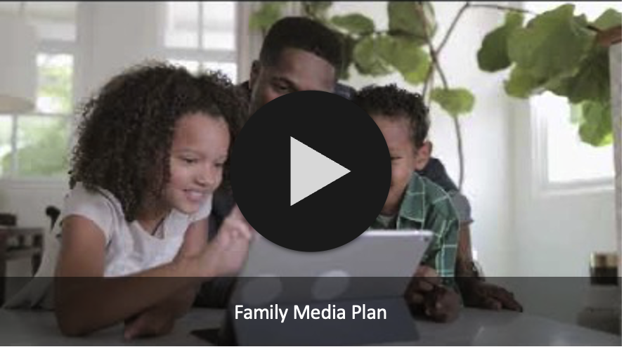
Notes:
SAY: Ready, Tech, Go! highlights tools, like the Family Media Plan, that can help families create appropriate family rules.
The Family Media Plan, developed by the American Academy of Pediatrics in collaboration with AT&T, helps guide families through digital-use conversations. Let’s take a quick look.
{Show video clip.}
{Click to next slide}

Slide 26
Introduce Your Child to High-Quality Content
TIP 2
Positive content
When kids engage with fun, age-appropriate resources, they are less likely to randomly search and find questionable content.
Unknown content
Notes:
SAY: Another digital wellness tip from example Ready, Tech, Go! is helping families find fun, age-appropriate digital content for their children.
This tip goes along the same lines as getting kids involved in sports, music, or other after school activities that give them something healthy to do with their time and energy. Similarly, when they engage with positive digital content, they are less likely to engage in not-so-positive ways.
{Click to next slide}

Slide 27


The Achievery
Notes:
SAY: There is no shortage of great online learning content for kids. One resource you may want to explore is the Achievery.
The Achievery, created by AT&T, has free educational and entertaining videos and learning activities for kids in kindergarten through 12th grade covering topics from language arts, to math, to science and technology The Achievery even includes digital literacy lessons that focus on Internet safety for young learners. These activities are designed for kids to work on by themselves or with an adult. Let’s take a look.
{Show video. When you click on the link, the video will open in a new tab.}
These, and many more healthy digital habits tips are explored through the Ready, Tech, Go! Program
{Click to next slide}

Slide 28
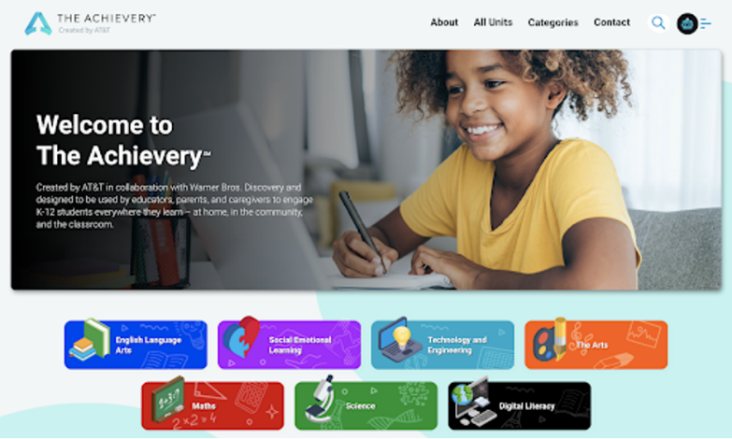
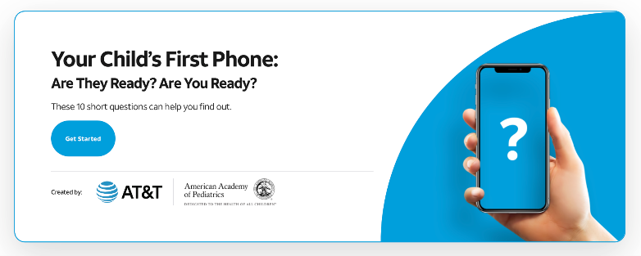
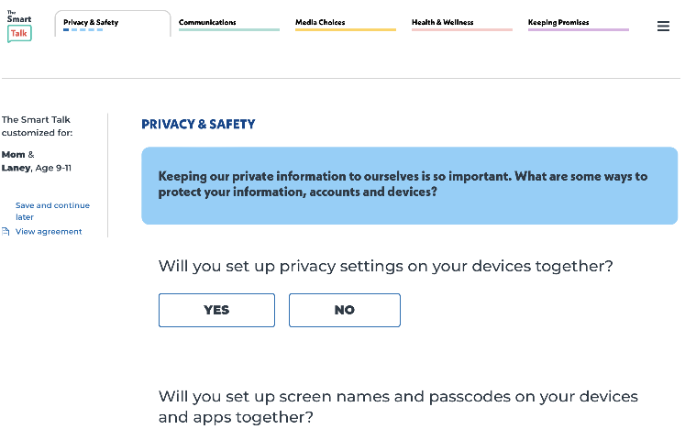
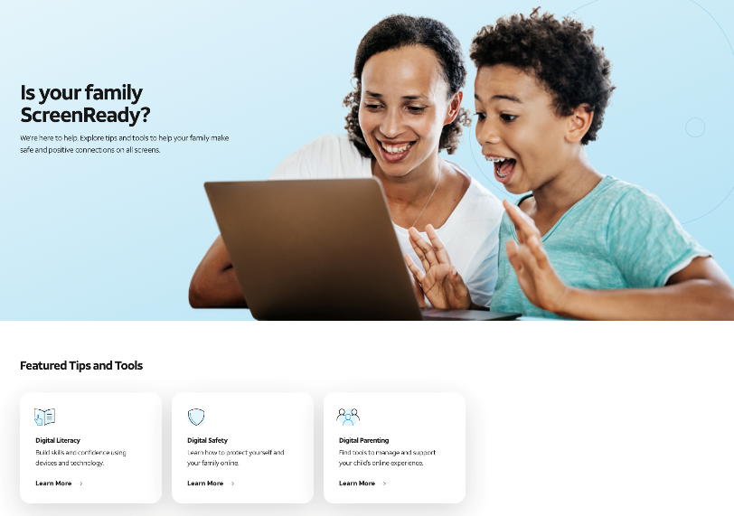
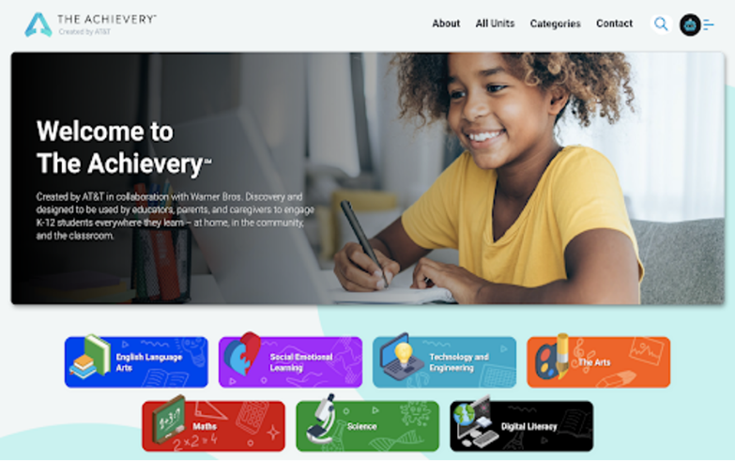
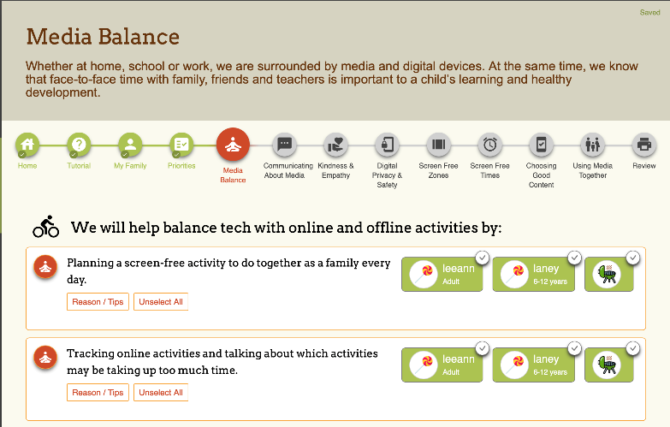
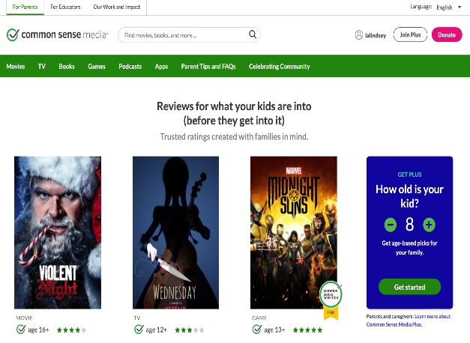
The Achievery
PhoneReady® Quiz
The Smart Talk
AT&T ScreenReady®
Family Media Plan
Common Sense Media
Notes:
SAY: These, and many more healthy digital habits tips and resources are explored through the Ready, Tech, Go! Program.
Now that we’ve had an overview of the program, I’d like to make sure you know what resources are available from National PTA to make sure that your Ready, Tech, Go! Program can be as successful as possible.

Slide 29

Program Toolkits – PTA.org/Connected
Planning ​
Hosting​
Celebrating
Promoting​
Notes:
{Say}
All our programs from Ready Tech Go!, to the Smart Talk, come with tool kits of plug-and-play templates that help PTAs plan, promote, host and wrap up their PTA Connected program. This means that our PTA volunteers do not have to reinvent the wheel or be digital safety experts. They can instead do what they do best: engage families in their schools to participate.
All resources are available to help your PTA put on a successful, stress free PTA Connected event. You can find them at pta.org/connected.
Here is how the toolkits are organized for each PTA Connected program on PTA.com/connected. For each program there are tools to help you plan an event either in person or virtually or you can plan and offer programs that participants can complete on their own time, at this own pace, from wherever they choose.
Planning: We want to make planning your event as easy as possible. Every toolkit includes an agenda, planning guide and an invitation to use to recruit volunteers. There are many resources to help you through the initial stages of planning for your program including a event planning guide, an invitation to invite volunteers, and talking points you can use.
Promoting: There are resources available to also support you in promoting your programming. As a PTA leader, you have access to many templates including social media and newsletter language, and a sample press release. All you have to do is just plug in your specific event information.
Hosting: Resources for hosting a Ready, Tech, Go! program, include a PowerPoint presentation with talking points that you can use to educate families about how to be screen ready. We’ve also created family activities that you can do during your session, to help keep things fun, interactive and experiential.
Celebrating Impact: Lastly, we provide resources for what to do after your event is over. Getting feedback from attendees is a great opportunity for your PTA to learn what you should keep or improve for future sessions.
All toolkits, including the education and family activities, are available in English and Spanish.
{next slide}

Slide 30
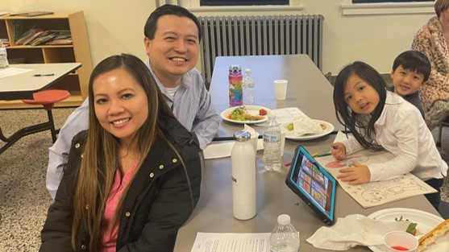
Grants
“We are a small Title I, socially and economically diverse bilingual school. Being able to offer a well-executed program and provide dinner and a raffle prize really helped us bring together families in the school”. – PTA Connected Grantee
Notes:
Now that we’ve gone through our PTA Connected programs, walked through what a Ready Tech Go program is like, and reviewed where your PTA can find plug and play resources, I wanted to mention that while not required to host a program, National PTA does offer a variety of grant opportunities for PTAs. Let’s talk about the impact that our grants have by hearing directly from a grantee this last year.
“We are a small Title I, socially and economically diverse bilingual school. Being able to offer a well-executed program and provide dinner and a raffle prize really helped us bring together families in the school”.
This quote comes from a PTA member of a Title 1 School in Texas that received funding to host a PTA Connected Program which was a huge addition to the PTA’s limited budget.
Funding has helped our member PTAs of every size, in nearly every state, representing students and families of diverse backgrounds, including many Title I schools and many that have never before received this money.
Grants recently closed for the 2023-2024 school year, but we hope you will still go to www.pta.org/grants to discover what types of opportunities are typically available at the beginning of each school year and begin planning for next year!
NEXT SLIDE

Slide 31
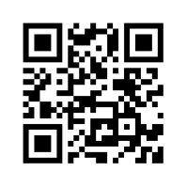
Questions, Comments, and Suggestions?
Visit PTA.org/Connected
Email: mwilson@pta.org
Notes:
{Say}
Does anyone have any questions for me? If you think of questions after this session, please email mwilson@pta.org. You can also find more information by visiting pta.org/connected.
{next slide}

Slide 32
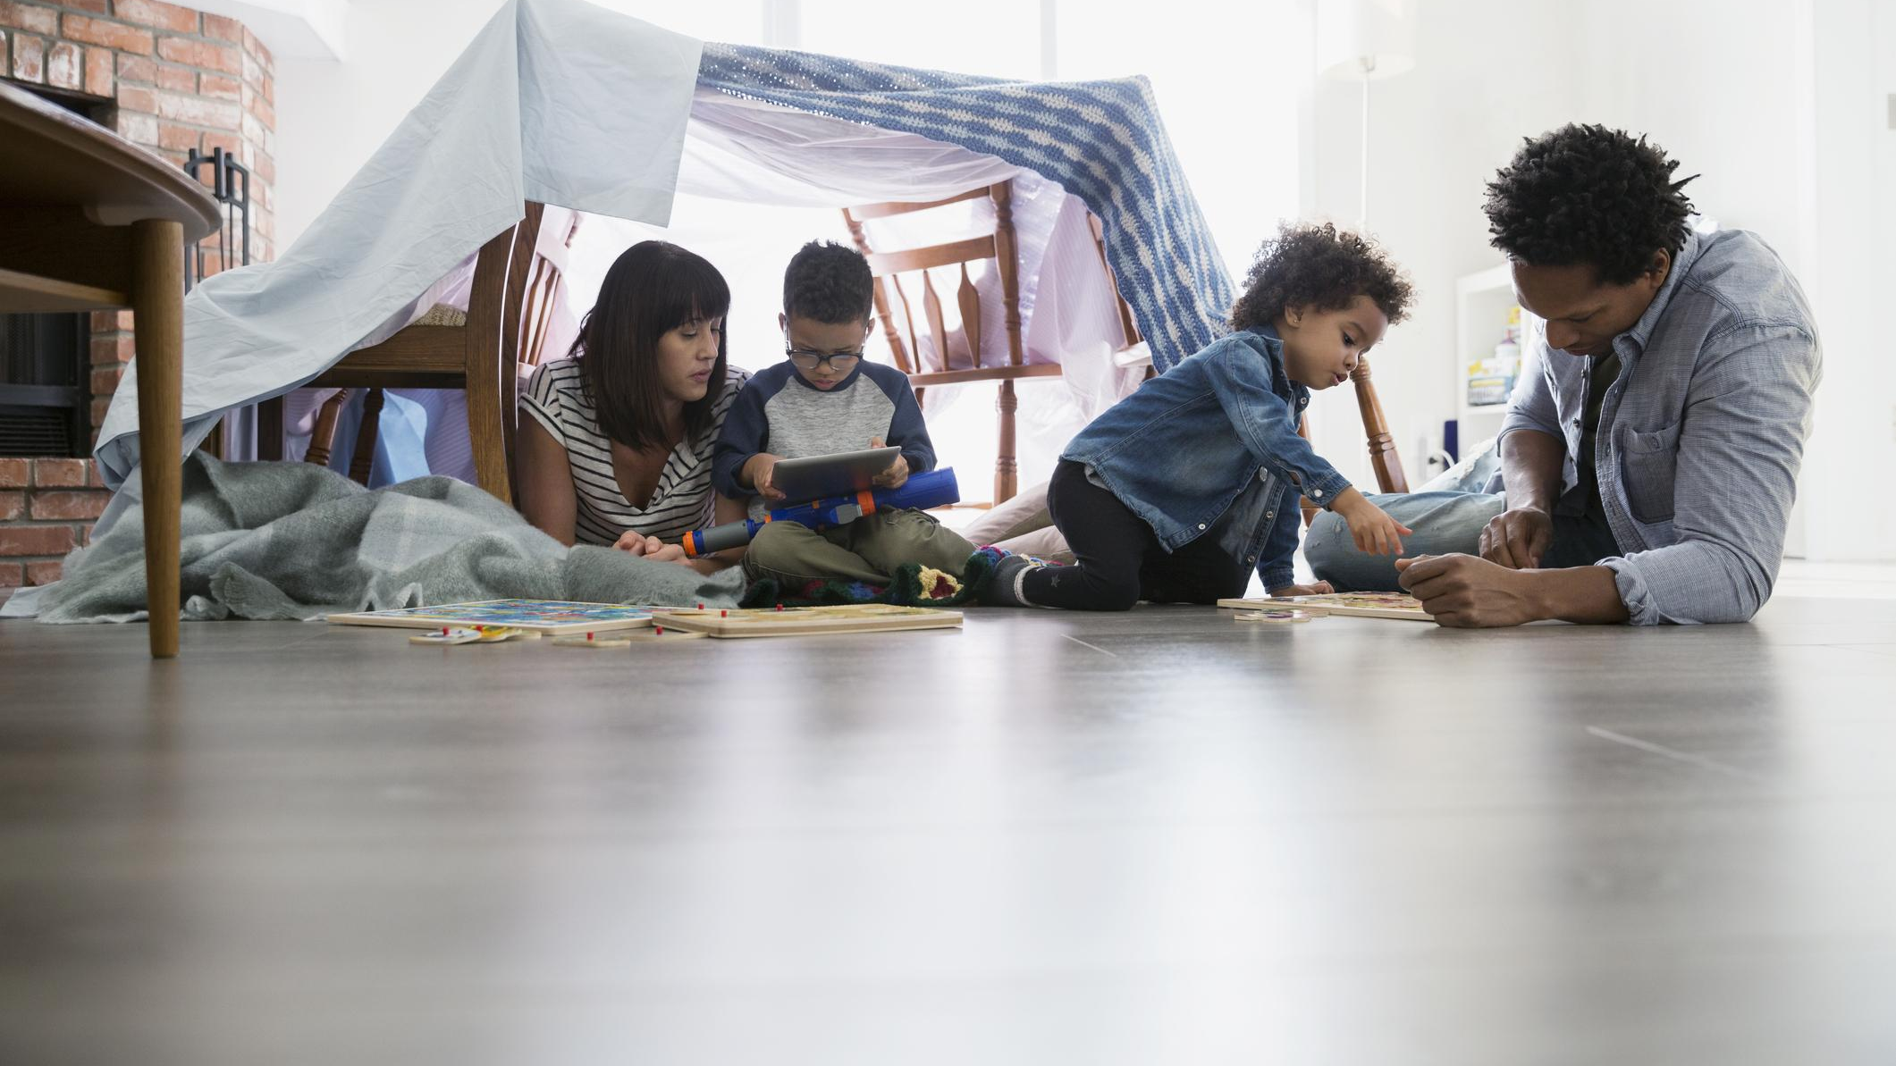
Thank you for joining!
Notes:
{Say}
This concludes the PTA Connected session.
Thank everyone for attending
Call to action: bring PTA Connected to schools in your communities.

