Slide 1
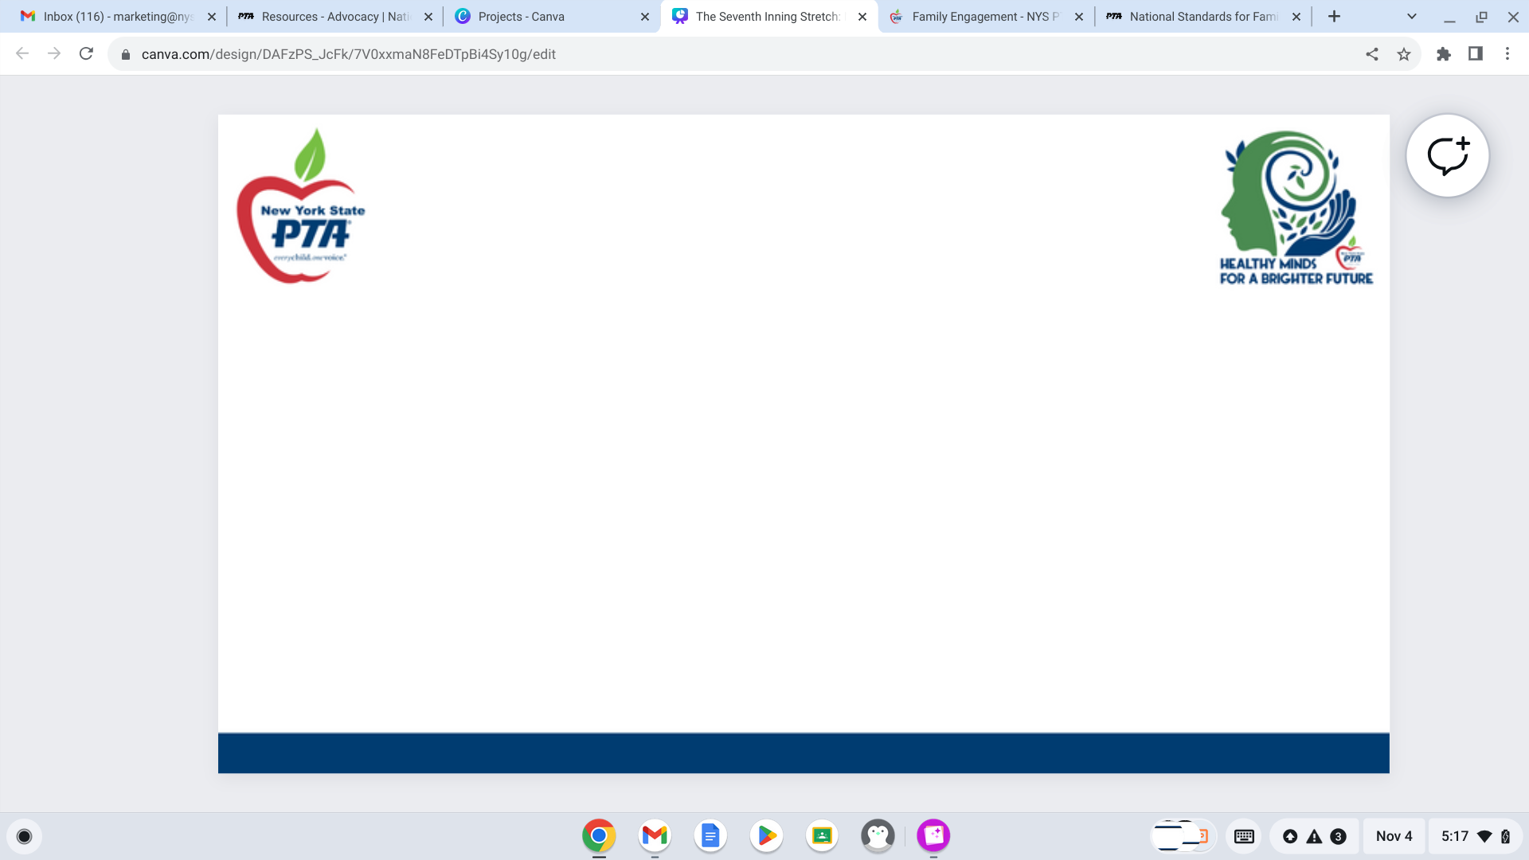


The Seventh Inning Stretch: Membership in the Second Half of the Year
- Kathleen Jenne -
NYS PTA Marketing Specialist

Slide 2


Notes:
Introduction:
Kathleen Jenne - NYS PTA Marketing Specialist (This slide will be converted into off screen notes and just an onscreen graphic. -Kathleen)
This is my first year serving on the NYS PTA Membership Team and my first time leading a NYS PTA workshop. I am excited to get to discuss PTA Membership Marketing with you!
Let me tell you a little about myself. I am a former Secondary Level Social Studies Educator and I am currently working as a Volunteer Services Coordinator at a local non-profit. I reside in Central New York - never “Upstate”, as this Long Island girl has learned from her North Country husband. My involvement with PTA began eight years ago when my eldest son was in Kindergarten. Like many of you, I wanted to help to enrich his school experience. This also helped me to build those vital relationships with my sons’ teachers and administrators. I recently completed my term of office as Secretary at both Van Buren Elementary and Donald S. Ray Middle School, and have assumed the role of Co-President at Van Buren. Additionally, I was the previous Regional Membership Chair and have continued serving as the Social Media Manager for Southeastern Region PTA. Just like you, I wear a lot of hats!

Slide 3


PTA Marketing at the Unit Level
-
How do we re-energize our Membership Drive after the Early Bird season?

Slide 4

Think back: what made you become a PTA member?

Slide 5

Everything The PTA has done, from book fairs and carnivals to advocacy for greater educational funding and graduation requirements, happened because someone decided to join a local unit.

Slide 6




The NYS PTA has a rich history of advocacy as well as program development. This work can be utilized as a membership recruitment strategy!

Slide 7
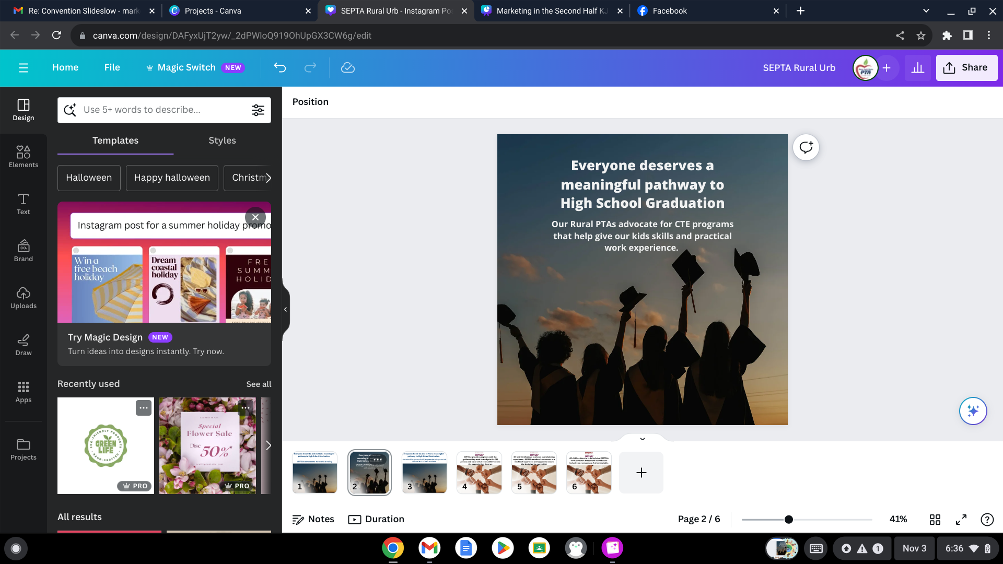


Reach out to those groups who feel unheard and show them how PTA Membership can lead them not only to finding their voice, but amplifying it.

Slide 8
PTA Marketing at the Unit Level
-
What advocacy work has your unit done within your district? Has your SEPTSA pushed for more inclusive school activities and clubs? Has your High School’s PTSA pushed for a mental health event?
Your advocacy work should be marketed and promoted in your Membership campaigns.

Slide 9

One example of utilizing the Power of You strategy would be to reach out to the families of children who qualify for Special Educational services and accommodations. Your school social worker or principal can help you send information to these families while protecting their identities. Show them how PTA membership can benefit them directly. These families often feel overwhelmed when trying to navigate the Committee for Special Education process. SEPTSAs can and do guide caretakers through this process. At the upper levels, let them know about the transitional services SEPTSAs provide.
Additionally, these students are often overlooked when planning events or organizing clubs and activities. SEPTSAs advocate for inclusion, not only at the state level but at the district and even building levels. Empower them and their families through PTA membership. Show them they are not alone. (**NOTE: This will be in the presenter notes, not on screen. Will replace this field with a larger version of top left corner graphic**)
Notes:
One example of utilizing the Power of You strategy would be to reach out to the families of children who qualify for Special Educational services and accommodations. Your school social worker or principal can help you send information to these families while protecting their identities. Show them how PTA membership can benefit them directly. These families often feel overwhelmed when trying to navigate the Committee for Special Education process. SEPTSAs can and do guide caretakers through this process. At the upper levels, let them know about the transitional services SEPTSAs provide.
Additionally, these students are often overlooked when planning events or organizing clubs and activities. SEPTSAs advocate for inclusion, not only at the state level but at the district and even building levels. Empower them and their families through PTA membership. Show them they are not alone. (**NOTE: This will be in the presenter notes, not on screen. Will replace this field with a larger version of top left corner graphic**)

Slide 10

How can Family Engagement be utilized as a Marketing Strategy?
National PTA Standards
Notes:
Discussion of what do we mean by Family Engagement, the National Standards, and how to utilize them in a membership campaign through examples.
-Family Engagement in schools has been proven to drastically improve a child's academic performance. What is the easiest way to begin this engagement process? Joining PTA! Connects you with your student's teachers, administration, etc. More importantly, this allows you to stay in the loop and have a voice in decision making as well as boosting advocacy efforts.

Slide 11

Reasons YOU Belong
Notes:
Value Area #1 PTA/PTSA Creates Connections
connections
Value Area #2
PTA/PTSA Supports Your Child
support
Value Area #3
PTA/PTSA Amplifies Your Voice
Speak about personal experience, PTA journey here - from STEM Fair to unit level advocacy to Regional and State involvement and WHY -- how to work that into an elevator pitch.

Slide 12
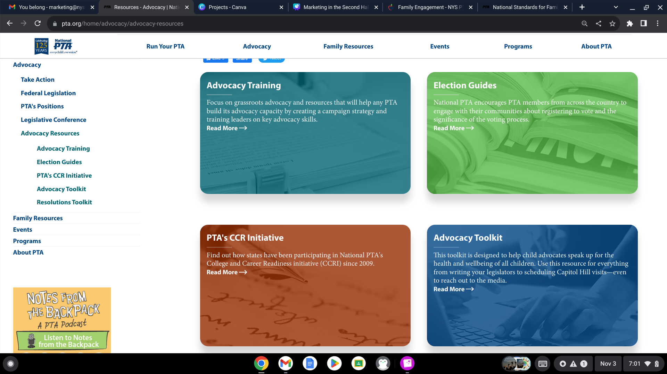
Advocacy resources
Notes:
Use Board of Election Meet the Candidate night I organized in B'ville as an example of personal PTA advocacy. Show how that can be marketed -- include Advocacy Action award boosting Unit's profile and getting attention which then turns into a membership numbers boost.

Slide 13


PTA Marketing at the Unit Level
-
Quick implementation tips for each season

Slide 14

Membership is a year-long journey that should be undertaken by every member of your PTA Board and beyond.
Yet, so many units tend to wind down their membership drives after the leaves start to fall.
We are here to reexamine the Membership Year and revitalize our campaigns.

Slide 15

November -
Gathering around the Thanksgiving Table, organizing the start of holiday fundraisers and holiday related school events.
How do we market PTA here?

Slide 16






How do we market PTA here?

Slide 17
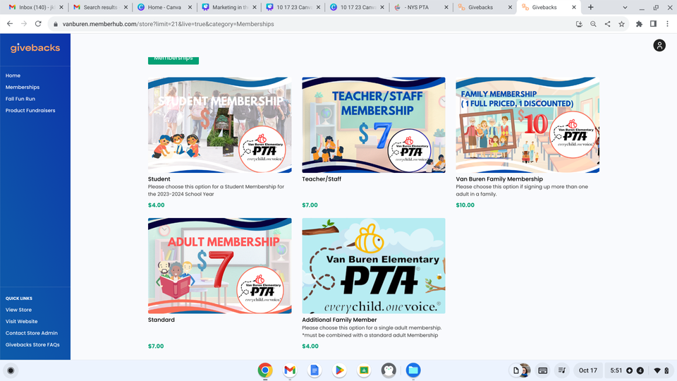

It’s the most stressful time of the year - PTA during the holiday season
Holiday Gift Bundle - Promote purchasing both a Spirit Wear item AND a membership for relatives, friends and more!

Slide 18
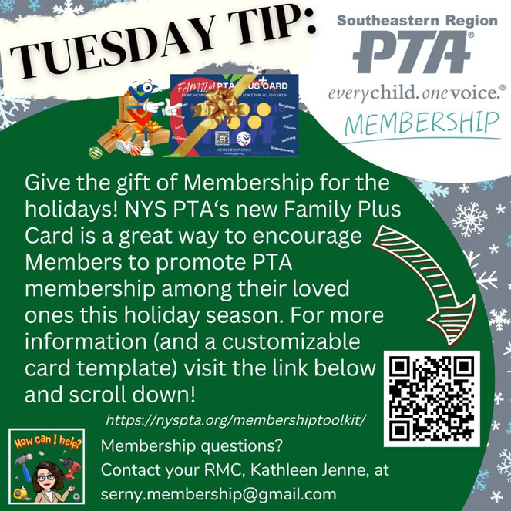
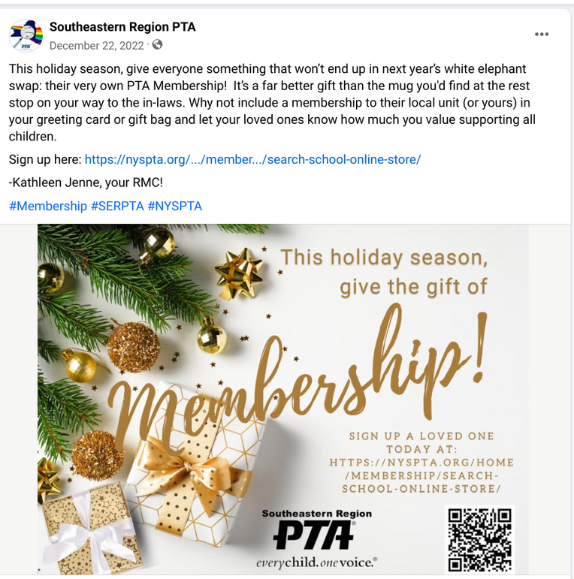

It’s the most stressful time of the year -
-
PTA during the holiday season

Slide 19




Hit the streets! Lots of holiday events and celebrations in the community - set up a Membership table at the concerts, ice skating parties, Breakfast with Santa, etc.

Slide 20

Classroom Membership Competition - Hot Cocoa and PJ party for the class that has the most memberships sold by January 15th!

Slide 21

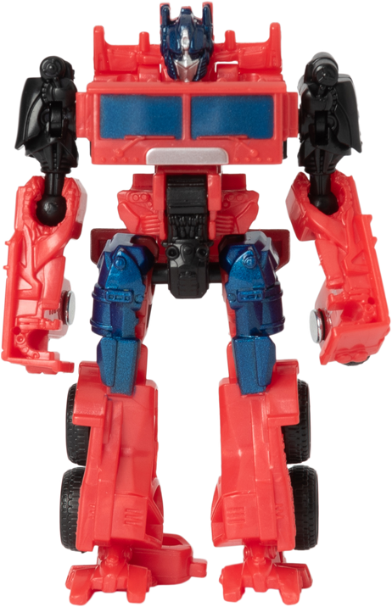





Hot toy item raffle - What’s this year’s must have item? Every PTA member who joins by 12/5 (for example) will be automatically entered into raffle to win it

Slide 22



The Post-Holidays Blues - Marketing in January and February

Slide 23




Push Sponsorships by local businesses -
*Note* only one named individual from the business can be a voting member. However, the company receives a certificate to display, which they can use to advertise their support on their website and/or social media.

Slide 24



Push Student Memberships by creating a “Kids PTA” at the elementary school level and/or appointing a student representative(s) at the secondary level –looks great for college applications, many PTAs offer scholarships to student members, or honor cords for graduation.

Slide 25

Founders’ Day celebration - membership drive and party!
Honor volunteers and members at an Founders Day award celebration. Most hours, best Membership cheerleader, etc. Offer a discount to members or an incentive such as a free dessert.

Slide 26
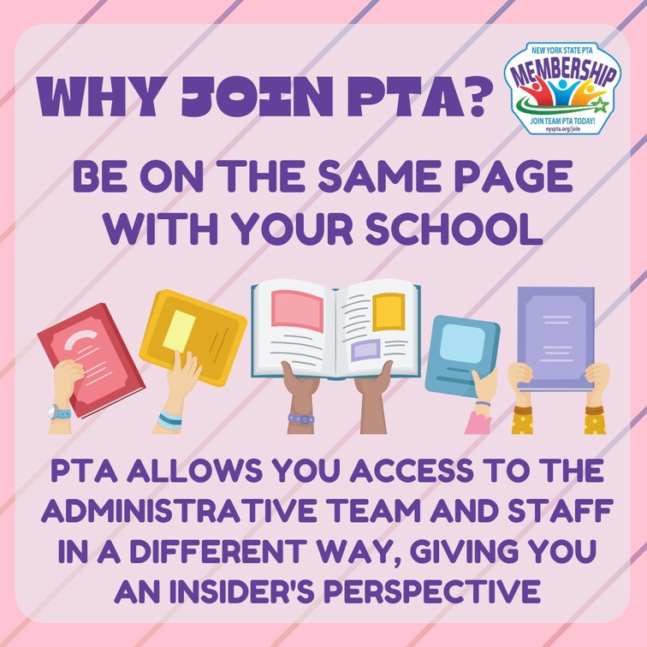
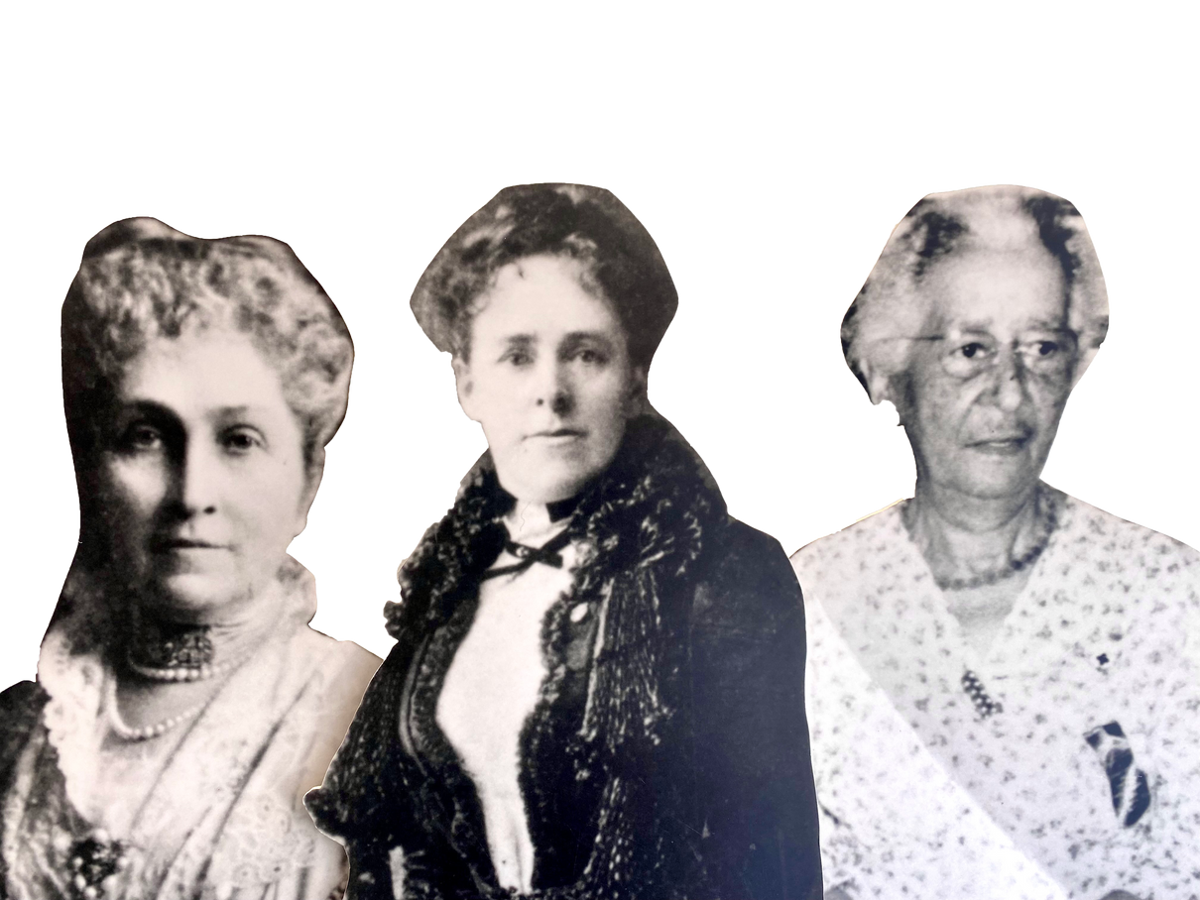
Hit the School Board Meeting circuit and use the time offered for public comments to discuss Founders’ Day, the legacy of PTA, and push for members

Slide 27
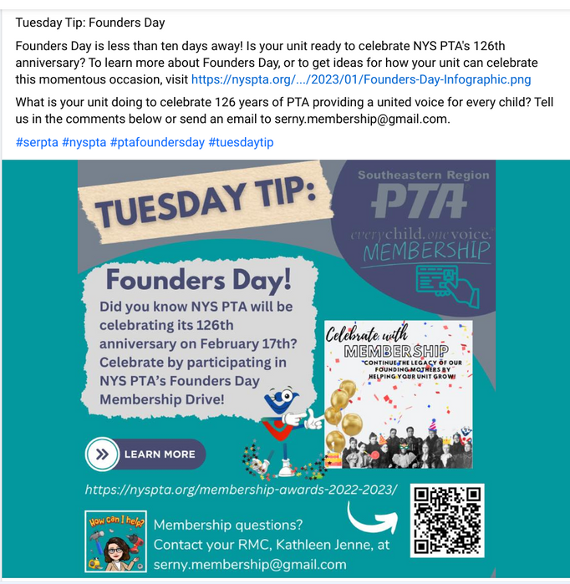
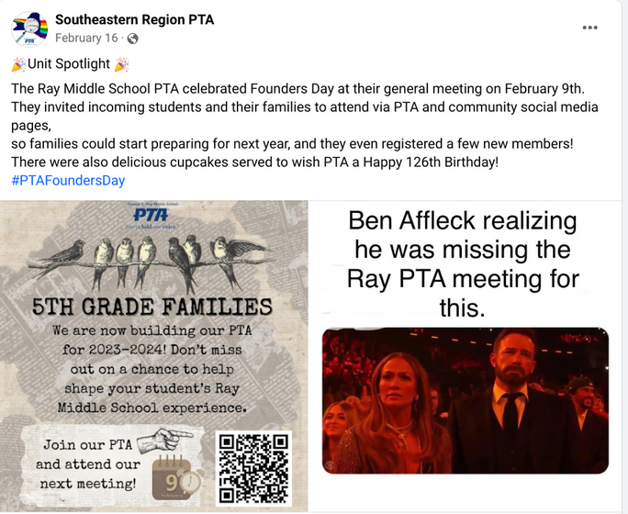
The Post-Holidays Blues - Marketing in January and February

Slide 28
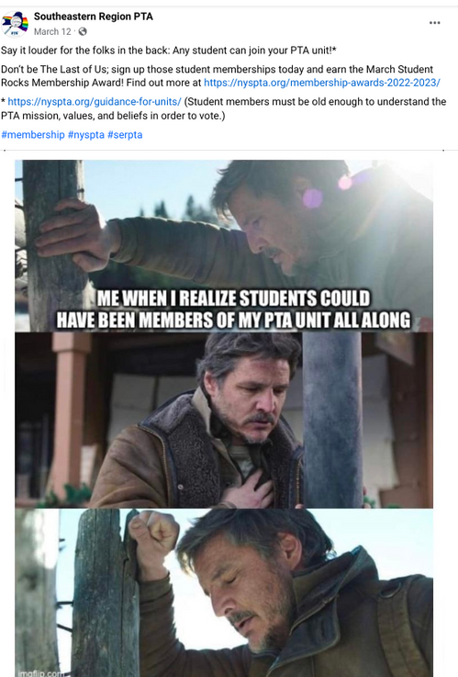
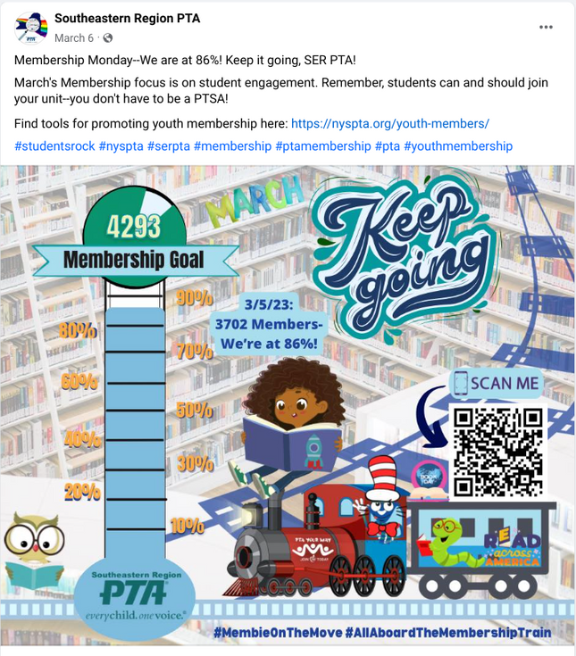
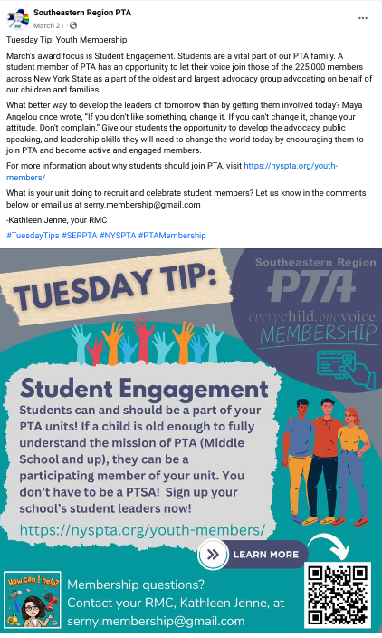
Membership comes in like a lion and out like a lamb –
how to capture September’s energy in March

Slide 29
Membership comes in like a lion and out like a lamb – how to capture September’s energy in March
➜ Host a book fair - only members can volunteer
➜Offer special honor cords to alumni members at graduation (Sachem does this.)
➜Spring spirit wear items - offer discounted bundles with memberships, offer discounts to current members
➜Pickle the Principal! Slime the Swim Coach! Dunk the Director! Super Soak the Superintendent! - Set a membership goal. If you reach it, kids get to do something over the top to a favorite teacher of administrator

Slide 30



Spring Training: Promoting Membership among transitioning groups

Slide 31


Spring Training:
Promoting Membership among transitioning groups
MIDDLE SCHOOL

Slide 32

Focus on incoming students and their families
Utilize cross promotion with buildings above and below yours in your district
Alumni legacy

Slide 33

PTA Officer Election Day - tap into those members who are looking to become more involved and encourage them and their supporters to join PTA

Slide 34




Membership
Home
Run!

Slide 35
Kathleen Jenne- Marketing@nyspta.org

