Slide 1
Transforming PTA Leadership: A New Horizon with AI Technology

Slide 2
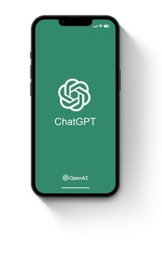
Introduction to ChatGPT for Leadership
Welcome to a transformative journey with AI. Discover how ChatGPT can revolutionize PTA communication and leadership.

Slide 3

Activity: Exploring ChatGPT
Interactive Demo: Use ChatGPT to respond to common PTA queries. Share and discuss the AI-generated responses.

Slide 4

ChatGPT's Role in Decision Making
Learn how ChatGPT can assist PTA leaders in making informed decisions and streamlining the decision-making process.

Slide 5

Activity: Decision-Making with ChatGPT
Group Activity: Utilize ChatGPT to brainstorm and draft a proposal for a new PTA fundraising event.

Slide 6

Crafting Messages with ChatGPT
Explore techniques for using ChatGPT to create clear, compelling PTA announcements and updates.

Slide 7

Activity: Writing Workshop
Hands-on Session: Draft a section of a PTA newsletter using ChatGPT, focusing on engagement and clarity.

Slide 8

Integrating ChatGPT into PTA Strategy
Strategize on incorporating ChatGPT into regular PTA communication workflows for enhanced efficiency.

Slide 9

Activity: Strategic Planning
Interactive Planning: Design a communication plan for a PTA initiative with the help of ChatGPT.

Slide 10

Q&A and Group Discussion
Open forum for discussing experiences, sharing insights, and addressing questions about using ChatGPT in PTA leadership.

Slide 11

Conclusion and Takeaways
Summarize the session's key points, discuss next steps, and encourage ongoing innovation in PTA communication.

