Slide 1

Engaging During Downtime
NYS PTA Convention
November 10-12, 2023
Lissa Zukoff - NYS Family Engagement Coordinator
family.engagement@nyspta.org

Slide 2


Our Shared Mission
PTA is a powerful voice for all children, a relevant resource for families and communities, and a strong advocate for the education and well-being of every child.

Slide 3

We PTA Year Round!

Slide 4
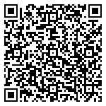
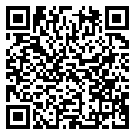
Be Mindful of Religious Observances
Many school closures are scheduled around holidays - do not schedule events on a day of religious observance (DRO)
Utilize a Diversity Calendar when Planning ANY event:
2023-2024 Multicultural Calendar
NYS PTA Diversity Toolkit: NYS PTA DEI Toolkit

Slide 5

How Do We Engage During School Breaks?
Participate in Community Fairs & Events
Programs: Flat Stanley, Essay Contests, PARP events, meet-ups, off-site events
Partner with other PTAs/SEPTAs
Social Media/Email Engagement
Ask for Suggestions at Meetings
Reach out to teachers in advance
Be friendly, kind, and engaging!

Slide 6

Maintaining Volunteer Motivation
Communicate and Respect Boundaries
Mutual Consideration
Offer Ongoing Support
Schedule Emails/Posts in Advance
Show Appreciation through Word & Deed

Slide 7

There’s Really No “I” in Team
Set Realistic Expectations
Forgive Yourself
No More FOMO
Delegate
Just Say No
Ask For Help
Acknowledge Your Achievements

Slide 8

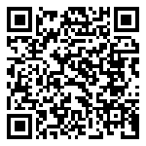
Plan Ahead for Downtime
What is your goal?
How will you know when you achieve it?
Is it a realistic and achievable goal?
Set clear time parameters
Be mindful of the PTA Mission Statement
How To Write an Action Plan

Slide 9

Keep Projects Moving Forward
Utilize Shared Google Docs
Reassess as Needed
Be PTA Flexible
Consider Volunteer Motivation
Schedule Emails/Posts in Advance When Possible

Slide 10

Can We Talk?

Slide 11

Lissa Zukoff - NYS Family Engagement Coordinator
family.engagement@nyspta.org

