Slide 1

Embracing the Mosaic: Exploring Diversity in our School Community
Kim Blasiak
NYS PTA Diversity Coordinator

Slide 2


What is Diversity?
DIVERSITY:
Diversity is the range of human differences, including but not limited to race, ethnicity, gender, gender identity, sexual orientation, age, social class, physical ability or attributes, religious or ethical values system, national origin, and political beliefs.
Notes:
All the ways in which people differ. Many different opinions, mutual respect.

Slide 3

Diversity in Schools
Our diversity is our strength! PTA volunteers who are “intentional” in their DEI efforts are most likely to experience great outcomes that benefit all children and their families rather than isolated patches of success.

Slide 4
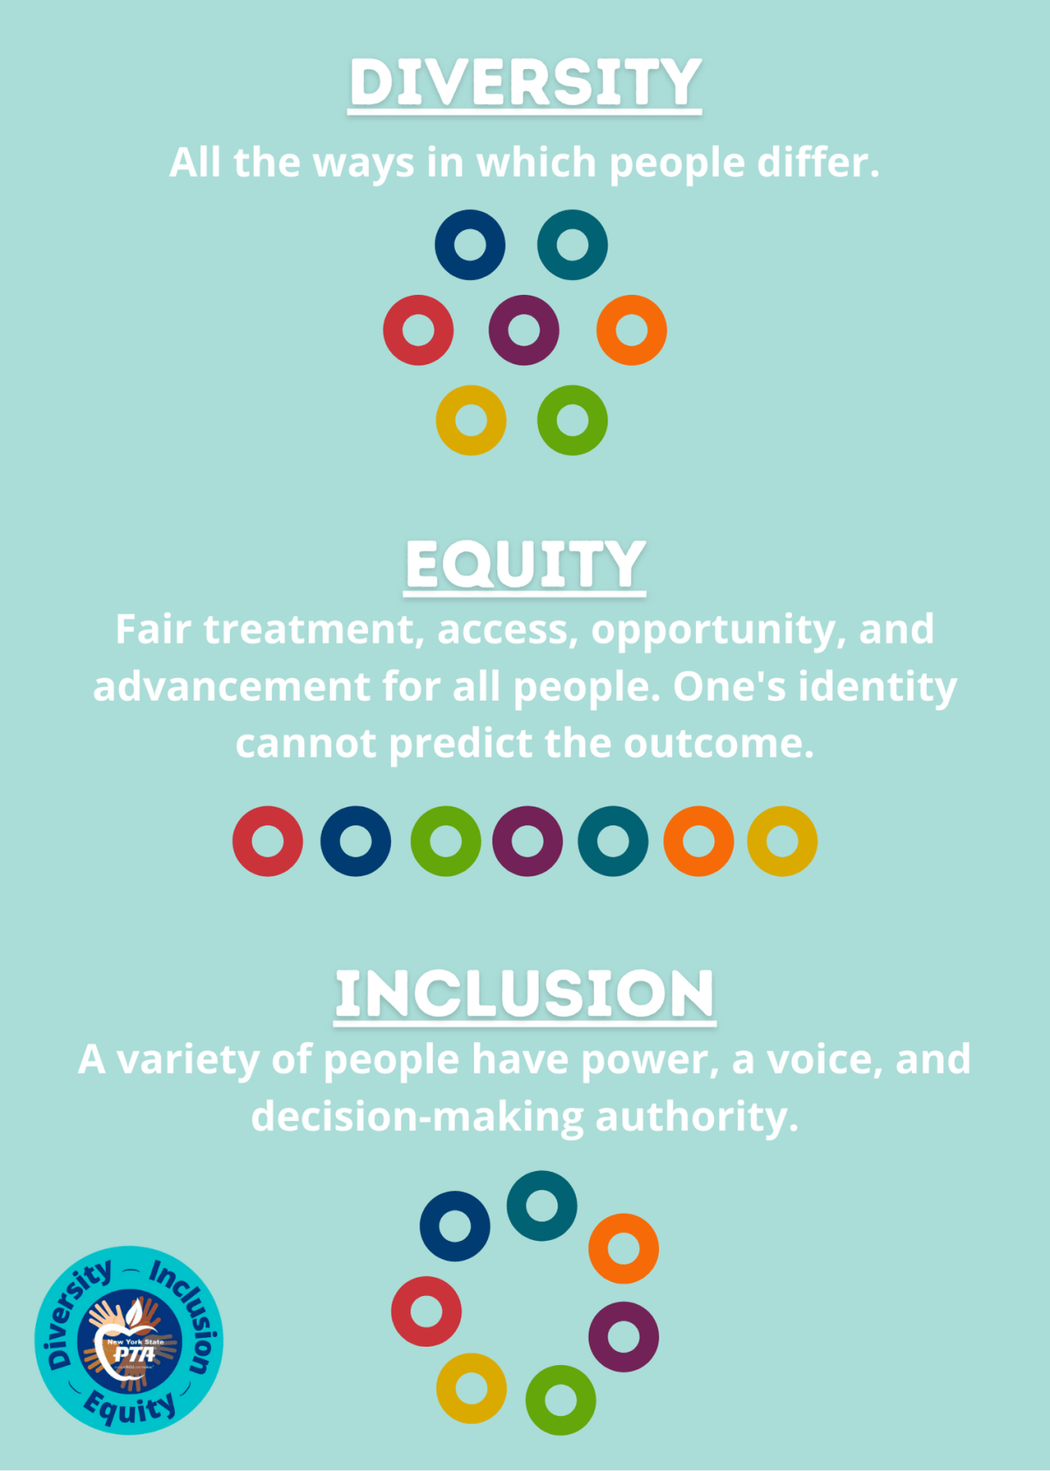
DEI: Diversity, Equity & Inclusion

Slide 5
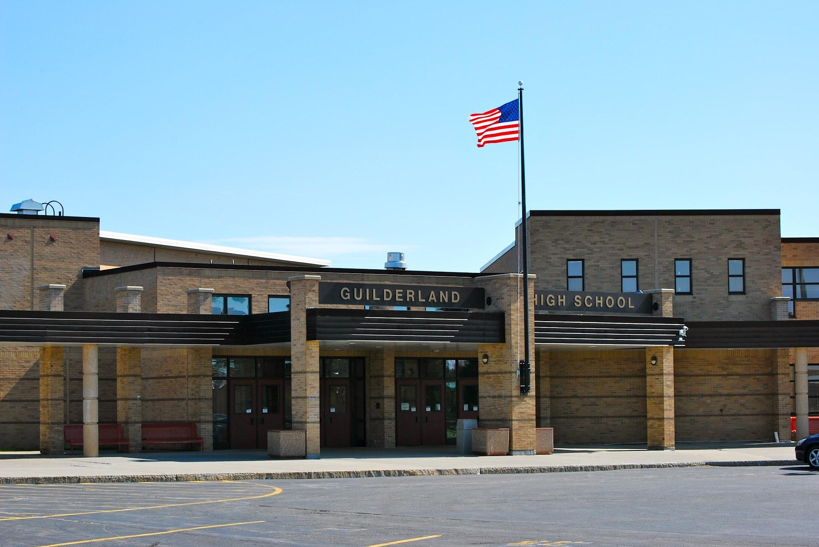
Diversity of NYS Schools
NYSED Data: 2021-22
NYS Education at a glance:
731 Schools Districts
4412 Public Schools
360 Charter Schools
2,448,537 Students
https://data.nysed.gov/enrollment.php?year=2022&state=yes

Slide 6

Why should you learn about your school community?
PTA Supports Every Child.

Slide 7

How do you learn about your school community?
Searching for your school specifically provides useful student and school data including information such as total number of students, enrollment data by gender, ethnicity, disabilities, economic disadvantage, English Language Learners, migrants, homeless, foster care, etc.
https://data.nysed.gov/parents/
https://data.nysed.gov

Slide 8
Other ways to learn about your school community.
Ask your Principal.
Ask your Director of Pupil Services.
Ask your Superintendent.
Attend Board of Education Meetings.
Look at your school calendar.
Questions to ask:
How many languages are spoken in our district/buildings?
What percentage of students are English Language Learners (ELL)?
What holidays are celebrated within our District?

Slide 9
Putting Information Into Action
Advertise PTA events through all possible electronic methods, social media as well as traditional methods such as print, mail, school backpack, etc. Assure event fliers and invitations are translated into all languages spoken in your school community.
Provide clear and transparent explanations of all PTA events and activities, especially to first-timers, not assuming that everyone is familiar with the activities, past traditions and customs of your school and/or PTA. The better informed and prepared everyone is the more comfortable they will feel and more likely to return.
Support remote platforms providing virtual options such as Zoom, Google Meets, etc. when possible. They present great opportunities for families with time restraints and travel, or accessibility challenges.
Engage in active and two-sided dialogue, allowing for opportunities for all stakeholders to express their opinions and needs and those organizing the event, not only speaking, but actively listening and following up.
Notes:
You may not even realize why some people aren’t attending PTA meetings.

Slide 10
How to be welcoming.
Organize events that develop positive relationships between teachers and families to help overcome cultural barriers that interfere with active family engagement in children’s education and schools.
Plan PTA events that help level the parent/family education field and close the information gap that may hinder family involvement in their child’s education. Events may include family math/science nights, technology, child/youth development topics, college/career prep and funding, to name a few.
Leaders need to be open-minded, presentable, and approachable, make others feel comfortable. Always realize the significance and responsibilities of leadership roles and how they can impact perceptions and recruitment of members and future leaders.
Avoid terms that may offend others, e.g. guys, ladies and gentlemen, handicapped, minority, etc.
Be sure to take into consideration dietary and religious restrictions as well as food allergies.

Slide 11
How to be welcoming.
When setting PTA meeting dates and times, consider possible conflicts, religious holidays and limitations that may prevent some from attending.
How about alternating days of the week and times of the day when scheduling PTA meetings? Consider surveying your school community to find best ways to reach most families.
When using any electronic translation, such as Google Translate, try to have a native speaker proofread the translated flier for accuracy. (NYS PTA Office)
Leaders need to be open-minded, presentable, and approachable, make others feel comfortable. Always realize the significance and responsibilities of leadership roles and how they can impact perceptions and recruitment of members and future leaders.
Name badges make it easier to properly address individuals and learn their names. Take the time to learn how to pronounce names correctly. Correct pronunciation of names is more than a common courtesy. It is a significant sign of caring and inclusion.

Slide 12
NYS PTA Resources
Diversity, Equity, and Inclusion - NYS PTA
DIVERSITY EQUITY AND INCLUSION RESOURCES - NYS PTA
Diversity & Inclusion Worksheet - NYS PTA
https://www.regents.nysed.gov/sites/regents/files/521bra7.pdf
https://nyspta.org/wp-content/uploads/2023/06/multicultural-calendar-2023-2024.pdf

Slide 13
Other Helpful Resources
Diversity, Equity & Inclusion - Run Your PTA | National PTA
Office of Diversity, Equity, and Inclusion | New York State Education Department
https://www.boces.org/dei/

Slide 14



Slide 15
Thank you!!

