Slide 1

The Impact of Social Media on Youth Mental Health
Susan Fisher, Resolutions Coordinator
Tharaha Thavakumar-Slavin, Genesee Valley Region Director

Slide 2

Learning Objectives
Understand role of social media in our lives
Understand and recognize cyberbullying
Discuss how to talk to kids about Social Media
Discuss experiences of youth and parents with technology use
Share ideas for how to be safe and create healthy boundaries

Slide 3
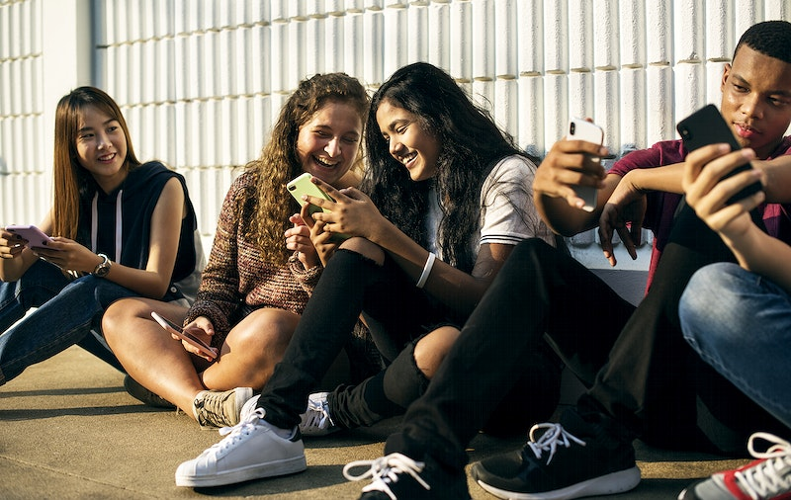
Why is talking about social media important?
Notes:
Create opportunities to learn
Prioritize safety of individuals
Open’s door to other topics

Slide 4

Does Social Media have a positive or negative impact on youth?
This Photo by Unknown Author is licensed under CC BY-SA
Notes:
Social Media can help individuals to
Builds Relationships - Creates opportunities for family co-play with adults and caregivers - playing with parents, siblings, school mates, (can be developmentally engaging, help find and explore strengths and Can be a bridge for talking and starting conversations about other important life topics. Team building and alliance can also be built through play
When we look at those who game - researchers have found that certain apps can actually enhance cognitive flexibility,they noticed that spatial and logic reasoning performance is improved, and some studies show this can help with academic success in STEM fields -
Cognitive load - games adjust to the players level, appropriate level of challenge
Increased engagement
Creates opportunity to look at the things they are engaging with and ASK OURSELVES- How can we use those same techniques to engage them in other causes, treatment, therapy, teaching, etc?
We can help reduce the Stigma by tapping into young people early on, we can teach and help them these skills within these digital contexts where they are meeting new people or connecting with friends, learn from others about norms and values, other cultures etc
Certain Apps like Youtube and Calm can be helpful to promote relaxation and calm
This can be a way of using these apps as assistive tools to help create healthy evening routines
Increased social bonding - learning new skills (dances, coordination, etc) all of these things can be a great asset to a developing mind

Slide 5











Can you identify these?

Slide 6
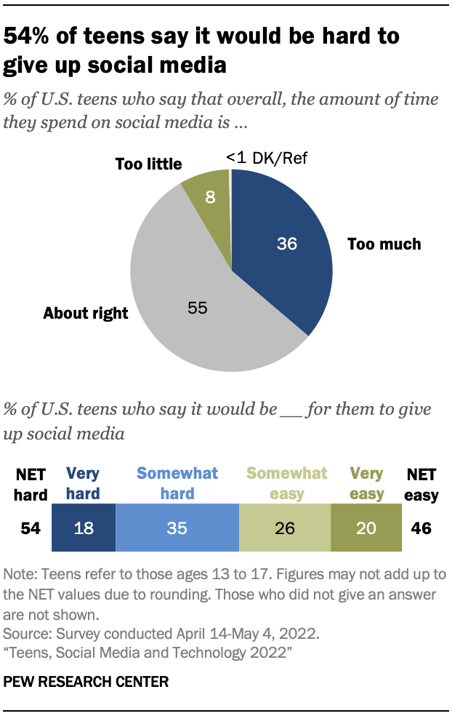
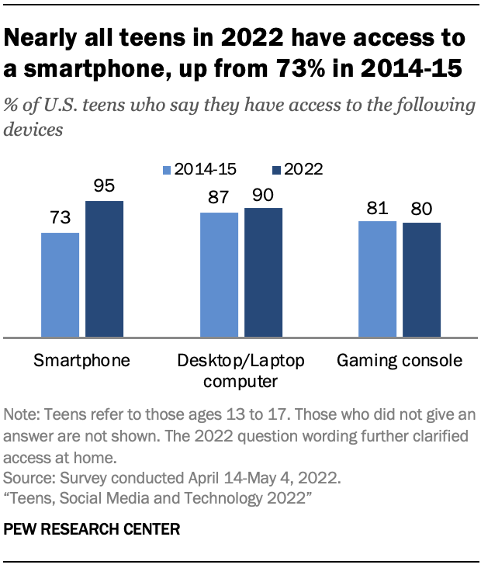
What does the research say?
Notes:
Teenagers with mental health concerns showed a larger increase in posting/commenting and expressed more negative expressions during the pandemic, compared with their peers without mental health concerns (Zhang et al., 2021). .
• Harmful social media posts can be linked to feelings of envy, inadequacy, and less satisfaction with life. In addition, teenagers’ addictive use of social media can lead to ADHD symptoms, depression, anxiety, eating disorders, and sleep deprivation (Columbia University, 2021).
• Instagram, with its algorithmically-driven feeds of content tailored to each user’s engagement patterns, can draw vulnerable teens into a dangerous spiral of negative social comparison and hook them onto unrealistic ideals of appearance and body size and shape (Harvard University).
In the study “#Being Thirteen: Social Media and the Hidden World of Young Adolescents’ Peer Culture,” the participants who checked Facebook or other networking sites between 50 and 100 times a day were 37% more likely to feel distressed than those who checked just a few times a day. Those who checked more than 100 times a day were 47% more likely to feel distressed (Underwood and Faris, 2017).
• Among girls who spent 3 hours or more per day on social media, 29% engaged in self-harm; among girls who spent 5 hours or more on social media daily, 31% were depressed (McAllister et al., 2021).
• Social media use can lead to a decrease in social contacts and an increase in loneliness (Apaolaza et al., 2013; Kraut et al., 1998).
• For adolescents suffering from depression, 3 types of social media use ― “oversharing” (sharing updates at a high frequency or too much personal information), “stressed posting” (sharing negative updates with a social network), and encountering “triggering posts” ― can aggravate their depression symptoms (Radovic et al., 2017).
For all the strengths and benefits that come from staying connected and opening our minds -
It is important to look at the whole picture.
Let’s address some of your concerns by looking at the other data out there and what it’s saying.
In one research study
45% of adolescents report using social media “almost constantly” while 44% report using it “several times a day”
40% of adolescent female and 20% of adolescent males report using social media for 3 hours or more a day >> females use more than males
In 2018, 30% of students asked reported that social media had a mostly positive impact on their lives, while 25% reported it having a negative impact on their daily lives
Among US adults 19% believe social media is completely responsible for the increase in depression among teenagers.
Among Gen Z (Born 2000 or later) and Millennials (born between 1982 and 1999) 82% believe social media is somewhat responsible for increase.
Among Gen X (born between 1965 and 1981) and baby boomers (1946-1964) tend to agree 87%-91% believe social media is responsible for increase.
Women are more likely than men to say social media has negative impact on their mental health
Anxiety and depression are on the rise among adolescents - but it is NOT to say that social media is the sole CAUSE but there are correlations between increased usage of social media and increased prevalence of anxiety and depressive symptoms
MYTH BUSTED - video games = isolation but 85-95% of all gaming are now social (playing and talking about things simultaneously) getting their social and identity needs met

Slide 7
How Social Media can affect mental health
The upsides:
The downsides:
Connect with friends
Feel like you belong
Get support
Learn about what’s happening in the world
Have fun!
Can make you base your worth on how you compare to others
A need to show the best version of yourself
Feeling jealous or not good enough
Can lead to a higher chance of depression, anxiety
Impact sleep
Notes:
Teenagers with mental health concerns showed a larger increase in posting/commenting and expressed more negative expressions during the pandemic, compared with their peers without mental health concerns (Zhang et al., 2021). .
• Harmful social media posts can be linked to feelings of envy, inadequacy, and less satisfaction with life. In addition, teenagers’ addictive use of social media can lead to ADHD symptoms, depression, anxiety, eating disorders, and sleep deprivation (Columbia University, 2021).
• Instagram, with its algorithmically-driven feeds of content tailored to each user’s engagement patterns, can draw vulnerable teens into a dangerous spiral of negative social comparison and hook them onto unrealistic ideals of appearance and body size and shape (Harvard University).
In the study “#Being Thirteen: Social Media and the Hidden World of Young Adolescents’ Peer Culture,” the participants who checked Facebook or other networking sites between 50 and 100 times a day were 37% more likely to feel distressed than those who checked just a few times a day. Those who checked more than 100 times a day were 47% more likely to feel distressed (Underwood and Faris, 2017).
• Among girls who spent 3 hours or more per day on social media, 29% engaged in self-harm; among girls who spent 5 hours or more on social media daily, 31% were depressed (McAllister et al., 2021).
• Social media use can lead to a decrease in social contacts and an increase in loneliness (Apaolaza et al., 2013; Kraut et al., 1998).
• For adolescents suffering from depression, 3 types of social media use ― “oversharing” (sharing updates at a high frequency or too much personal information), “stressed posting” (sharing negative updates with a social network), and encountering “triggering posts” ― can aggravate their depression symptoms (Radovic et al., 2017).
For all the strengths and benefits that come from staying connected and opening our minds -
It is important to look at the whole picture.
Let’s address some of your concerns by looking at the other data out there and what it’s saying.
In one research study
45% of adolescents report using social media “almost constantly” while 44% report using it “several times a day”
40% of adolescent female and 20% of adolescent males report using social media for 3 hours or more a day >> females use more than males
In 2018, 30% of students asked reported that social media had a mostly positive impact on their lives, while 25% reported it having a negative impact on their daily lives
Among US adults 19% believe social media is completely responsible for the increase in depression among teenagers.
Among Gen Z (Born 2000 or later) and Millennials (born between 1982 and 1999) 82% believe social media is somewhat responsible for increase.
Among Gen X (born between 1965 and 1981) and baby boomers (1946-1964) tend to agree 87%-91% believe social media is responsible for increase.
Women are more likely than men to say social media has negative impact on their mental health
Anxiety and depression are on the rise among adolescents - but it is NOT to say that social media is the sole CAUSE but there are correlations between increased usage of social media and increased prevalence of anxiety and depressive symptoms
MYTH BUSTED - video games = isolation but 85-95% of all gaming are now social (playing and talking about things simultaneously) getting their social and identity needs met

Slide 8

Cyberbullying
behaviors that intend to harm or coerce, that take place over digital devices like cell phones, computers, and tablets.
Behaviors and Impact
  Engage with bullying behaviors in-person
  Accessibility
  Time
  Supervision
Notes:
includes sending, posting, or sharing negative, harmful, false, or mean content about someone.
can include sharing personal or private information that causes embarrassment or humiliation.
sometimes crosses the line into unlawful or criminal behavior.
Bullying is behavior intended to harm or coerce another person and requires an imbalance of power and repetition
Bullying includes physical, verbal, and social harm
However, cyberbullying is unique in the sense that it is primarily verbal and social as it takes place in the digital world
The digital world is so expansive and complex that harmful, false, and mean content can be communicated in many ways
For example, a negative comment, the amount of “likes” an interaction has, and even the usage of a certain emoji can enhance the negative feelings a target could feel after being cyberbullied
Personal and private information is at risk of being of communicated through digital means and this can cause embarrassment and humiliation in an instant second
And the content utilized in the digital world can be really difficult to keep under control because of the freedom we have in this world
It is also important to point out how cyberbullying can become unlawful or criminal
An example would be sharing inappropriate images that goes against laws of consent and/or age permitted laws
Text messaging, instant message, and email each follow a similar chat structure of one-to-one or group discussion that have capabilities of sending videos, photos, documents and the sharing of content from other online platforms
For youth particularly, there are additional social media apps such as Tik Tok and Whatsapp that directly target them
It is important to note that platforms for social interaction are always being developed and used by youth which requires more investigation into what children are using and how they are using it
These are common risk factors for youth to experience cyberbullying
If there are already patterns of bullying behaviors by someone in-person, they are more likely to engage in cyberbullying
This is the same for targets - if they are are targets of in-person bullying they are more likely to become targets in the digital world as well
If youth have access to digital platforms that aren’t secured or don’t have safety measures to protect them, they are at more risk of experiencing cyberbullying
If we remember from earlier how new platforms are always being created, we have to remember how they might not have any safety measures and that can be dangerous
Also the amount of time youth spend using technology and the more interactions they have in the digital world, the more at risk they are of being cyberbullied…
….Especially if there is a lack of supervision with their activity
The number of people we can interact with online in seconds is tremendous and these people can be anyone from any walk of life.

Slide 9

What makes cyberbullying different from bullying?
Both have similar patterns in behavior, but cyberbullying is:
Persistent
Permanent
Hard to notice
Notes:
It is often easier to be cruel using technology:
Can be done from a physically distant location at any time of the day with unlimited online usage
Anonymous/fake information can be used to hide and protect the identity of them, providing “protection”
They don’t have to see the immediate response by the target
It is easier to be cruel using technology for many reasons
There is physical distance between the one engaging in cyberbullying and the target
Using technology can be at any time of the day with many having unlimited usage
Also those who engage cyberbullying can cloak their identity using anonymous or fake screen names and contact info, giving them a sense of protection even though their actions may be used against them one day
Lastly, those who engage in cyberbullying don’t have to see the immediate response by the target and this can reduce the chance for them to feel any remorse and guilt for their behavior

Slide 10

Impacts of Cyberbullying
Feeling depressed, sad, angry, and frustrated
They are afraid or embarrassed to go to school
Low self-esteem, family problems, academic difficulties, school violence, and various delinquent behaviors
May not know who is targeting them, or why
Having suicidal thoughts and in some cases, completing suicide
Notes:
Hurtful actions can more easily go viral and isolate those being cyberbullied even further
Large number of people can find out about the incident in a short period of time and can participate in the victimization
Some teens might not realize the serious harm they’re causing
Cyberbullying can happen in addition to in-person bullying and in some cases, can actually cause more harm
Going viral and getting a significant number of interactions with a cyberbullying situation can further harm and isolate the targets
A large number of people from school, the neighborhood, the city, and even the entire world can participate in the victimization of targets or at least find out about the incident with the simple touch of buttons on their digital devices
The number of potential targets, those who engage in cyberbullying, and the witnesses and bystanders of cyberbullying has no limit!
Another aspect of this is that the harm being done might not even be realized by people engaging in or involving themselves in the cyberbullying
An example might be a child on FB, not thinking of the situation in its entirety, reacting with a “laughing” emoji face on an aggressive comment from a child cyberbullying another child - now that aggressive comment is being supported and the target may feel more isolated
Well, there are many detrimental outcomes that have been reported by youth:
First, many targets report feeling depressed, sad, angry, and frustrated.
From our research, there was one teenager who said: “It makes me hurt both physically and mentally. It scares me and takes away all my confidence. It makes me feel sick and worthless.”
Those who are targets of cyberbullying also reveal that they are often afraid or embarrassed to go to school.
So now, the climate and culture of the school includes the digital climate and culture of the school and its students
In addition, research has revealed a link between cyberbullying and low self-esteem, family problems, academic difficulties, school violence, and various delinquent behaviors
One important piece to note is that targets may not know who is targeting them, or why, and this can increase all of the feelings we have said here
Finally, cyberbullied youth also report having suicidal thoughts, and there have been a number of examples in the United States and abroad where youth who were targeted ended up taking their own lives.

Slide 11

What can parents and families do?
Help develop social and emotional skills such as time management and self-discipline
Familiarize yourself with online platforms
Approach your child with curiosity
Be there for your child
Pay attention to changes in behavior
Notes:
Try to get involved on the online platforms your child is active on. Don't be afraid to explore different platforms and become familiar with them yourself. By being familiar with the platforms yourself, you can better understand warning signs and how to help your child.
Be curious when your child is online. Ask them questions like what game they are playing and who they are playing with. Asking questions will help you to understand what types of platforms your child uses and how they use them. Knowing the types of platforms your child is on can allow you to be more proactive.
Respect your child's privacy, but let them know that their safety is your #1 concern. Follow your child's lead and allow them to open up without being pushy. Reassure them know that you are on their side and support them. By building this trust, your child will be more likely to come to you for help.
For families and caregivers, you should
Know what technology your children have access to
Nowadays between the increased use of technology in our children’s life, in both their personal life, and school responsibilities, it's important to understand the features of the device and what are the limits of its capability- ex. Is there internet connection, do they only have access to school programs, are there access limits and/or time limits you're able to set up in the “settings” sections of the device.

Slide 12

Start the conversation
Establish reasonable limits and boundaries
Pick the right time
Don’t make assumptions
Listen non-judgementally
Be supportive
Talk about the future
Keep the door open
Notes:
Establish reasonable limits and rules:
Set time limits
Use the features on digital devices and online platforms to limit what they have access to online and some features help you maintain awareness of what they are doing
Establish open communication between you and your children. Mood changes can be associated with being a victim of cyberbullying such trouble sleeping and increased irritability, and open communication will help you identify if cyberbullying is happening.
And lastly, take interest in the internet and social media yourself! Do some reading up on what apps your kids mention. Become familiar with all the features of the technology to better understand how to manage it. Being familiar with the technology your children have access to will help you better understand how it works and how to help prevent cyberbullying.
Have many of you have ever tried to take away your child's cell phone/tablet or gaming device as a punishment? (pause)
Some of you might be shuttering while remembering how quickly things escalated after that – We know that taking the device away is the initial instinct when a situation occurs, but if the child is using the device for a coping mechanism, outlet, or to assist with their workload, this could be more problematic.
This is why talking openingly about the expectations, limitations and consequences of ahead of time can be helpful to navigate the waters should an issue arise.
Let’s spend a few moments unpacking some tips on HOW to start that conversation together -
DO find a good time to talk, one that works for both the caregiver and child and a neutral space to chat. This could look like waiting for people to have a chance to wind down after a long day, and not during a chaotic time like the early morning rush or right when people get home and are in transition mode. Just like adults, student may need space and time to decompress after a long day of trying to sit still and pay attention. Having these conversations during times where both people are prepared to listen and learn can lead to greater success.
Don’t assume they already know the risks. Just because they are using these apps and devices daily, does not mean that they are fully understanding the risks and long term consequences of how they are being used. Unlike adults who have had experience and opportunities to learn over time, kids are being thrown into technology rather quickly and there isn’t always time to process or walk through things together before your child starts engaging.. We want to avoid shaming them about what they don’t know and take the time to
Listen non-judgmentally to their concerns, or when they share more about the types of things they are doing online, for example - if they share with you that they are using chat rooms or posting things on social media that might be concerning - the initial reaction might be to get scared and upset , or maybe we get angry at them - and yell. These things will most likely lead to other person shutting down, and the space feeling no longer safe for open sharing.
We can avoid that by being supportive and patient while you work through things together. If the child knows that they are going to be met with support and understanding, they may be more inclined to initiate the conversation or reach out for help during times of need.
Saying things like “We can learn about this together” or “I am here to help you figure this out” can be helpful.
It is important to talk to your child about the future, and the impact using the internet unsafely could have on their long-term wellbeing and happiness. It can be easy to fall into impulse and post the first thoughts or reactions that come to mind . Our comfort levels are higher when sharing and doing things from behind a screen but that doesn’t mean that we are not linked to the information we share-
Using statements like “Did you know that it is possible for school administrators, college staff or potential employers access information and photos once they are online?” might encourage them to brainstorm possible consequences before posting or sharing things. For example, the draw for some people with Snapchat is that the pictures “GO AWAY” after opening them, but there are still ways to screenshot and save images to a camera roll for later use. This goes for anything that is posted , if you post and then delete the image or comment might be gone, but it will be unclear how to find out who saw it, saved it or took a photo of it before hand so its easier to take the extra moment before posting and briefly think about the long term before we make an action.
We want to motivate our kids to make healthy choices for themselves, not just for the approval or acceptance of others - so talking to them about their unique personal goals, aspirations, concerns, fears, thoughts, and dreams can go a really long way. Asking them what they get out of an app, or how that app has been helping them might help caregivers get a better understanding of the positives attached to it - or gives room to talk about the concerns if a child shares its actually causing them sadness or stress
Talking about social media won’t be one time thing, so keeping the door open is important. Building trust and allowing children to feel comfortable to share will hopefully minimize any potential harm or misuse.
Create opportunities to learn together
Connect with other parents
Learn about the biological impacts
Talk to your provider for serious concerns

Slide 13

Next steps
Create opportunities to learn together
Connect with other parents
Learn about impacts

Slide 14
Thank you!
Susan Fisher; resolutions@nyspta.org
Tharaha Thavakum-Slavin; geneseevalleyrd@nyspta.org

