Slide 1


Lights! Camera! Environmental Action!
Presented by:
Amy Hysick, Wellness Coordinator
Patricia Genco, Health Specialist
Maria Sanders, Environmental Specialist

Slide 2

Objectives
Discuss important Environmental Concerns facing our communities and what do all these abbreviations mean
⬜ PFAS/PFOS
⬜ PCB
⬜ Lead and others
⬜ AQI (Air Quality Index)
What Actions can we take for a Safer Environment for all families
What can PTA do

Slide 3

How can we Advocate
Home School PTACommunity
Where
to
Start
What
Actions are
Needed
Identify
the
Issues
Who
can
Help
Search
for a
Solution
Who
can
Help
Notes:
There are so many things we can do to advocate for the environment at home , in our schools through PTA and in our communities.
At home we can start by reducing our waste- cutting back on our water consumption, the amount of plastics we use daily- buy used before purchasing new- eating plant based diet, start composting
In schools, start a planting/gardening club/ make sure your school is recycling plastic/paper, ink cartridges, etc. does your school have filtered drinking water , do they limit the mercury used products , get involved with the district on decision making committees - ensure they have environmental considerations in mind when decisions are made on infrastructure projects and on transportation issues.
PTA can start a letter writing campaign regarding clean drinking water. sending letters to the EPA and the NYS Department of Environmental Conservation- Clean Water Environmental Advocates NY, Clean and Healthy

Slide 4
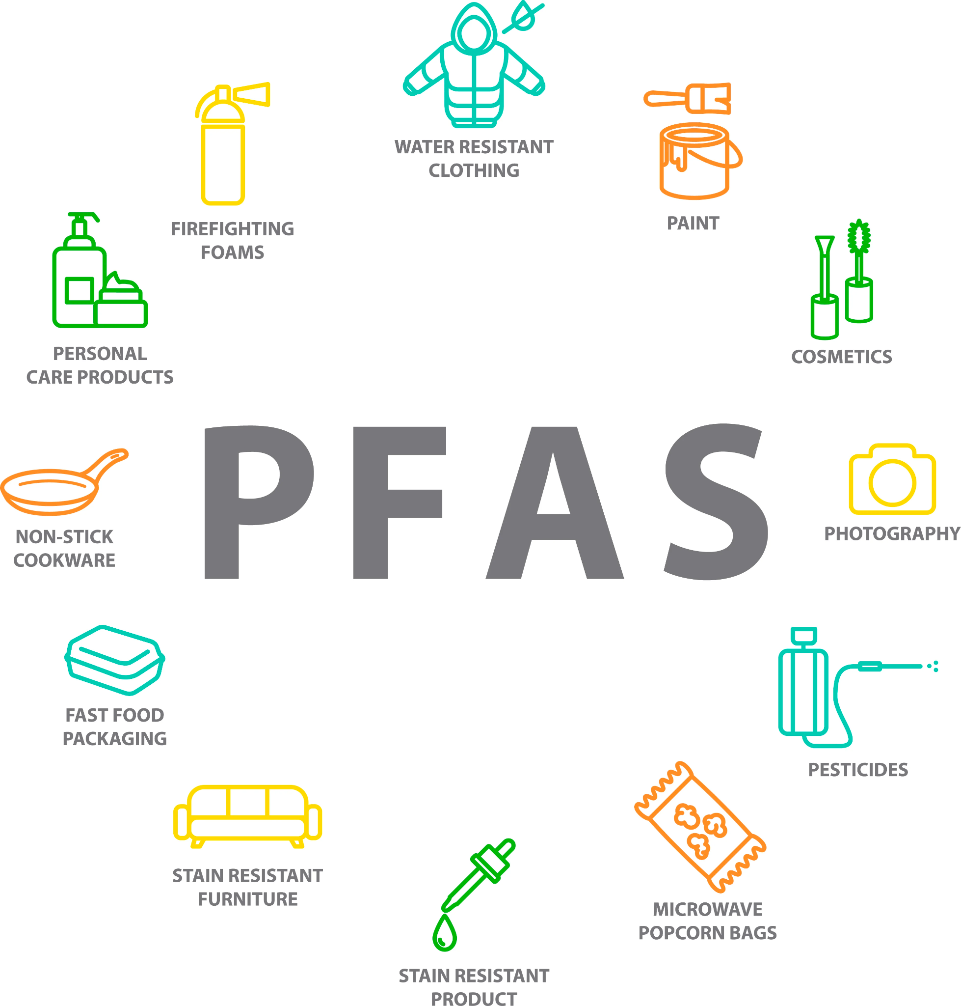
What are PFAS/PFOS, etc. and why should I be concerned
What are PFAS/PFOS, etc. and why should I be concerned
Man-made chemicals, found in:
Grease-, stain-, and water-repellent items
Non-stick cookware, cleaning products, and personal care products
Leach into water supplies (and then into us)
Restricted/limited in the US (with more legislation pending)
Notes:
PFAS chemicals are man made( invented in the 30’s)
There are
don’t degrade(breakdown or deteriorate) easily; (atoms are very strong)
they stick around in the body and the environment for a long time,(One common characteristic of concern of PFAS is that many break down very slowly and can build up in people, animals, and the environment over time.)
and they are very stable in water.
They were made to repel oil, water and grease, making them useful for many consumer products. Companies use these chemicals in many common items, like paper food packaging, stain-proof rugs, waterproof clothing, some types of dental floss and nonstick cookware. firefighting foam
PFOA and PFOS
No longer produced(since 2000’s) in the US but still manufactured and used in products in other countries
U.S. manufacturers have replaced PFOA and PFOS with other members of the PFAS family. The effects of these next-generation PFAS chemicals well understood nor their effects.
-leach into surface and ground water from places like landfills, factories and military bases.
98% of Americans have PFOA/PFOS/PFC’s in their blood
Image source: https://news.sundanceusa.com/news/what-you-need-to-know-about-pfas-in-packaging

Slide 5
What are PFAS/PFOS, etc. and why should I be concerned
Health Risks?
Reproductive effects and developmental effects
Increased risk of some cancers, including prostate, kidney, and testicular cancers.
Interferes with the body’s natural hormones
**But we don't really know all of the health effects.**
Replacement chemicals (PFOA & PFOS) haven't had health effects studied, either.
Notes:
PFAS chemicals are man made( invented in the 30’s)
There are
don’t degrade(breakdown or deteriorate) easily; (atoms are very strong)
they stick around in the body and the environment for a long time,(One common characteristic of concern of PFAS is that many break down very slowly and can build up in people, animals, and the environment over time.)
and they are very stable in water.
They were made to repel oil, water and grease, making them useful for many consumer products. Companies use these chemicals in many common items, like paper food packaging, stain-proof rugs, waterproof clothing, some types of dental floss and nonstick cookware. firefighting foam
PFOA and PFOS
No longer produced(since 2000’s) in the US but still manufactured and used in products in other countries
U.S. manufacturers have replaced PFOA and PFOS with other members of the PFAS family. The effects of these next-generation PFAS chemicals well understood nor their effects.
-leach into surface and ground water from places like landfills, factories and military bases.
98% of Americans have PFOA/PFOS/PFC’s in their blood

Slide 6
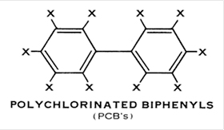
PCB’s
Polychlorinated biphenyls – man-made industrial chemicals
Non-flammable, chemically stable, high boiling point, electrically-insulative (so lots of industrial uses)
Banned in 1979, but still hanging around in:
Transformers
Cable insulation
Fluorescent light ballasts
Electrical equipment
PCB's don't break down easily in the environment and can accumulate in body tissues.
Are carcinogens (cause cancer) and cause non-cancer health effects in nervous, immune, reproductive, and endocrine systems.

Slide 7
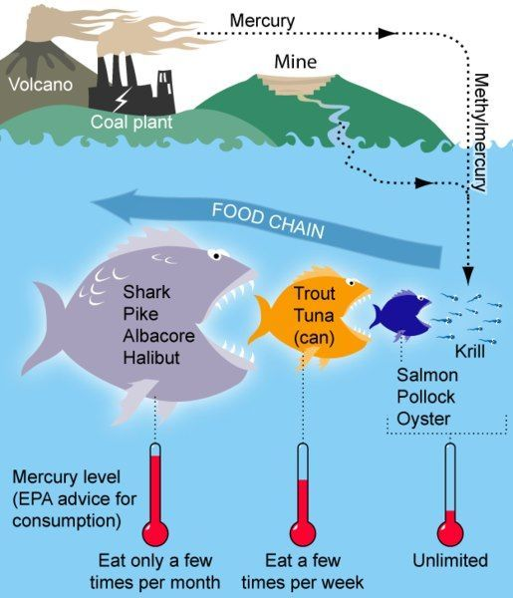
Hg (mercury)
Mercury - naturally-occurring element in Earth's crust.
Released by volcanoes, transformed by bacteria into methylmercury
Methylmercury accumulates in living things and becomes more toxic as you move up the food chain
Children and pregnant women must be careful
Elemental and methylmercury are toxic to nervous systems
Harmful also for digestive and immune systems, lungs, and kidneys

Slide 8
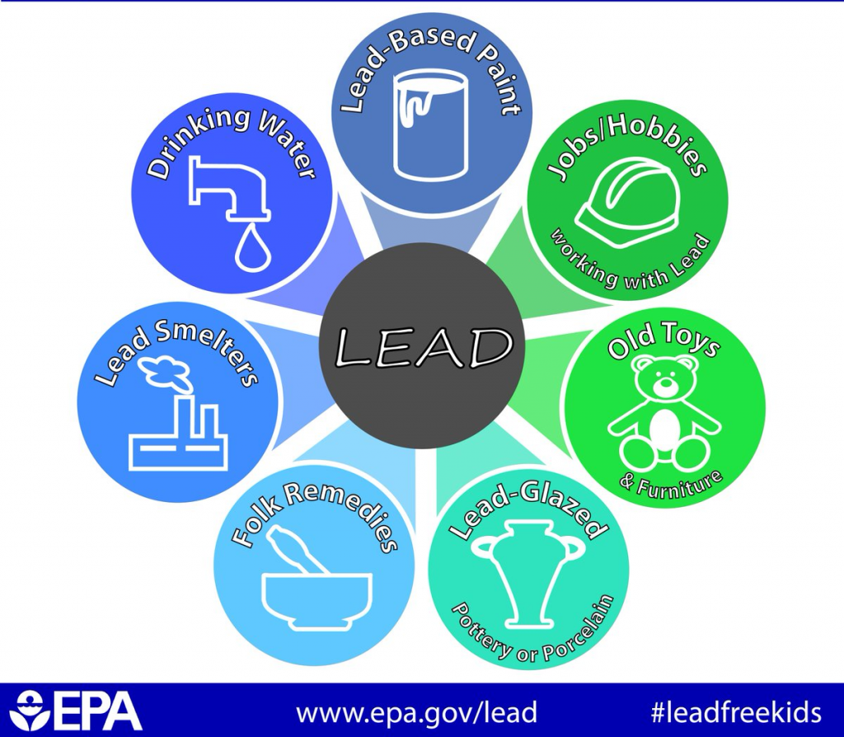
Pb (lead)
Lead - no safe level of exposure for children (greatest effects) – and effects are permanent.
Negatively affects:
intelligence, ability to pay attention, academic achievement
slowed growth and development
learning and behavior problems
hearing and speech problems
Most harmful for children under 6.

Slide 9
AQI (Air Quality Index)
AQI - the EPA's measure of environmental pollutants in the air
*The higher the number, the higher the contaminant level
**Under 100 is considered 'Satisfactory' – above 100 is 'Unhealthy'
AQI measures and reports:
ground-level ozone
particulate matter
carbon monoxide
sulfur dioxide
nitrogen dioxide
Notes:
Air Quality Index
Over the past few months with all of the talk and issues with the wild fires in Canada effecting the air here in the states- you all may have heard about the AQI ( Air Quality Index)
SO what is it and what does it mean
Think of the air quality index as a scale

Slide 10
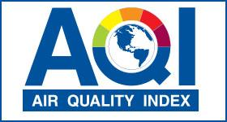
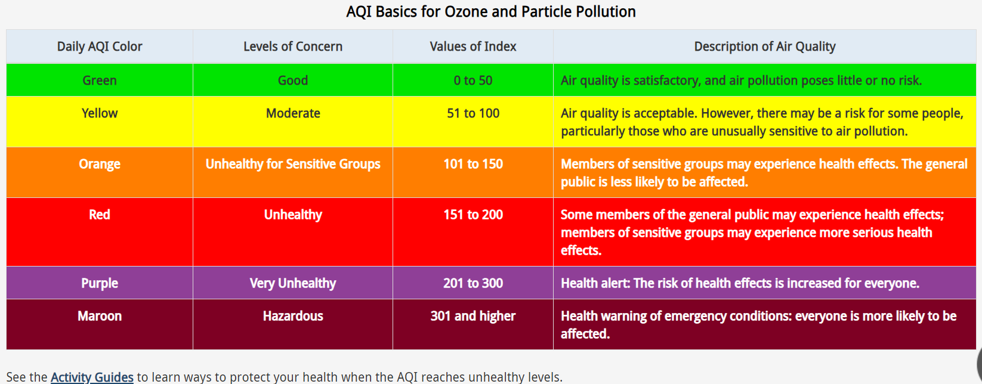

Slide 11

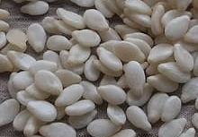
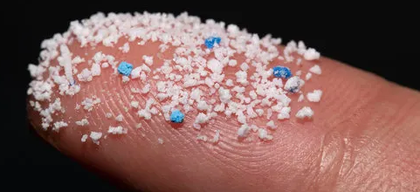
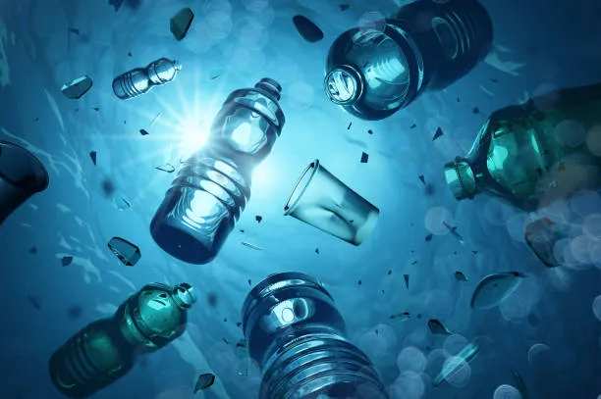
Microplastics
Plastic fragments less than 5 mm in diameter
come from breakdown of plastics in the environment
microbeads in cleansers
fleece fabrics in the laundry
They make their way into the marine ecosystem and animals mistake them for food. They can cause digestive and immune issues.
Over 90% of commercial water bottles have microplastic particles (averages ranging from 325-10,000 pieces per liter!!!!) but an average of only 5.5 pieces in tap water…

Slide 12
How can we Advocate
Home School PTACommunity
Where
to
Start
What
Actions are
Needed
Identify
the
Issues
Who
can
Help
Search
for a
Solution
Who
can
Help
Notes:
There are so many things we can do to advocate for the environment at home , in our schools through PTA and in our communities.
At home we can start by reducing our waste- cutting back on our water consumption, the amount of plastics we use daily- buy used before purchasing new- eating plant based diet, start composting
In schools, start a planting/gardening club/ make sure your school is recycling plastic/paper, ink cartridges, etc. does your school have filtered drinking water , do they limit the mercury used products , get involved with the district on decision making committees - ensure they have environmental considerations in mind when decisions are made on infrastructure projects and on transportation issues.
PTA can start a letter writing campaign regarding clean drinking water. sending letters to the EPA and the NYS Department of Environmental Conservation- Clean Water Environmental Advocates NY, Clean and Healthy

Slide 13
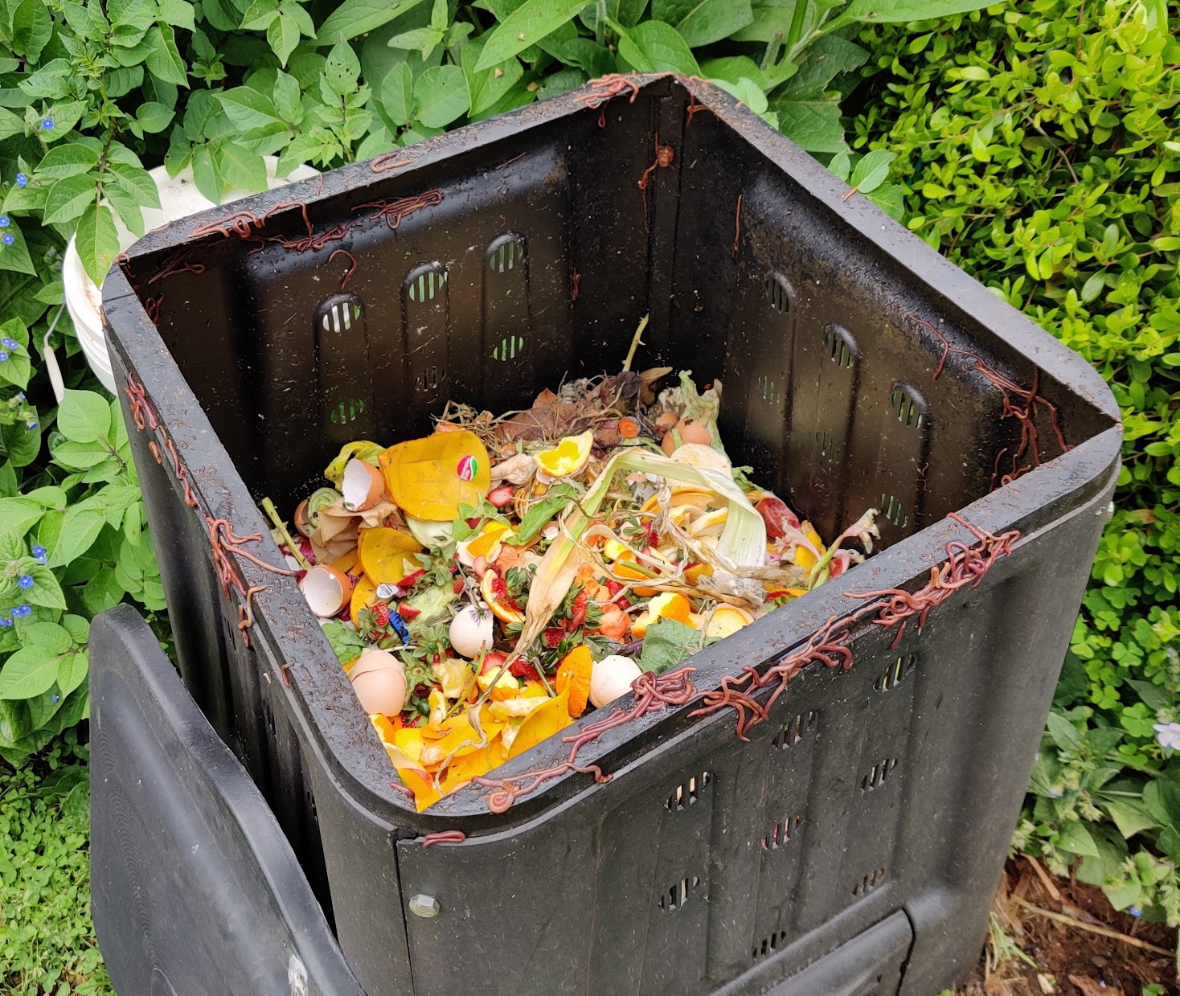
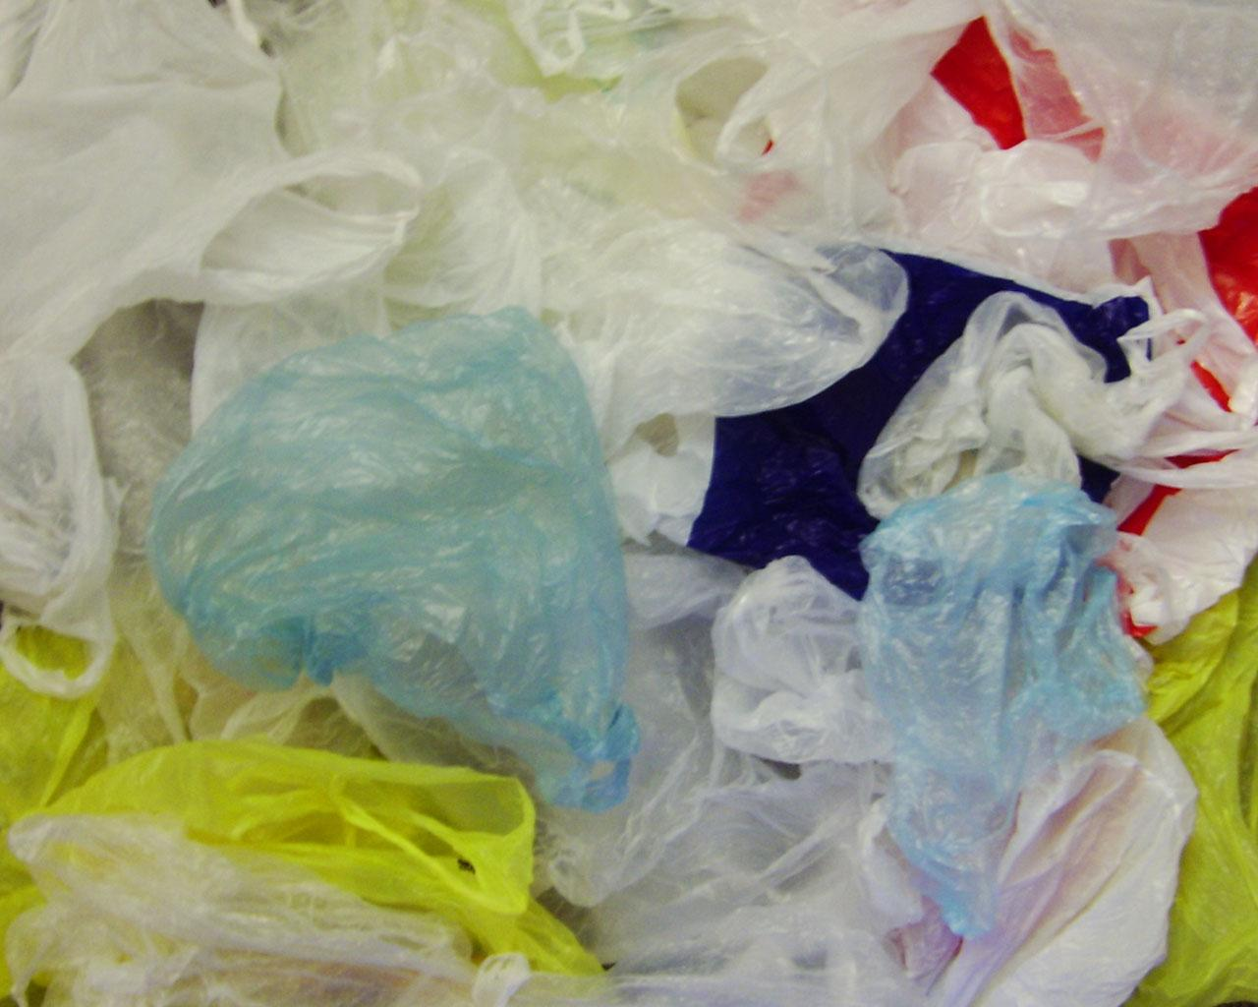

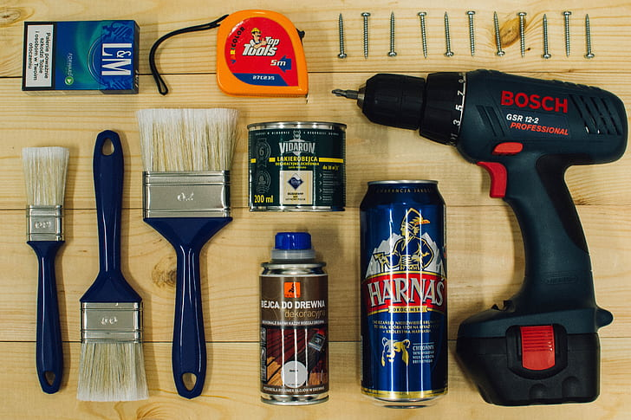
Search for a Solution
At Home:
composting of food waste
reduce the use of single-use plastics
be mindful of the packaging of the products you use
intentional choices of environmentally safe building/renovation materials for home improvement projects
be mindful of water consumption
think about a shift toward a plant-based diet
calculate (and then reduce) your carbon footprint
Notes:
Air Quality Index
Over the past few months with all of the talk and issues with the wild fires in Canada effecting the air here in the states- you all may have heard about the AQI ( Air Quality Index)
SO what is it and what does it mean
Think of the air quality index as a scale

Slide 14

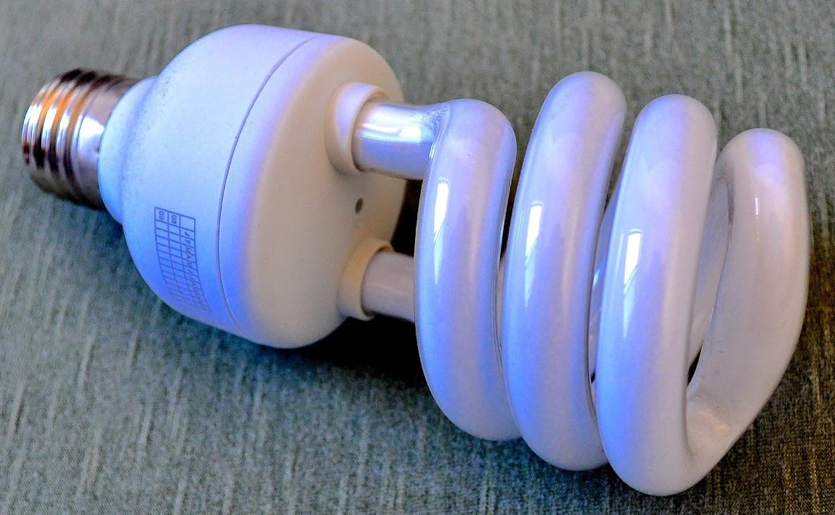
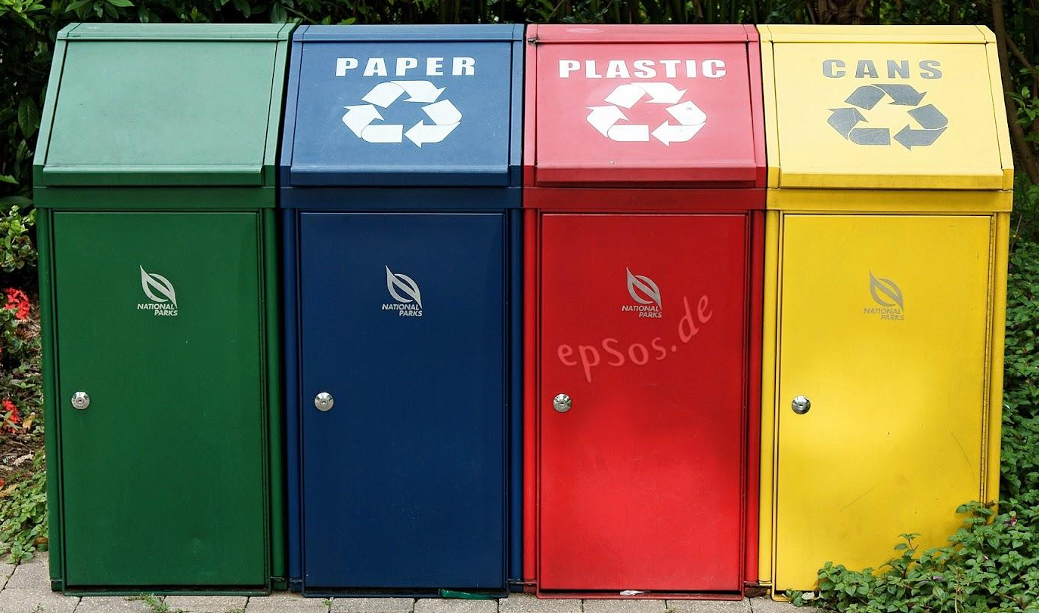
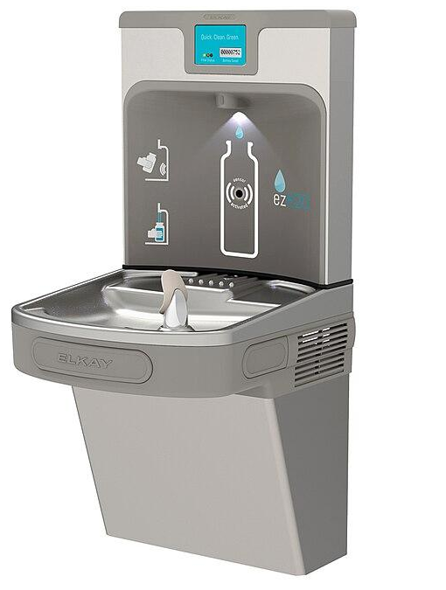
Search for a Solution
At School:
have conversations with school leaders about reducing energy consumption
make sure that there are no mercury-based products used in schools
ensure that water testing (for lead and contaminants) is conducted frequently
advocate for access to filtered water in schools
ensure that plastic, paper, and ink cartridges are recycled in school buildings
Notes:
Air Quality Index
Over the past few months with all of the talk and issues with the wild fires in Canada effecting the air here in the states- you all may have heard about the AQI ( Air Quality Index)
SO what is it and what does it mean
Think of the air quality index as a scale

Slide 15
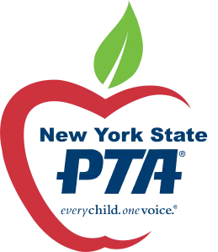
Search for a Solution
At PTA/Community:
bring up these issues at PTA meetings
letter-writing campaigns
phone call campaigns
attend webinars about environmental issues
contact local legislators
Notes:
Air Quality Index
Over the past few months with all of the talk and issues with the wild fires in Canada effecting the air here in the states- you all may have heard about the AQI ( Air Quality Index)
SO what is it and what does it mean
Think of the air quality index as a scale

Slide 16
Search for a Solution
What action do you want?
Spread awareness of the issue
Bring it up at a meeting (PTA, Board of Education)
Have conversations with school leaders about the concerns
Legislation?
Educate & get the community involved
Phone calls/letters to legislators
Lobby Days
Voting
NYS PTA Resolution – write one!
Statement of Concern
NYS PTA Position Paper
Notes:
Air Quality Index
Over the past few months with all of the talk and issues with the wild fires in Canada effecting the air here in the states- you all may have heard about the AQI ( Air Quality Index)
SO what is it and what does it mean
Think of the air quality index as a scale

Slide 17
NYS PTA “Where We Stand”
PAPER RECYCLING AND RECYCLED PAPER USE
AIR QUALITY STANDARDS IN INDOOR ICE ARENAS
REDUCING & PHASING OUT THE PURCHASE OF POLYVINYL CHLORIDE (PVC) PLASTIC IN NEW YORK SCHOOLS
IMPLEMENTING ENVIRONMENTAL EDUCATION AND LEGISLATIVE ACTION
CELLULAR PHONE TOWERS
INDOOR AIR QUALITY GUIDELINES FOR SCHOOLS
PROTECTION OF GROUNDWATER SUPPLIES
SOIL CONTAMINATION ON SCHOOL GROUNDS
BIO-SOLIDS IN NEW YORK STATE
MERCURY REDUCTION IN THE ENVIRONMENT
GENETICALLY MODIFIED ORGANISMS (GMOS) AND GENETICALLY ENGINEERED (GE) FOODS (Being Updated)
INTEGRATED PEST MANAGEMENT ( Pesticide use as a last resort)
USE OF POLYSTYRENE PRODUCTS
SEWAGE WASTE PROBLEMS
TOXIC ART SUPPLIES
INERT INGREDIENT LISTING ON PESTICIDE PRODUCTS
HAZARDS FROM LAND, WATER, AIR, NOISE, AND LIGHT POLLUTION
MAXIMUM TEMPERATURE IN THE SCHOOL SETTING

Slide 18
NATIONAL PTA
POSITIONS
Clean Water
Environmental Health, Remediation, Sustainability and Climate Change
RESOLUTIONS
Indoor Air Quality
Lead Poisoning Prevention

Slide 19
REFERENCES
New York State PTA www.nyspta.org
National PTA https://www.pta.org
The Environmental Protection Agency https://www.epa.gov/
AirNow.gov https://www.airnow.gov/aqi/

Slide 20
