Slide 1

MINDFUL VOLUNTEERING
Lucille Vitale ─ NYS PTA Vice President
Amany Messieha Dgheim ─ NYS PTA 1st Vice President
Notes:
Welcome attendees
Introductions
Explain “full plate” activity

Slide 2

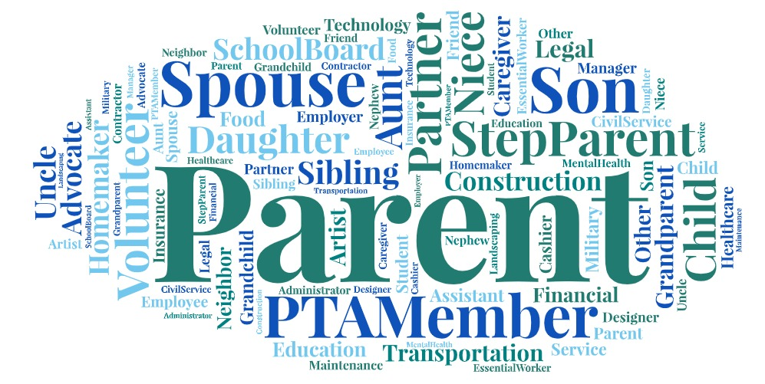
Notes:
As you have probably guessed by now, the purpose of this activity is to visually demonstrate how full all our plates are with all the roles that we play in our individual lives.
Some of the descriptions you selected are common among most of us. Some are more unique to you, but all in all we need to realize and acknowledge all those roles and responsibilities that are on YOUR plate and the plates of other volunteers!
How full is your plate?!
We have seen now how full our plates can actually be, how many roles we all have on a day-to-day basis, and how much we are all expected to do.
Do you ever feel overwhelmed? All of these activities and responsibilities can become very overwhelming. What do you do then?

Slide 3
MINDFUL VOLUNTEERING
Does it seem like your volunteer duties often interfere with all of your other responsibilities? Do you ever feel overwhelmed?
How full is your plate?!
This workshop will provide ways to prioritize wellness and practice the principles of mindfulness while balancing the juggling act of volunteering and living your personal life.
Notes:
Many of us can feel like our volunteer duties do in fact interfere with our other responsibilities. In today’s times, there are many activities for our children to get involved with (i.e., school/academic clubs, sports, band, orchestra, scouts, etc.) that seem to have increased exponentially than even since we were all students in school. Our own parents did not seem to have the very busy schedules that we all find ourselves having. Many households now need multiple incomes; we may have households with both parents working as well as the students holding down jobs.
The responsibilities of everyone seem to be much greater than in past times. On top of it all, we take on many different volunteer roles. We can hold an elected position which may require very specific duties to be carried out for our PTA, a chairmanship, which may require a group of people on a committee to complete a task or hold an event, a committee member, which may require a lot of hands-on work to complete a task, or you may volunteer to participate in a particular event (holiday fair, book fair) which may require your time.
In this workshop, we will discuss the dynamics of balancing home and work life with your volunteer work while remaining mindful of all the things we do and how we can remain happy and healthy trying to do it all.

Slide 4
MINDFULNESS
The practice of paying attention in the present moment, intentionally and with non-judgment.
The observation of thoughts, emotions and body states.
Notes:
The state or quality of being mindful, or the practice of maintaining a non-judgmental state of heightened or complete awareness of ones thoughts, emotions, or experiences on a moment to moment basis
Emphasizing:
Self awareness and awareness of others.
Intentional awareness.
The state of active, open attention to the present moment.

Slide 5

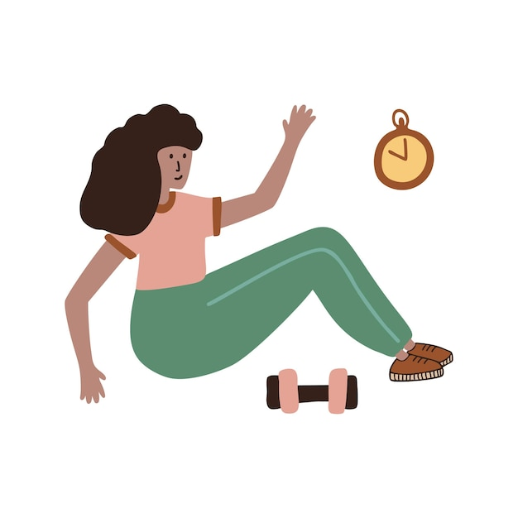

MINDFULNESS PRACTICES
Art therapy
Meditation
Martial arts
Yoga
Physical activity
Hobbies
Notes:
Art Therapy: Remember how much fun it was to paint, draw, or mold things out of clay when you were a child? It turns out that making art can be a powerful therapeutic tool for adults, even in the management of medical conditions, including pain. Adding time to enjoy listening to music or playing an instrument is equally therapeutic and helpful for stress relief.
Meditation is an umbrella term for various ways to accomplish focused attention and may even lead to a relaxed state. There are many types of meditation and relaxation techniques that have meditation components. These practices have been shown to reduce stress, which may help cultivate better health outcomes.
A sense of calm, peace, and balance achieved through meditation can benefit your emotional well-being and overall health. Breathing exercise/ focus.
Martial Arts: The ancient form of gentle Chinese martial arts called Tai chi (TIE-CHEE) is sometimes referred to as meditation in motion. It promotes serenity through gentle, flowing movements. The self-paced series of postures or movements are done slowly and gracefully while practicing deep breathing.
Yoga is an ancient Indian practice that brings the mind and body together. Multiple studies have confirmed that yoga offers many mental and physical benefits.
Physical Activity: any and all in any pace or strength your body can handle and you can make time for is proven to be extremely beneficial to both body and mind. It can be as intense or as mild as you choose: walking, running, swimming, simple exercises, break a sweat, your choice! (Taking your dog for a nice walk can do you Both a lot of good!)
Hobbies: these are a huge range of things that are personal and individual in their effectiveness. Fishing, reading, family time, watching TV, cooking (for fun), etc.
Don’t forget about yourself and your own personal enjoyment! Remember to try and incorporate mindful activities in your day-to-day life to relieve stress and to benefit your overall health.

Slide 6

WHAT CAN MINDFULNESS DO FOR US?
Reduce Stress
Increase Focus
Improve Emotion Regulation
Increase Emotional Intelligence
Increase Empathy and Respect
Increase Resilience
Improve Physical Well-being
Improve Creativity & Collaboration
Notes:
Reduce Stress: Improve ability to manage stress
Increase Focus: Improve ability to pay attention, focus and concentrate
Improve Emotion Regulation: Reduce impulsiveness, anger, and outbursts
Increase Emotional Intelligence: Improve conflict resolution skills and developing healthy relationships- Paying attention to social cues (non-verbal behavior)
Increase Empathy and Respect: Increase empathy and understanding of others (triggers)
Increase Resilience/grit/toughness: Increase capacity to overcome challenges
Improve Physical Well-being: Increase engagement in physical activity and health awareness. Reduces pain!! (long meetings- take breaks)
Improve Creativity & Collaboration: Improve expression of creative arts and other forms of self-expression. (Goal = a better job not just let’s get this over with!)

Slide 7
TESTIMONIALS FOR MINDFULNESS
“I learned acceptance of my fears and how many people are similar to me.”
“I learned how important it is to be patient with others and put myself in their shoes.”
“I learned that having empathy can make a difference to everyone around you.”
Notes:
Fear of public speaking
Fear of a Zoom webinar recording (e.g. Finding it difficult to record a webinar without an audience- missing interactions- not getting any response while you are speaking)
What are you uncomfortable about when doing your volunteer/ PTA work?! (e.g. writing formal letters, language barriers could exist (i.e. having difficulty reading, writing or understanding in English. Communicating with district/ school administration, staff, other parents, etc.)
Other similar experiences…
Reassure each other, positive feedback and expressions
Connect volunteers with resources to help them such as translation services, forms already translated on NYS PTA’s website, etc.
Support each other and show empathy.
Definition of Empathetic: showing an ability to understand and share the feelings of another, even if it’s not your experience!

Slide 8

WHAT IS MINDFUL VOLUNTEERING?
Volunteering:
Gives us a sense of purpose
Activates our kindness
Empowers us to “make a difference”
Cultivates positive emotions
Yields happiness and better health
Notes:
We all crave a personal sense of meaning/ purpose. One of the best ways to activate your kindness is through volunteering.
Remember that everyone is a bio-psycho-social-emotional being. A holistic approach to others is beneficial.
The benefits of active benevolence (well meaning kindness), ‘Helper Therapy’ for example, have been totally proven. For example, data shows that recovering alcoholics engaged in supporting other alcoholics were 2x’s more successful in maintaining sobriety a year later than their unengaged peers. (For those unfamiliar: Within AA, Alcoholics Anonymous, its possible to volunteer to sponsor newer participants and uphold a mentorship relationship.)
In the emerging field of PNI, (psychoneuroimmunology, the study of stress and happiness on immune function) there is a growing body of studies demonstrating that cultivating positive emotions enhances immune and central nervous system function.
Therefore, through finding the ideal social causes you care about and mindful volunteering, we make a difference that brings overall happiness. In addition, we meet others who share our sentiments for these causes and these friendships are literally therapeutic.
So your volunteer work is supposed to bring you: better health and happiness!

Slide 9

MINDFUL VOLUNTEERING BENEFITS
What are the benefits to me?
Experience enhances skills
Commitment proves values
Connections create opportunities
Free therapy
Notes:
Experience enhances skills:
Volunteering, especially in PTA, offers valuable (free) training. Volunteers train other volunteers and provide them with the resources they need in order to support them in becoming skilled members of the team.
In certain studies of workforce and employment trends, the majority of employers reported that they would recruit a candidate with volunteering experience over one without and most employers believe that volunteering adds skills.
Commitment proves values:
When employers see volunteer experience on a resume, they are more confident of you having strong values, being motivated and hardworking. Committing to a cause/ nonprofit proves your values.
Connections create opportunities:
Those who discover their volunteering passion, invariably end up expanding their social network of like minded people. This can mean valuable connections who are aware of your personality and work ethic, possibly leading to a key referral for a future job and frequently lifetime friendships!
Free therapy (positive feelings/ a break from routine):
Altruistic volunteers who have found their favorite cause, experience a layered benefit.
(According to neuroscientist Dr. Alex Korb, Ph.D. and author of The Upward Spiral: Using Neuroscience to Reverse the Course of Depression, One Small Change at a Time, says its possible to give your mind an upward spiral of small steps and actions that cause more experiences of joy.)
Fulfilling volunteer work causes us to experience satisfaction and joy! Hence, volunteering can become an affordable therapy for building contentment!

Slide 10
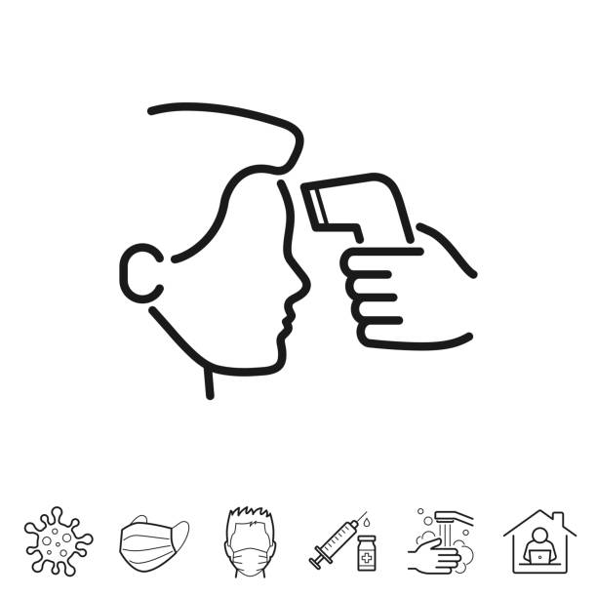
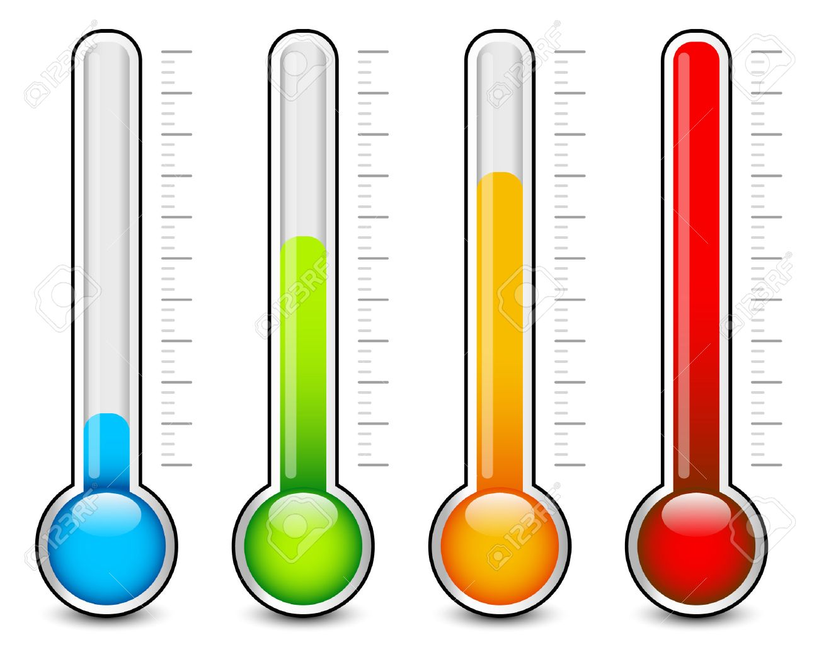
HOW IS YOUR VOLUNTEERING?
Do you ever feel:
Stressed
Anxious
Overwhelmed/overloaded
Unsatisfied
Misunderstood
Under/unappreciated
Frustrated/angry
Notes:
Stressed- many different factors can cause stress- you can feel mental stress from the workload, upcoming deadlines that need to be met, being tired from long hours, or physical stress (lifting heavy boxes, going shopping for a large event, etc.).
Anxious- Circumstances that you may not have control over can bring on anxiety, e.g. doing something you are not completely comfortable doing, new experiences, anticipating a controversial issue, etc.
Overwhelmed/Overloaded- taking on too much at one time, not delegating to the appropriate people, feeling you alone have to save the world, not getting enough rest or properly eating can also add to these feelings.
Misunderstood- Not clearly stating your intentions or having confusion as to what needs to be done. Are you clear, concise, mindful of the audience’s abilities/ limitations?
Under/ unappreciated:
How many times did you work hard in an event or activity and did not even get a “thank you”?! Saying thank you goes a long way! It is very important to feel appreciated and to always show appreciation to others.
Frustrated/Angry- feeling of frustration and even anger can occur when you are stressed, anxious, overwhelmed, overloaded, misunderstood, and/or underappreciated. Sometimes you can be in disagreement with other volunteers or staff and feeling frustration/ anger. How do you address differences?!

Slide 11

MINDFUL VOLUNTEERING = POSITIVE VOLUNTEERING
What can I do better?
Be self-aware
Be mindful of others
Delegate
Learn to say “no”
Follow your interests/ passion
Communicate (speak up)
Notes:
Be self-aware: being mindful of your own state of mind and feelings that are showing in your facial expressions, body language and choice of words, etc..
How you feel affects how you react! BREATH! PAUSE!!!
Remain calm, non-confrontational, and keep your emotions in check.
Be mindful of others: pay attention to their social cues, expressions, body language, tone of voice, words, and what is triggering them. People have sensitivities. How about we table? Take a break? Then find a common ground to agree on.
Delegate: You do not have to “run the whole show!” There are other volunteers who can definitely help you carry out the tasks. Utilize the right people and know that it’s healthy to delegate, grow and develop the team. Delegating is actually a positive reflection on your ability as a volunteer. You may lose volunteers if you’re not utilizing them!
Learn to say “no”: If your plate is so full, try to avoid adding to it where you can no longer balance all, fulfill each duty well without stressing yourself. ***QUALITY OF YOUR PTA VS QUANTITY***
Follow your interests/ passion: when you follow your interests and passions, you’re likely to have a more enjoyable volunteer experience and be more productive. At times you may be asked to do something outside of your original interests, comfort zone, but you may surprise yourself and actually like it! If you don’t enjoy it, then speak up and next time change to something else!
Communicate (speak up): Expressing your concerns is healthy! Select the right place and time as well as choose your words carefully. Best not to wait until you are frustrated/ angry. Communication is TWO WAY! Listen as well as verbalize. Listening is a skill that is essential for successful communication.

Slide 12
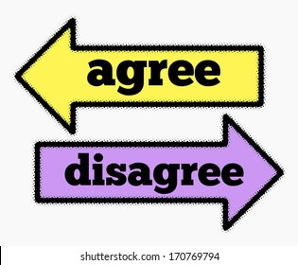
MINDFUL VOLUNTEERING = POSITIVE VOLUNTEERING
How to disagree without being disagreeable?
Choose place and time
Maintain respect/decorum
Hold everyone accountable
What to avoid?
Focus on PTA’s Mission
Notes:
How to Disagree Without Being Disagreeable?
PTA volunteers sometimes disagree amongst themselves. Other times they may disagree with administration, staff, other parents, etc.
Choose the right place and time: Applying good judgement. Is there enough time in the meeting? Does it need to be tabled? Is it appropriate for the current audience?
Email: think before you respond. Do you need to “copy all”?
Always maintain respect and proper decorum: no accusations, pointing fingers, voice raising. Your choice of words is important. Your tone of voice, facial expressions and body language are important.
Hold each other accountable: bad behavior should not be tolerated. The chair of the meeting is responsible to maintain order.
What to Avoid? Highly controversial and politicized conversations or known triggers. Ask yourself is there an accomplishment in having this discussion? You cannot change others’ beliefs, ideologies, affiliations, etc. Focus on the task on hand not the person(s).
Maintain focus on the mission of PTA: always bring the conversation back to “what’s in the children’s best interest” and finding common grounds to achieve that.
Ways To Say “I Disagree” without being disagreeable or argumentative:
Disagreeing with someone can be quite nerve-racking because you want to express yourself, but you also don’t want to come off as rude or confrontational.
I disagree is a frequently used expression that conveys that a person holds a contrasting opinion or perspective on a topic or issue.
Other ways to say I disagree:
“I’m not sure that I agree with you.”
“That’s a fair point, but I disagree.”
“I understand where you’re coming from, but I disagree.”
“There’s truth to what you’re saying, but I disagree.”
“I see what you’re saying, but I disagree.”
“I see it differently.”
“I have a different perspective on that.”

Slide 13
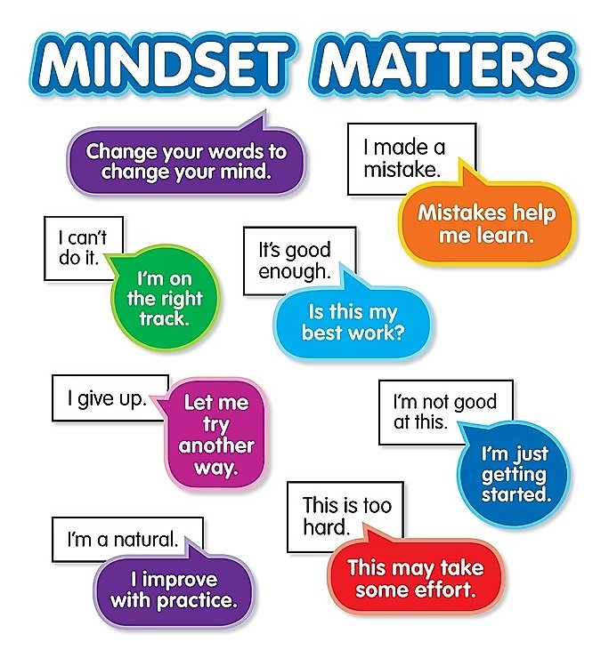
Notes:
REVIEW HANDOUTS: Helpful Mindfulness Tools MINDSET MATTERS-
MENTION ****Positive affirmations****

Slide 14
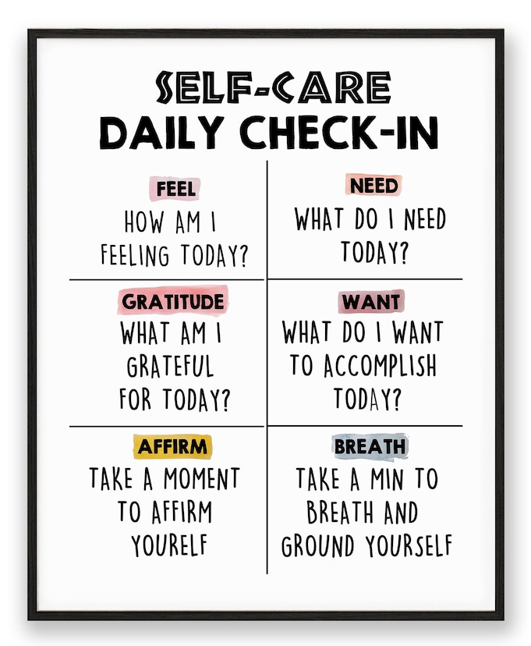
Notes:
REVIEW HANDOUTS: Helpful Mindfulness Tools Self- Care Daily Check-in

Slide 15
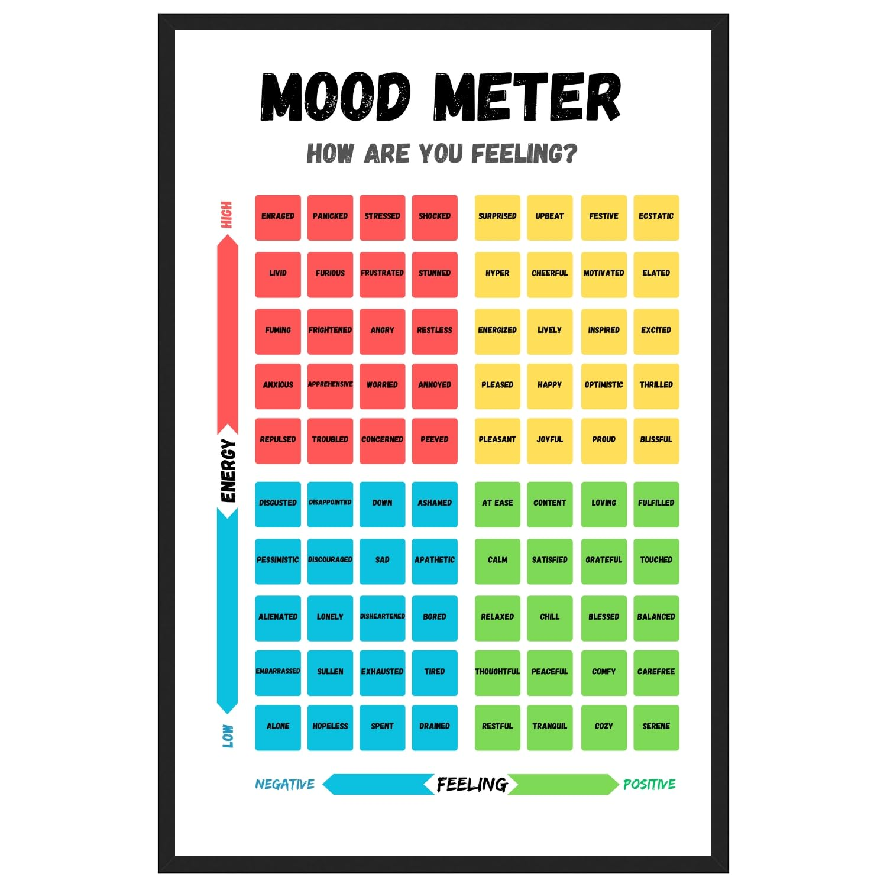
Notes:
REVIEW HANDOUTS: Helpful Mindfulness Tools Mood Meter- How Are You Feeling?

Slide 16
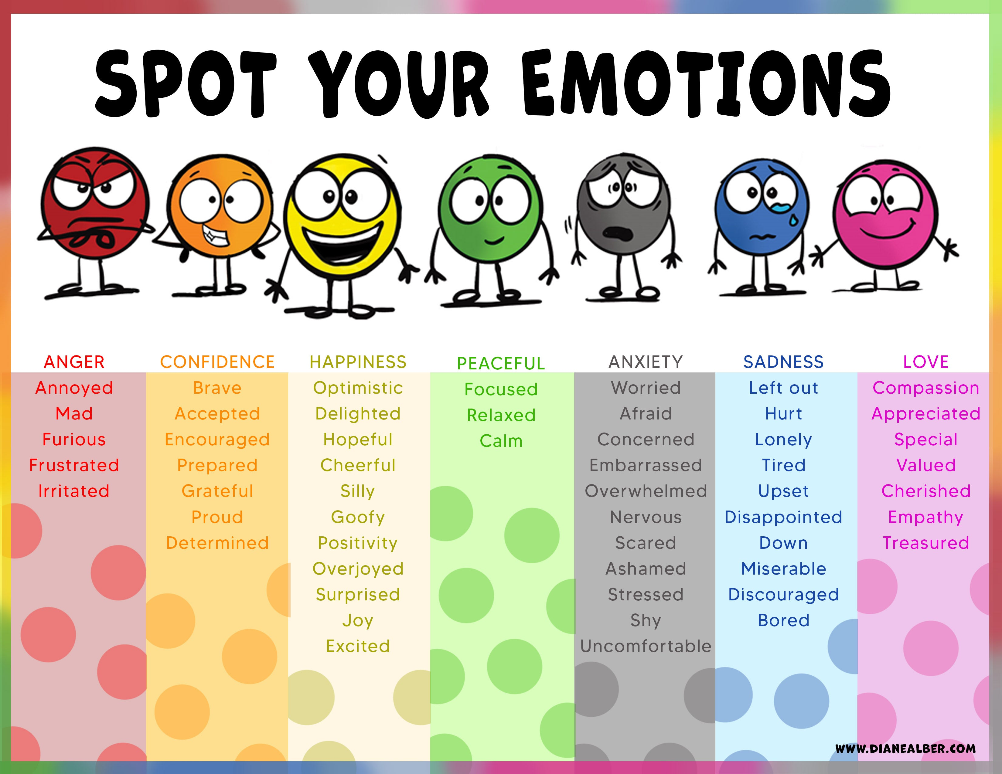
Notes:
REVIEW HANDOUTS: Helpful Mindfulness Tools Spot Your Emotions

Slide 17

Notes:
ANY QUESTIONS???

Slide 18
CONTACT US
Lucille Vitale ─ NYS PTA Vice President
vpvitale@nyspta.org
Amany Messieha Dgheim ─ NYS PTA 1st Vice President
1stVP@nyspta.org
Notes:
Please feel free to contact us with any questions you may think of later at our emails shared on screen!

