Slide 1
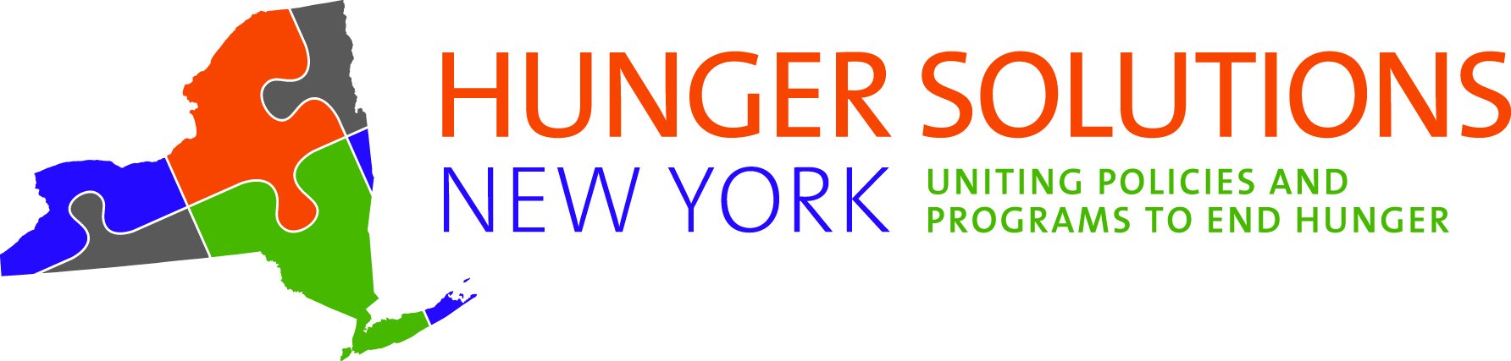
Healthy School Meals for All NY Kids
New York State PTA: Legislative Summit 2024
Jessica Pino-Goodspeed, LMSW
Deputy Director of Public Affairs
Hunger Solutions New York
Jessica.PinoGoodspeed@HungerSolutionsNY.org

Slide 2

Hunger Solutions New York is a statewide anti-hunger organization.
We increase awareness of, support for, and
participation in federal nutrition assistance programs.
Supplemental Nutrition Assistance Program (SNAP)
School Breakfast Program (SBP)
Community Eligibility Program (CEP)
Summer Food Service Program (SFSP)
Child and Adult Care Food Program (CACFP)
Special Supplemental Nutrition Program
for Women, Infants, and Children (WIC)

Slide 3

Healthy School Meals for All NY Kids
Policy campaign to establish and fully fund permanent, statewide universal free school meals
Co-lead a diverse coalition of over 285 organizations.
Bringing together anti-hunger, education, health, agriculture, and equity-focused organizations – alongside students, parents, school administrators, and other concerned New Yorkers.
Learn more at www.SchoolMealsforAllNY.org

Slide 4
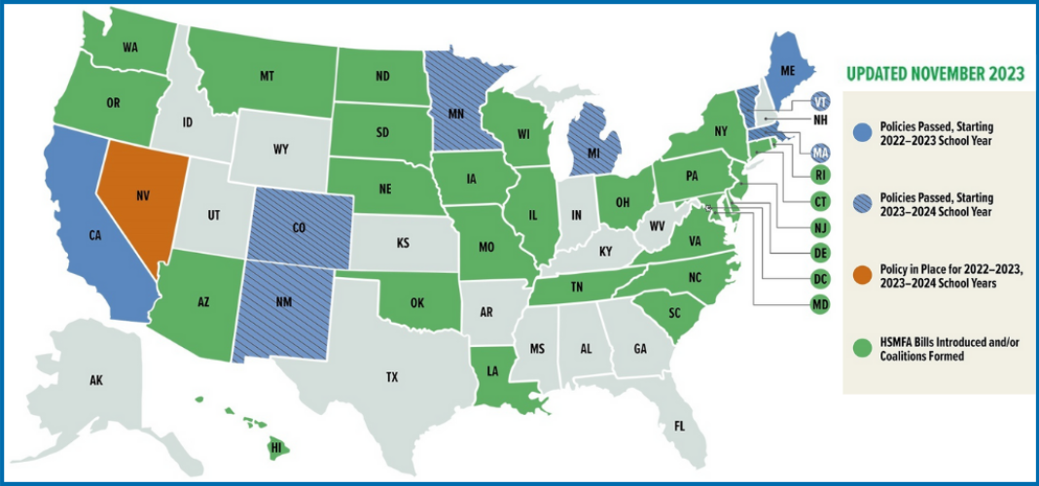
National Momentum for HSMFA
Nationally:
8 states have passed permanent HSMFA policies.
At least 26 states – including NY – have active legislative campaigns.
Source: Food Research and Action Center. Healthy School Meals for All. Accessed 1/10/23.

Slide 5

Strong support in New York:
285+ leading health, education, and anti-hunger organizations have signed on in support.
77% of NY voters support state funding for HSMFA, according to a Siena College poll from November 2023.
HSMFA included in the 2024 People’s Budget, a set of budget priorities from the Black, Puerto Rican, Hispanic, and Asian Legislative Caucus.
Our push to provide free meals for all New York students is far from over.

Slide 6
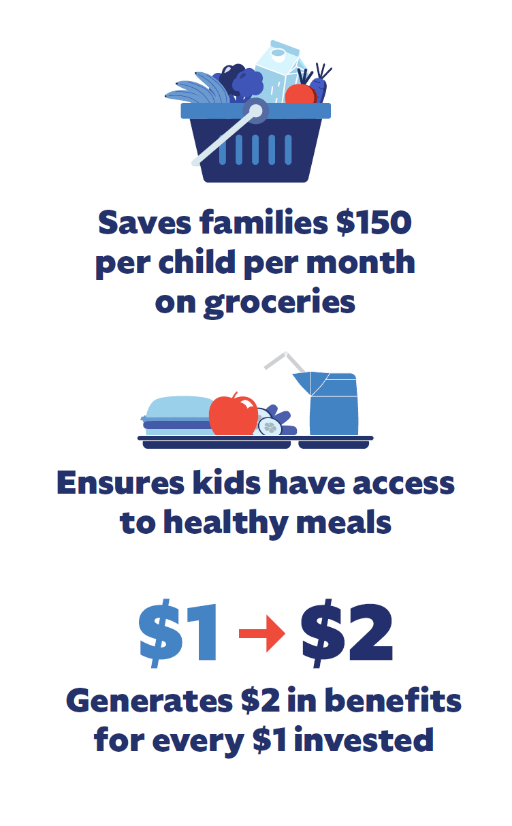
Why Healthy School Meals for All?
Support students’ mental and physical health
Improve academic outcomes
Provide high-quality nutrition
Build capacity for Farm-to-School
Reduce hunger
Make New York more affordable for families
Notes:
It’s a common sense policy that is grounded in research.
Universal school meals support students' physical and mental health; improve attendance; and help students perform better on standardized tests in reading and math.
School meals can account for over half of a child’s daily calories, and across all income levels, they are among the healthiest meals kids eat.
Universal school meals can support food security for the nearly 1 in 6 NY children experiencing hunger, and save their families an estimated $150 per month per child in food costs.

Slide 7

What happened in FY2024 State Budget?
10

Slide 8
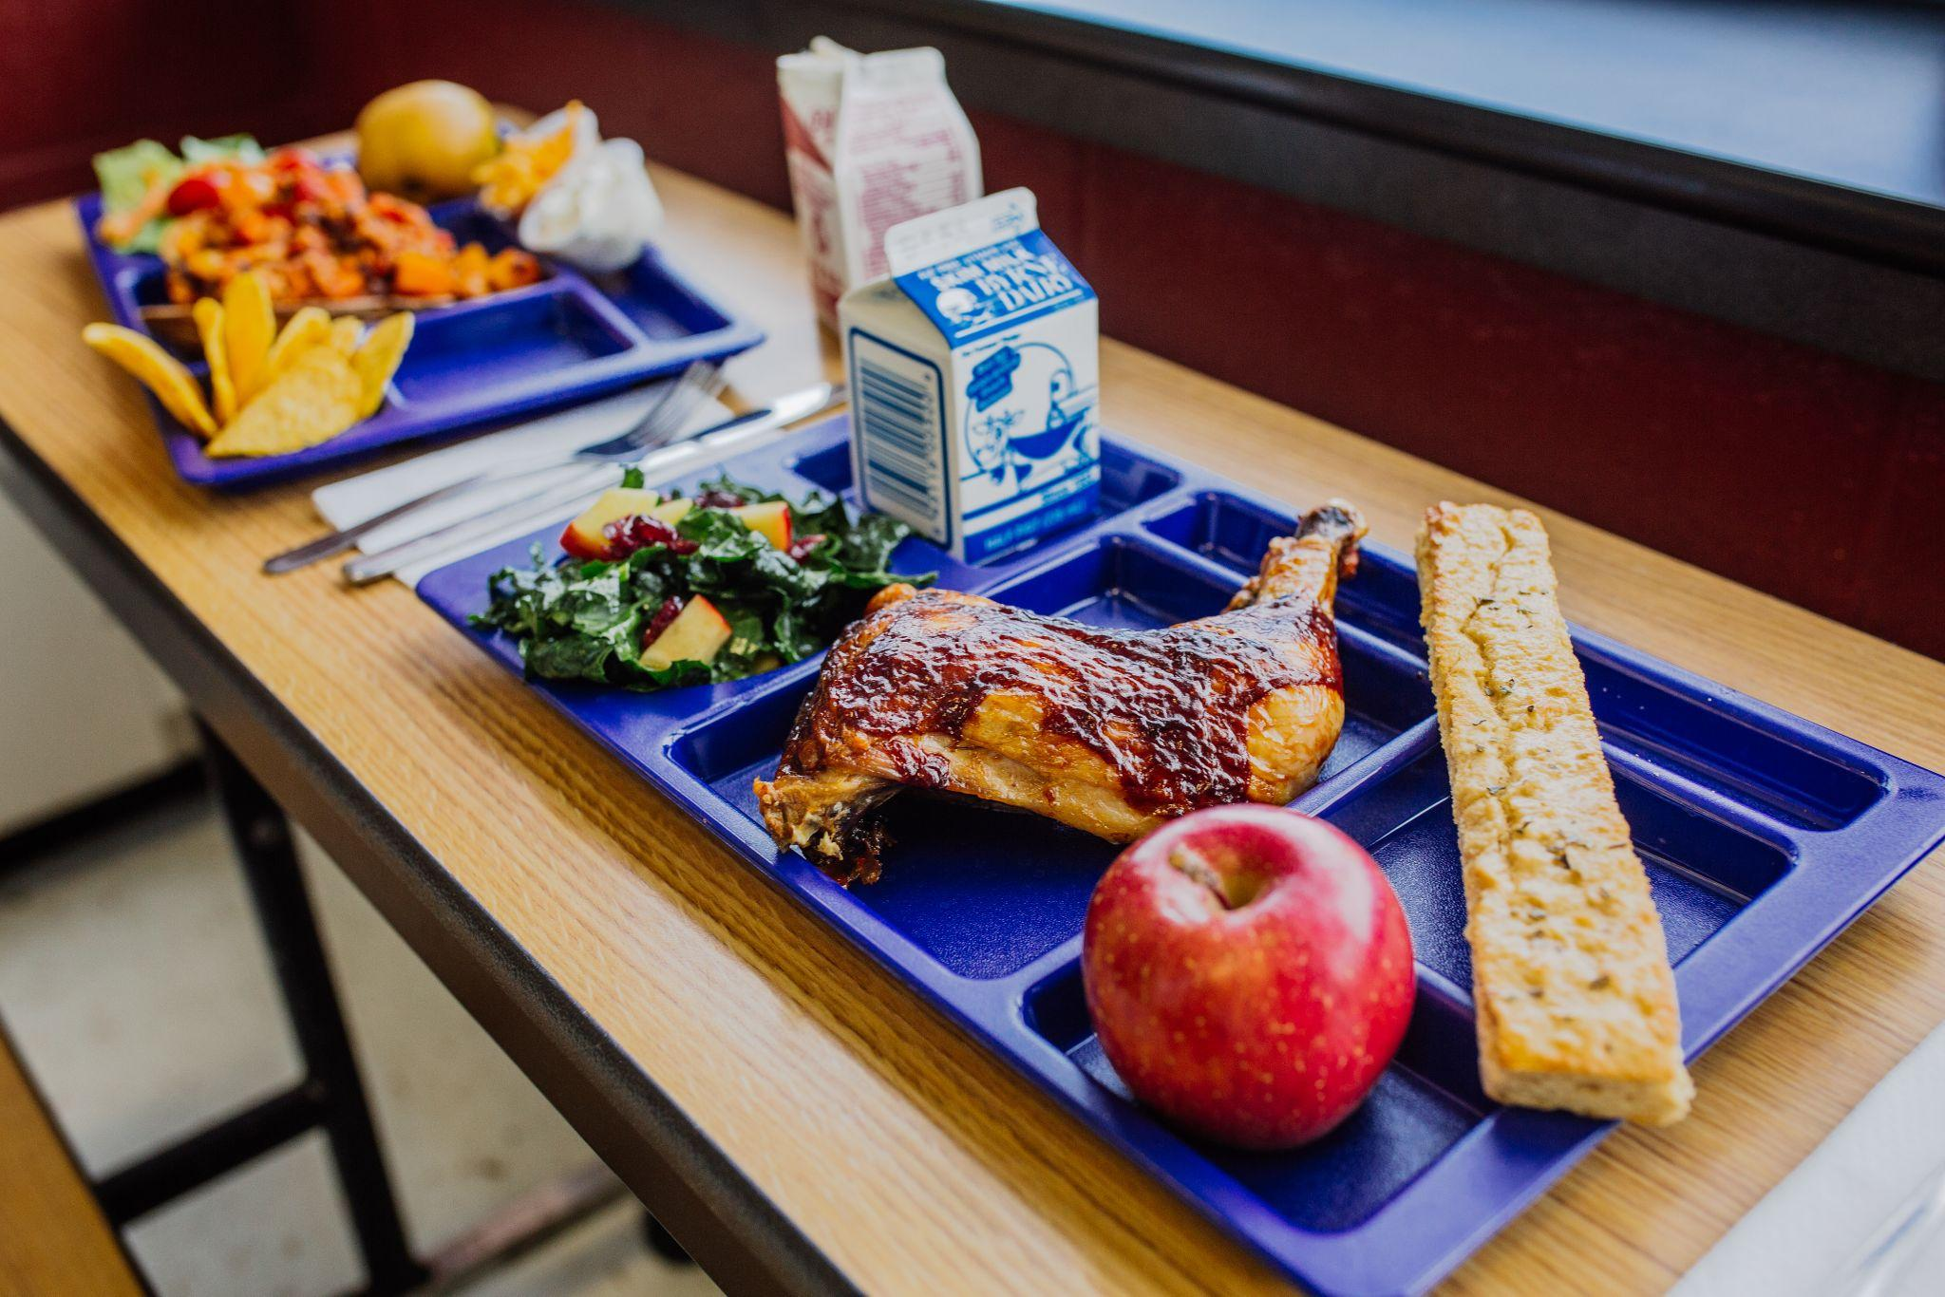
Expansion of Free School Meals via CEP
State Budget included a partial expansion of free school meals
As a result, in the 2023-2024 School Year:
More than 1,200 new schools offering free meals to all students
More than 347,000 students newly gained access to free meals
Learn more about the
CEP State Subsidy: bit.ly/NY-CEP
Notes:
JPG
Implementation will start in the upcoming 2023-2024 SY
This funding will be allocated to all schools that currently participate in CEP.
Current CEP schools receiving less than full federal reimbursement operating CEP will receive state funds to make their programs “whole”. These are current schools operating CEP with ISPs below 62.5%.
Eligible, unenrolled districts: Schools who are eligible for CEP, but not yet participating, would be able to adopt CEP to provide free meals to all students and receive the CEP state subsidy to make their program whole. In other words, the State will subsidize reimbursement not covered by the federal government.
Schools must enroll in CEP to tap into this new state funding.

Slide 9
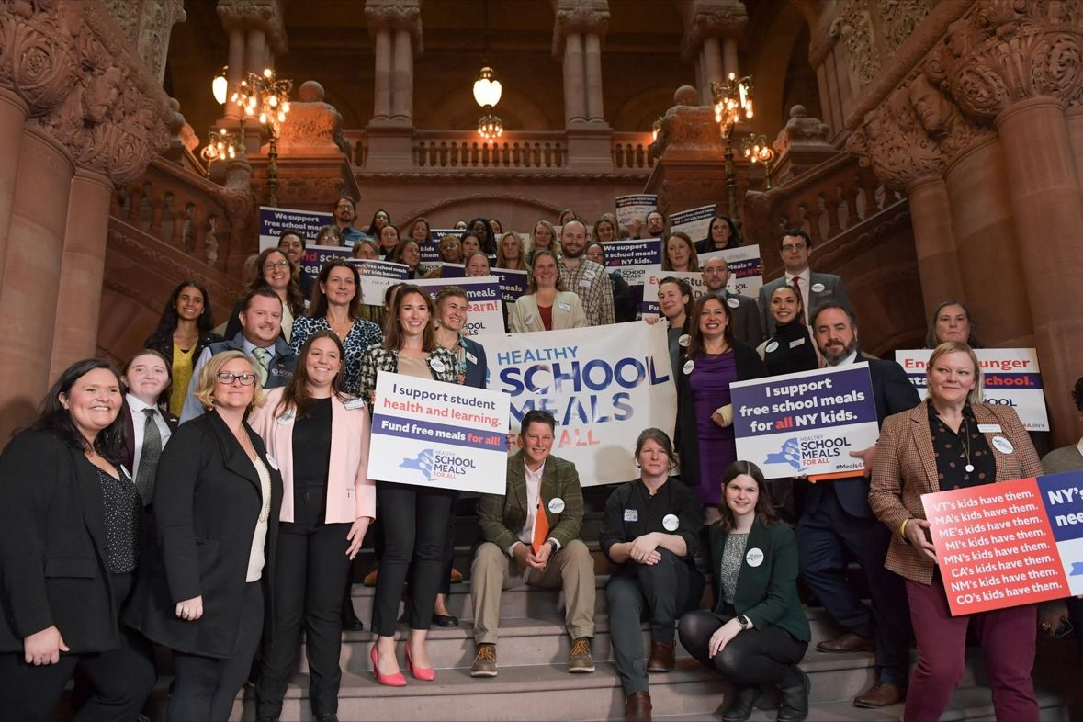
Thank you for your advocacy!
Notes:
funding was preserved in the executive budget @ $145.6M

Slide 10

Full Funding for Healthy School Meals for All in FY 2025

Slide 11
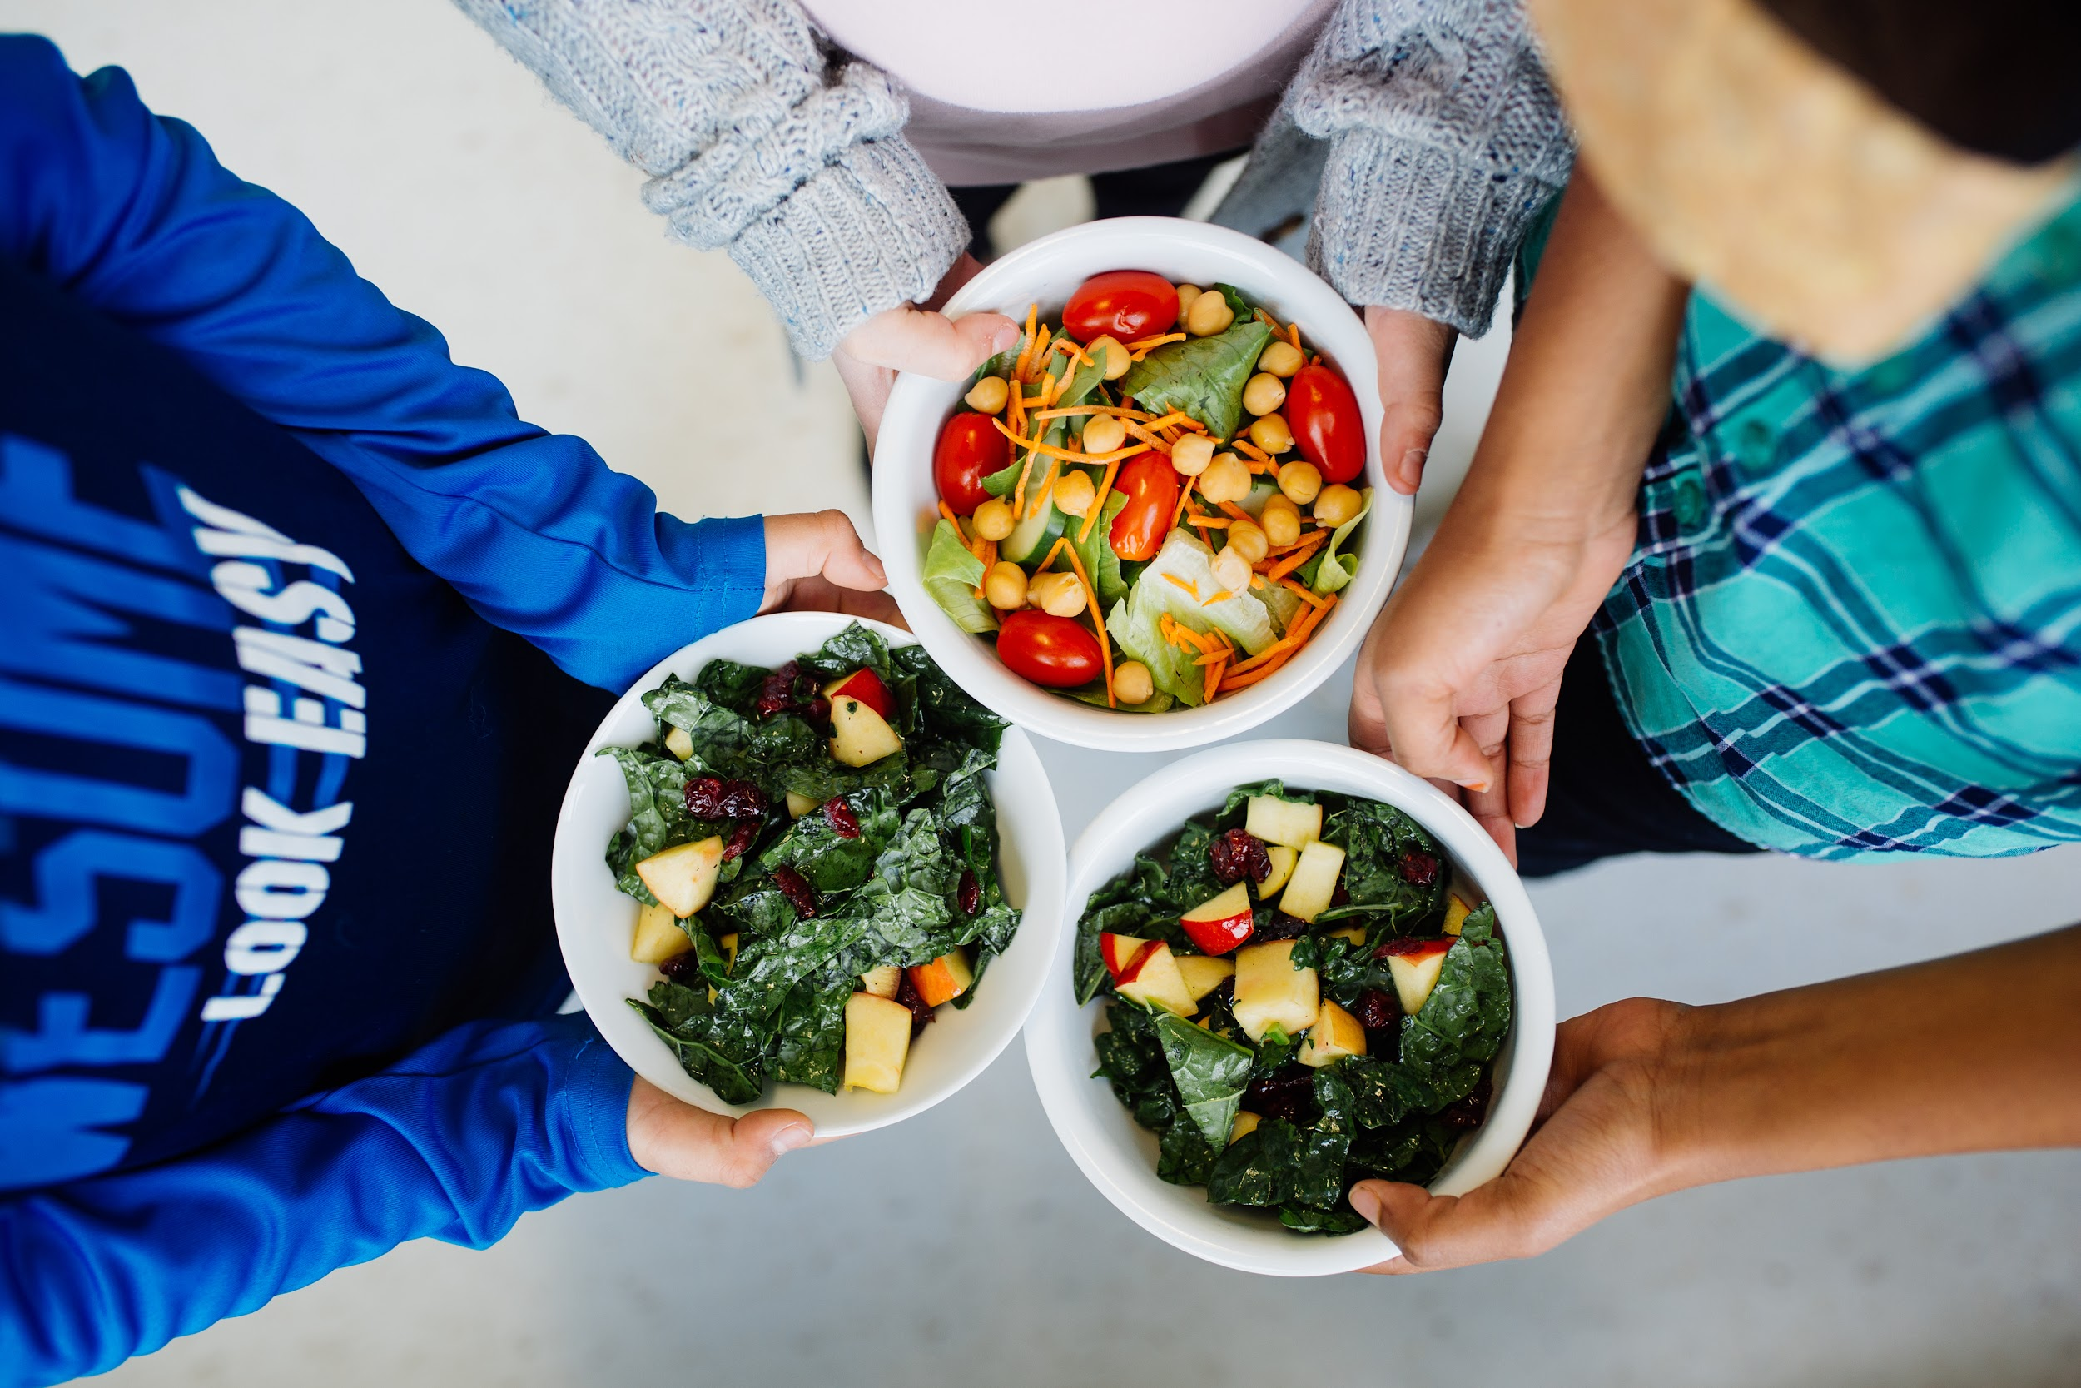
Who’s left out of the current expansion?
New York schools and students without access to universal school meals:
659 schools left out of the expansion of free school meals
320,911 students do not have access to school meals at no cost
Notes:
JPG
Implementation will start in the upcoming 2023-2024 SY
This funding will be allocated to all schools that currently participate in CEP.
Current CEP schools receiving less than full federal reimbursement operating CEP will receive state funds to make their programs “whole”. These are current schools operating CEP with ISPs below 62.5%.
Eligible, unenrolled districts: Schools who are eligible for CEP, but not yet participating, would be able to adopt CEP to provide free meals to all students and receive the CEP state subsidy to make their program whole. In other words, the State will subsidize reimbursement not covered by the federal government.
Schools must enroll in CEP to tap into this new state funding.

Slide 12
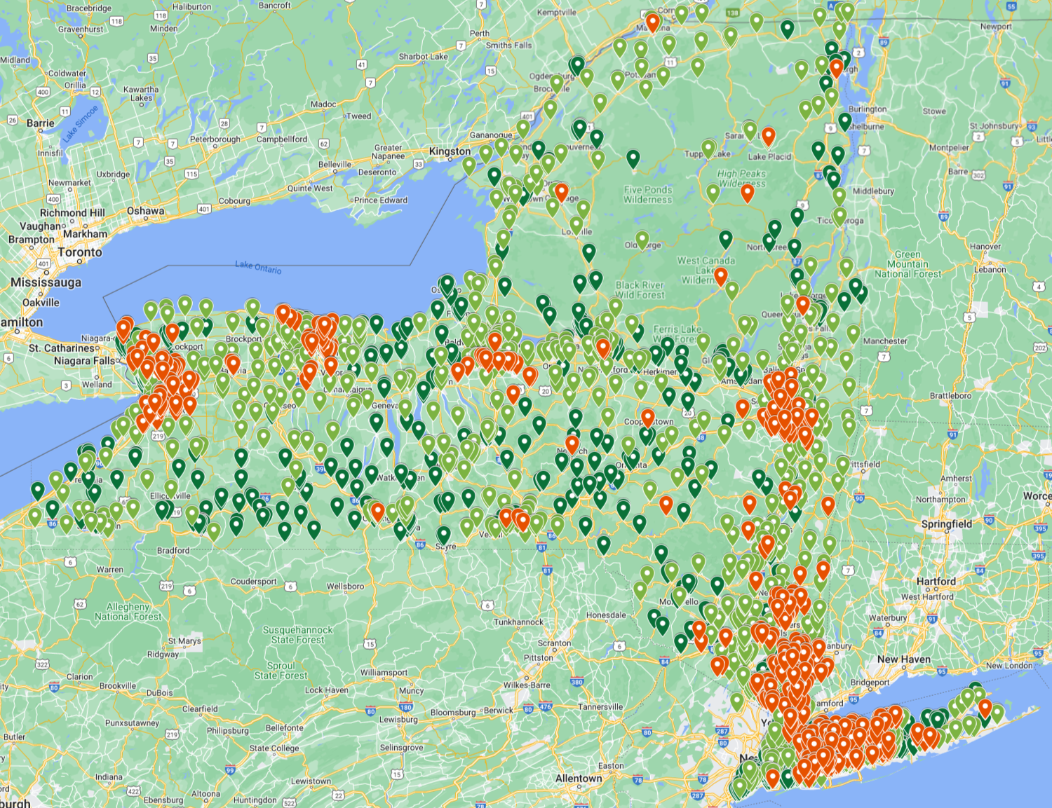
Who’s left out of the current expansion?
Those left behind include:
Working families struggling to make ends meet, but earning too much to qualify for free school meals.
Schools in suburban areas with high costs of living.
Communities with significant need, but low participation in programs like SNAP and Medicaid.
https://bit.ly/HSMFANY-Map
Notes:
JPG - Three NYS regions account for 78% of schools and 81% of students left out of the expansion. Nearly half of those left out – more than 145,000 students – are located on Long Island.
Implementation will start in the upcoming 2023-2024 SY
This funding will be allocated to all schools that currently participate in CEP.
Current CEP schools receiving less than full federal reimbursement operating CEP will receive state funds to make their programs “whole”. These are current schools operating CEP with ISPs below 62.5%.
Eligible, unenrolled districts: Schools who are eligible for CEP, but not yet participating, would be able to adopt CEP to provide free meals to all students and receive the CEP state subsidy to make their program whole. In other words, the State will subsidize reimbursement not covered by the federal government.
Schools must enroll in CEP to tap into this new state funding.

Slide 13
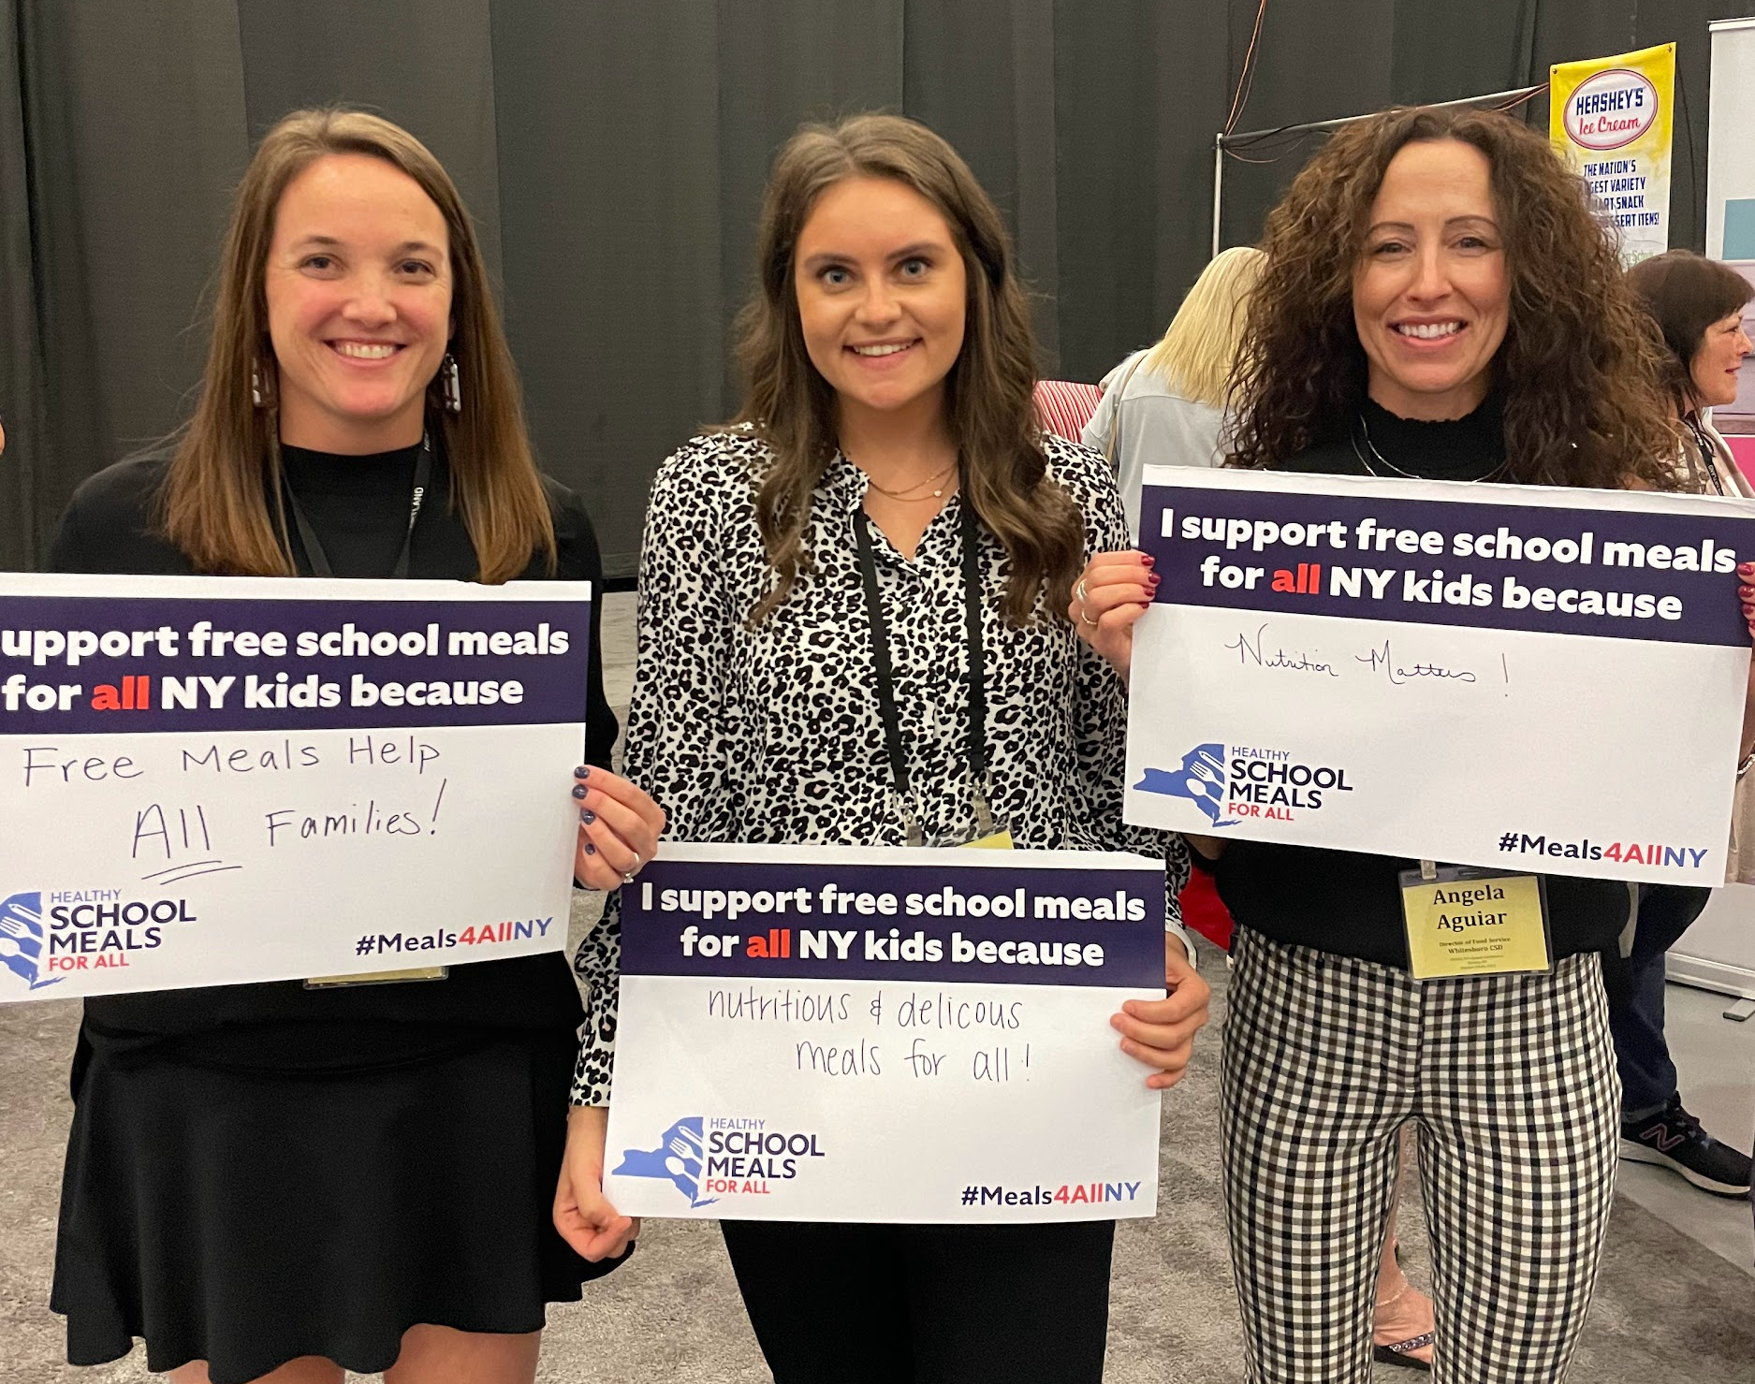
Cost estimate
An anticipated additional annual investment of $90.4 million is needed to establish a permanent, statewide universal school meals program.
Notes:
JPG
For less than one-tenth of one percent - $90 million - of the State’s $233 billion budget, Governor Hochul and the State Legislature can ensure all New York school students have access to free school breakfast and lunch.

Slide 14
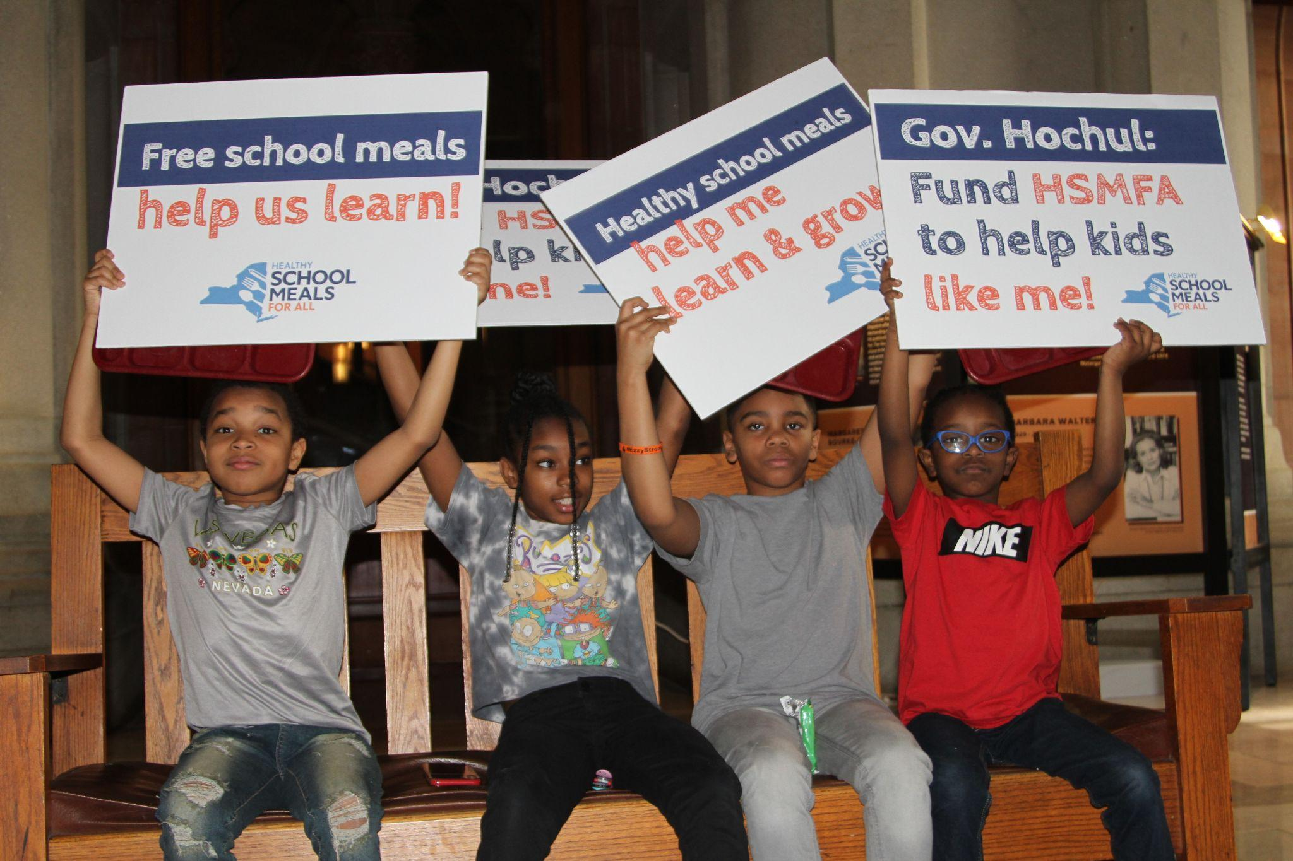
Action Steps

Slide 15
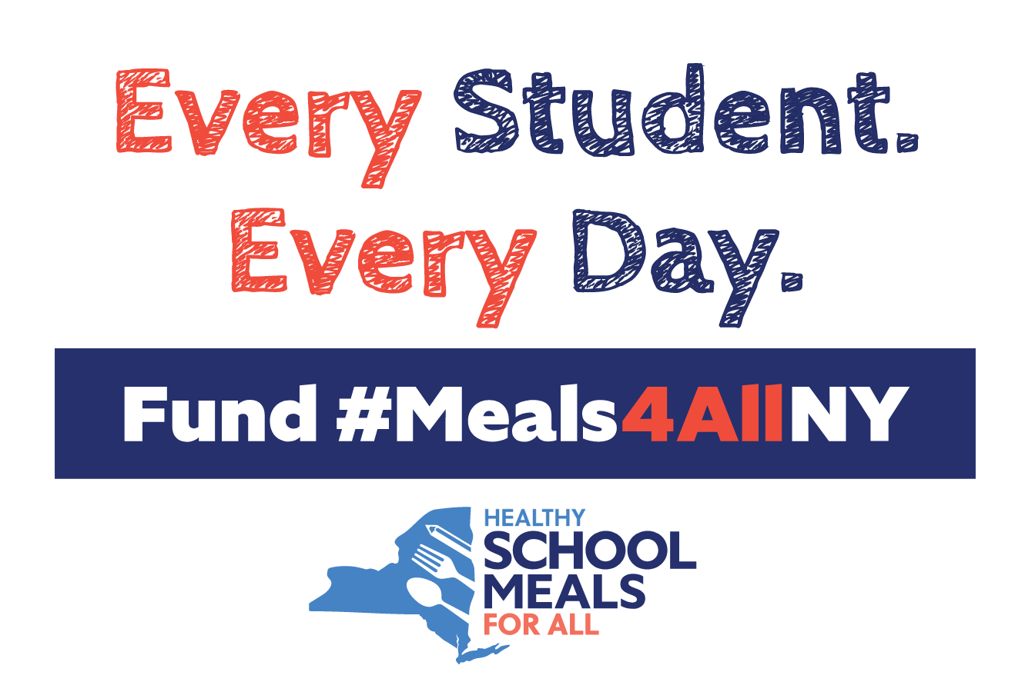
The Ask
New York must ensure all schools operating the federal school meal programs can provide school breakfast and lunch at no cost to all students.
Tell lawmakers: Prioritize full funding of statewide free school meals in the FY 2025 Final State Budget
Maintain last budget’s $145.6M investment
Include an additional $90.4M to close the gap for the students and schools left behind

Slide 16

Key Actions
Share your experience with legislators.
Send a letter to lawmakers: https://p2a.co/JimWBuX
Amplify #Meals4AllNY on Social Media:
  Toolkit: https://schoolmealsforallny.org/resources/
  Coalition Emails: Sample social for all media coverage
Stay connected www.SchoolMealsforAllNY.org

