Slide 1


MemberHub
What You Need to Know!
Dania Welch
NYS PTA Membership/Insurance Manager
dwelch@nyspta.org or 518-452-8808

Slide 2

Agenda
What is it?
Notes:
MemberHub is a software company based in North Carolina. We partnered with MH back in 2018 to expand their platform to more than just an online membership system into a database for NYS PTA. Since then, they have partnered with 30 or more state PTAs across the nation. They continue to listen to feedback to improve the software and to add to its functionality. It truly can be a one-stop shop for PTA administration as well as communication and family engagement software for your schools

Slide 3
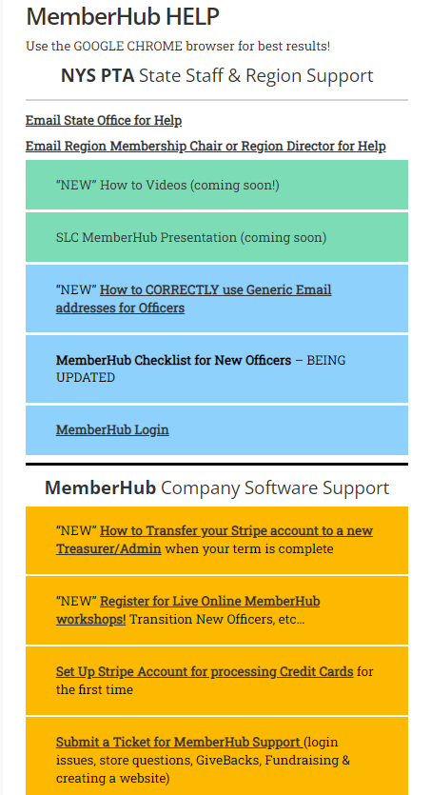
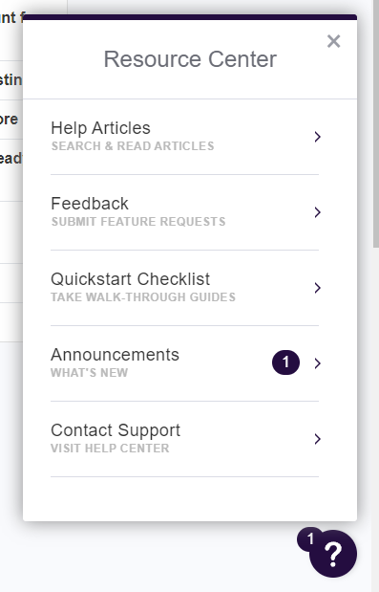
MemberHub Help
MemberHub Help page at NYSPTA.org
Step by Step How to Video Playlist (coming soon)
Submit a Ticket to MemberHub support
Contact your Region or the State Office
Click the ? Symbol on any page in MemberHub and then Search the Help Articles available
Notes:
Resources for MemberHub Help! Please do not hesitate to reach out for assistance. We do not want you to spend more time than necessary to work with the software. No worries, we are here to help!

Slide 4
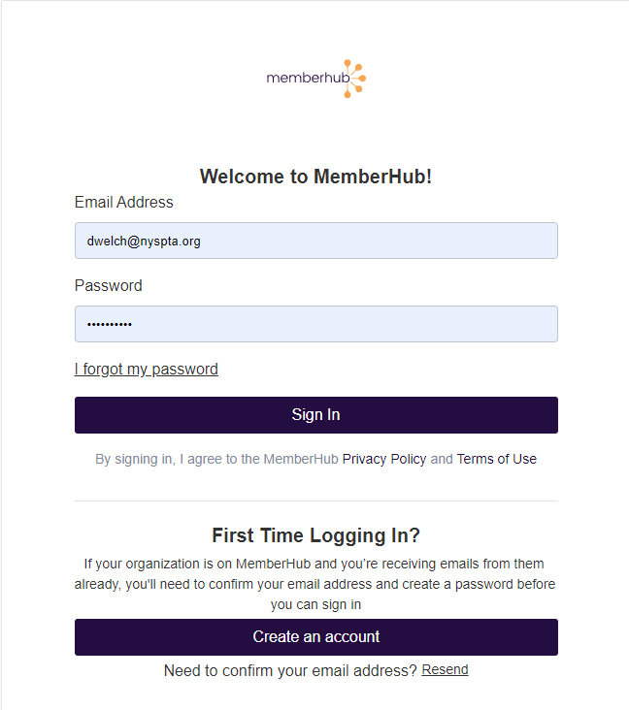
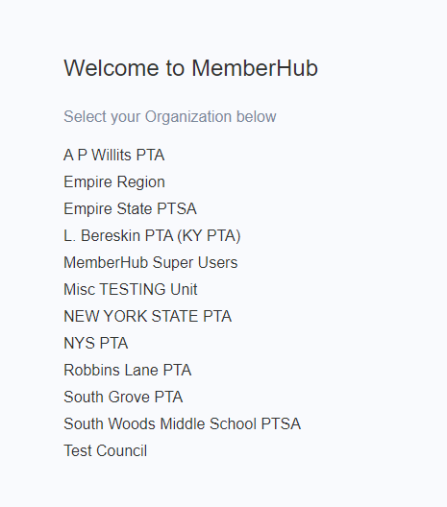
Login to MemberHub
Notes:
Login at MemberHub.com. If first time, use the Create an Account link. You may be asked to Select your Organization once you login if it’s your first time and your email resides on multiple sites.

Slide 5
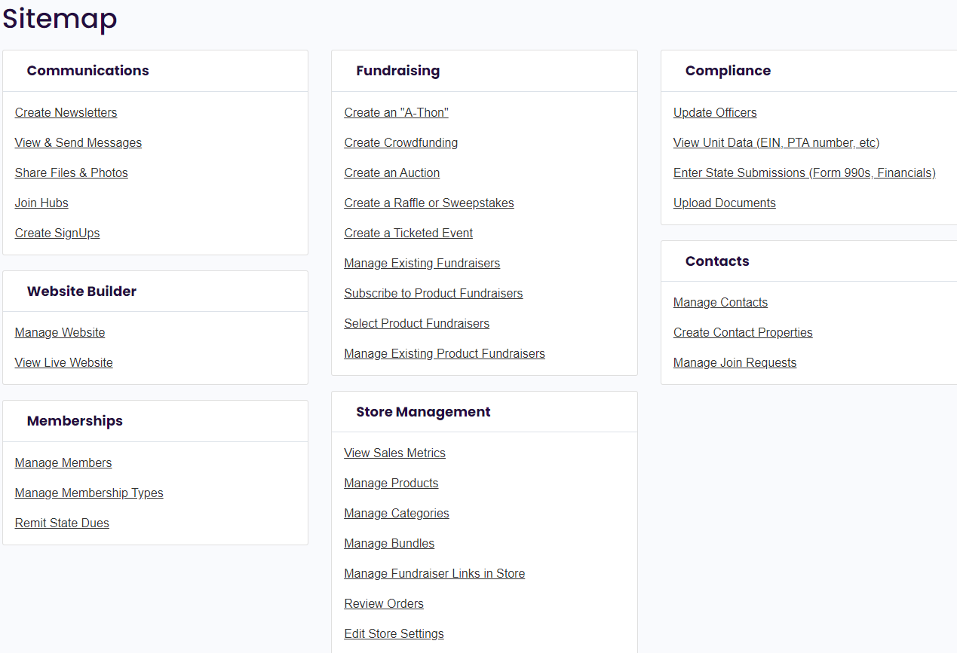
NEW Navigation
Notes:
As of last week (approx July 10, 2022), MH made some changes to the navigation and where some items are housed on the software. There is more of a MENU style system now. What was referred to as Modules are now listed as “Your Tools” and it’s much easier to navigate around and not lose track of what section you are in!

Slide 6
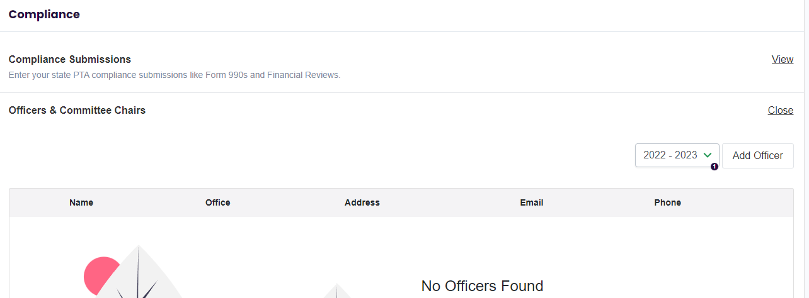
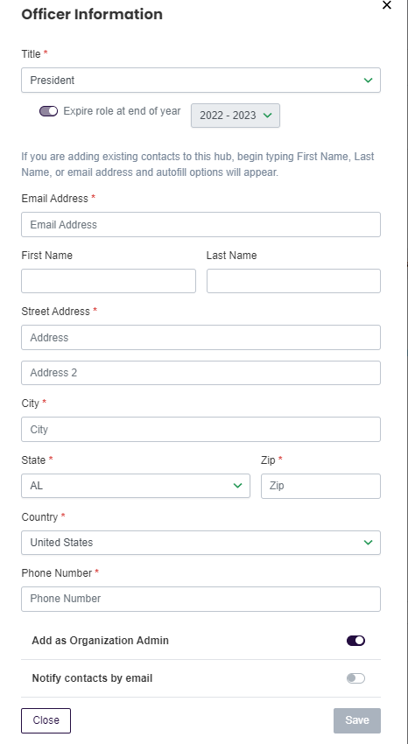
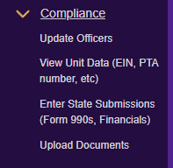
Compliance – Update Officers
Notes:
Officers MUST be added each year even if there are no changes from the previous year! Once you click the Add Officer button and select the position title, the form expands if that officer role requires more info!

Slide 7
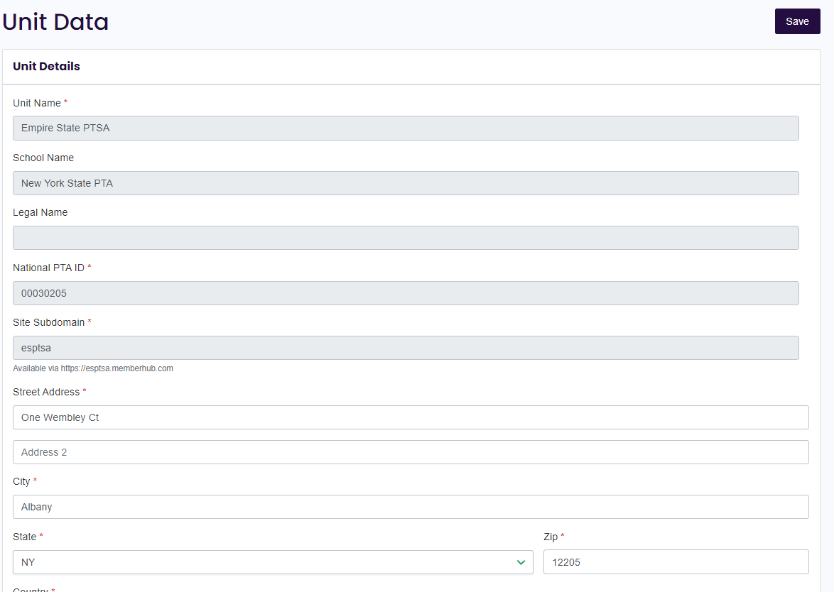
Compliance – View Unit Data
Unit Details: (page 1 of 4)
PTA Unit Name
School Name & School Address, National PTA ID#
Site Subdomain (used in Store Link)
Notes:
The Unit Data page hold all the information that pertains to your unit that we keep in our database at NYS PTA. Most of the fields you cannot edit but if you find data that is not correct, please contact the state office and we can help. The next 4 slides explain the data contained on this page.

Slide 8
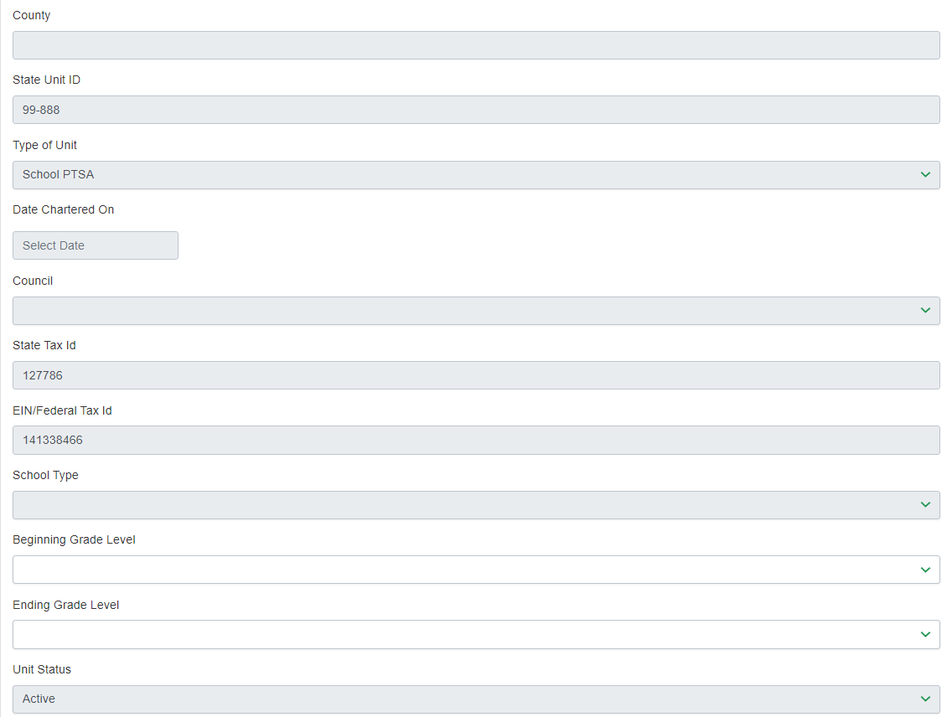
Compliance – View Unit Data
Unit Details: (page 2 of 4)
State Unit Id (Unit Code)
Date PTA was Chartered
Council (if applicable)
State Sales Tax Id (sales tax exemption)
IRS EIN (used to file annual 990 returns to keep income tax exemption status)
School Type & Grade Levels
Unit Status (Active or Closing)
Notes:
Title and Content

Slide 9
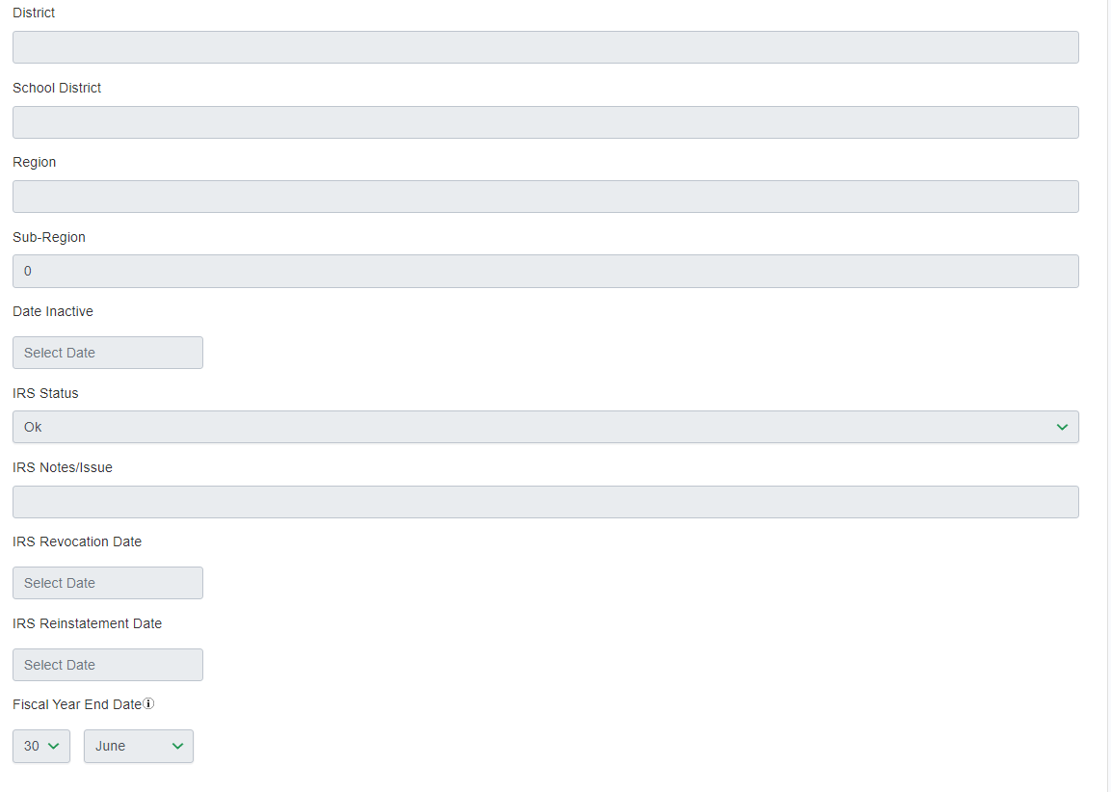
Compliance – View Unit Data
Unit Details: (page 3 of 4)
District (n/a)
School District Name
Region (12 Regions statewide)
Sub-Region (used by Region Board)
IRS Status (Must not be Revoked to be in “Good Standing” compliance)
IRS Notes (used by State Admins)
Revocation Date (if applicable)
Reinstatement Date (if applicable)
Fiscal Year End (should be June 30)
Notes:
Title and Content

Slide 10
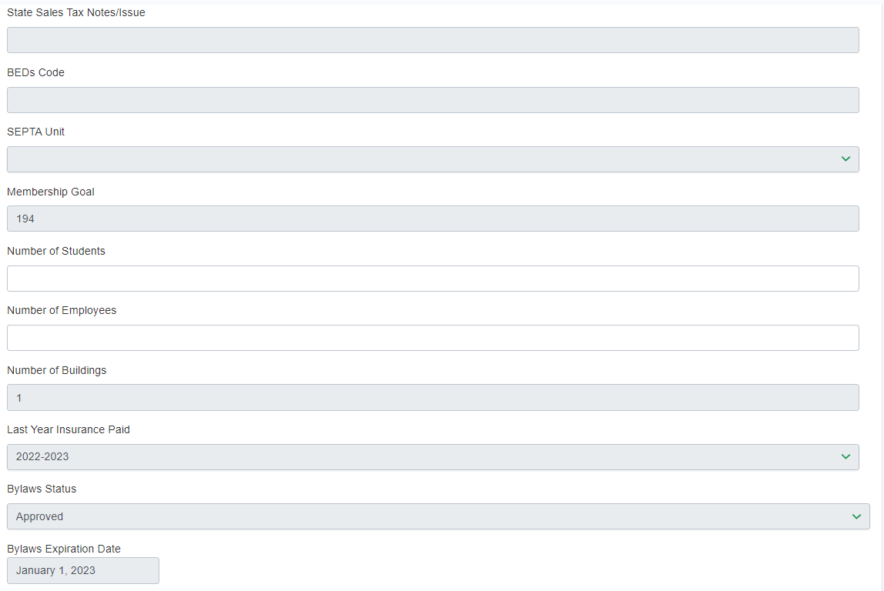
Compliance – View Unit Data
Unit Details: (page 4 of 4)
State Sales Tax Notes (used by State Admin)
BEDs Code (used by State Admin)
SEPTA Unit (Yes or No)
Membership Goal (Assigned by NYS PTA)
Number of Students (future use by State)
Number of Employees (PTA needs to enter # of School Employees for Super Teacher/Staff Award calculation)
Number of Buildings (used by State Admin)
Last Year Insurance Paid (must be current year to be in “Good Standing” compliance)
Bylaws Status & Expiration Date (must be not expired to be in “Good Standing” compliance
Notes:
I have highlighted the field “Number of Employees” because this one will need to be filled in by one of your Officers. You can ask your principal what the total number of employees are at your school. This number is needed in order for us to calculate if your membership qualifies for the Super Teacher/Staff award!

Slide 11
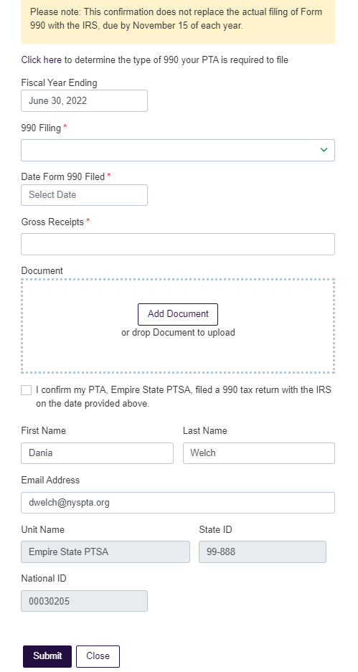
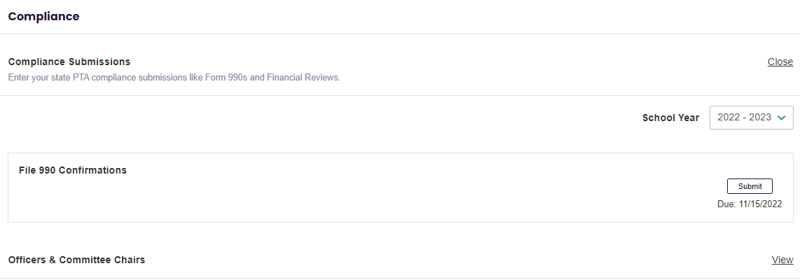
Compliance – 990 Submissions
Once you click SUBMIT – this form pops up to enter the details of your 990 submission with the IRS. You can also add a document with the acceptance confirmation you received from the IRS
Notes:
The 990 Submissions page is a place where you store a record each year to confirm that you have filed your 990 Annual return with the IRS. This is NOT WHERE YOU FILE THE ACTUAL 990. Most PTAs use the File990.org service that NYS PTA pays for to make filing easier. The President and/or Treasurer will get an email from File 990 every week as a reminder starting in July. The deadline to file is November 15. This is normally taken care of by the outgoing Treasurer.

Slide 12
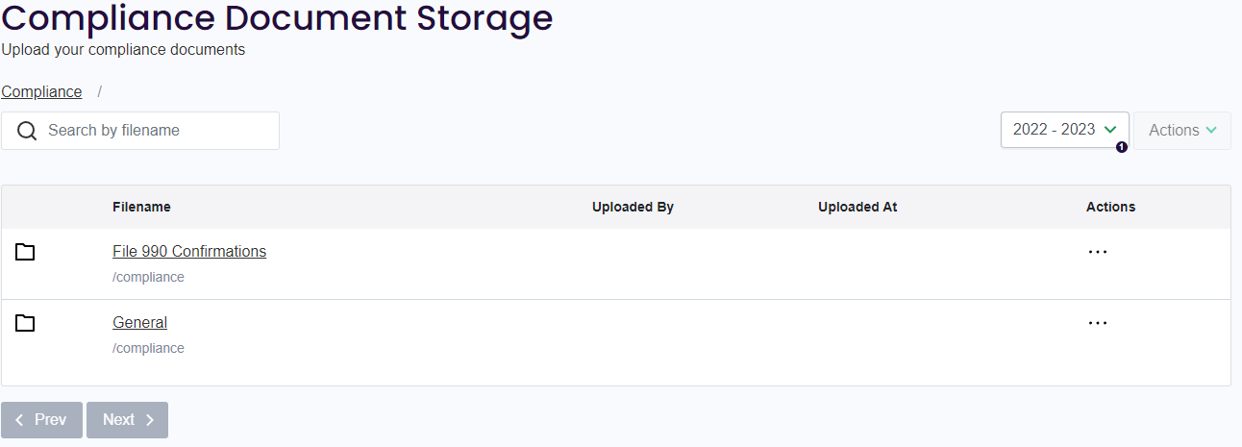
Compliance – Upload Documents
If you choose, use the GENERAL folder to store:
Approved Bylaws or Amendments
PTA Procedures (if any adopted)
Unsigned copy of your Sales Tax ST-119.1 and a copy signed by your current President
Copy of your Original Sales Tax Exemption Certificate
Documents from the IRS (990s, Letter of Determination, Reinstatement (if applicable)
Certificate of Insurance
Minutes of your PTA Meetings
Budget Spreadsheets
Monthly Bank Statements -reviewed and signed off by a non-bank signor
Annual Audit files
This folder is only accessible by PTA admins
Notes:
Having a place in MemberHub that is accessible to your Admins is a great place to store documents that you want to have available throughout the year but in future years as well. We recommend you utilize this valuable resource.

Slide 13
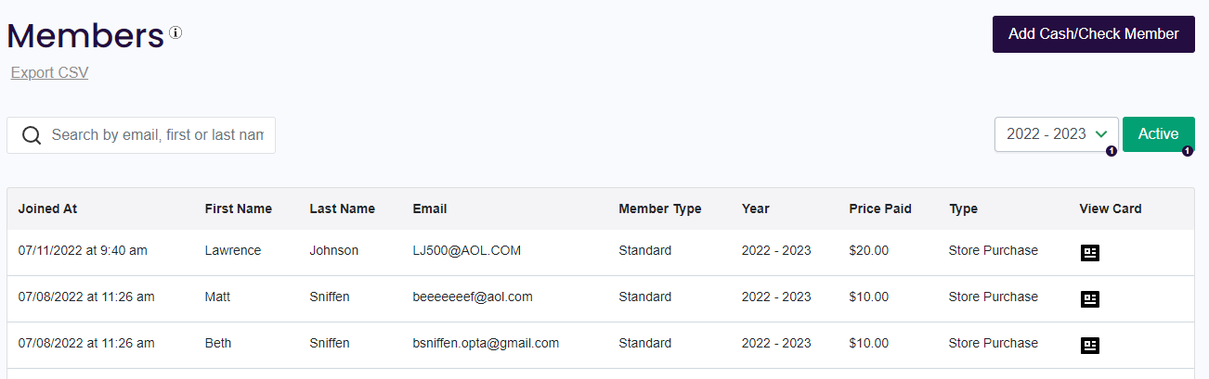
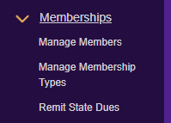
Memberships – Manage Members
Members who have joined online or cash/check members who were added by the PTA will appear on this list.
To see prior year membership lists, you can change the YEAR in the drop down menu
SEARCH with an email or name to look for members
EXPORT CSV the list at any time to use offline
Access the membership card by selecting the VIEW CARD icons to send a link to a member who missed it in their email receipt
Please Note: the amount reflected in the column labeled PRICE PAID column might not properly reflect the individual’s amount paid if memberships were purchased online together in one transaction.
Notes:
This is the page where you will see your list of Members for the current year and previous years back to 2018. You will be able to add your Cash/Check members here and also you will see your members who join online. Please check out the functions on this page to search, export, view and send card links, etc…

Slide 14
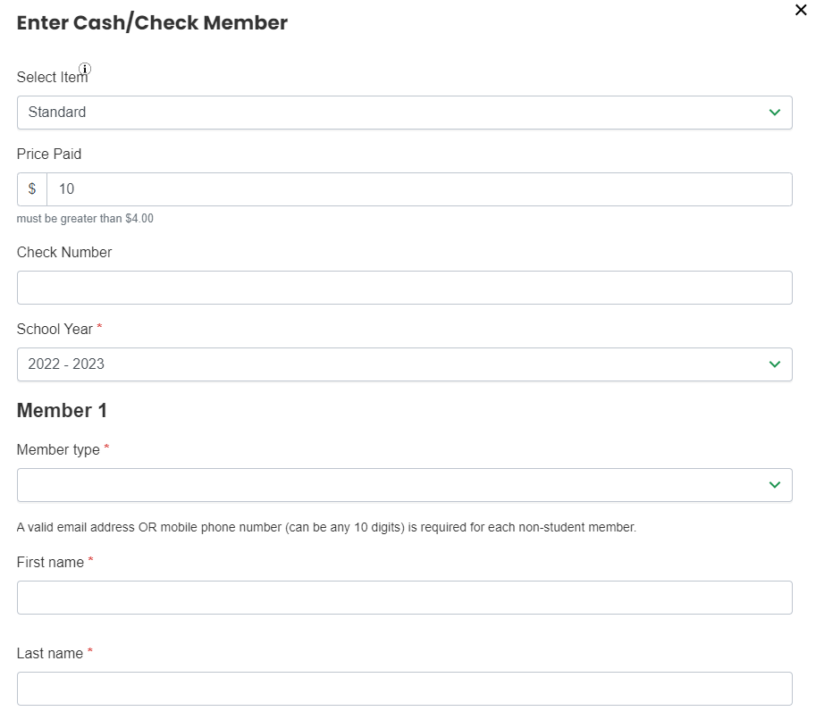
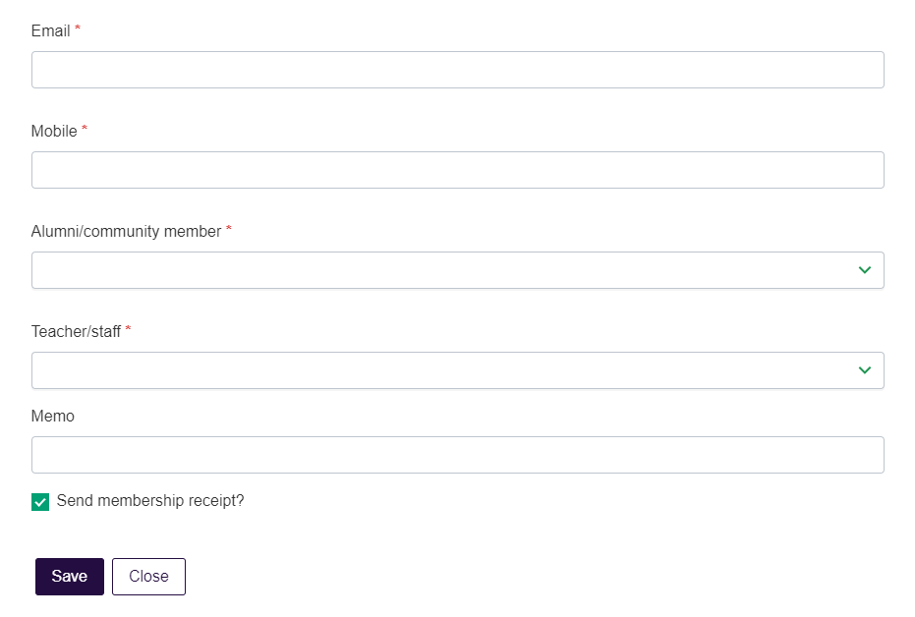
Memberships – Add Members
Price Paid – will default to what is in your store and should reflect fees in your Bylaws
Check # – enter or leave blank for cash
Enter Member Type (use drop down)
First Name & Last Name (must be an Individual not a Family or Business)
A valid email OR mobile number must be entered (you can use any 10 digits to bypass)
Students should leave both Email and Mobile BLANK
Alumni & Teacher/Staff questions MUST be answered using dropdown
Leave “Send Membership Receipt?” checked & SAVE
Notes:
When you Add Members, you must enter either an email OR a valid phone number OR any 10 digits. STUDENT member should leave both fields blank. We do not want to collect student contact information. There are also two questions that are required to have an answer Alumni/Community member Yes or No (this would be members outside of your school community). You could use this to see how your membership efforts are paying off in maintaining Alumni and garnering outside Community support. You also have the Teacher/Staff Yes or No question. This one is used in the calculation of the Teacher/Staff award but also is data that you can use to see how you are growing your school staff support each year.

Slide 15
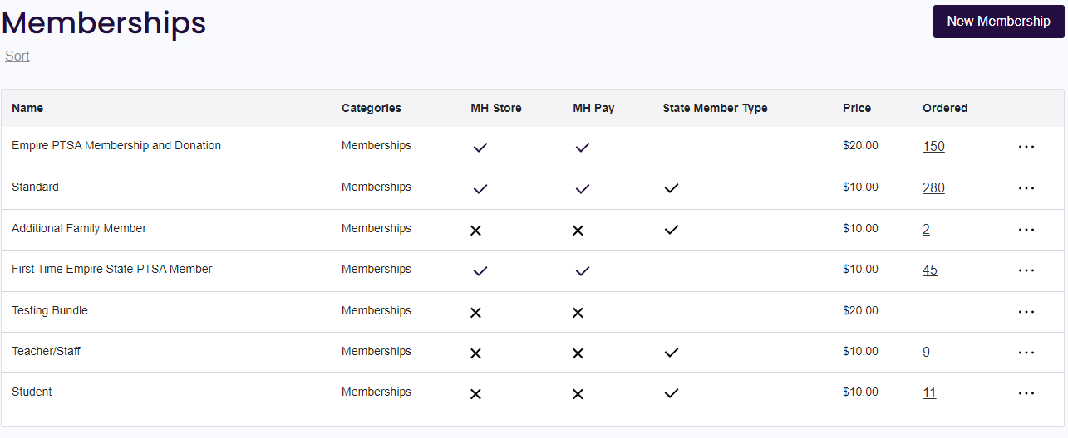
Manage Membership Types Items
Your Membership Items are listed on this page
State Member Types are indicated (Standard, Additional Family Member, Teacher/Staff and Student
The checkmark indicates LIVE and the X indicates HIDDEN from the Store
Prices must match your Bylaws
You can edit the items by clicking the 3 dots on the right of each item
  Add custom fields to collect data specific to your PTA
Create New Membership Item – Create an additional Membership item that combines two types together (ie. Family Package) or combine with a Donation or a small Free gift with purchase (Note: Standard Membership items should always be available as well)
Notes:
Manage Membershp Types (or items as I like to refer to them) is where you manage what is LIVE or HIDDEN in your Online Store and all the details of those Memberships items. You may want to add additional fields to collect data from your members (are you interested in volunteering, etc..) This is also where you can Create New Membership items or enhance the State Membership Items that default automatically in your store. You can rename them, add picture logos, combine with other membership types to create a family package, combine with a donation opportunity or a free gift with purchase, etc. Please remember you must have available the individual membership as an option as well. It has been proven that creating these packaged items and being creative is an EASY way to grow membership across the board.

Slide 16
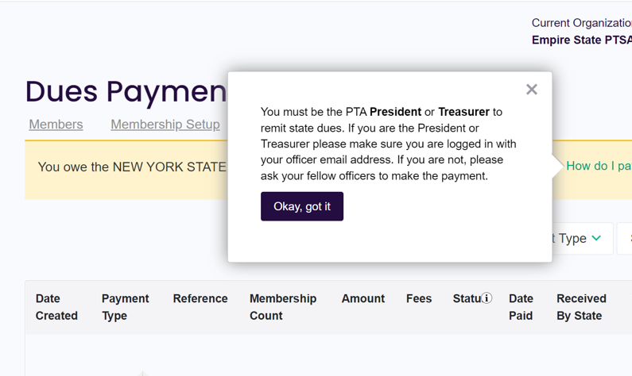
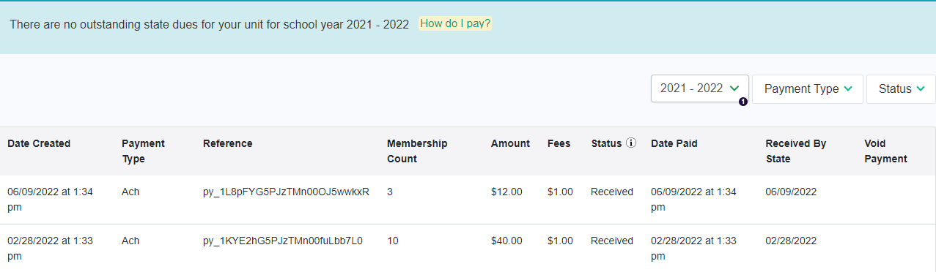
Memberships – Remit State Dues
Admin must be listed as current year President or Treasurer to see “Pay with ACH” link in the yellow banner
According to Bylaws – Dues should be paid monthly with the first payment of 25 or more members due by Oct 31
All Dues payments completed will be listed by school year using the drop down menu
Notes:
The President or Treasurer are responsible for paying the State dues. The $4 per member dues is the combined amount for both State and National dues.

Slide 17
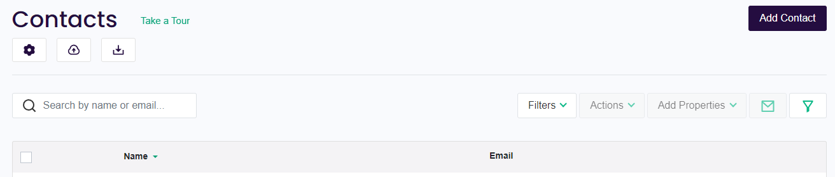
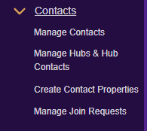
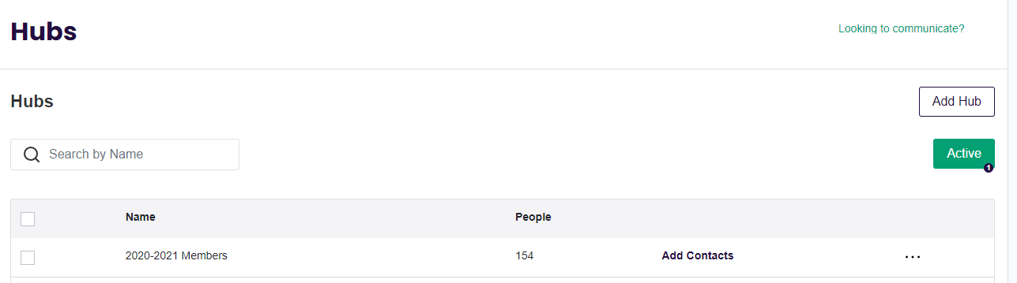
Manage Contacts & Hubs
Most of the Contact records are created when a Member joins or someone makes a purchase in your store or when you Add an Officer. You can Filter contact records to help you manage Admin access.
Hubs can be created for different groups that you want to communicate with separately (ie. committees, classrooms, members, etc.)
It’s helpful to create a hub of Members on June 30 before the Membership year rolls forward and the member status is reset to non-member.
Notes:
There will be video instruction available on how to filter your contacts to check admin status and how to update. And another video on how to create a hub for last year’s members if one was not created on June 30. Stay tuned for those later this summer.

Slide 18
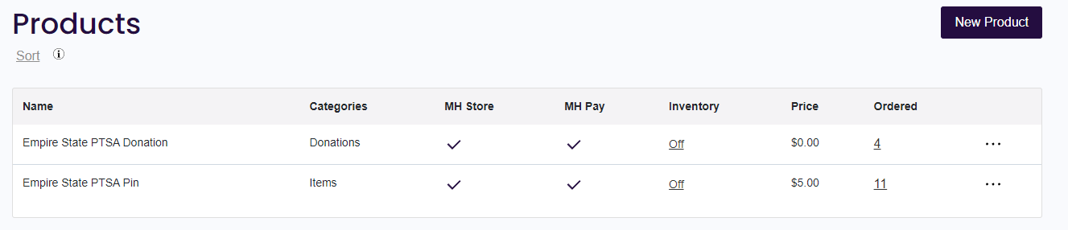
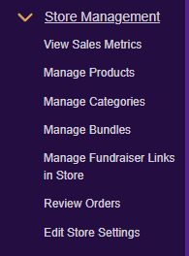
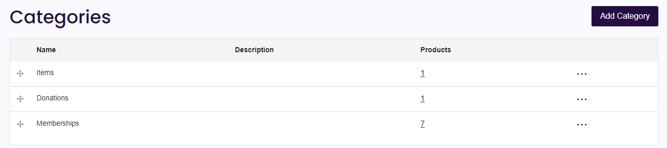
Store – Products & Categories
Add Products like Spirit Wear or Event tickets and use Categories to keep like items grouped together by using these menus
Notes:
The Online Store Management area is for all items that are NOT membership that you want to sell in your store. You can also use the store to sell event tickets like we did for Summer Leadership Conference. There are many help articles within MemberHub support (just click the ? Symbol an search) to find out more!

Slide 19
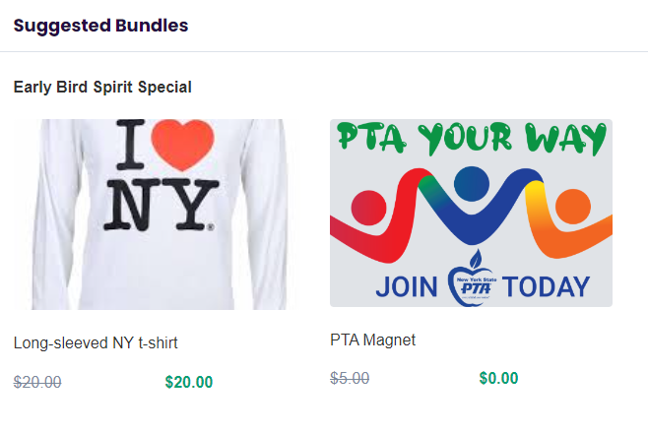
Store – Manage Bundles
Consider Bundling Membership Items with a Product to promote Membership or Bundle 2 Products together with a discount to encourage additional sales!
Bundled product will only be discounted when purchased at the same time as the Membership Item or the other product in the bundle
The “Suggested Bundle” appears at the bottom of the page showing the discount when EITHER item is selected in the Store
Please Note: Membership items cannot be discounted in a bundle, they must match your Bylaws
Notes:
Bundling Products is a bit different than creating new Membership Items that we talked about earlier. Bundles are used to create a situation when a purchases click on any of the items you have put into your bundle, they will see the “suggested bundle” items below that will be offered at a discount that you have preset up when you created the Bundle. Please note, that MEMBERSHIP cannot be discounted in this way. If you combine a Membership item with a store item as part of a bundle, the store item will be only thing that can be discounted.

Slide 20
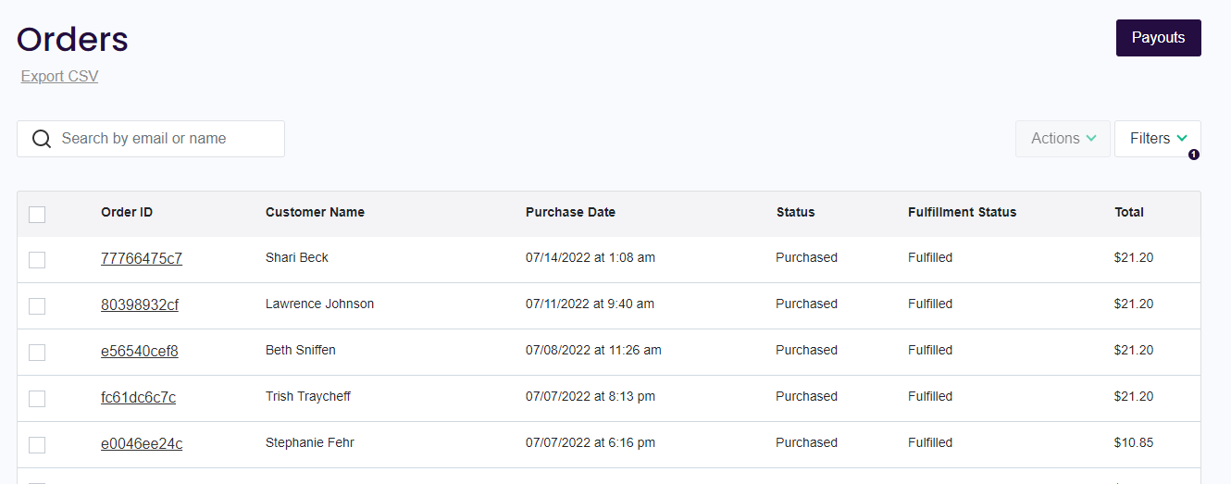
Store – Review Orders
Order List
List of all orders including Products and Online Memberships. You can use the filters to view particular categories, products, or timeframes. If you click on the Order ID link, it will open up the details of that individual order.
PAYOUTS (Treasurers)
Deposits for your sales are made weekly on Fridays.
Payout reports will match each deposit amount with the details so you can record your deposit correctly in your PTA bookkeeping.
Notes:
This page will be where Admins can review the store and membership orders all in one place. You will use the PAYOUTS button to export reports that will match up to your DEPOSITS made to your bank account every Friday if you have any activity in your store. These reports allow your Treasurer all the detail they need to properly record the deposit.

Slide 21
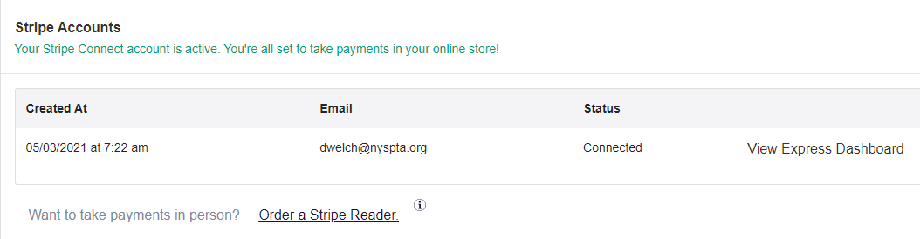
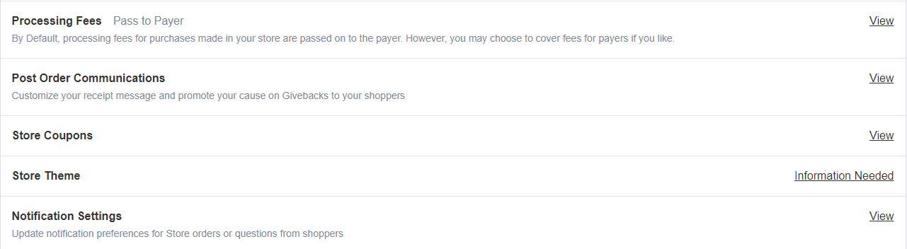
Store – Edit Store Settings
Stripe account status – credit card processing account
Processing Fees – Pass on to Payer or Absorb
Post Order Communications – customize the receipt for online sales and online membership orders
Notification Settings
  Contact Admin - Select the admin(s) who should receive these emails. If none selected, the emails go to ALL admins
  Order Notifications - Select the admin(s) if any who should receive notification of orders. If none selected, no one will be notified
Notes:
In the Store Settings area, we recommend you visit this area to check your Notification Settings. Also, to get more information on Store Coupons and Store Theme, please refer to MemberHub support to learn more about these features

Slide 22
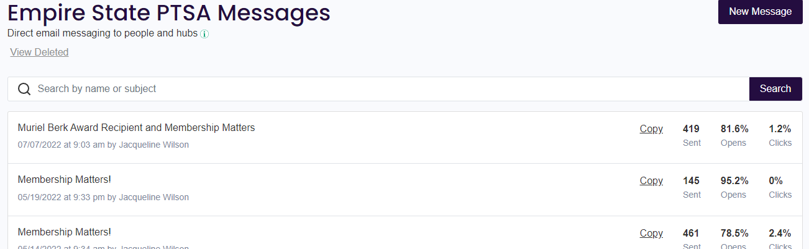
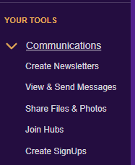
Communications
Communications
Look for more information about how to Send Messages & Create Newsletters in the recordings available from other workshops being presented this weekend!
Notes:
We have some pre-recorded webinars on how to use the Communication features such as Newsletters and Messages. I’ll make sure those recordings are available on the MemberHub Help page along with any new step by step videos that I create or that I find helpful from MemberHub support. There is lots of opportunity utilizing this software at all levels of the association.

Slide 23

Questions
THANK YOU FOR VIEWING THIS TRAINING!
Dania Welch
NYS PTA Membership/Insurance Manager
dwelch@nyspta.org or 518-452-8808
Notes:
Thank you so much for viewing this presentation! Please reach out anytime for more information.

