Slide 1
The PTA and The Principal, The Superintendent, and The School Board
Presented by Yvonne Johnson
National PTA President

Slide 2

Our Shared Mission:
To make every child’s potential a reality by engaging and empowering families and communities to advocate for all children.

Slide 3
PTA Values
Collaboration: We will work in partnership with a wide array of individuals and organizations to broaden and enhance our ability to serve and advocate for all children and families.
Commitment: We are dedicated to children’s educational success, health, and well-being through strong family and community engagement, while remaining accountable to the principles upon which our association was founded.
Diversity: We acknowledge the potential of everyone without regard, including but not limited to: age, culture, economic status, educational background, ethnicity, gender, geographic location, legal status, marital status, mental ability, national origin, organizational position, parental status, physical ability, political philosophy, race, religion, sexual orientation, and work experience.
Respect: We value the individual contributions of members, employees, volunteers, and partners as we work collaboratively to achieve our association’s goals.
Accountability: All members, employees, volunteers, and partners have a shared responsibility to align their efforts toward the achievement of our association’s strategic initiatives.
Notes:
(5 min)Review the values – Have everyone read one value.
How can you bring the values to your role of board member?
Talk about how the mission is what grounds us and what we stive for. Our values are how we work together and with the community to get the work done.
It is how we treat each other in every meeting and interaction. It applies to more than the board, but all members, staff and partners.

Slide 4

What PTA Value do you see?
https://www.youtube.com/watch?v=jU4oA3kkAWU

Slide 5
Learning Objectives
By the end of this session, you will:
Understand how and why you should build relationships with key education partners
Learn strategies to use to increase family school partnerships
Leave the workshop feeling more confident, aware, and engaged in this work
Strengthen the voice of families in your school communities.

Slide 6
What is PTA?
PTA (Parent Teacher Association) is the nation’s oldest and largest child advocacy association.
PTA’s mission is to make every child’s potential a reality by engaging and empowering families and communities to advocate for all children.​
NY State PTA oversees all the PTAs in New York, comprised of over hundreds of local units in early childhood centers, elementary, middle and high schools and charter schools.​
PTA provides schools and families with advocacy tools, membership benefits, leadership, parent and family education and empowerment material and the ability to impact change through collaboration, coalition building and partnerships.​
PTA builds community with our programs for building family school partnerships​

Slide 7
PTAs working with the building leader/principal
Building trust between the PTA and the administration
You are an advocate for families but also for the principal
Include your principal in planning meetings for the PTA
The principal is a member not the leader of the PTA
Ensure the principal attends your meetings and provides updates to the families
Notes:
The principal is responsible for
carrying out school district, state, and federal laws and policies;
appropriately using budgetary allotments to the school;
supervising school staff and students to ensure the opportunity for quality education for all students;  providing instructional leadership for the school and nurturing a community of learners;
developing and implementing - with teachers, parents, community members and students - school goals and objectives;
working with parents, businesses and other community members to gain support for the school;  overseeing the management of the school's physical plant;
building an organizational structure which establishes and encourages shared decision making and continuous progress;
articulating the vision of the school.

Slide 8
PTAs can build strong partnerships with building leaders/principals?
Invite them to attend meetings​
Share concerns​
Answer questions & provide facts
Ask for feedback on important topics​
Share information with the principal
Include the parent/family voice when speaking to the principal
Open lines of communication/ be responsive
Offer support
Demonstrate the value PTA brings to the school
Notes:
The principal and the PTA work together toward the mutual benefit of the school. The Principal frequently encourages the school staff to become PTA members and support the work of the organization. The teachers are another important link between the PTA, the students and the parents.

Slide 9
PTA is not The School’s ATM
A PTA or PTSA is NOT a fundraising or money-raising organization​
​Purpose is to promote the welfare of children​
​Educate parents, teachers and the community about the needs of schools​
​Material aid or capital equipment to the school is not a function of the PTA​
​Funds should be for a definite, pre-determined and budgeted purpose​

Slide 10
The PTA and the School Board
School boards do a better job when they are challenged and supported by an informed and involved community,
PTAs should encourage participation in the decision-making process to develop school policy.
PTA can be a partner to the school board in the following areas:
Communication
Participation
Accountability

Slide 11
Communication
  Establish regular two-way communication with the school board.
  Appoint a PTA liaison to attend school board meetings and share information with the PTA such as agendas and reports.
  Keep the PTA membership informed of school board actions and policies through reports in newsletters, meetings, and special programs.
  Establish a PTA spokesperson. To avoid confusion, it is important that the PTA spokesperson voice the consensus of the PTA, not personal views or opinions.
  Present PTA positions on issues such as tax increases, recess, public school funding, and more.
  When appropriate report PTA concerns, as well as families' reactions to school policies and community problems with the school board

Slide 12
Participation
  Encourage the school board to develop and implement a formal, written family school partnerships policy.
  Make sure PTA representatives sit on special school board advisory committees and task forces.
  Ask a school board member to help plan and/or attend PTA conferences, workshops, and open forums
  Invite school board members to participate on PTA committees and attend PTA programs.
  Encourage parents to attend school board meetings by letting them know relevant meeting details-time, location, and agenda.
  Call public attention to important school issues being decided by the school board. Encourage public comment
  Ask them to join your PTA

Slide 13
School Board Elections and the PTA
School board members are either elected or appointed to serve a specified number of years
PTAs should be involved in a nonpartisan way
Find out when regular or special school board elections are occurring and:
Alert community members to the coming elections (or appointment) of school board members, encouraging them to be informed and to vote;
Publicize the duties of a school board member and the qualifications of the candidates;
Sponsor community meetings where all school board candidates are invited to speak.
PTAs do not support or oppose individual candidates for public office-PTAs support issues and principles.

Slide 14
The PTA and The Superintendent
Build a mutual beneficial relationship with the Superintendent
Opens the door of communication
Be responsive and available
Support district initiatives
Share positions on behalf of families on key issues
Promote the importance of PTA’s 6 tenants for strong family school partnerships

Slide 15
Creating strong relationships with your Superintendent
Tips for a good working relationship between the PTA and the superintendent include:
Understanding roles
Becoming familiar with policies
Establishing two-way communication
Attending each other's meetings
Keeping members informed
Calling attention to important issues
Finding common ground for all students
Following up on phone calls. Emails, and meetings with a summary of what was discussed

Slide 16
Review of Learning Objectives
You can now understand how and why you should build relationships with these key education partners
You should have learned some strategies to use to increase family school partnerships
You will leave this workshop feeling more confident, aware, and engaged in working with your principal, superintendent and your local school board.
You can work with families to strengthen their collective voices of the families in your school communities.
Notes:
This slide should be used at the end of your presentation.
Presenter will revisit each learning objective to reinforce the learning.

Slide 17

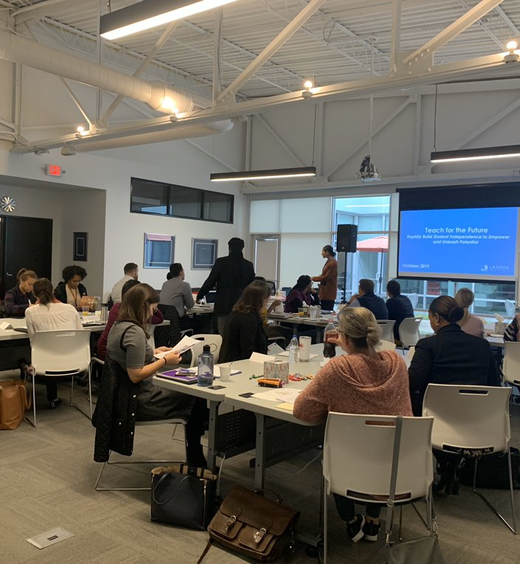

This Photo by Unknown Author is licensed under CC BY-NC-ND

Slide 18

Thank You!
Notes:
Ask for questions, reflections or comments.

