Slide 1
I Feel So High School…
Marketing to the Upper Levels
- Kathleen Jenne -
NYS PTA Marketing Specialist
- Danielle Blanchard St. Louime -
NYS PTA Membership Engagement Specialist

Slide 2




Slide 3




PTA Marketing at the Unit Level
-
What are the needs of Middle, Junior, and High School students and their families?

Slide 4

Think back: what were your motivations for getting involved in upper level PTAs?

Slide 5

Mental Health Awareness
Student Rights
School
Meals For
All
Bullying
Arts Programs
Fun Events
Dress codes

Slide 6

How can PTA help equip students and families with the necessary tools to address these needs?

Slide 7

PTA can guide our members, both students and adults, on how to harness their own power to meet these needs for themselves and their community.

Slide 8


Everything The PTA has done, from school dances and prom night parties to advocacy for greater educational funding and graduation requirements, happened because someone decided to join a local unit.

Slide 9






The NYS PTA has a rich history of advocacy as well as program development. This work can be utilized as a membership recruitment strategy!

Slide 10


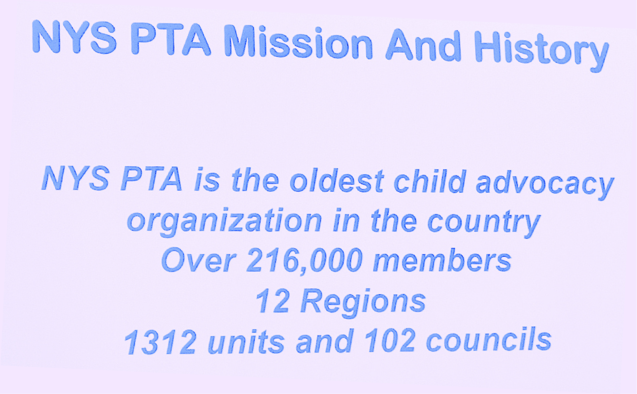

Slide 11


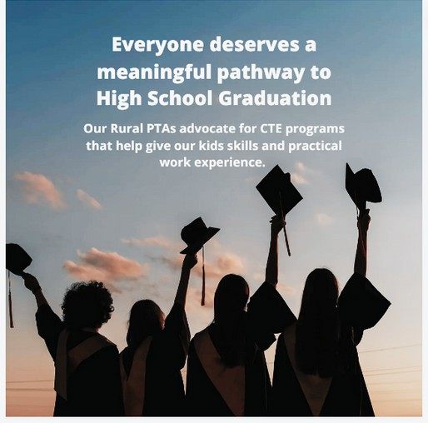

Reach out to those groups who feel unheard and show them how PTA Membership can lead them not only to finding their voice, but amplifying it.

Slide 12


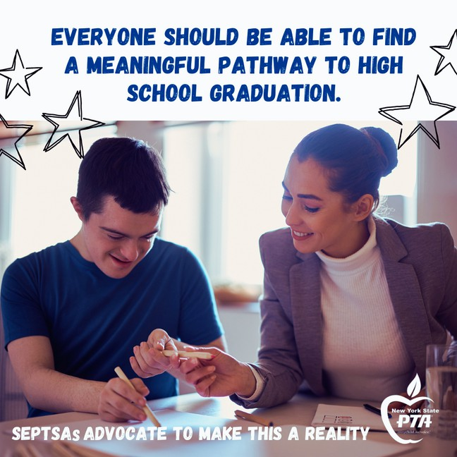





Slide 13

PTA Marketing at the Unit Level
-
What advocacy work has your unit done within your district? Has your SEPTSA pushed for more inclusive school activities and clubs? Has your High School’s PTSA pushed for a mental health event?
Your advocacy work should be marketed and promoted in your Membership campaigns.

Slide 14


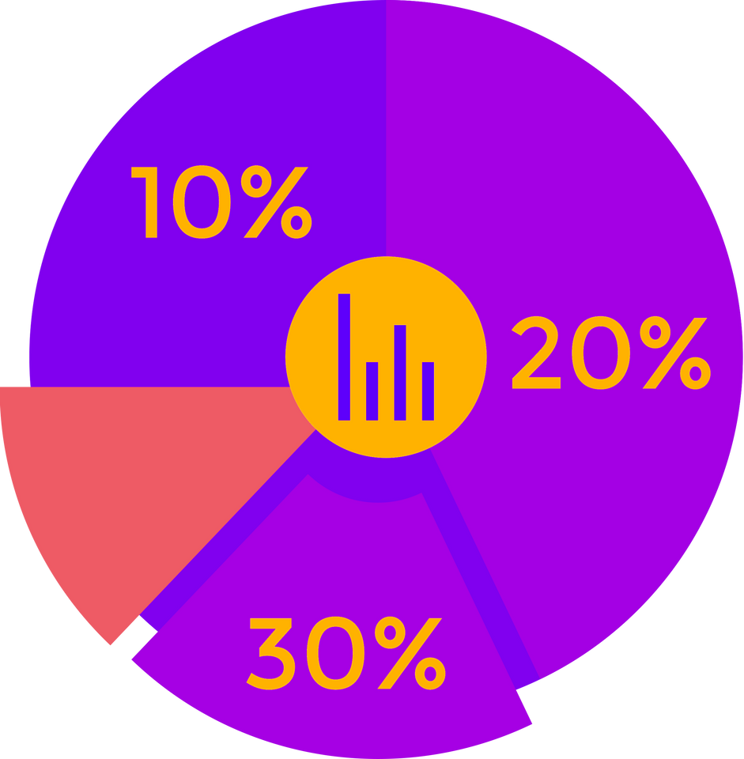

Slide 15

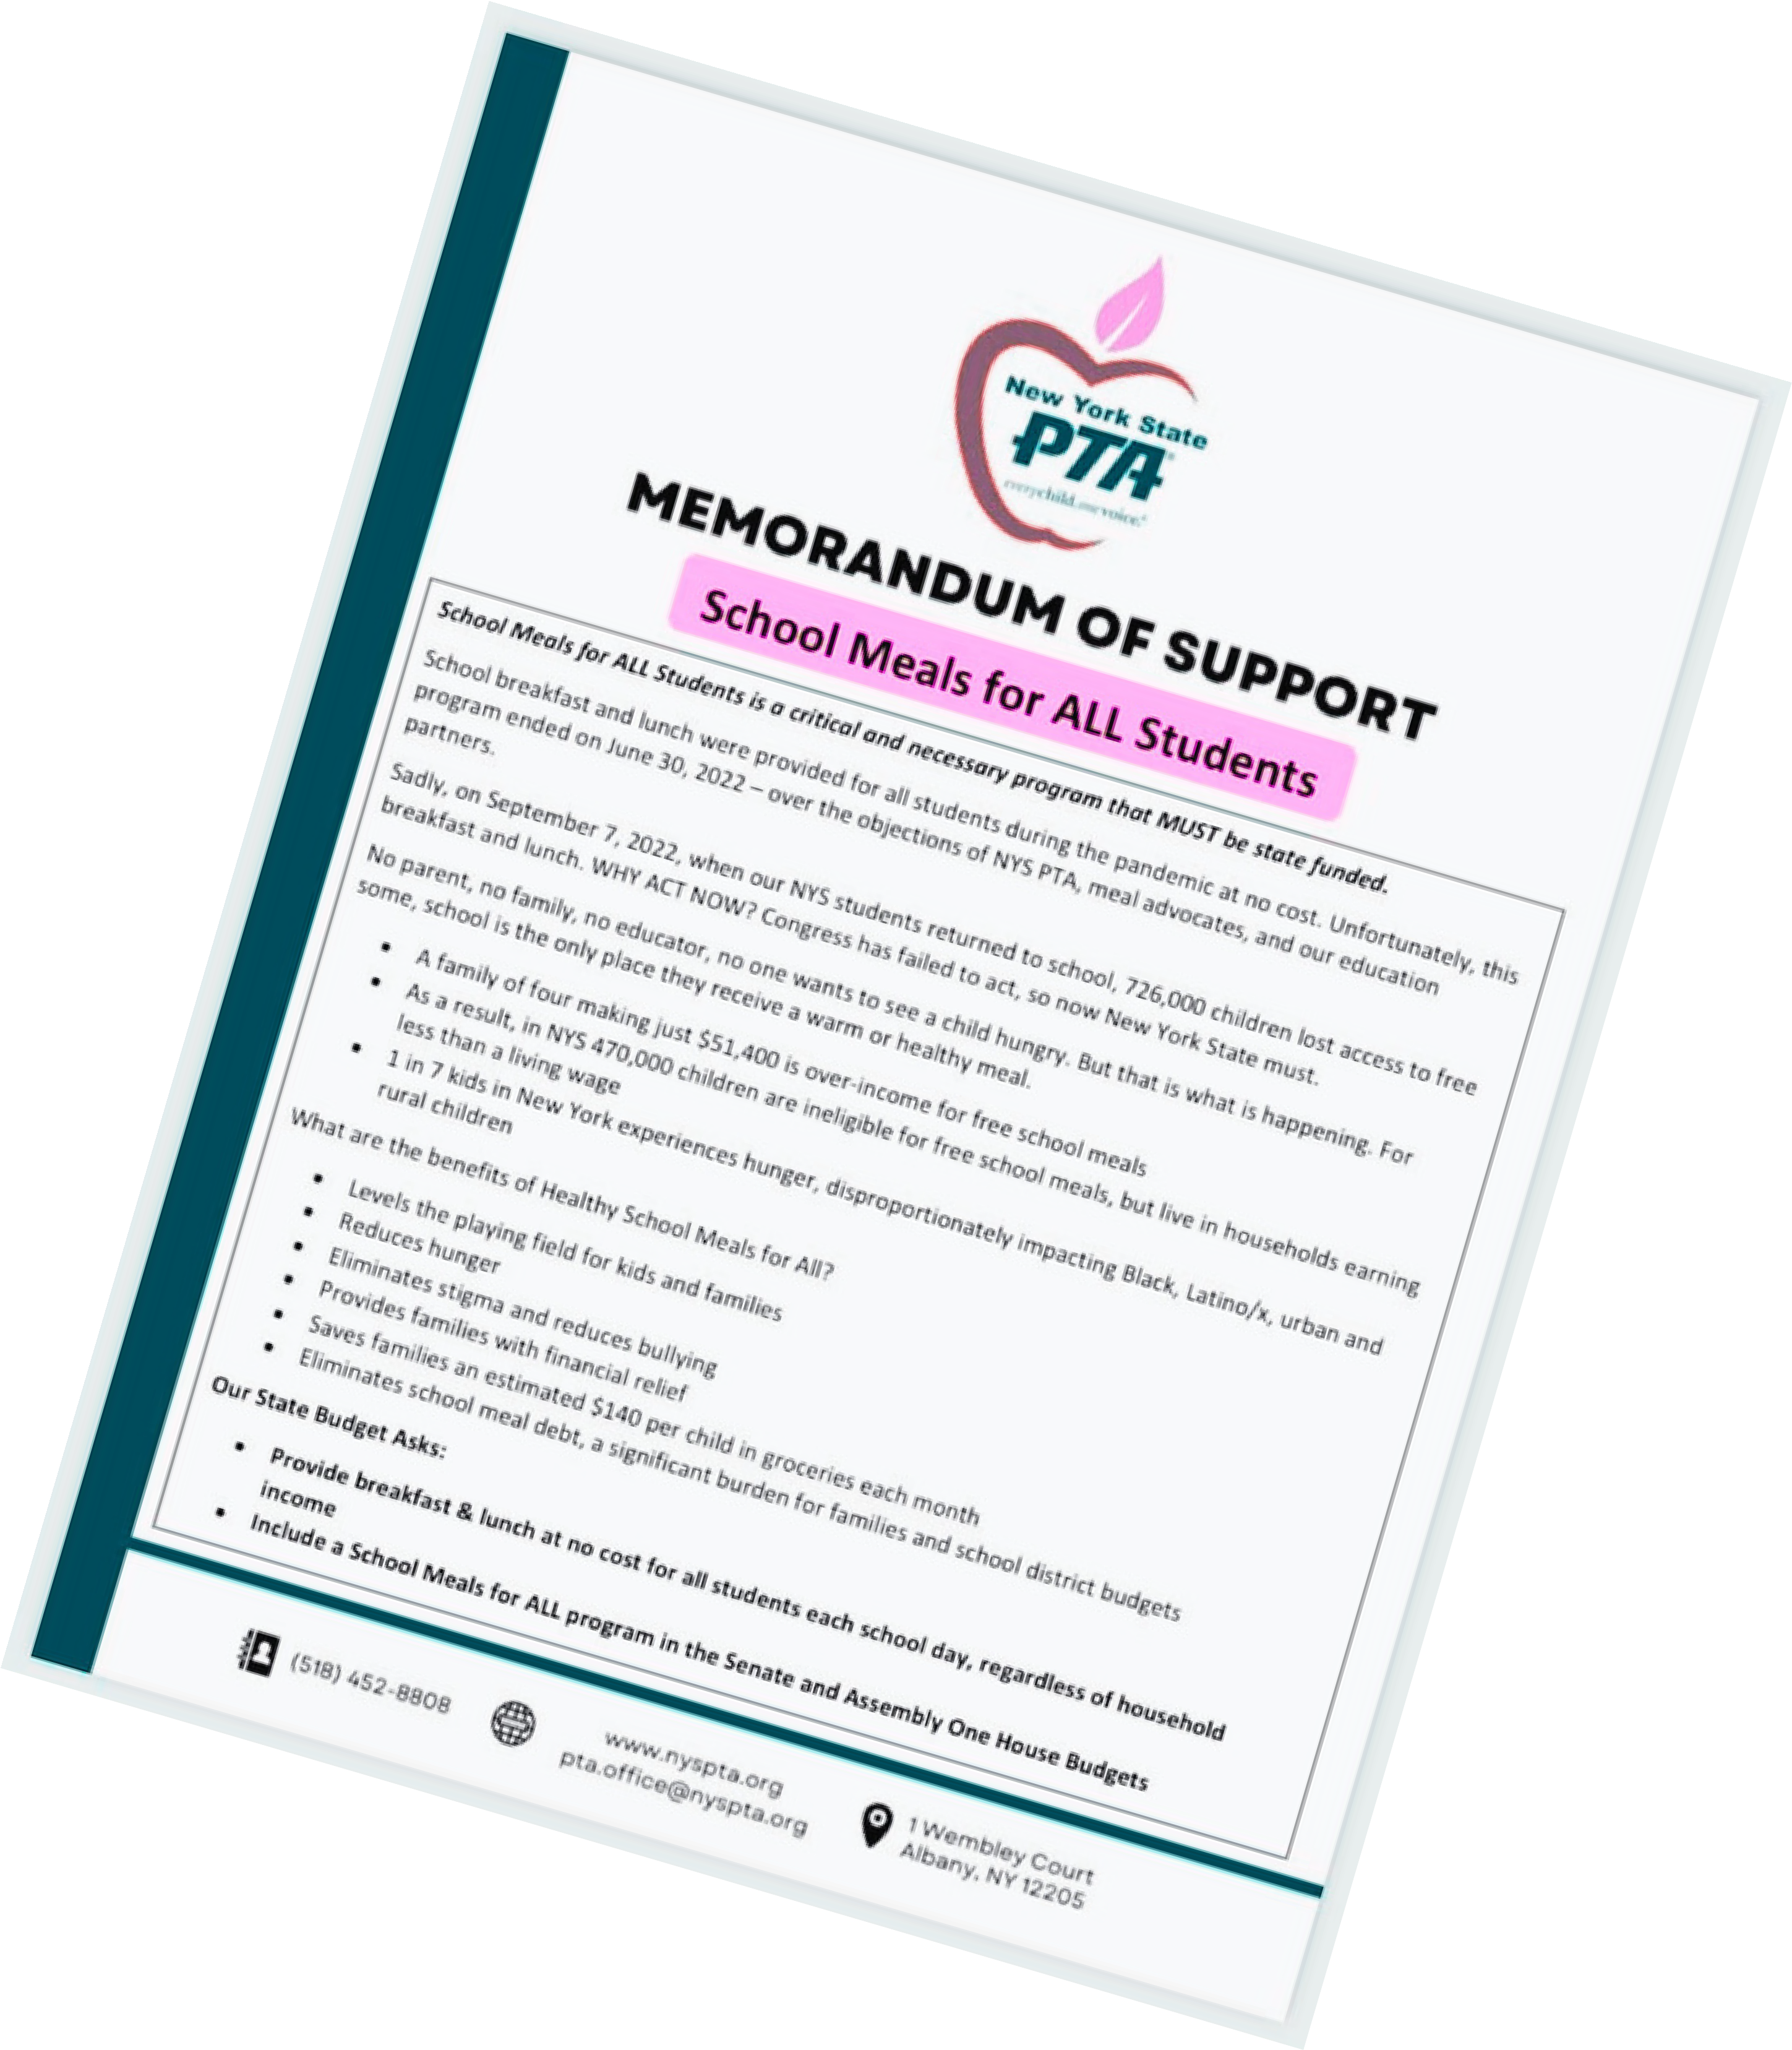




Slide 16

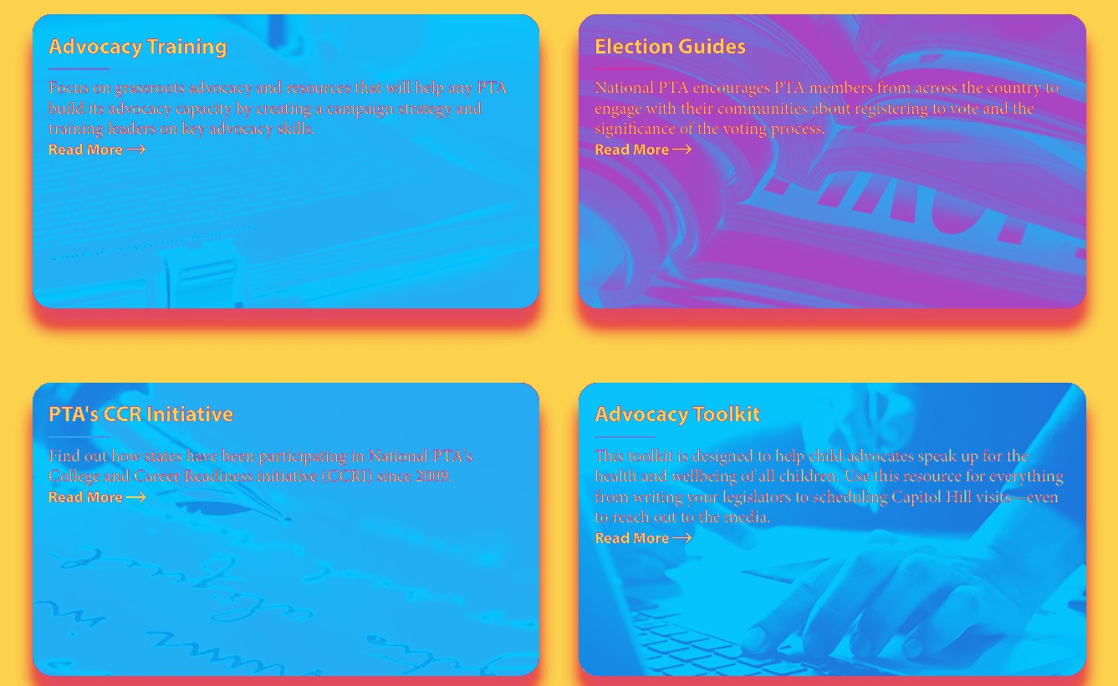
Advocacy resources

Slide 17

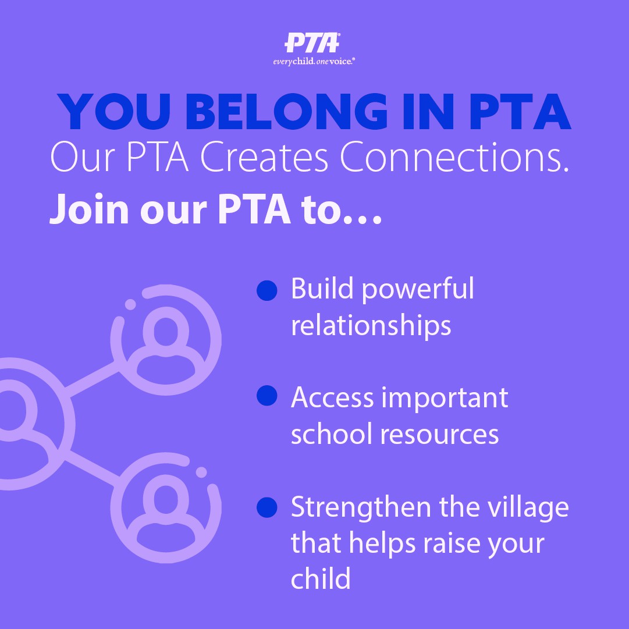
Reasons YOU Belong

Slide 18

How can Family Engagement be utilized as a Marketing Strategy?
National PTA Standards

Slide 19




PTA Marketing for Middle, Junior, and High School Units
-
Some quick and easy tips for every season

Slide 20

EVERY SINGLE EVENT AND ACTIVITY YOUR PTA DOES IS A MEMBERSHIP MARKETING OPPORTUNITY!

Slide 21






















Slide 22

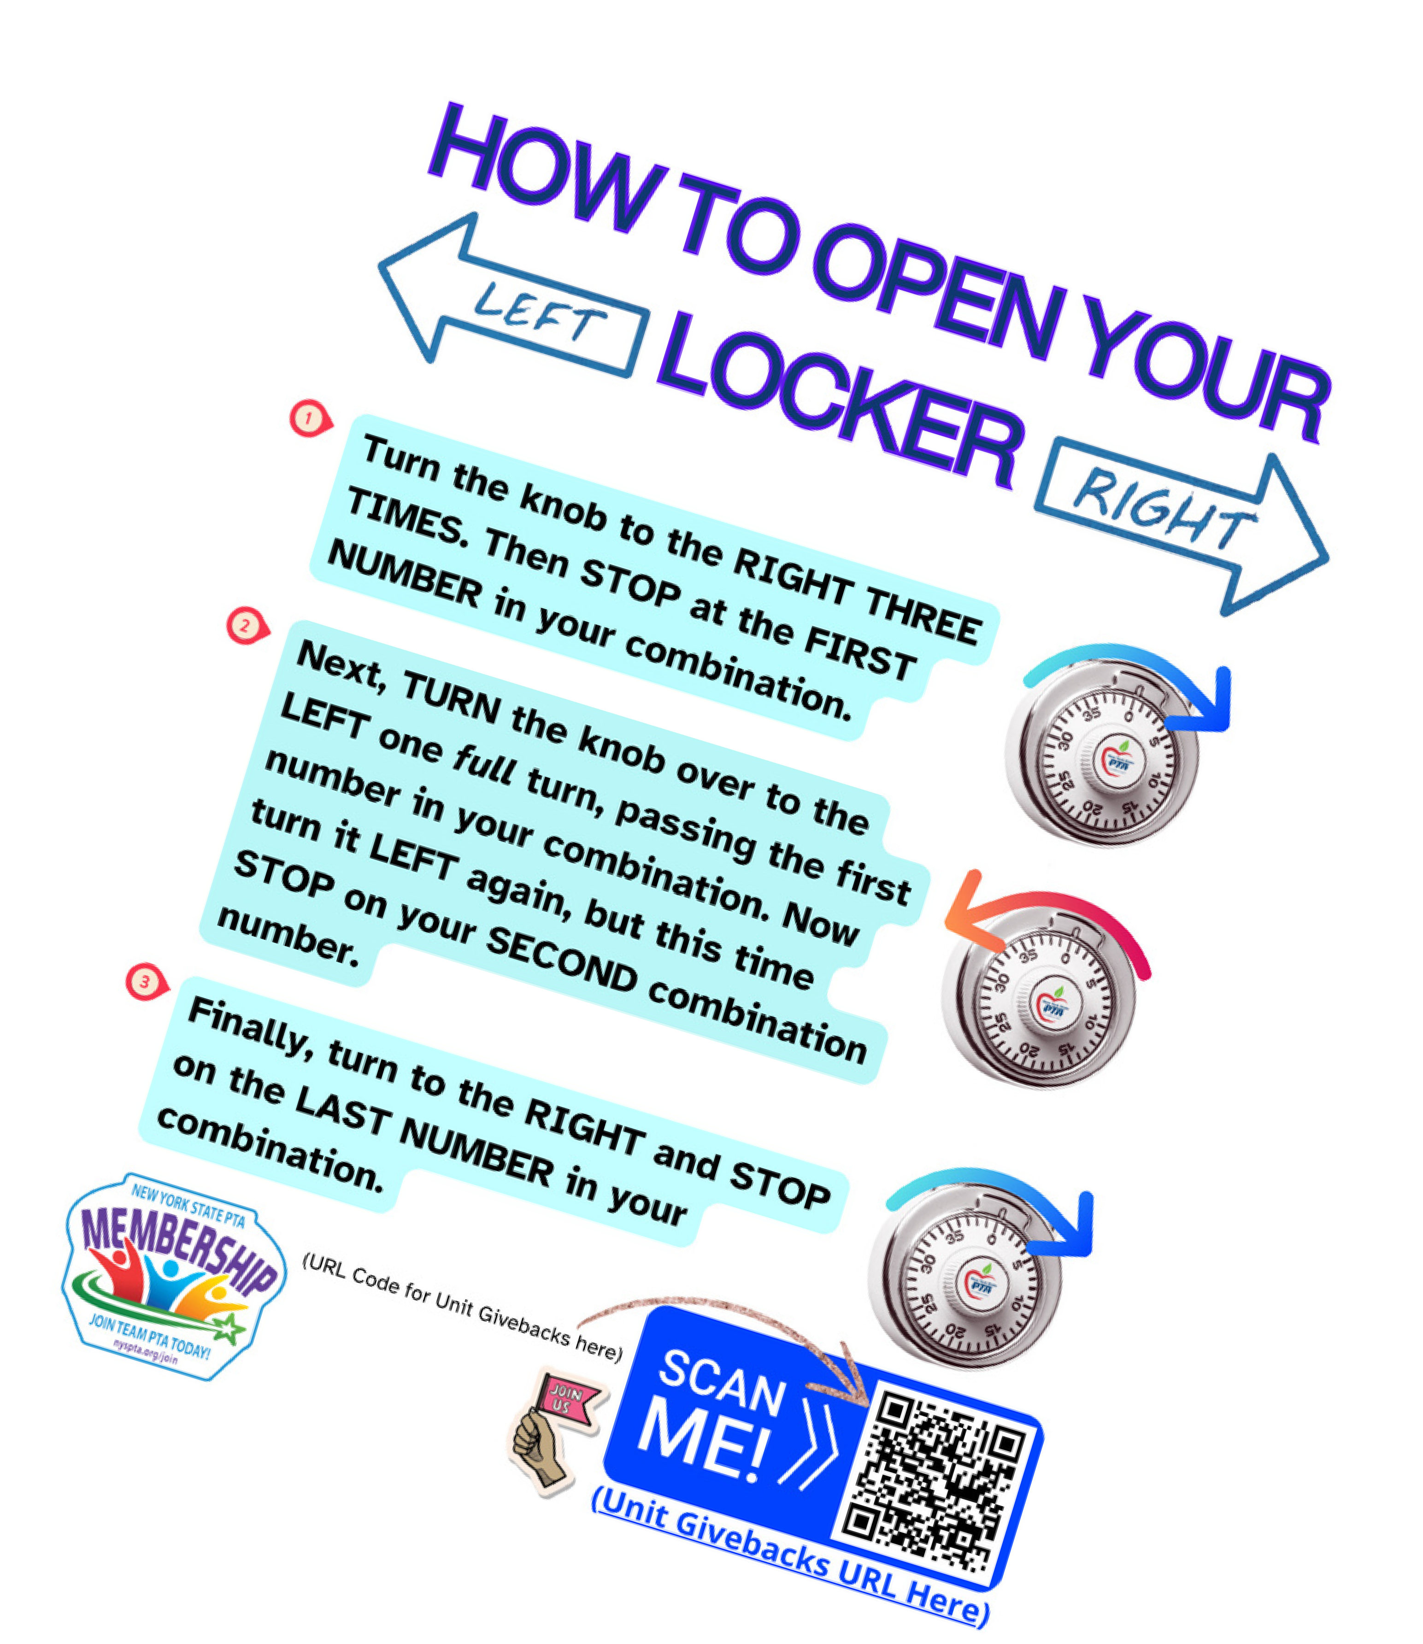
Make a helpful flyer, such as a how to open your combo lock guide. Put your logo and Givebacks QR code on it. Everytime they look at it, they’ll think of you and it makes it easy to join!

Slide 23

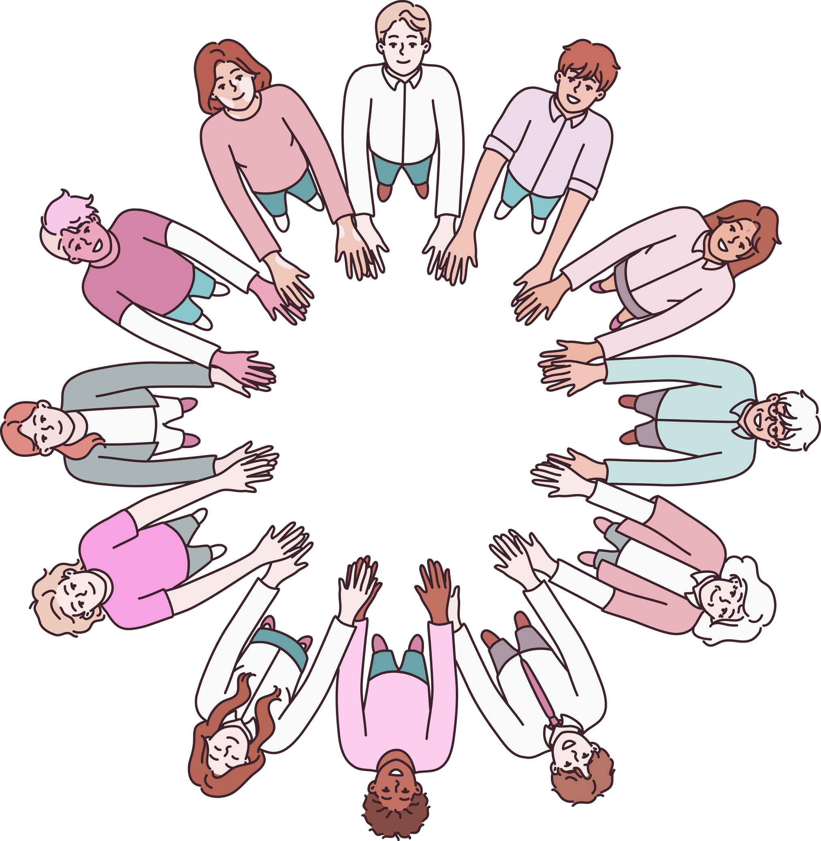

Ask to speak at a school assembly or student government meeting. Let the students know why they need a seat at the table!

Slide 24




How do you encourage Student Membership?
Student representative(s) Transcripts/College applications Volunteer service requirements Scholarships, honor cords Discounts and pre-sale codes Exclusive Swag

Slide 25
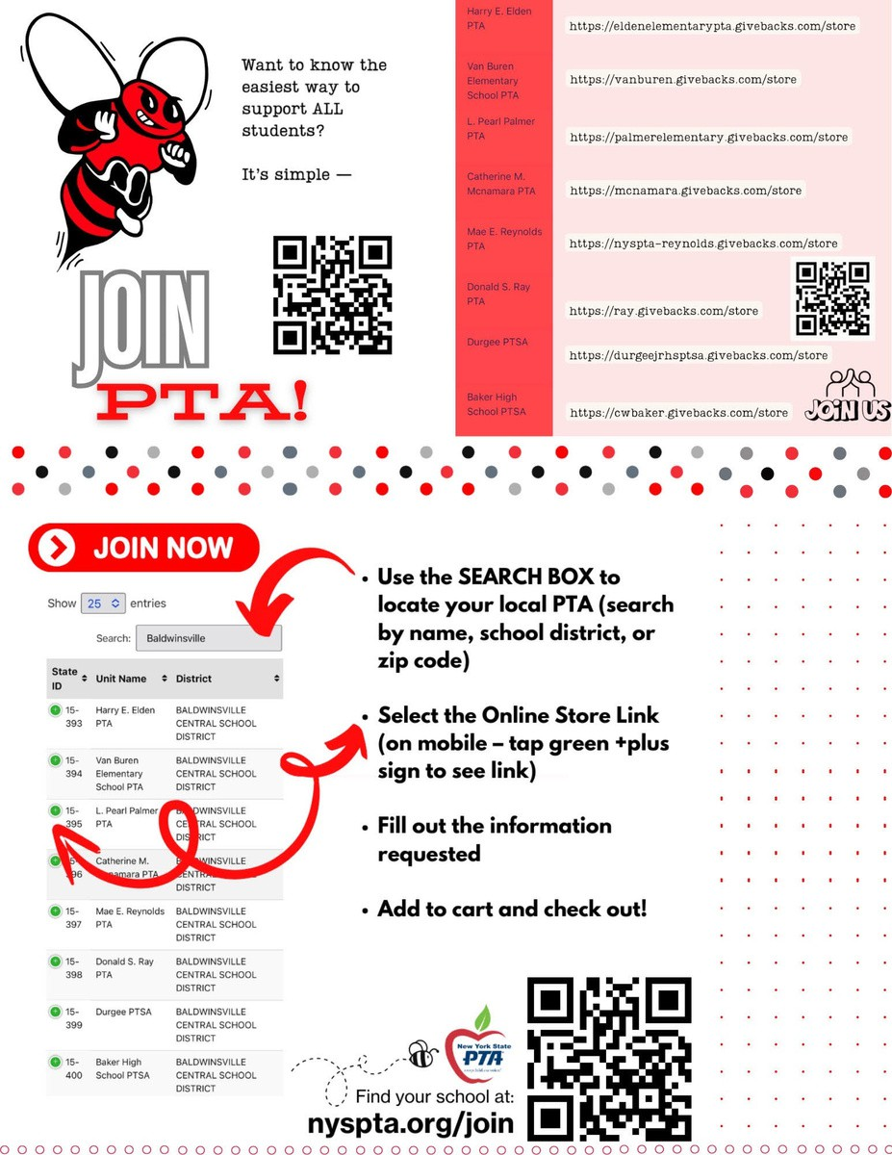






Slide 26


Slide 27

























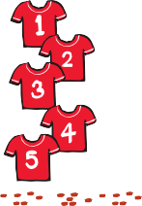


























Push Sponsorships by local businesses -
*Note* only one named individual from the business can be a voting member.
However, the company receives a certificate to display, which they can use to advertise their support on their website and/or social media.

Slide 28




Partner with your School Administration and Student Council to organize a donation drive for your community for the holiday season. Help others, strengthen relationships, and promote PTA!

Slide 29




Slide 30


Mar 2025 – Students Rock Award
Enter more than 20% of your total membership as Student members (Select “STUDENT” member type in the dropdown box) to earn the Students Rock Award and badge
Pay State/National dues for all members who have joined to date by March 31

Slide 31


May is Mental Health Awareness Month. Partner with your district and/or medical community to create an educational event for your school community. Don’t forget to include a membership table.

Slide 32


PTA Officer Elections - tap into those members who are looking to become more involved at their new schools and encourage them and their supporters to join your PTA

Slide 33
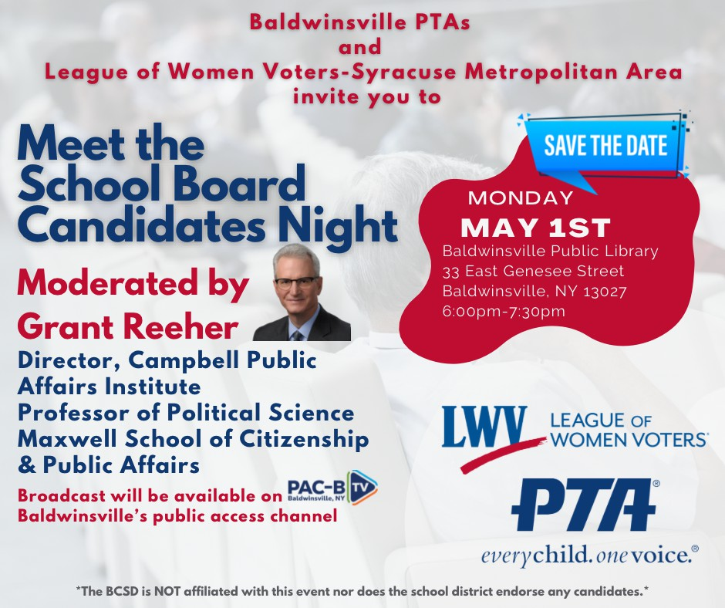
Host a “Meet the School
Board Candidates” Night for your community!

Slide 34


June is Pride Month. Participate as a PTA in a local event and promote membership in your unit!

Slide 35

The Next Chapter:
Promoting Membership among transitioning groups

Slide 36


Focus on incoming students and their families
Utilize cross promotion with buildings above and below yours in your district
Alumni legacy

Slide 37
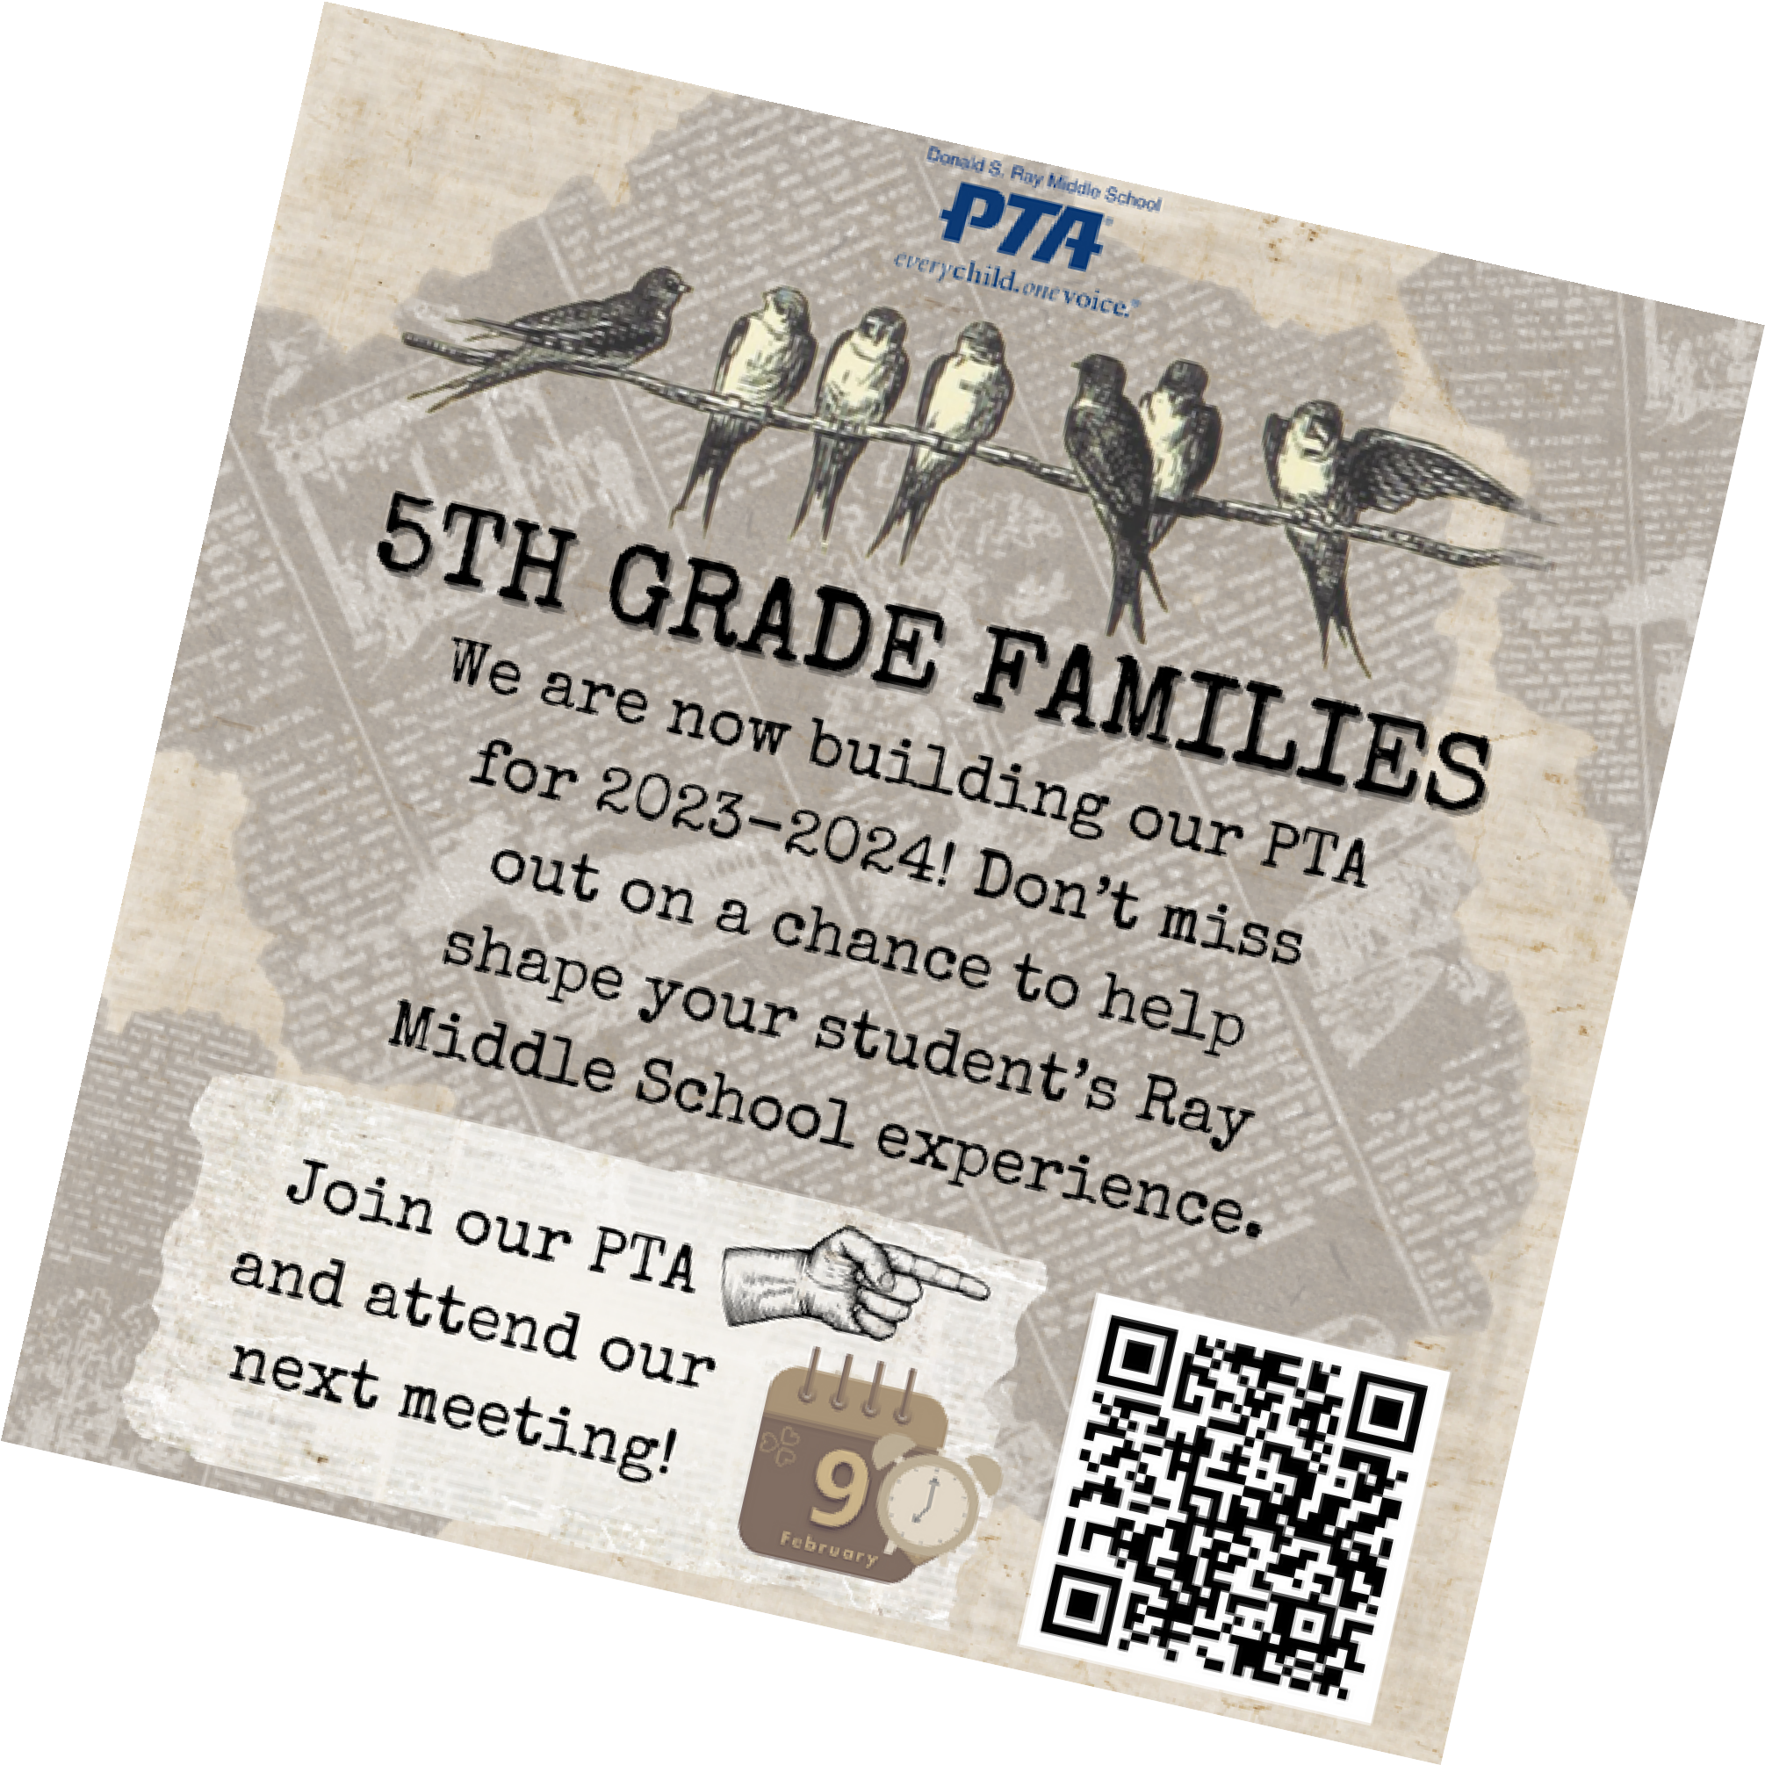





MIDDLE SCHOOL

Slide 38



Slide 39







Need inspiration or a quick turn and go flyer? For Marketing materials, visit https://nyspta.org/membershiptoolkit/
Marketing questions? Email
Kathleen Jenne - Marketing@nyspta.org
Engagement Materials are available at https://nyspta.org/success-story-archive/
Membership Engagement Questions? Email
Danielle Blanchard-St. Louime - membershipengagement@nyspta.org

Slide 40

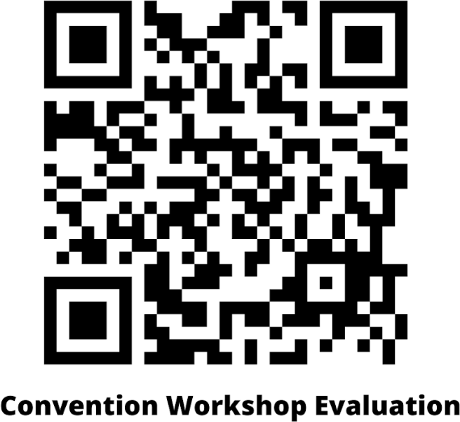

Slide 41


Marketing PTA to the Upper Levels
Include: Remind students of the benefits of PTA involvement—looks good on transcript, leadership skills development, opportunity to learn about event planning, fundraising, advocacy work, grassroots community engagement, public speaking, etc Advocacy, Advocacy, Advocacy!! - Hit this hard! Teens are passionate and have strong opinions on issues such as mental health, environmental issues, educational issues, human rights, school policies, etc. Show them the work PTA has done/is doing and let them become a part of it!
Partner with and recruit from student government! Show them how collaboration and membership can achieve success.
It’s a different world — what is PTA at this level? What can it be? It’s more than just the post prom party!
Encourage your unit to allow older students to be chairs or even officers (not President or Treasurer)
How to engage busy families/caregivers at secondary level — get inspired by examples like Sachem down on LI doing cords at graduation, student representatives in PTA , etc.

