Slide 1

Trauma Informed PTA -
How to Support Students
in Foster Care and Families
Experiencing Homelessness
Susan Fisher, Resolutions Coordinator
Namiko Suga, Juvenile Protection Specialist

Slide 2

What Is Trauma?
Trauma describes experiences or events that are physically, mentally, or emotionally harmful
Divorce, the death of a parent or caregiver, abuse or neglect, food insecurity, lack of permanent housing, separation from one or both parents, health issues, racial or religious discrimination… all are examples of traumatic events

Slide 3
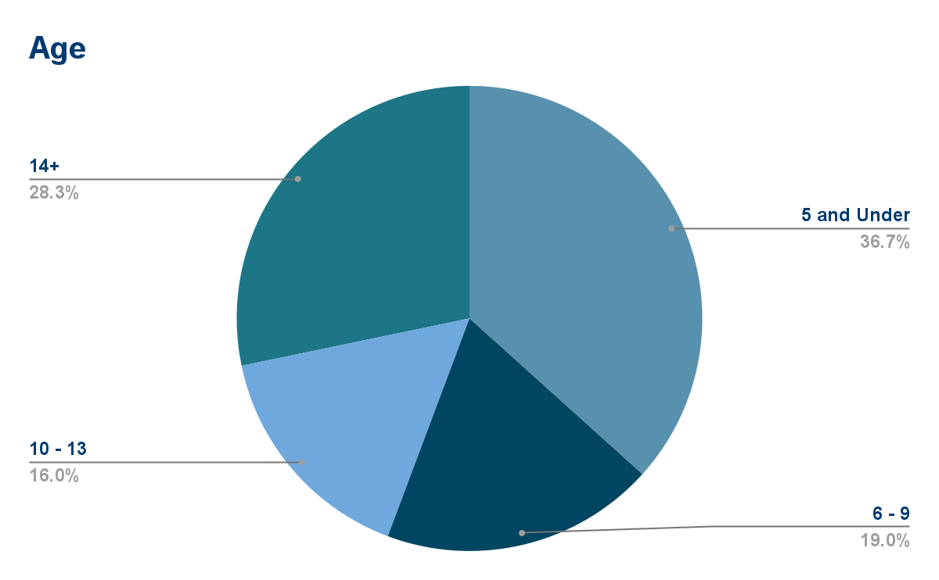
Children and Youth in Foster Care in NYS
As of June 2024: 13,442 children are in the foster care system in New York State
By age:
5 and under: 4930
6 to 9: 2557
10 to 13: 2155
14+ : 3799

Slide 4
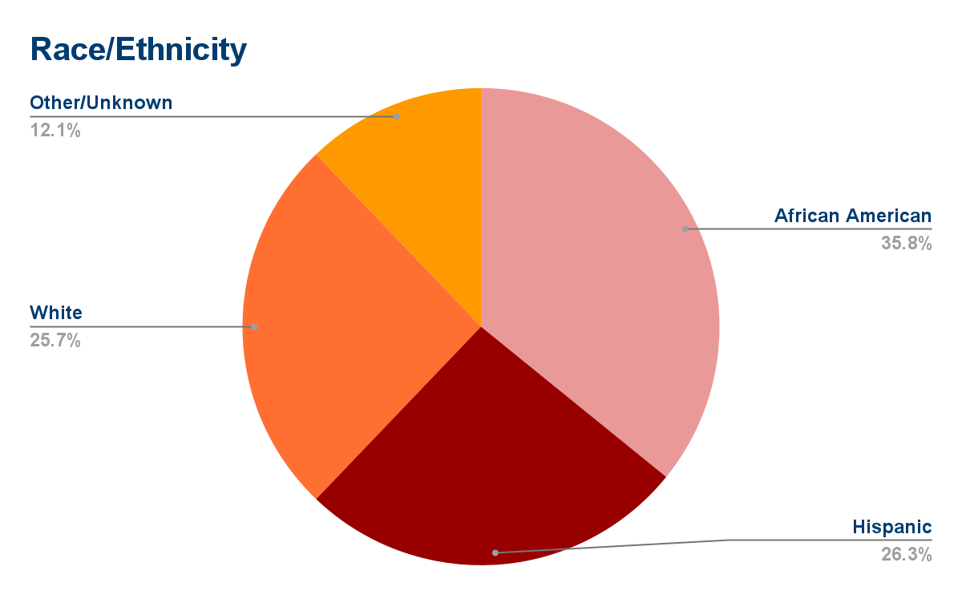
Children and Youth in Foster Care in NYS
Foster child advocacy groups note that over 35% of children in foster care are Black children, while making up only 15% of the total child population in NY
By Race/Ethnicity:
African American 4818
Hispanic: 3536
White: 3455
Other/Unknown: 1633

Slide 5
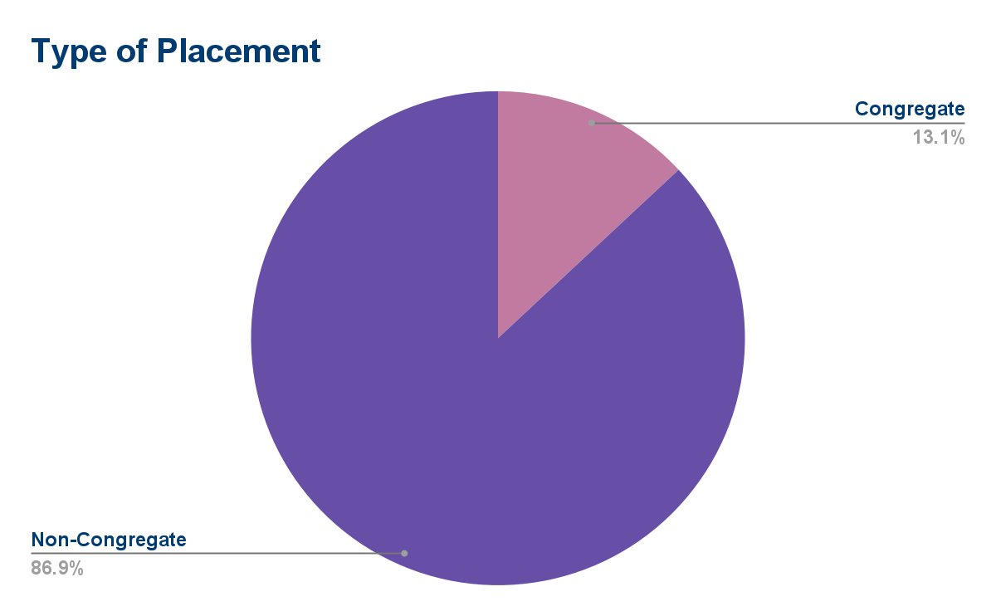
Children and Youth in Foster Care in NYS
Non-Congregate:
Foster boarding home
Foster adoptive home
Approved relative home
11,687 children/youth
Congregate:
Institution
Group home
Group residence
Agency operated boarding home
Other
1,755 children/youth
Notes:
Every new placement is a traumatic experience

Slide 6
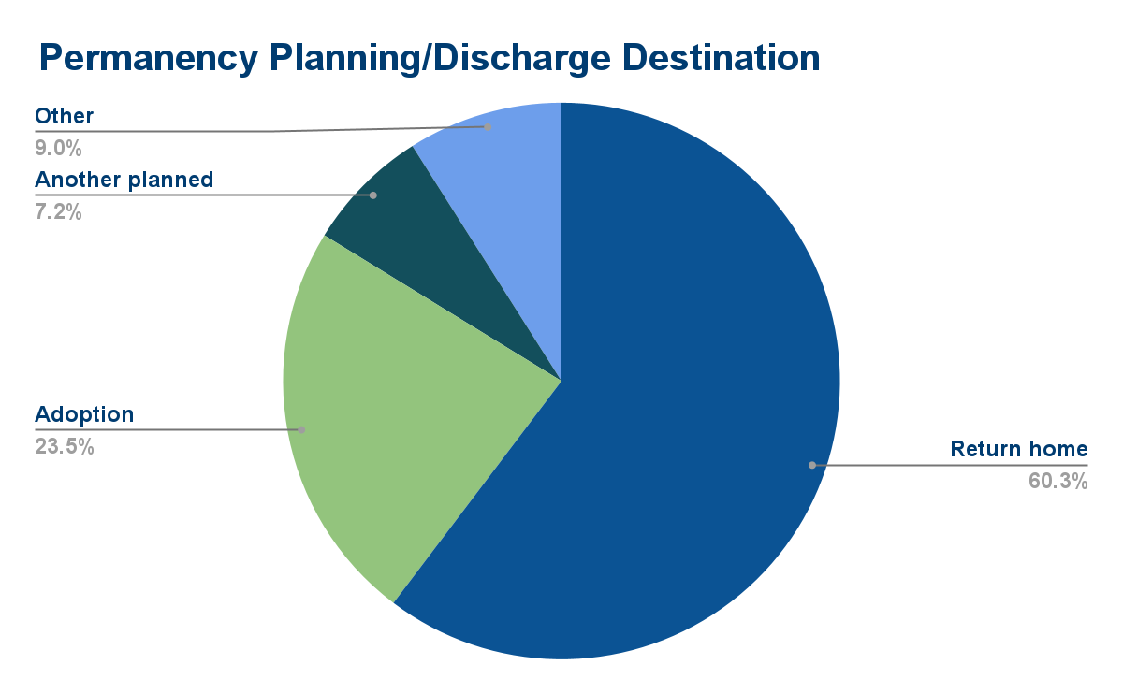
Children and Youth in Foster Care in NYS
Permanency planning doesn’t necessarily lead to actual outcome. Older teens and children with diagnosed disabilities are more likely to “age out” of the system

Slide 7
The McKinney-Vento Act
McKinney-Vento Act defines homeless children and youth as any student “who lacks a fixed, regular, and adequate nighttime residence.”
  School Choice
  Immediate Enrollment
  Transportation
  Free Meals and Title I Services
  Help from McKinney-Vento Liaison
Notes:
School Choice: If you move into temporary housing, your children have 3 school choices! They can stay in the same school they went to when you had a permanent address, OR stay in their most recent school, OR transfer to the school for where you are staying now. This includes public preschool programs.
Immediate Enrollment: You can enroll your children in school without the usually required documents. The school must enroll your children within 1 day even without immunization forms, guardianship papers, birth certificates, or proof of address. After your children are enrolled, the school can help you get any needed records.
Transportation: If your children stay in their same school, they can get free transportation to/from that school. If you move from temporary to permanent housing during the school year, your children will still get transportation for at least the rest of the school year, and maybe one more year, if it’s their last year in the building. This includes pre-school aged students.
Free Meals and Title I Services: Your children can get free meals at school. You do not need to fill out any forms about your family’s finances. Students in temporary housing can also get Title I services, including emergency supplies, counseling, tutoring, etc
Help from McKinney-Vento Liaison: Every school district has a McKinney-Vento liaison. The liaison is a staff person who will help you enroll your child in school and connect you and your family with services. If you don’t know who your district’s liaison is, follow this link or call us at 800-388-2014 and we can tell you

Slide 8
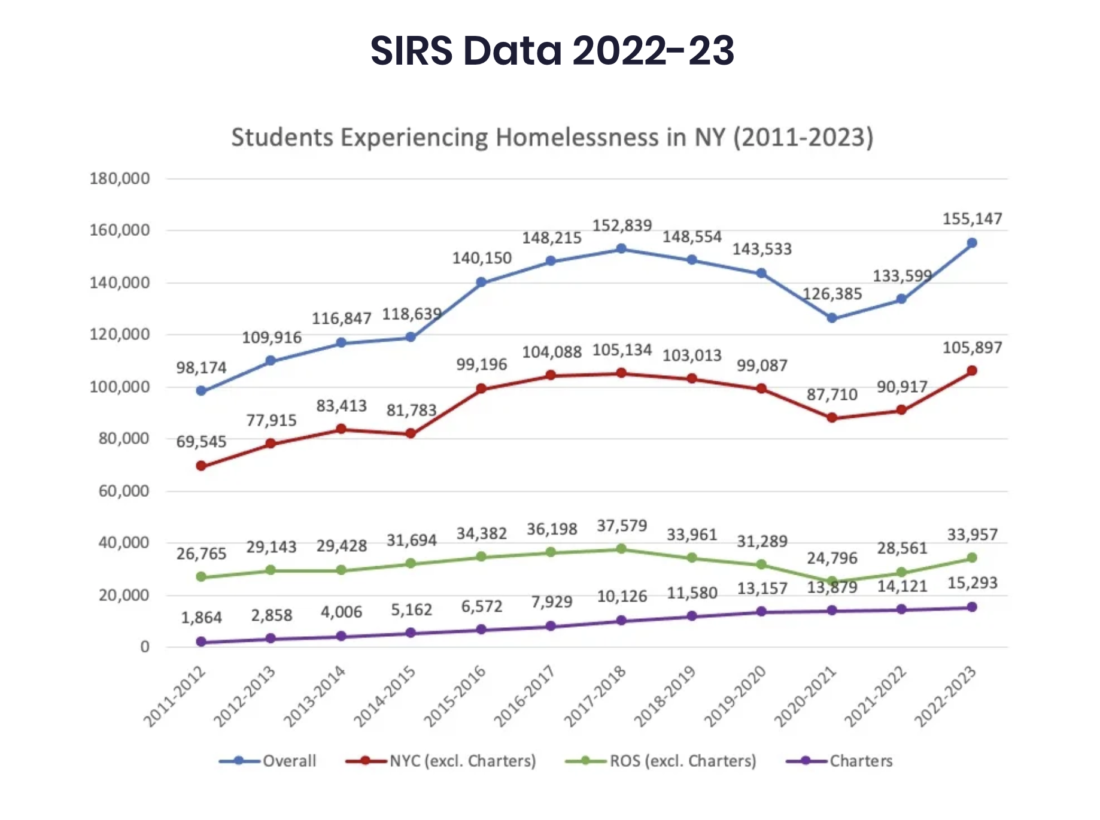

Slide 9
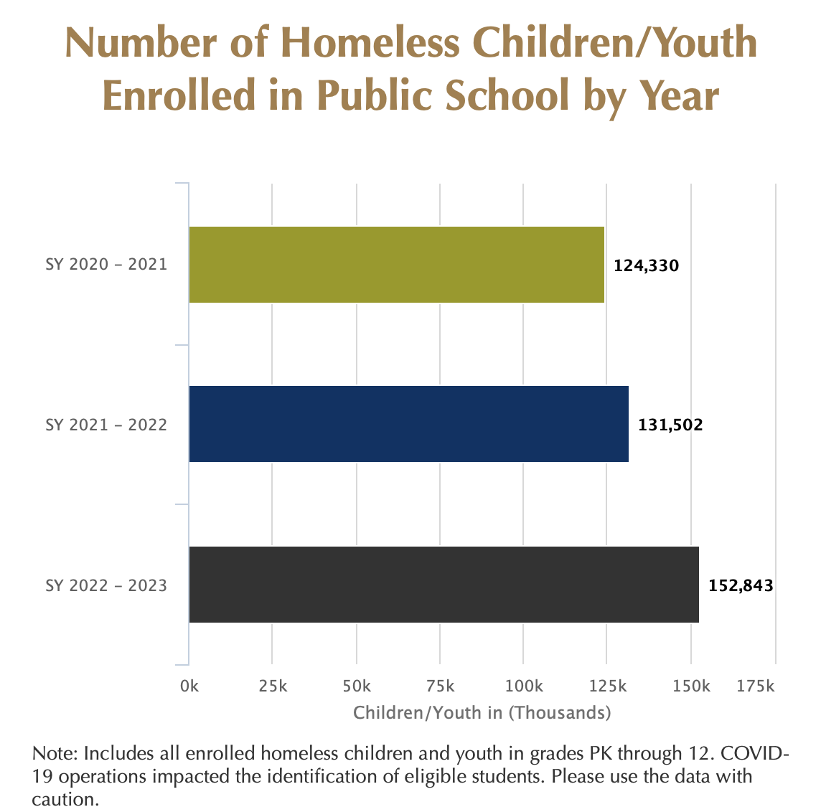
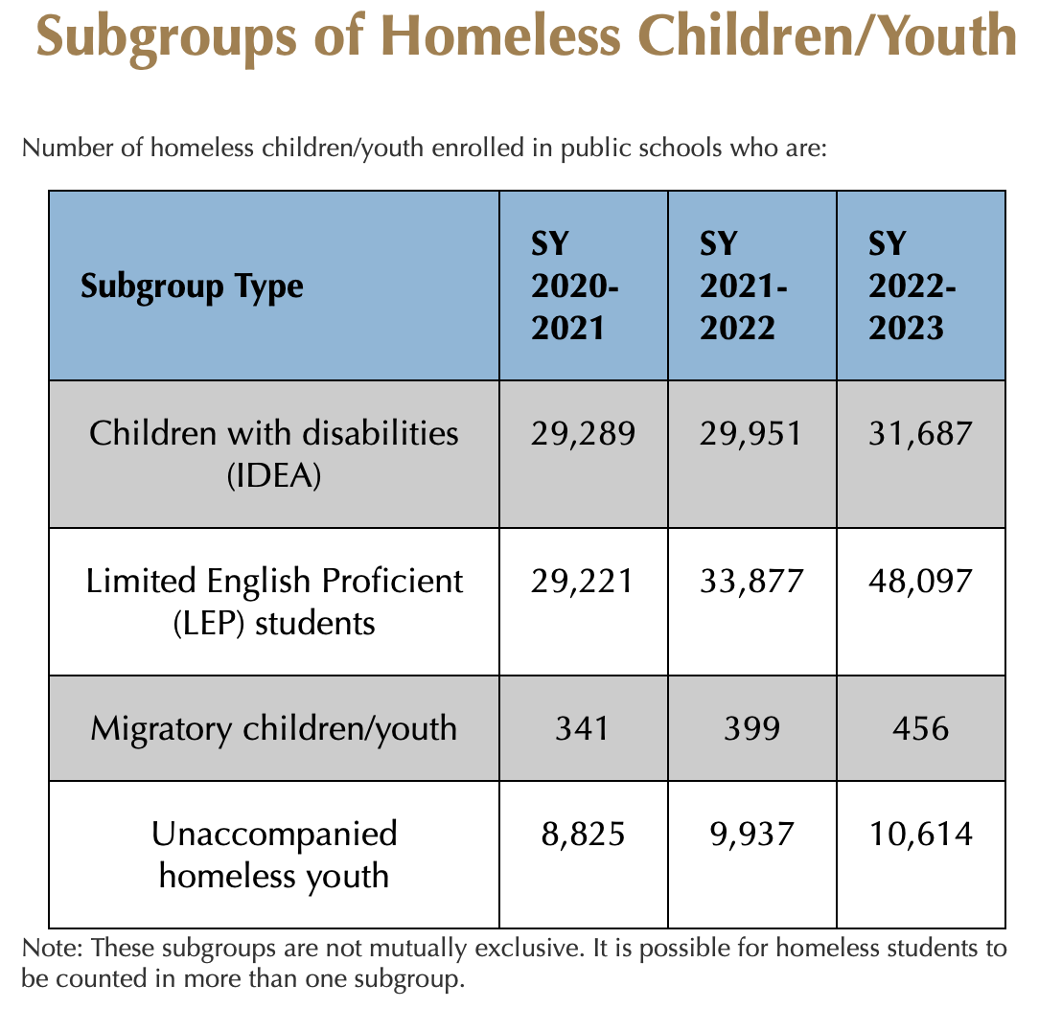

Slide 10
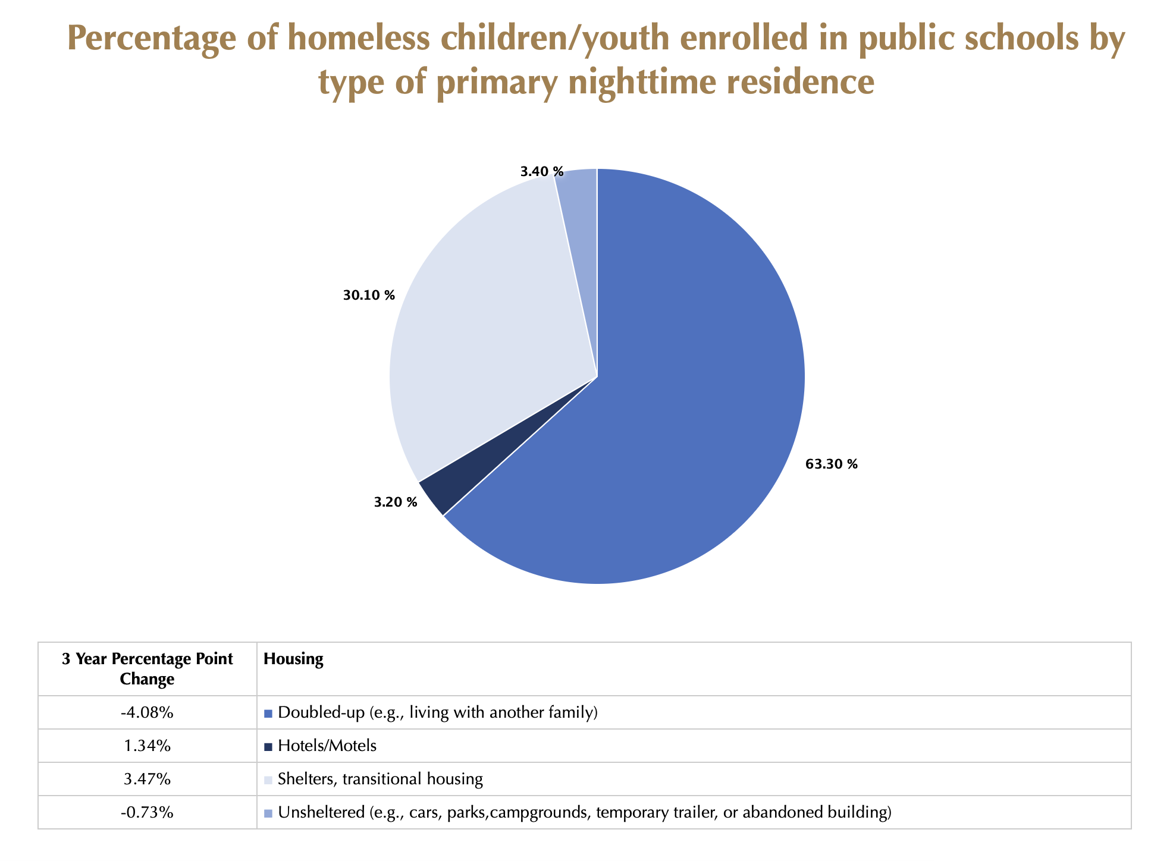

Slide 11
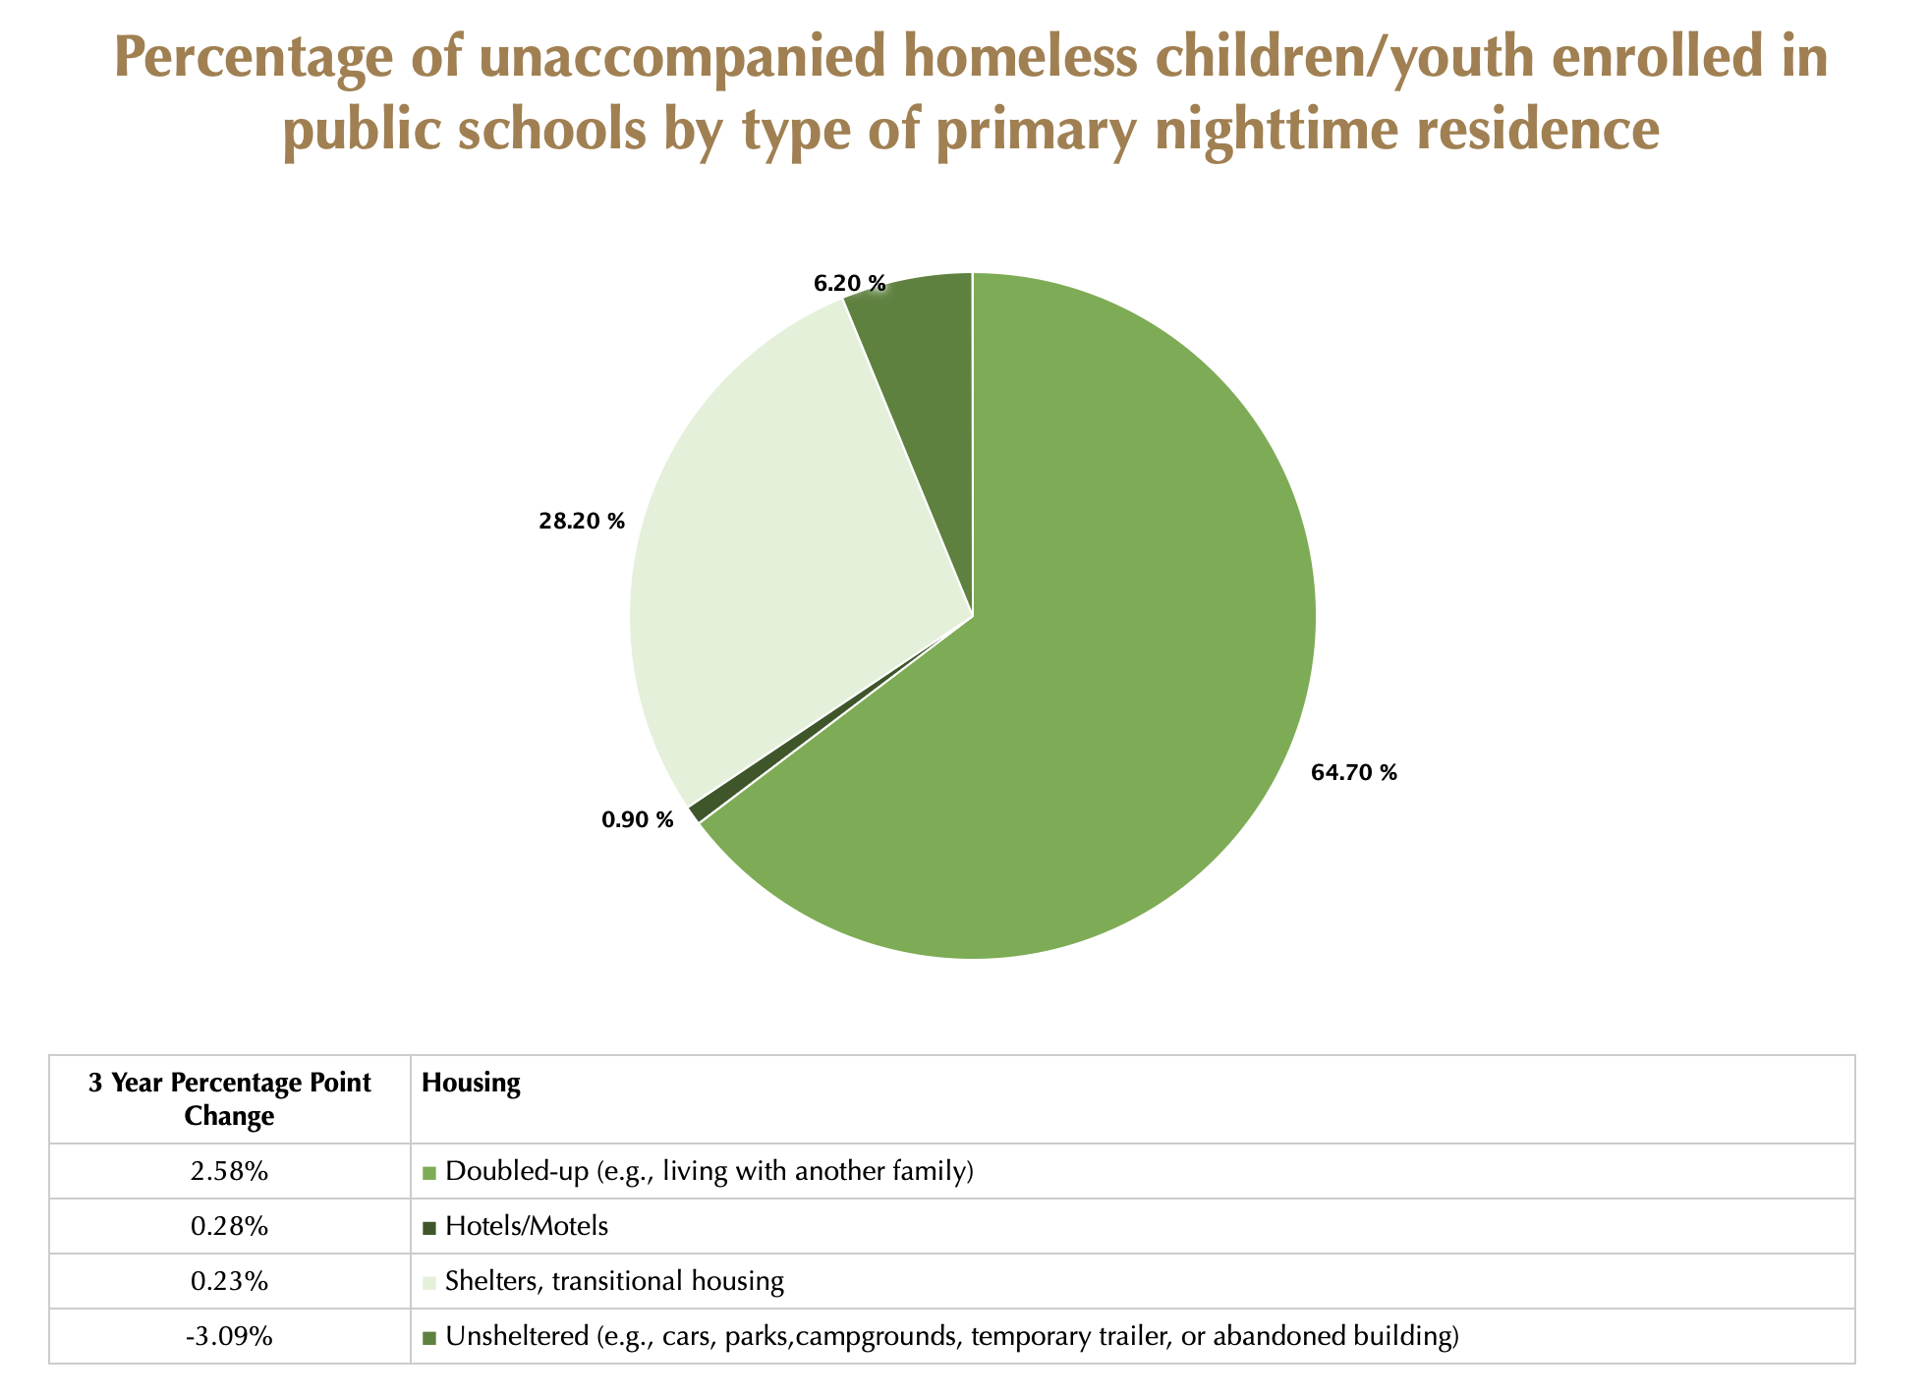

Slide 12
Here is what we know about young children and families who experience homelessness:
The number of young children experiencing homelessness has reached a historic high.
  According to recent federal data, more than a million children under the age of 6 were identified as experiencing homelessness.
Children who are experiencing homelessness have more developmental, health, emotional, behavioral, and learning challenges than their peers.
Homelessness can create barriers to participating in early childhood and school-age childcare programs.
  Such programs can help lessen the negative effects of homelessness on children and assist families in succeeding.
    Moving frequently is an example of a barrier.

Slide 13
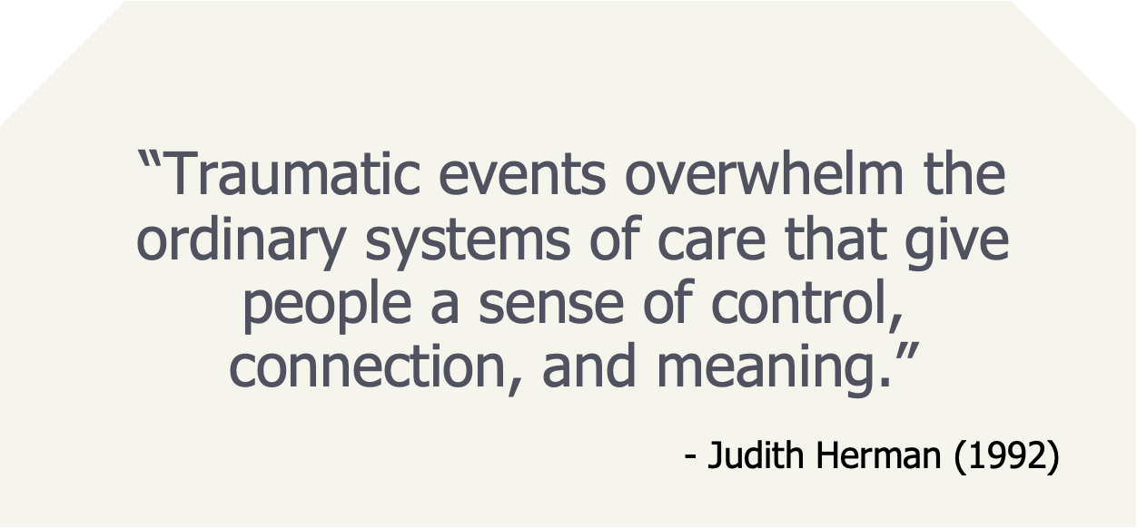
Notes:
DEFINITION OF TRAUMA by Judith Herman Excerpt from J. Herman, Trauma and Recovery: The Aftermath of Violence – from Domestic Abuse to Political Terror, New York: Basic Books (1992), 33. “Psychological trauma is an affiliation of the powerless. At the moment of trauma, the victim is rendered helpless by overwhelming force. When the force is that of nature, we speak of disasters. When the force is that of other human beings, we speak of atrocities. Traumatic events overwhelm the ordinary systems of care that give people a sense of control, connection, and meaning.
Judith Herman is a psychiatrist, trauma researcher and author who was a pioneer in the field of trauma research

Slide 14
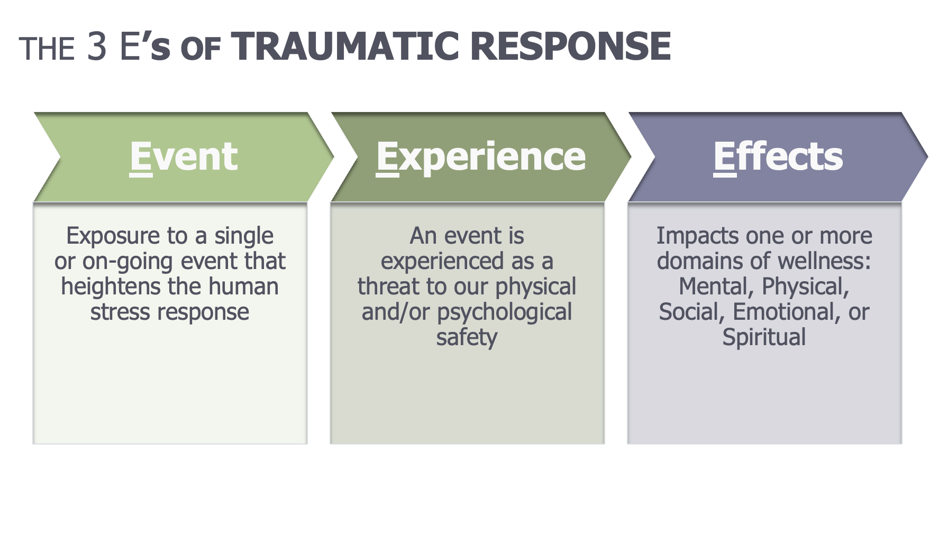
Notes:
We can’t remove exposure to traumatic experiences, but we can shift the response to exposure in self, others and community/organizations through trauma responsive practices. With knowledge comes opportunities for resilience.
When we think about trauma, it’s useful to remember the three E’s:
Emotional or Psychological trauma results from an Event, series of events such as accidents, disasters rape or abuse, or set of circumstances that could include living with severe poverty or in a chronically stressful home.
The event is Experienced by an individual as physically or emotionally harmful, threatening or life altering, outside of their control or overwhelming their ability to cope and has lasting Effects on a person’s mental, physical, social, emotional, or spiritual well-being.
The person’s subjective experience of the event or events is the critical feature of emotional trauma. Two people exposed to the same event, events or set of circumstances can have very different outcomes depending on complex relationships between the individual and their environment, past experiences, cultural and gender identities, developmental stage and protective factors.
Emphasize that the Experience represents our opportunity to BUFFER. By listening to the whole story of what happened to the individual, we can better help people cope with the short- and long-term impact of trauma.
We will be talking more about the effects and the domains of wellness as we move forward

Slide 15
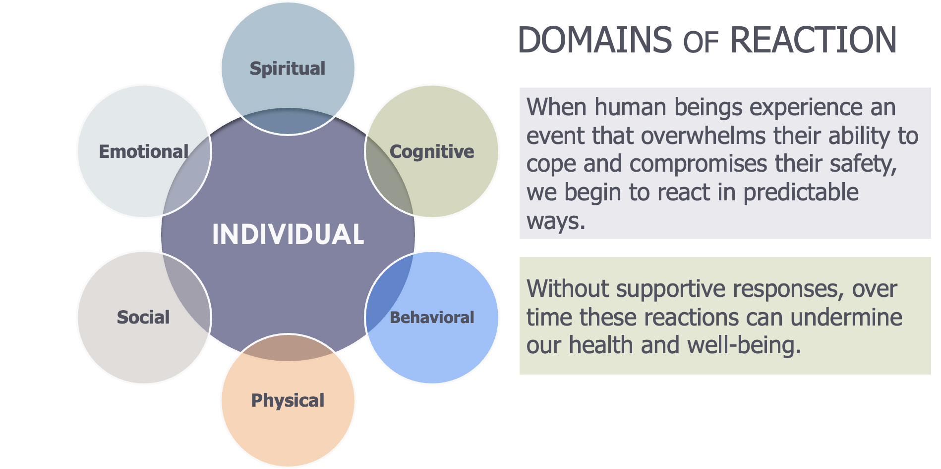
Notes:
Reference Handout 1 – Common Reactions by Domain
Discuss slide and provide or ask participants for examples. This helps us understand the 3rd E - Effects
•Spiritual – worldview, sense of identity, crisis of faith
•Cognitive – flashbacks, nightmares, intrusive thoughts
•Behavioral – avoidance, numbing with substances
•Physical – fight/flight/freeze (human stress response) is engaged to survive. Review in greater detail in Module 2
•Social – withdrawal, difficulty with trust, establishing or keeping relationships
•Emotional – anger, sadness, fear, heightened reactivity

Slide 16

Notes:
Post video Activity option – Pair-Share: Instruct participants to turn to a partner and answer these questions. Allow 2-3 minutes
•What stood out to you?
•What did you already know?
•What action do you want to take?
•In large group take 2-3 answers

Slide 17
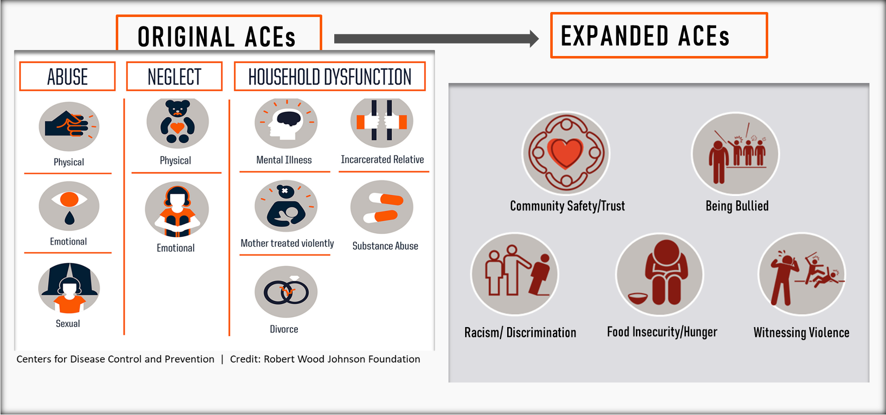
Notes:
The ACE Study revealed five main discoveries:
•ACEs are common…nearly two-thirds (64%) of adults have at least one.
•They cause adult onset of chronic disease, such as cancer and heart disease, as well as mental illness, violence and being a victim of violence.
•ACEs don’t occur alone….if you have one, there’s an 87% chance that you have two or more.
•The more ACEs you have, the greater the risk for chronic disease, mental illness, violence and being a victim of violence. People have an ACE score of 0 to 10. Each type of trauma counts as one, no matter how many times it occurs.
Subsequent studies with more diverse samples have been conducted with similar findings Reference the Philadelphia ACEs Study and the handout on page X of Participant Guide]. More recent research has expanded the list of ACES to include experiences such as exposure to community violence, being bullied, exposure to racism and discrimination, and being in foster care or institutionalized
ACEs research has led to greater research on understanding the neurobiological connection between adversity and health as well as what promotes resilience, healing and recovery, which we will be covering in future modules.

Slide 18
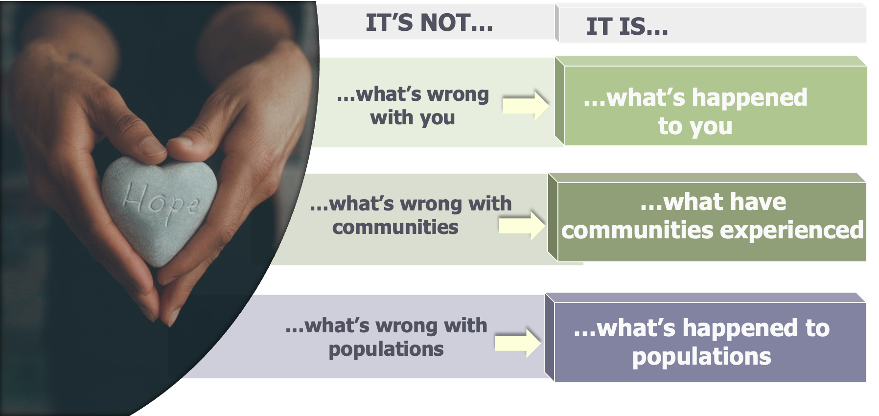
Shifting Perspectives
Notes:
Through this training our goal is to create a shift in how communities, organizations and individuals think about others. When we adopt a mindset of curiosity instead of blame and judgment, we are moving toward a Trauma-Informed approach to our interactions with others. We are better positioned to listen and learn and support where and how its needed. We can engage with compassion to practice, procedure and policy to increase individual, organizational and collective wellness. We’ll continue to deepen our knowledge and expand our skills over this series to achieve this goal.
Specifically, addressing trauma requires a different question that moves beyond "what's wrong with you?" - a deficit oriented mindset – to “what happened to you” - a mindset of compassionate curiosity about the role of trauma in someone's life

Slide 19
How Does a Trauma Informed
Approach Work in PTA?
A trauma-informed approach recognizes that trauma impacts many children and youth in our schools. PTA programs and events should strive to create a safe and supportive environment for them and their families through understanding and compassionate interactions.

Slide 20
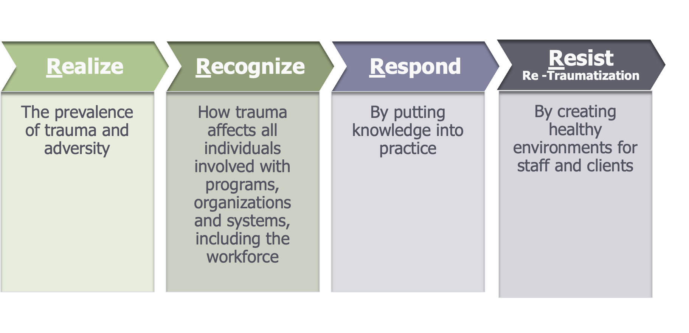
The 4 R’s of Trauma-Informed Practice
Notes:
Here is what we mean when we say that anyone can be trauma-informed and trauma-responsive. When we consider a trauma informed approach, we are really looking at how a treatment provider, program, agency, organization or community thinks about and responds to those who have experienced or may be at risk for experiencing trauma
The 4 R’s Of Trauma Informed Care
Realizing (Knowing)–New York State has provided significant investment in increasing capacity around realizing the prevalence of trauma and adversity as well as the impact on growth and development. We need to stay vigilant and make sure that new professionals continue to gain this knowledge. In this module we are taking a deeper dive into the more nuanced aspects of Recognizing and Responding
•All people at all levels of an organization should have a basic understanding about trauma & the effects of trauma
•Trauma should be systematically addressed in treatment and recovery settings
•Because trauma experiences are not confined to the behavioral health service sector, it should be understood across systems of care for the most effective outcomes
•
Recognizing (Seeing)
•People in organizations/systems are able to recognize signs of trauma and how trauma affects how an individual perceives and interacts with the world
•May be experienced by both those seeking services and those providing
•Everyone would benefit from trauma-informed approach
Responding (Action/Doing)
•Programs, organizational systems respond by applying principals of trauma-informed care
•Responses can include: services, policies/procedures, environmental changes
•Organizations have a culture based on beliefs about resilience, recovery & healing
Resist Re-Traumatization
•Create physically and emotionally safe environments for staff and clients
•Teach staff to recognize how organizational practices may trigger painful memories (re-traumatizing clients)

Slide 21
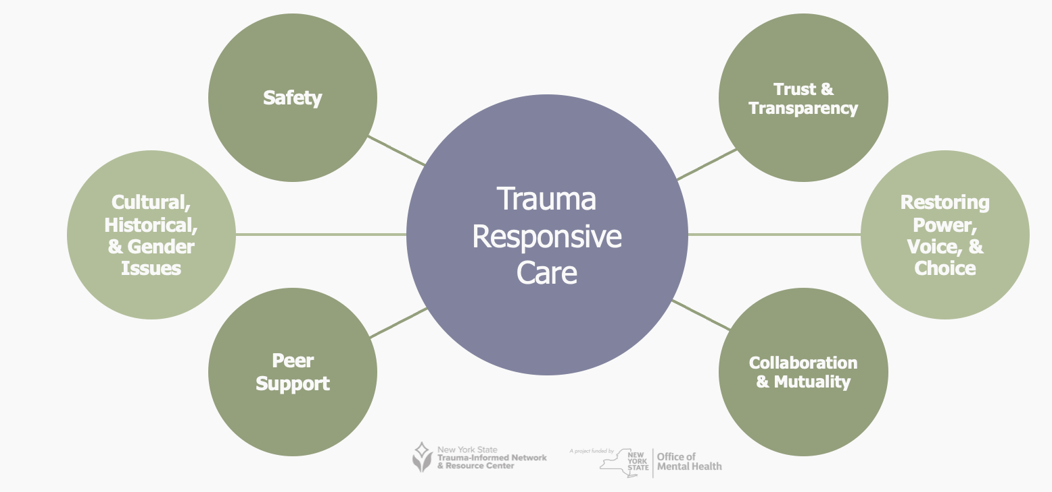
Core Values of Trauma-Responsive PTA
The Core Values of a Trauma-Responsive PTA are infused into all aspects of the work our association and apply to our leaders, volunteers, and community members.
Notes:
Safety
Before any other needs can be addressed with colleagues or clients, we must establish a sense of safety. Once safety is felt, our brains are open to relationship building and learning. Because we know that people exposed to trauma and chronic stress are often self-critical and self-blaming, organizations and individuals must adopt a non-judgmental approach about trauma in all communication with people and promote physical, emotional and cultural safety
Trust & Transparency
We know that exposure to trauma and adversity can promote distrust of others. As a result, organizations and individuals must communicate clear, consistent messages (common language) and follow through with expected behaviors/actions.
Restoring Power (Empowerment), Voice & Choice
Creating the conditions so that people have the opportunity to exercise their power – voice and choice – can be stepping back to create the space for others or stepping up to exercise our voice​
Collaboration & Mutuality
Sharing power with others through authentic collaboration
Peer Support
Peer support is the “process of giving and receiving encouragement and assistance to achieve long-term recovery. *MHANational.org
Peer supporters “offer emotional support, share knowledge, teach skills, provide practical assistance, and connect people with resources, opportunities, communities of support, and other people” (Mead, 2003; Solomon, 2004). In behavioral health, peers offer their unique lived experience with mental health conditions to provide support focused on advocacy, education, mentoring, and motivation
Cultural, Historical & Gender Issues
This is the explicit intersection in all areas of systems with educating staff about racial equity work, working to implement anti-racist and anti-oppressive practices as well addressing other biases and inequities based on gender, sexual orientation, etc.

Slide 22
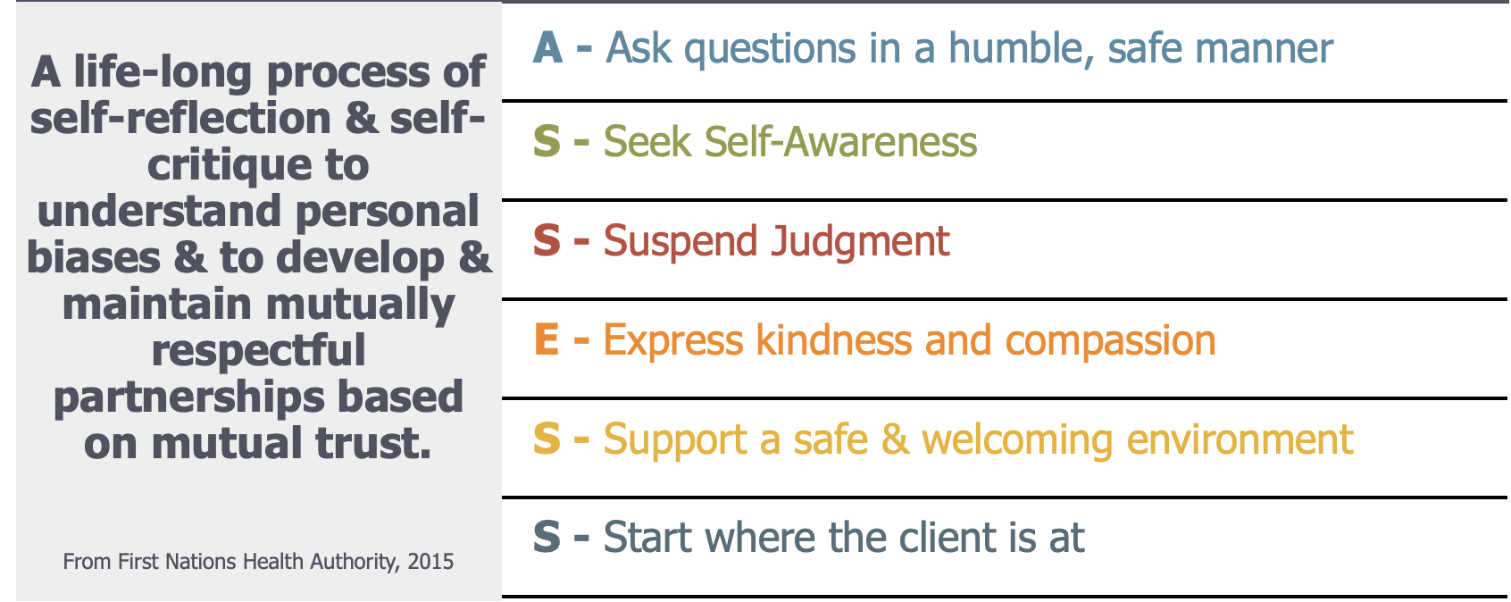
BUILDING CULTURAL RESPONSIVENESS:
CULTURAL HUMILITY
Notes:
The journey toward Culturally Responsive & thus, trauma responsive, organizations starts with us each as individuals through the practice of Cultural Humility.
Cultural humility is a term coined by Melanie Tervalon and Jann Murray-Garcia in 1998 to describe a way of incorporating multiculturalism into their work as healthcare professionals. Replacing the idea of cultural competency, cultural humility was based on the idea of focusing on self-reflection and lifelong learning.
•To encourage personal reflection and growth around culture in order to increase service providers' awareness
•Introspection
•Co-learning
•Encourages lifelong learning with no end goal but rather an appreciation of the journey of growth and understanding
•Puts professionals and clients in a mutually beneficial relationship and attempts to diminish damaging power dynamic
Review action steps from slide:
Practice Cultural Humility – Being Compassionately Curious
ASSESS:
A – Ask questions in a humble safe manner
S – Seek self-Awareness
S – Suspend judgment
E – Express kindness & compassion
S – Support a safe and welcoming environment
S – Start where your client is at
Refer to Handout 13 with guided cultural humility activity

Slide 23
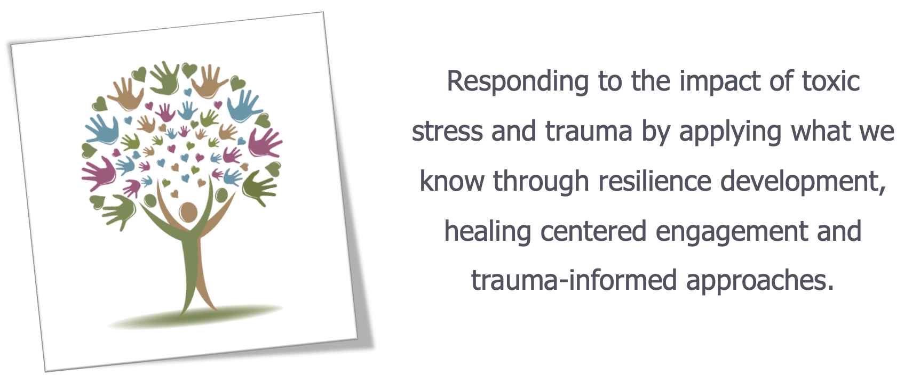

Slide 24


Building & Sustaining Trauma-Responsive Organizations
Notes:
•When we think about change, it will look/feel different to different people and within different organizations.
•A starting place is where we have power or influence. Normalize that this will be a range for everyone. There is no wrong starting point.
•Use your circle of influence and as it grows, grow your action (Laura Porter )
•Through this lens, begin to think about what this means for your role, your team and the organization as a whole
Transactional Steps
There are concrete actions and steps that we can and will take
Transformation
What is my way of being? How to I do I show up and how do I enter into relationship with others. This is where transformation begins.

Slide 25
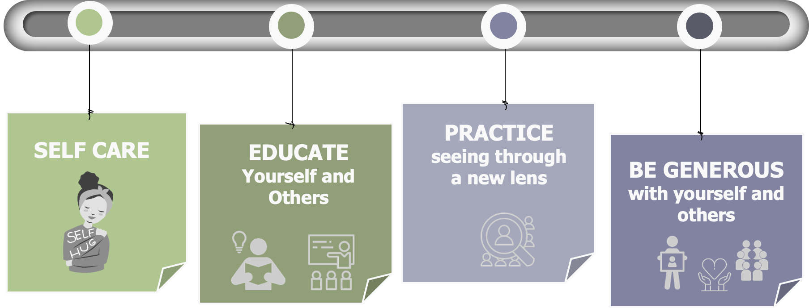
START with YOURSELF
Notes:
Facilitator:
Review the slide noting that individuals will begin where it makes sense for them. It may be in one area or in several.
Self-care - Provide Handout 16 for participants to create own self-care plans
•Start with ourselves – if we are depleted, we are unable to give to others
•Pace yourself; take breaks when possible and take time off from work
•Develop your own list of self-soothing activities that “fit” at work - and use them
•Breathing, relaxation, meditation
•Walk
•Stand in the sun
•Stretch
•Text or call a friend
•Watch a funny video on your phone
•Color
Educate Self
•Engage in education/training for new understanding and skills
•Take advantage of supervision/consultation
Seeing Through a New Lens
•It can be easy to revert to habitual thinking. How do you keep new perspectives in the forefront?
•Reminds yourself that interpretation drives intervention
•Why might someone be reacting that way? What is the unmet need?
Be Generous
•Identify strengths
•Your own
•Colleagues’
•Clients’
•Share them with others – “I noticed you are really good at managing your time. Can you give me a pointer?”

Slide 26

Putting Knowledge Into Practice…
What is one NEW ACTION that you can put into practice tomorrow?

