Slide 1

Family Matters
When Self Care is Easier Said than Done:
Support for Caregivers and Families
Lissa Zukoff
NYS PTA Special Education Specialist
specialeducation@nyspta.org

Slide 2


PTA MISSION
To make every child's potential a reality by engaging and empowering families and communities to advocate for all children

Slide 3

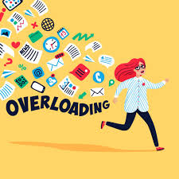


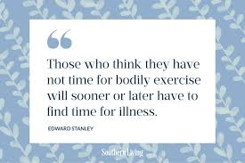
DON’T GO ON A SELF CARE GUILT TRIP!

Slide 4

MINDFULNESS MINUTE

Slide 5
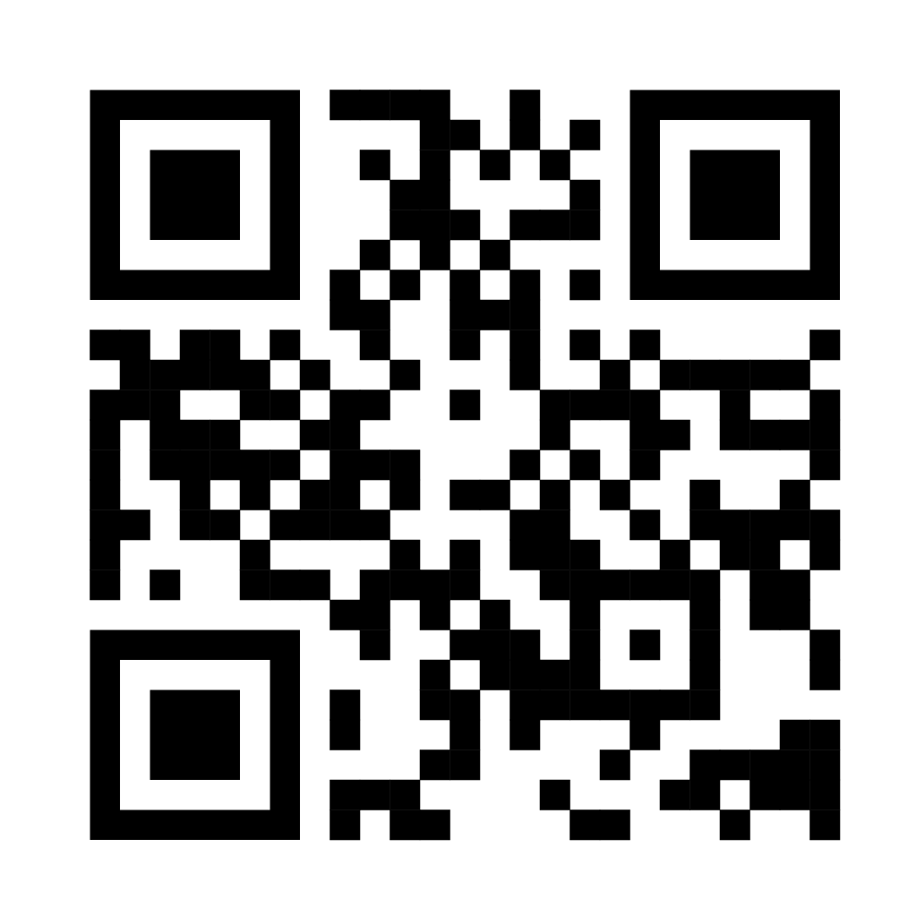
CAREGIVER BURNOUT
Caregiver burnout is a state of mental, physical, and emotional exhaustion that can occur when someone is responsible for the health and safety of another person. It can cause caregivers to feel tired, anxious, depressed, withdrawn, and stressed
Article: Coping with Burnout as a Parent of a Special Needs Child

Slide 6
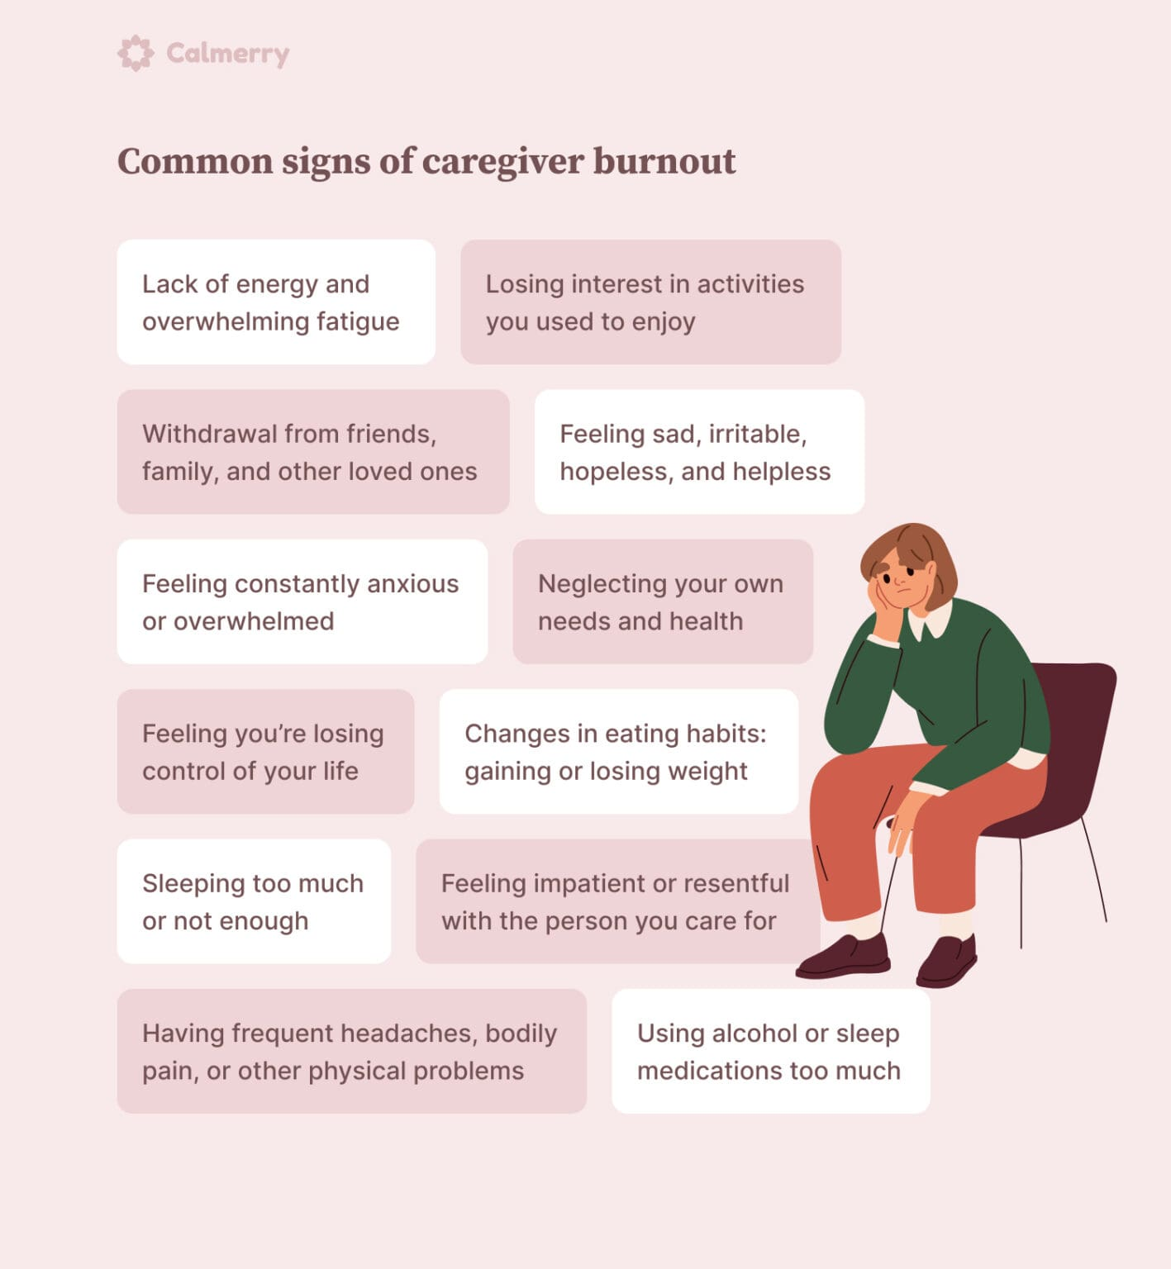
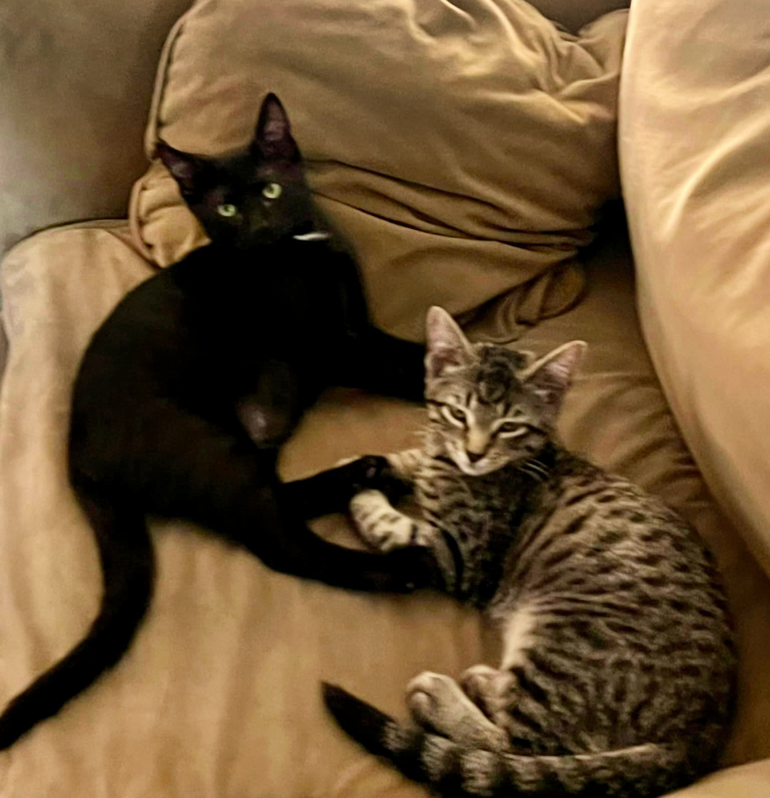

Slide 7
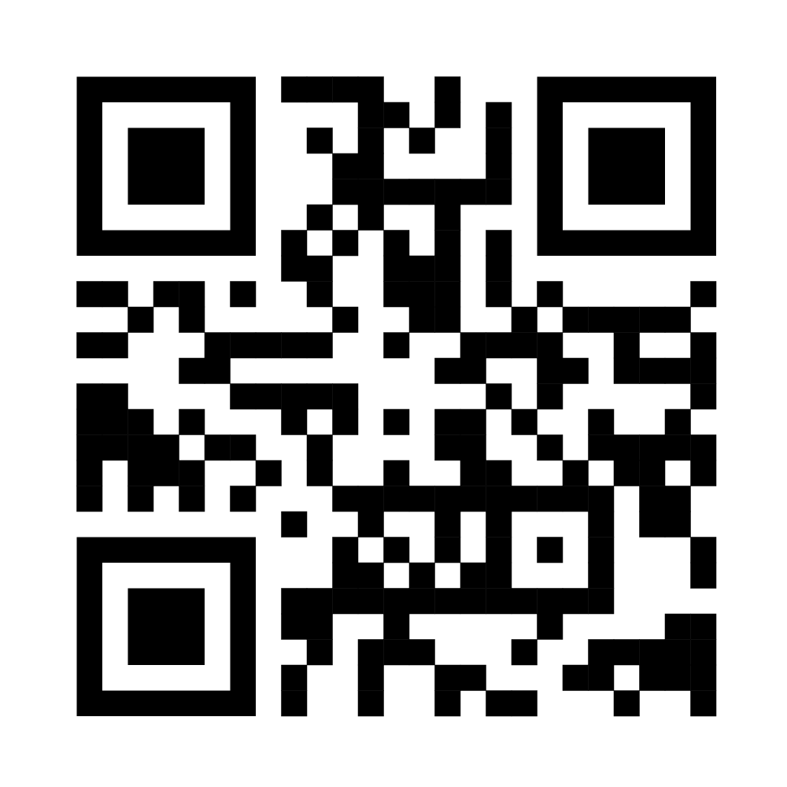
JUST THE FACTS
Forty-one percent of caregivers report low overall well-being — 32% more than non-caregivers.
Working Americans who also provide care to loved ones are predominantly women — at 56% versus 44% men
One in 5 caregivers have taken a leave of absence and/or a demotion to accommodate their caregiving duties.
When it comes to mental well-being, not even a quarter (23%) of caregivers report "good" mental health, and 40% say that their caregiving responsibilities negatively impact their stress levels.
Statistics from:
https://www.guardianlife.com/reports/caregiving-in-america

Slide 8
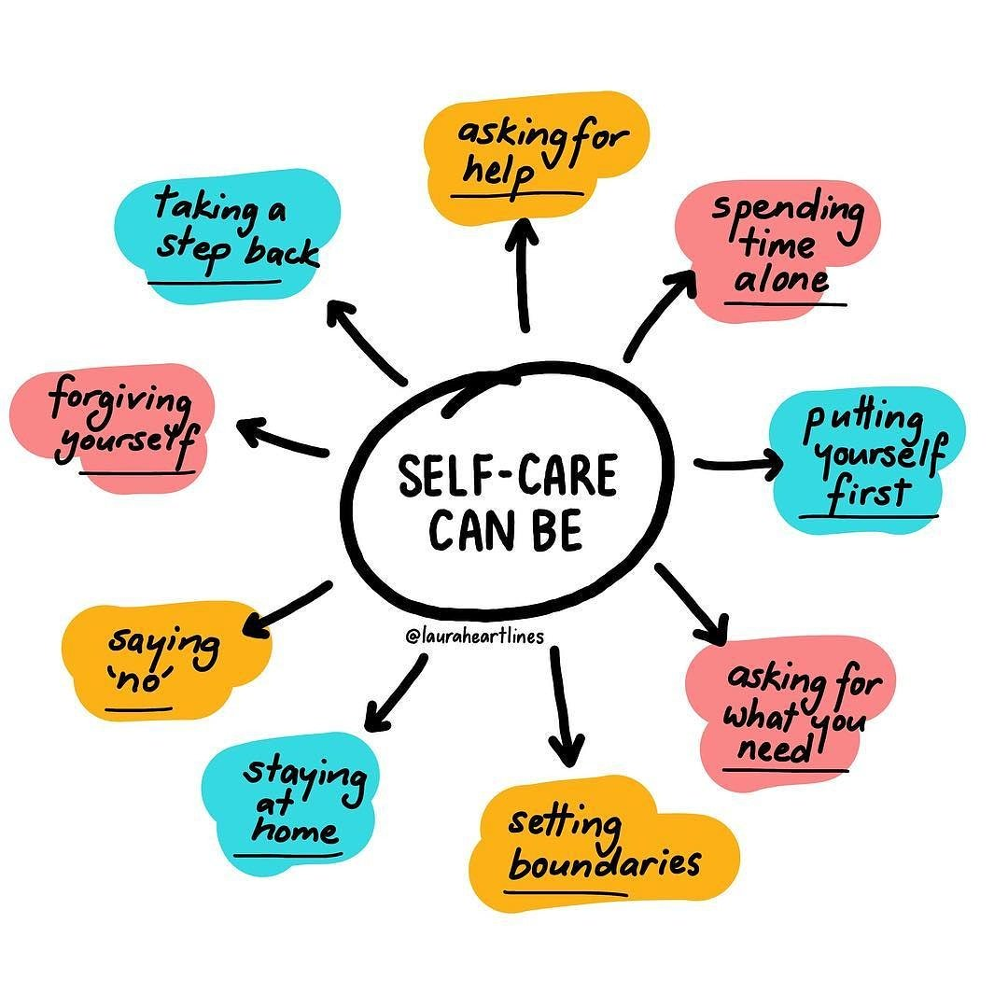
REFRAME HOW YOU THINK ABOUT SELF CARE
Call a friend
Have a treat
Use technology your way
Accept help
Read a book
Get dressed every day
Take care of your health
Buy the shoes
Puzzle Books
Hug someone
Join SEPTA
GIVE YOURSELF GRACE

Slide 9
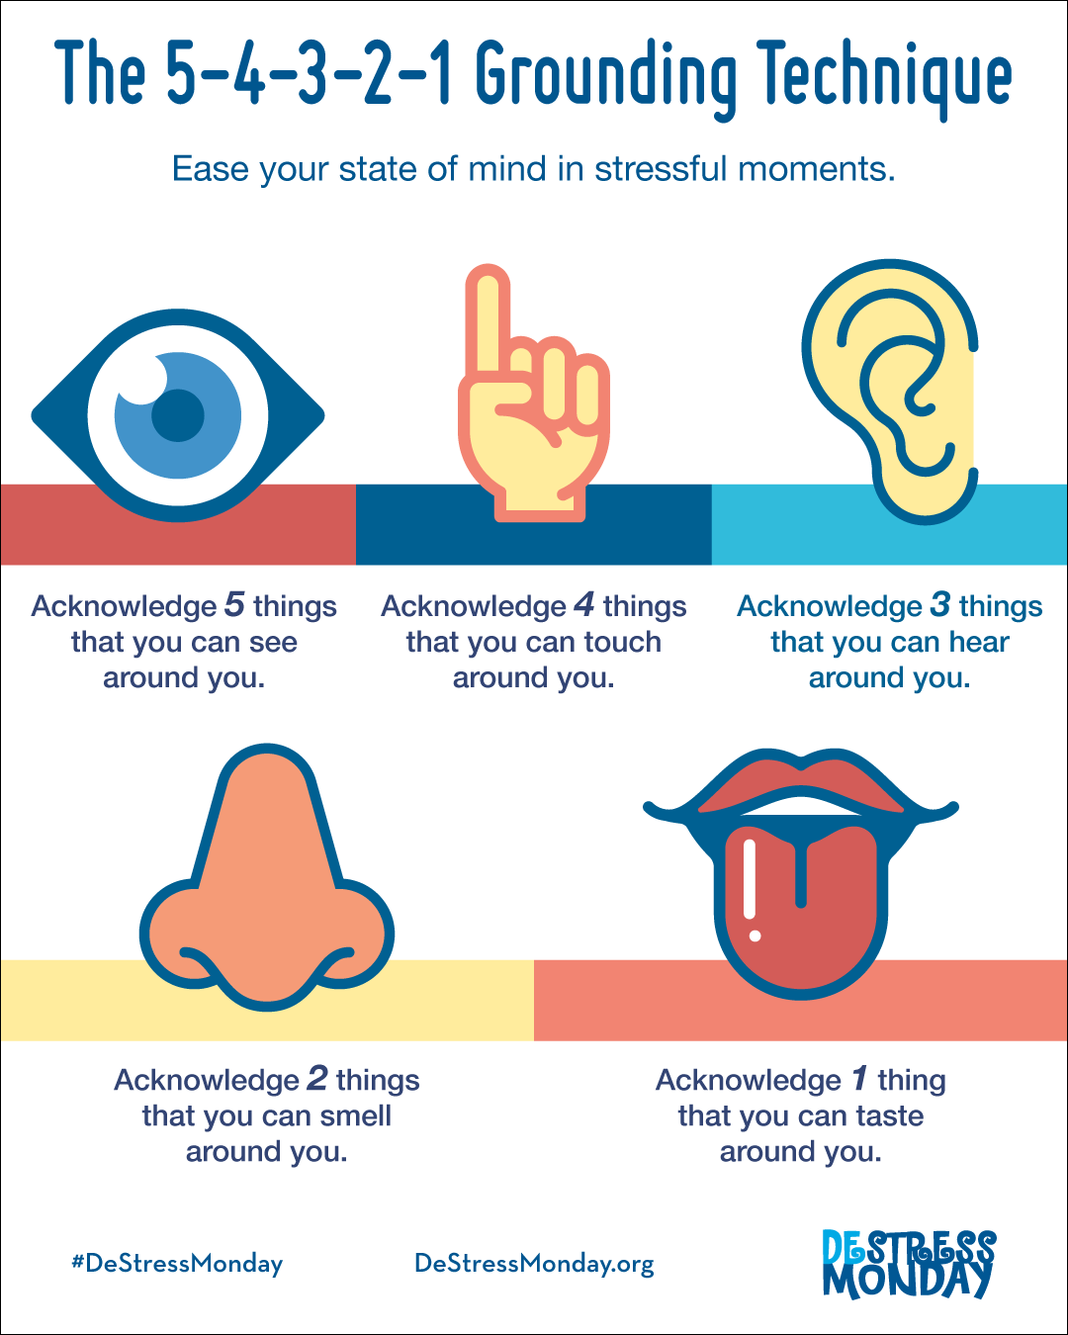
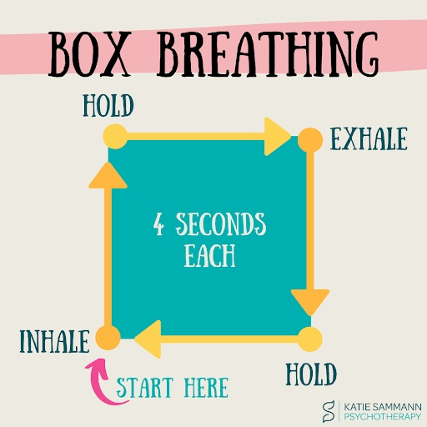
MINDFULNESS ACTIVITIES
Journal - set a timer
Chair Yoga
Meditate
Pray
Color
5-4-3-2-1 Technique
Box Breathing
Recognize something positive about yourself

Slide 10
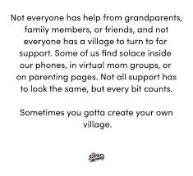
HOW CAN YOU SUPPORT FAMILIES?
Not Every Family Looks The Same
Be Inclusive
Ask the Questions
Share Resources
Communicate with School Personnel
Don’t Gossip

Slide 11
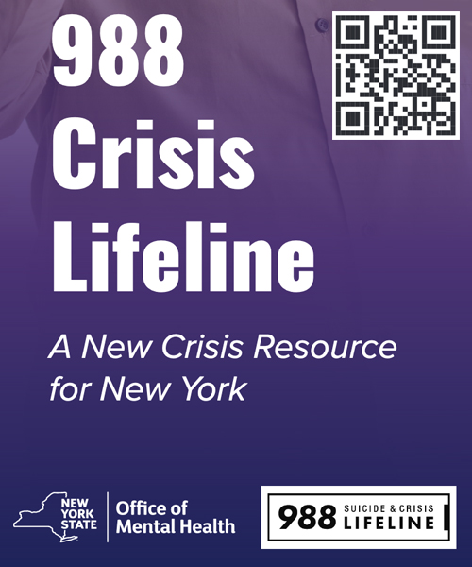
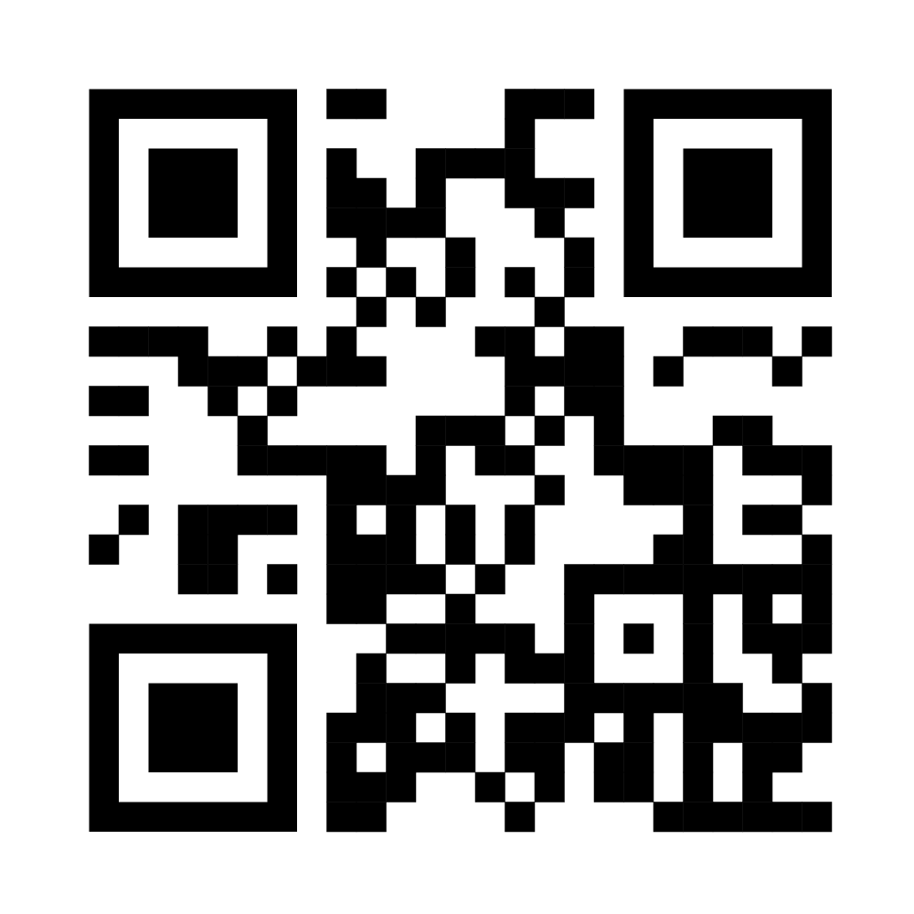
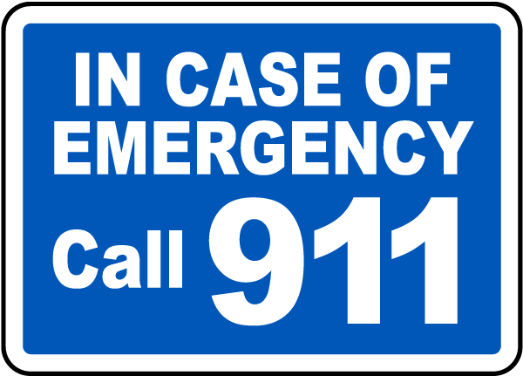
I’M NOT A DOCTOR & I DON’T PLAY ONE ON TV
NYS Crisis Prevention Hotlines & Education
https://omh.ny.gov/omhweb/bootstrap/crisis.html

Slide 12

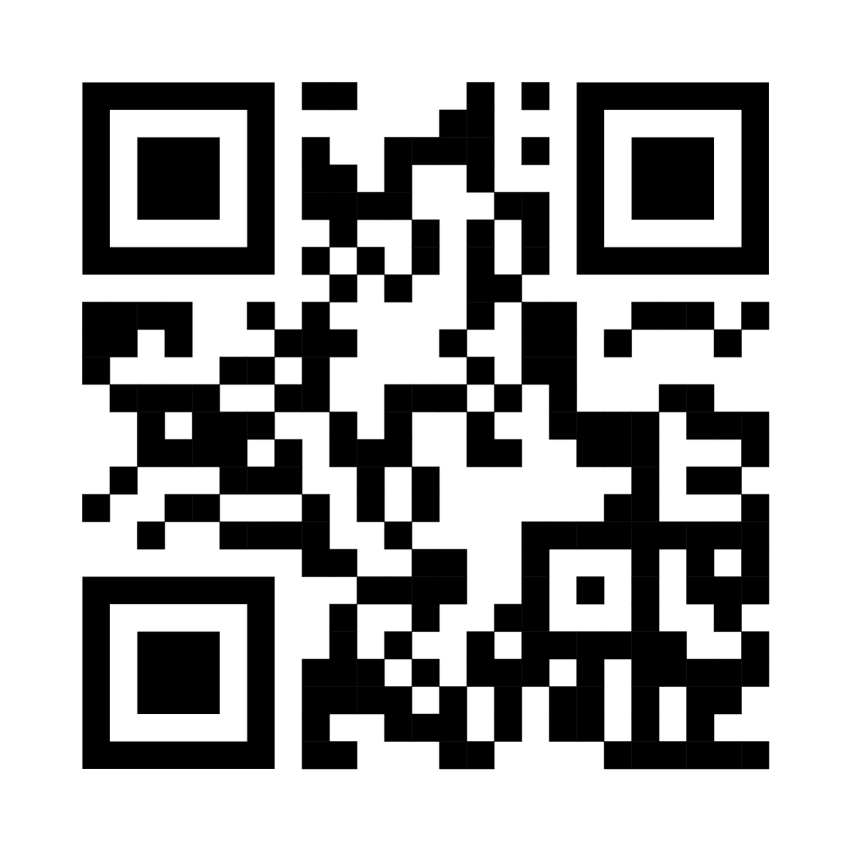
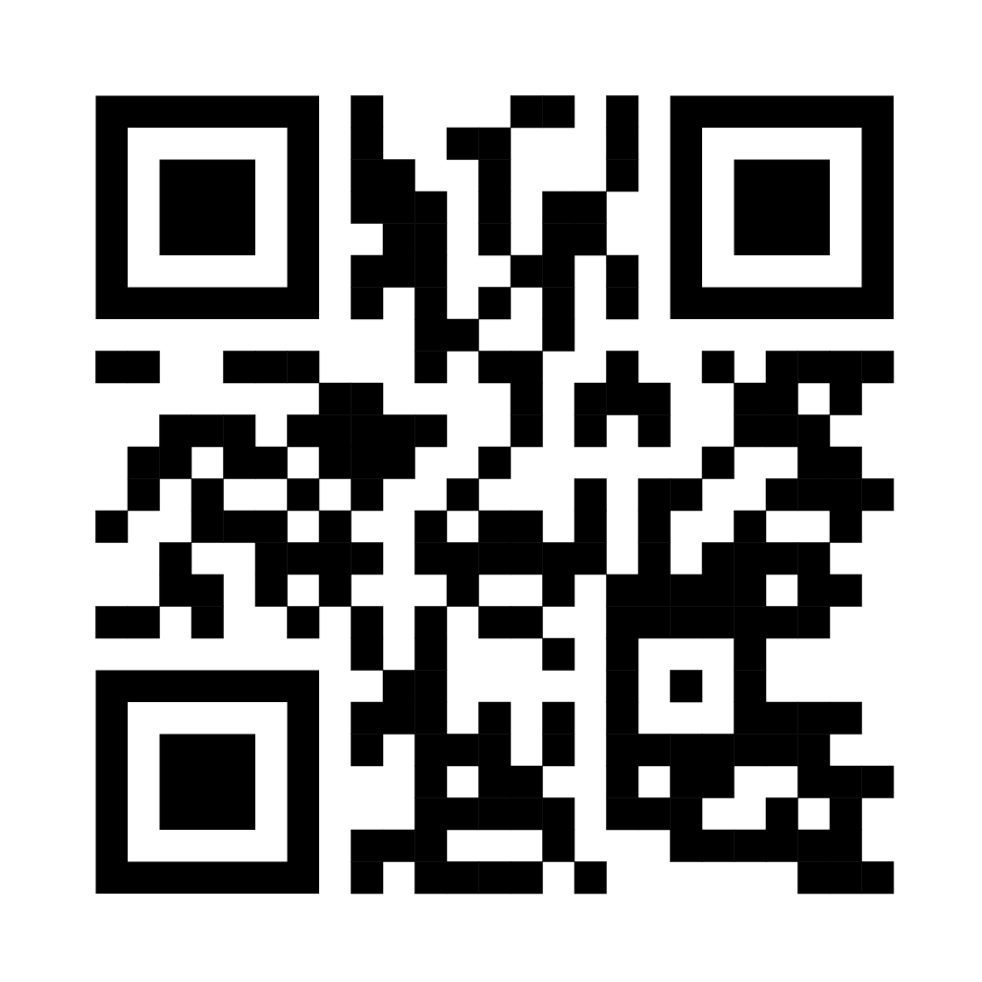
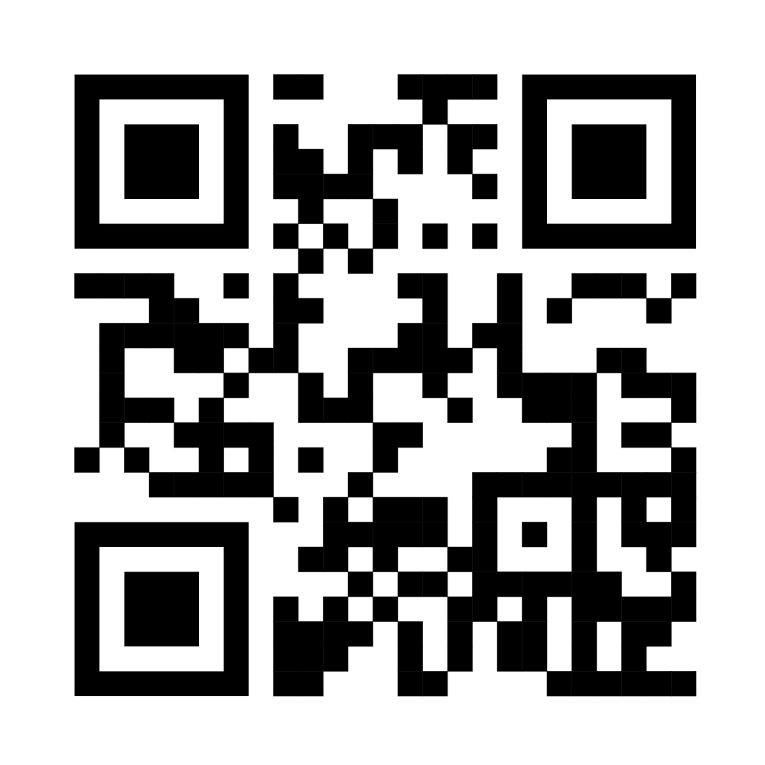
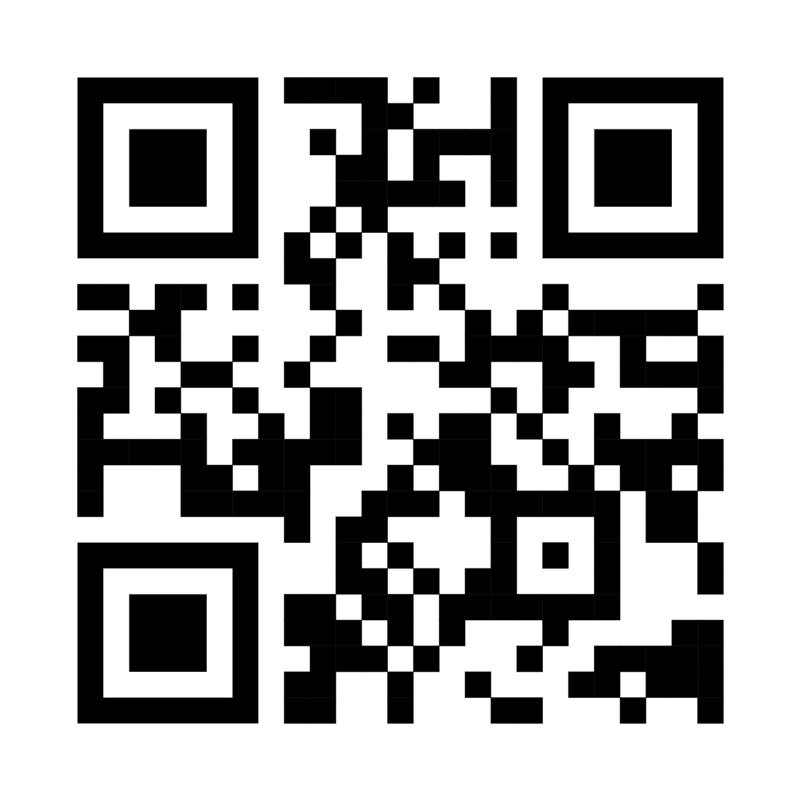
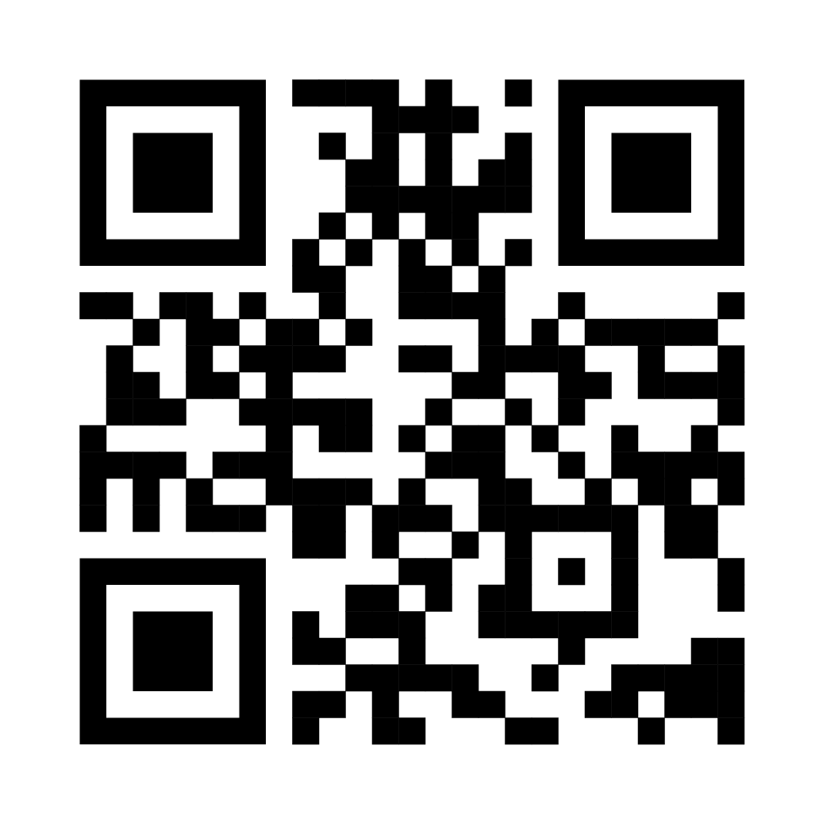
RESOURCES
Mental Health Association in New York State
Substance Abuse and Mental Health Services Administration (SAMHSA)
Taking Care of YOU: Self-Care for Family Caregivers
Mayo Clinic, Caregiver Stress Management
The U.S. Surgeon General Advisory on the Mental Health and Well-Being of Parents

Slide 13







Slide 14


Lissa Zukoff, Special Education Specialist
specialeducation@nyspta.org

