Slide 1

Hot Topics in Education
Amy Hysick, Education Coordinator
Megan Zarchy, Family Engagement Coordinator

Slide 2

Regionalization – NOT Reorganization
This is NOT a plan for BOCES to ‘take over’ school districts
It is a way to pool resources to offer more opportunities to students:
  Advanced coursework (AP or IB Courses)
  Extracurricular activities
  Shared staff
  Student Support Services
The idea is to create more equitable opportunities for ALL students and use financial resources wisely

Slide 3
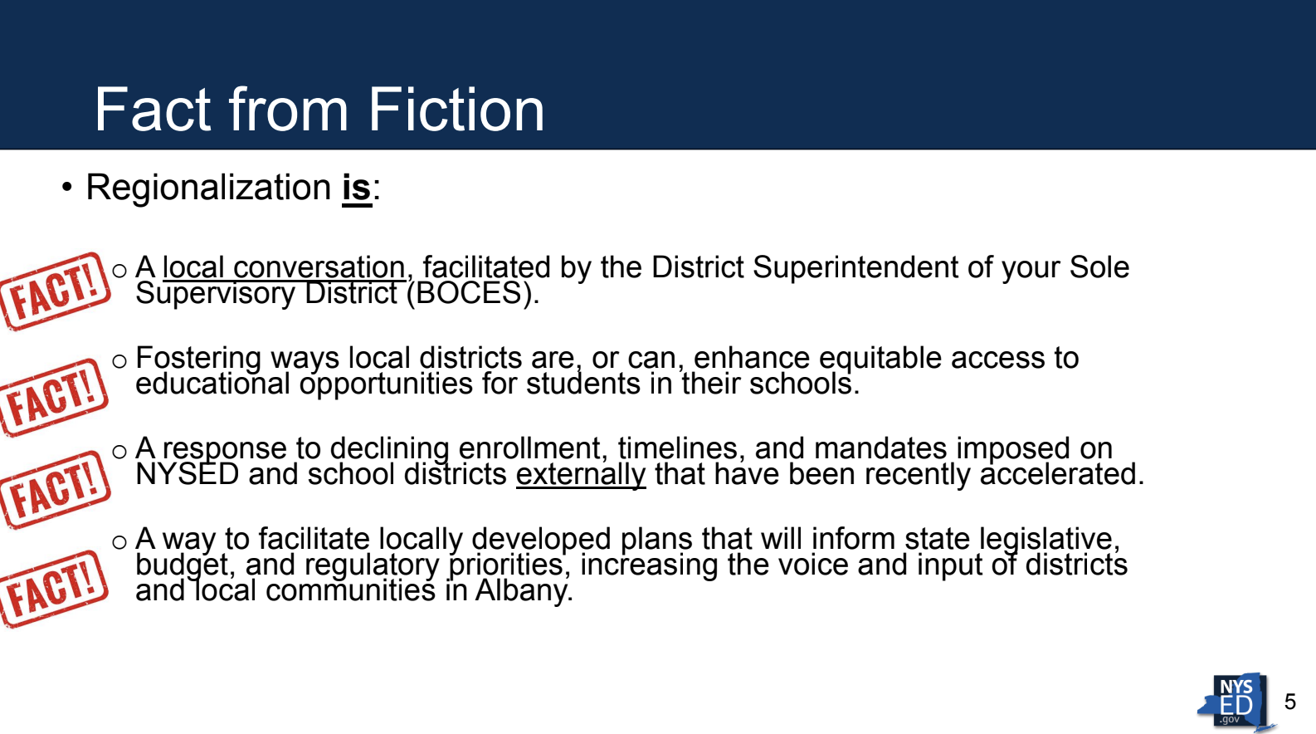

Slide 4
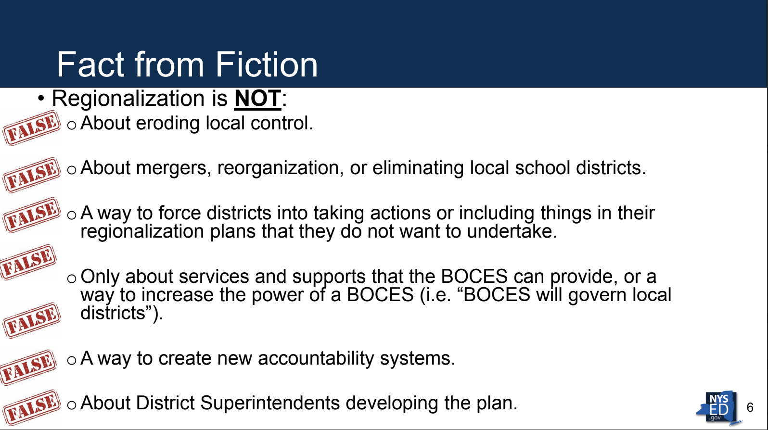

Slide 5
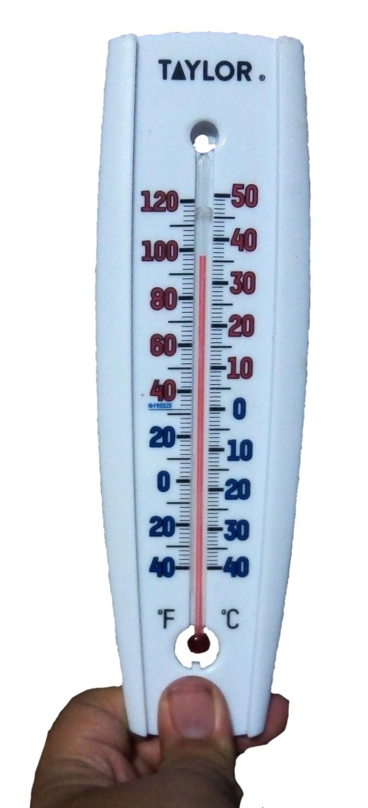
Maximum Temperature Regulations
** S3397a/A9011 Establishes a maximum temperature in school buildings and indoor facilities (Awaiting governor’s signature)
** Also provides a definition of extreme heat condition days and the standard to measure room temperature.
** Amends education law by requiring extreme heat conditions to
be added to building level emergency plans developed by the building-level emergency response team

Slide 6
Maximum Temperature Regulations
** 82 degrees – school must take preventative action in learning space to mitigate heat (i.e. turning off lights, pulling down shades)
** 88 degrees – educational/support spaces MUST be vacated
** Act shall take effect September 1, 2025
** Does NOT require districts to install AC units in every classroom

Slide 7

Blue Ribbon Commission Recommendations
**

Slide 8
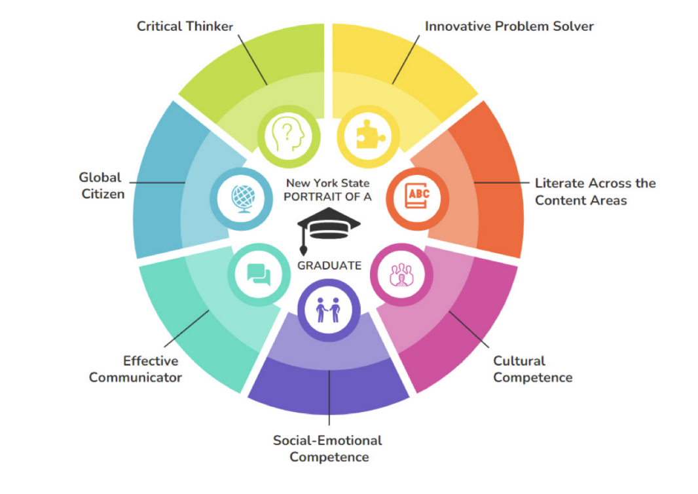
Portrait of a Graduate
Set of high-level skills, knowledge areas, and competencies that reflect successful outcomes of P-12 education.
Reflects what students should know, be able to do, and embody upon graduation.

Slide 9
Redefine Credits/Learning Experiences
Current regs = Carnegie units (180 min/week or 108 hours/year) for one diploma credit
Proposed change = move away from a time-based system to ways for students to demonstrate proficiency on learning standards & components of the Portrait of a Graduate
**But no details yet on HOW this will happen or what students need to do.
(Internships? Capstone projects? Project-based learning?)

Slide 10
Sunset Diploma Assessment Requirements
Students still need to be assessed locally – and 3-8 tests required by federal law
4+1 pathway won’t be used to fulfill diploma requirements (once adopted)
Plans to move to one diploma in Fall 2027
  Graduates starting in Jan 2028 and beyond will have a
  NY State High School Diploma

Slide 11

No more Regents exams?
There will still be Regents exams offered!!!
Satisfy current diploma requirements
Opportunity for students to demonstrate mastery
Students just won’t be required to pass them to graduate

Slide 12

Diploma changes
Current options:
Local/Regents/Regents with Advanced Designation/CTE
Seal of Biliteracy, Civic Readiness, Mastery in Math
Under the new changes:
ONE diploma with Seals
Allows students to demonstrate unique interests and
accomplishments - but still maintain graduation
requirements and standards

Slide 13
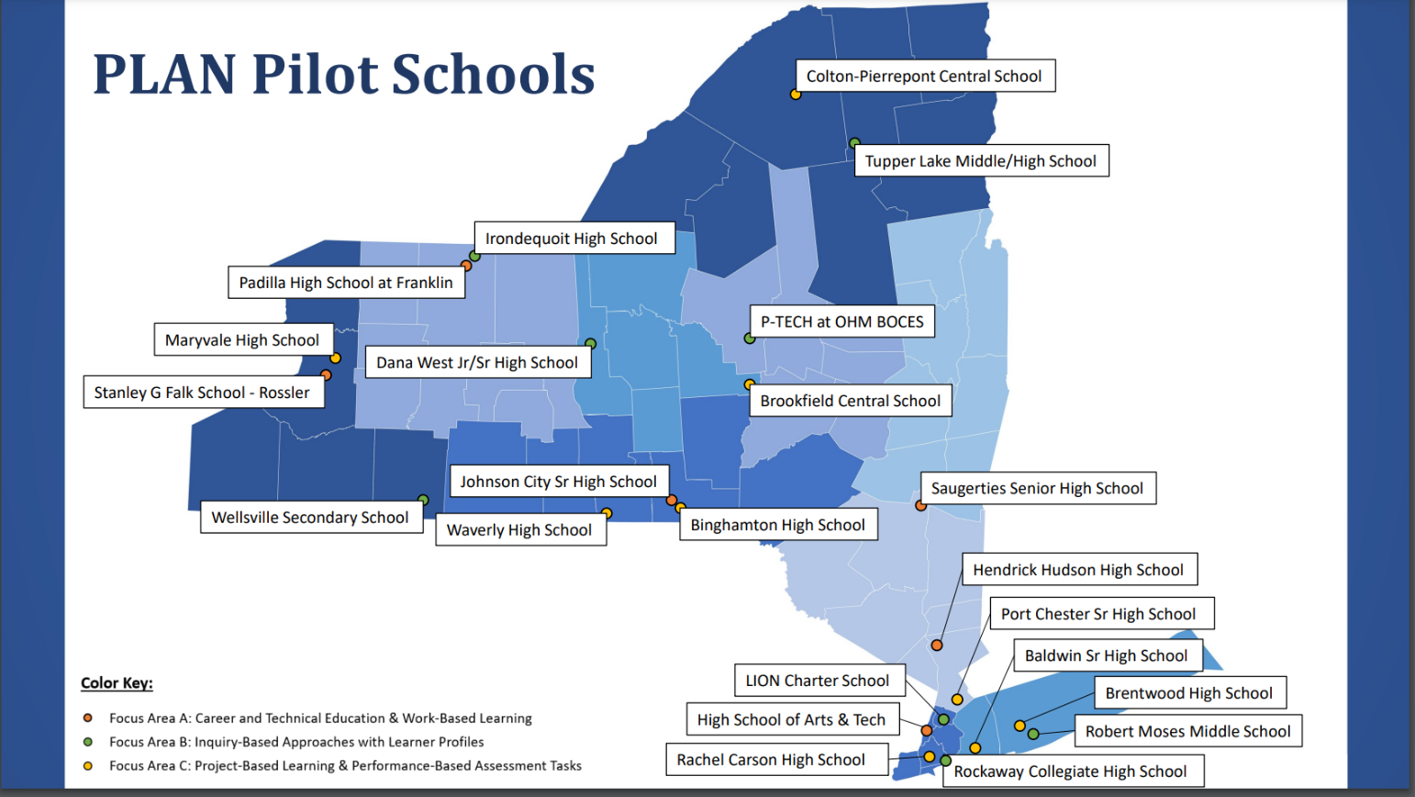
PLAN Pilot
** Studying how best to support networks of schools and educators in shifting their instructional practices
Each Pilot Network will adopt, adapt, and learn from successful models operating in one of the focus areas:
Career & Technical Education and Work-Based Learning
Inquiry-Based Approaches w/Learner Profiles
Project-Based Learning/Performance-Based Assessment Tasks

Slide 14
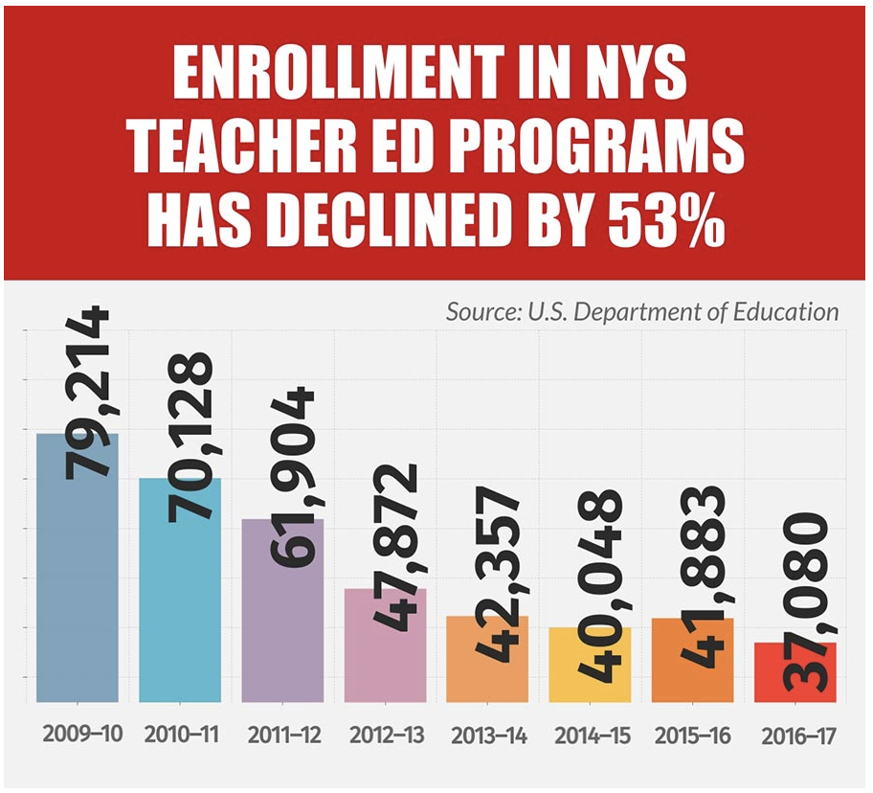
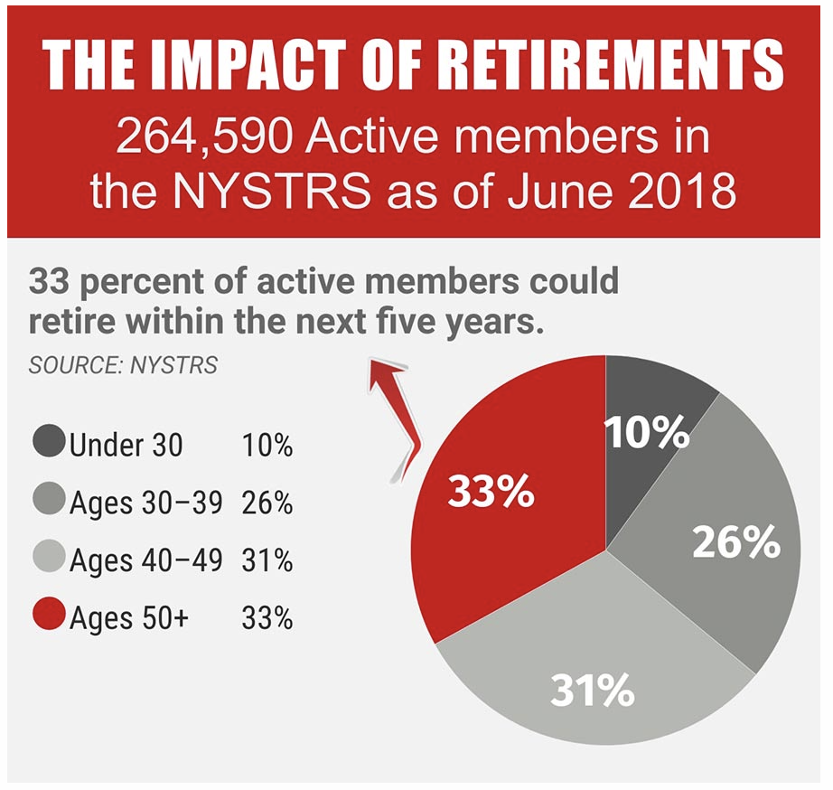
NY’s Teacher Shortage…
NYS Teacher Retirement System projects that ⅓ of NY’s teachers could retire in the next 5 years
US DOE identified EIGHTEEN teacher shortage areas across the state (10 years ago there were TWO.)
Information from NYSUT website

Slide 15


NY’s Teacher Shortage…
Requirements for teachers haven’t changed, but there are more pathways into the classroom for career changers
  Transitional certificates
  Residency/Apprenticeship programs
Information on certification and education requirements
Offers group or 1-on-1 coaching
Program finder to locate EPP’s
List of Registered Apprenticeship Programs
Paid position throughout placement
Tuition assistance for SUNYs

Slide 16
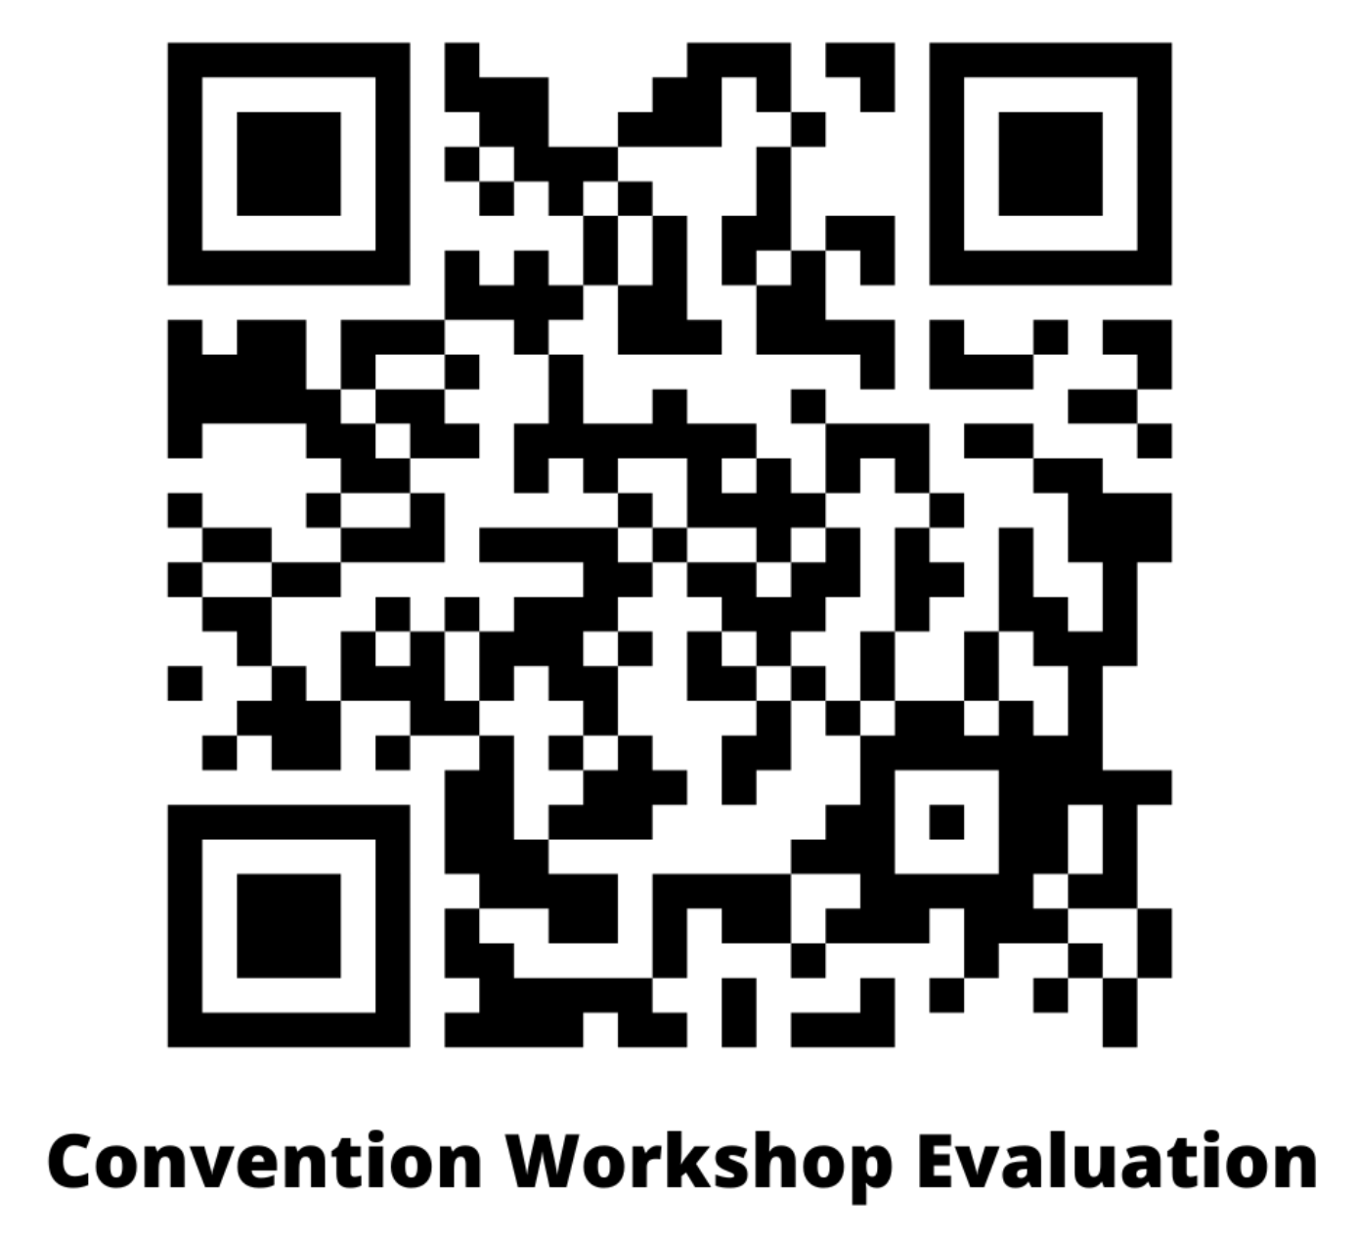
Thank you for coming!
Amy Hysick
education@nyspta.org
Megan Zarchy
family.engagement@nyspta.org
Please contact us if you have
questions!

