Slide 1



Recipe For Building A Competent Board
Presented by
Joan Wabnik
Vice-President NYS PTA
This Photo by Unknown Author is licensed under CC BY-SA
Notes:
Hello I am Joan Wabnik, Vice President of NYS PTA and welcome to Recipe For Building a Competent Board

Slide 2


Our Goals Today
Explore why some boards thrive or fail
Identify ways YOU can build your board and effective teams
Learn team building tips

Slide 3
PTA’s Mission
PTA”s mission is to make every child’s potential a reality by engaging and empowering families and communities to advocate for all children.

Slide 4
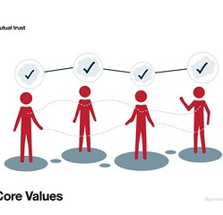
PTA VALUES
Collaboration
Commitment
Diversity
Respect
Accountability

Slide 5
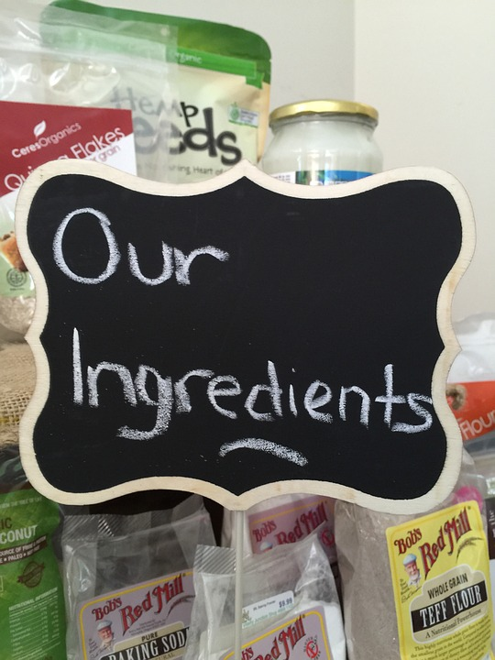

RECIPE
INGREDIENTS Recruit Orient Develop Assess
This Photo by Unknown Author is licensed under CC BY-SA

Slide 6

Recruit
Who is on your board matters
Diverse leaders- reflect the community
Invite new leaders-keeps the board updated
New members bring new ideas
Success of our leaders depends on the success of the members

Slide 7
Who is part of your board matters and why
This Photo by Unknown Author is licensed under CC BY-SA

Slide 8
Who is on the board matters
Essential to this recipe that the board reflect the diversity of its members and community
Members who have time to devote to the position assigned.
Is willing to participate in all board events and meetings
Each board member should understand the expectations for the position assigned

Slide 9

Orient

Slide 10

Orientation
Documents
Guidance
Meet other board members
Define positions
State expectations

Slide 11

Board Member Training
Welcomes new members
Encourages engagement from the beginning
Prepares members
Provides basic knowledge
Success of board members
Meet other board members

Slide 12

Documents for Board members
Bylaws
Procedures
Directory
Code Of Conduct
Calendar
This Photo by Unknown Author is licensed under CC BY-SA-NC

Slide 13

BYLAWS
Meetings required
List officers of Executive Committee
Members of the Executive Board
Annual meeting date
Amount of dues
Expiration of bylaws

Slide 14
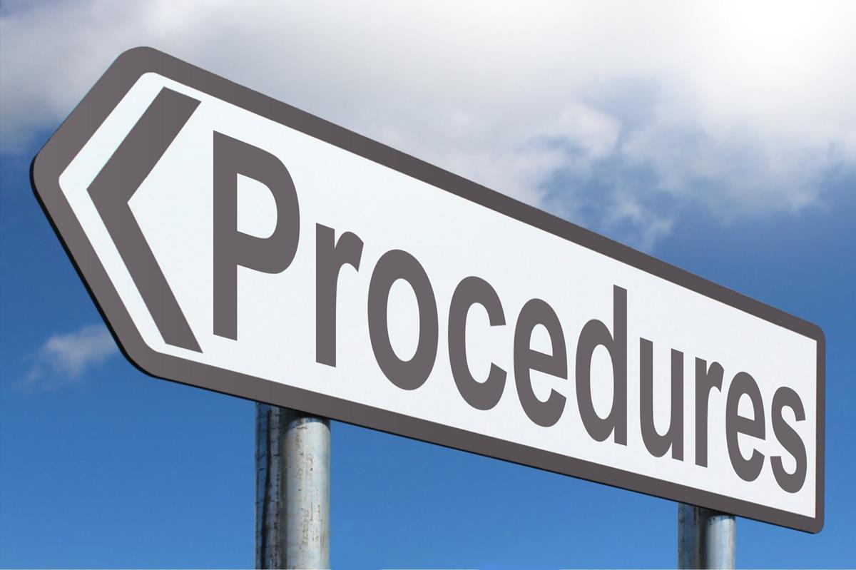
Procedures
Your specific roles and descriptions for officers and board chair positions can be found in your procedures. Keep in mind, these may vary from PTA to PTA depending on local needs
This Photo by Unknown Author is licensed under CC BY-SA

Slide 15

Directory
Contact information for board members
Recommend a generic email address
If board members except text message
Directory for board members only

Slide 16
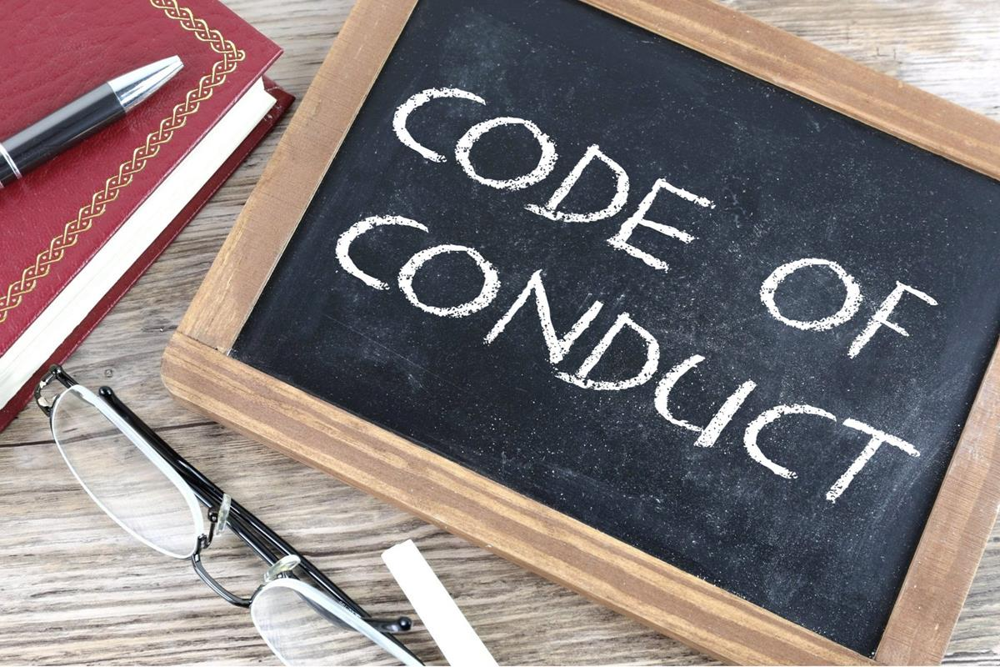
Code of Conduct
Located on the NYS PTA website, nyspta.org
Addendum to Resource Guide
Outlines what board members can or cannot do as a representative of NYS PTA
Each Board member should sign a copy
Discuss at Orientation

Slide 17
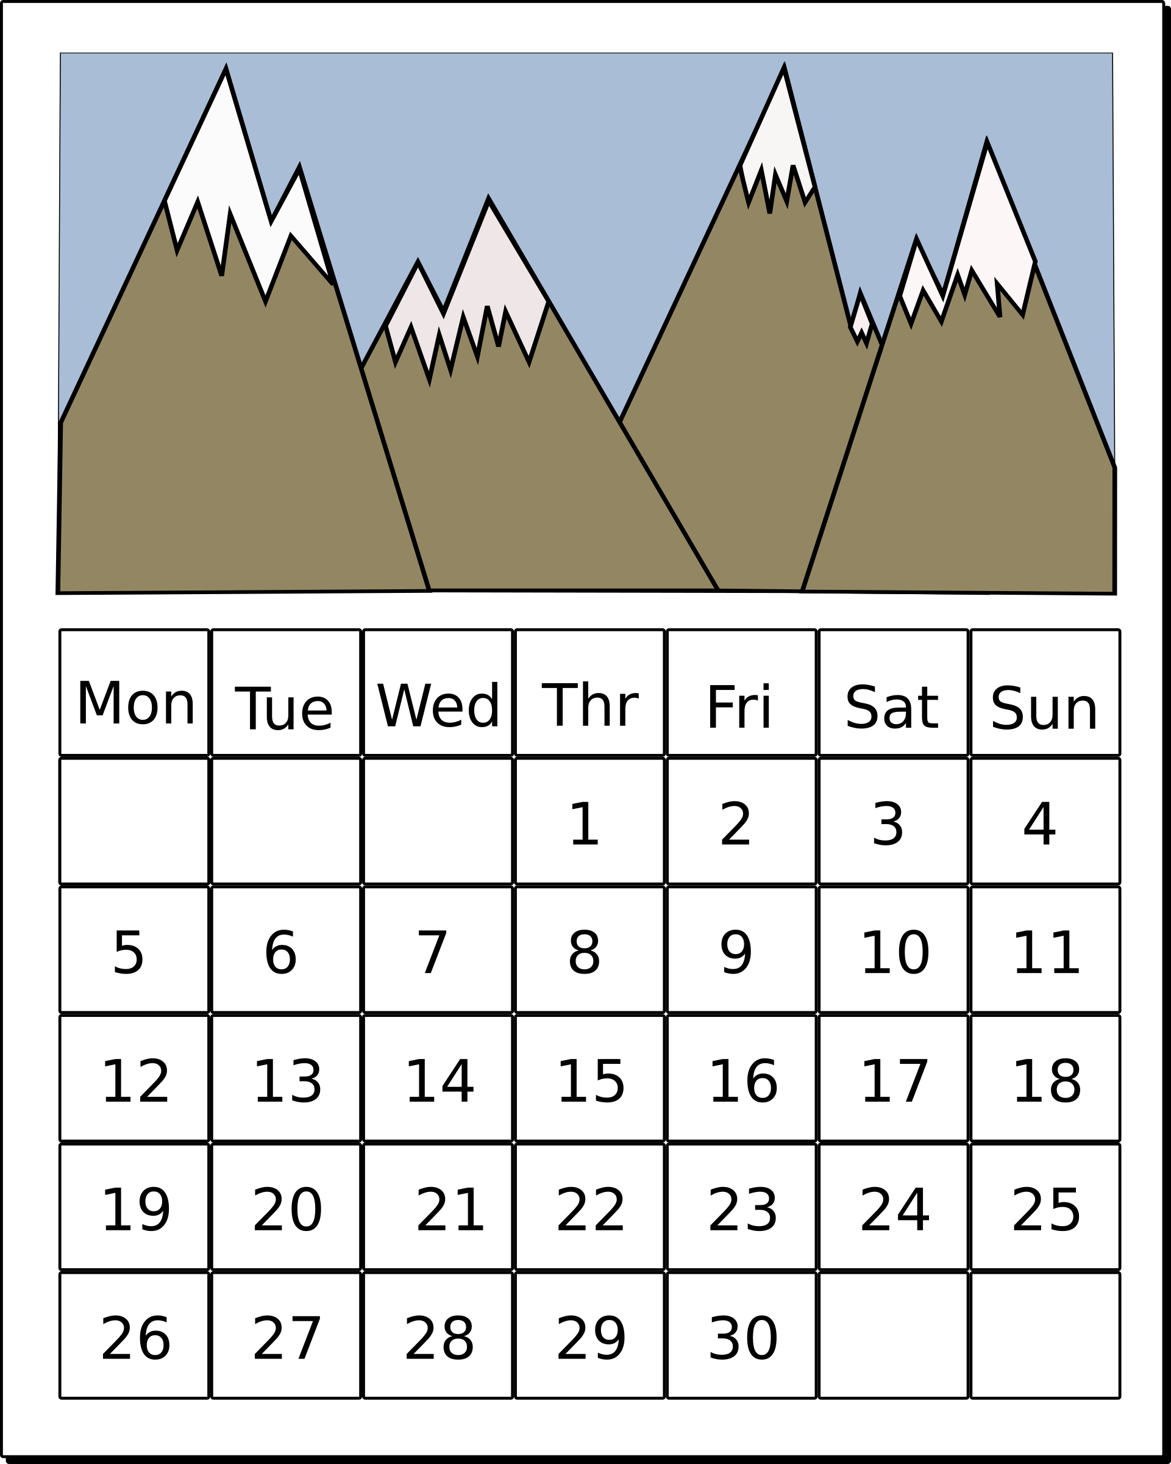
Calendar
Meeting dates
Due dates
Dates of holidays
Event dates

Slide 18

DEVELOP “Leaders are not born, they are made.” Vince Lombardi
Orientation
Bylaws
Procedures
Expectations

Slide 19

DEVELOP
Provide training for new and returning members
Review Procedures
Review Job descriptions
Review the obligations of each position
Create plan of work
This Photo by Unknown Author is licensed under CC BY-SA

Slide 20

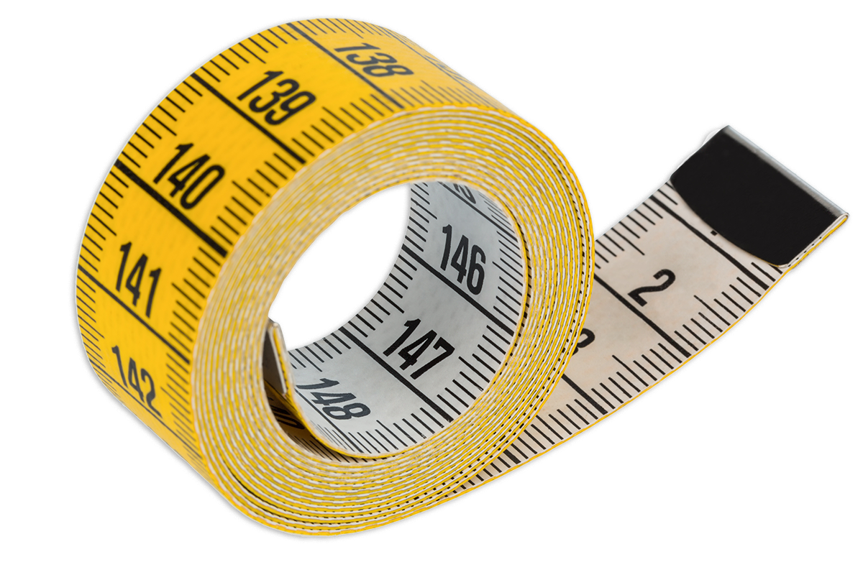
Assess

Slide 21
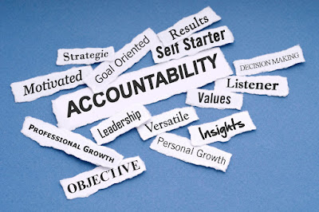
Assess
Evaluate boards overall performance
Evaluate individual board members
Hold board members accountable
Review job descriptions
Review work plans

Slide 22

ASSESS
Communicate with board members
Evaluations for each event
Review each event , did it meet expectations
Is your PTA increasing participation
Do members attend meetings and training
Seek opinions from all members

Slide 23
Conclusion
Send a form or notice to ask people what they might be interested in doing
Never set up a member to fail
Communication
Improve the perception that your PTA might be a clique

Slide 24
Information
Resource guide
https://nyspta.org/home/pta-leaders/nys-pta-resource-guide/
Training materials
https://nyspta.org/home/pta-leaders/trainingmaterials-webinars/
Joan Wabnik
Vice President NYS PTA
631-793-5677
vpwabnik@nyspta.org

