Slide 1

creating a dynamic, robust, and well-prepared educator workforce
NYS PTA
Redefining Pathways into Education
Through Apprenticeships
edhubny.org

Slide 2


Welcome!
In response to the urgent need to recruit, develop and retain a responsive, well-prepared educator workforce for students in communities across the state, EDHUBNY* provides technical assistance to agencies that serve children of all ages. From childcare to preschool through school age students, EDHUBNY works with partners to develop the workforce that’s needed.
* (supported by federal DOL Apprenticeship Building America funds)
Colleen McDonald
Director, EDHUBNY

Slide 3
New York Faces an Urgent Educator Shortage
Educators are the backbone and key economic driver of every other industry.
This crisis demands bold, coordinated action starting with investment in local talent and paid, community-rooted educator pathways.
180,000 new educators needed in the next decade
53% decline in NYS teacher preparation program enrollment since 2015
More than 20% of teachers in New York’s high-poverty schools (rural and urban) are teaching out of their certification area
33% of New York’s current teachers are eligible to retire within the next 5 years

Slide 4




BARRIERS
Cost of Tuition, unpaid placements, Certification Costs, Wraparound Service Needs, employer costs
Navigating Complex Systems and lack of administrative bandwidth; unknown - new agency partner Lack of available programs with employment

Slide 5

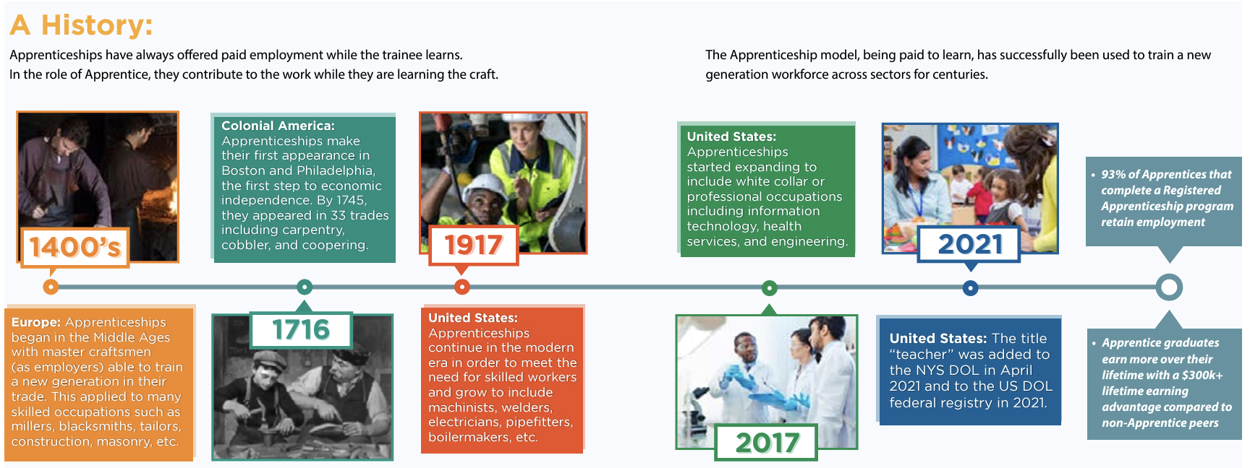
Overview: Apprenticeships
A highly successful training model used for centuries in many sectors.

Slide 6

In all Industry Sectors RAPs Work by providing:
Resources and Support
Confidence and Retention
Improved Learning through Application
Professional Growth and Collaboration
Leading to 94% Retention Rates!
Notes:
Access to resources and support = Increased diversity
Immersive on-the-job experience = Increased confidence and greater retention
Improved P-12 student learning and discipline = Better schools
Growth of experienced teacher (SBTE) = Teacher leadership
Collaborative P-20 relationships (UBTE) = Shared responsibility and decision making

Slide 7

How do RAPs apply to education careers?

Slide 8
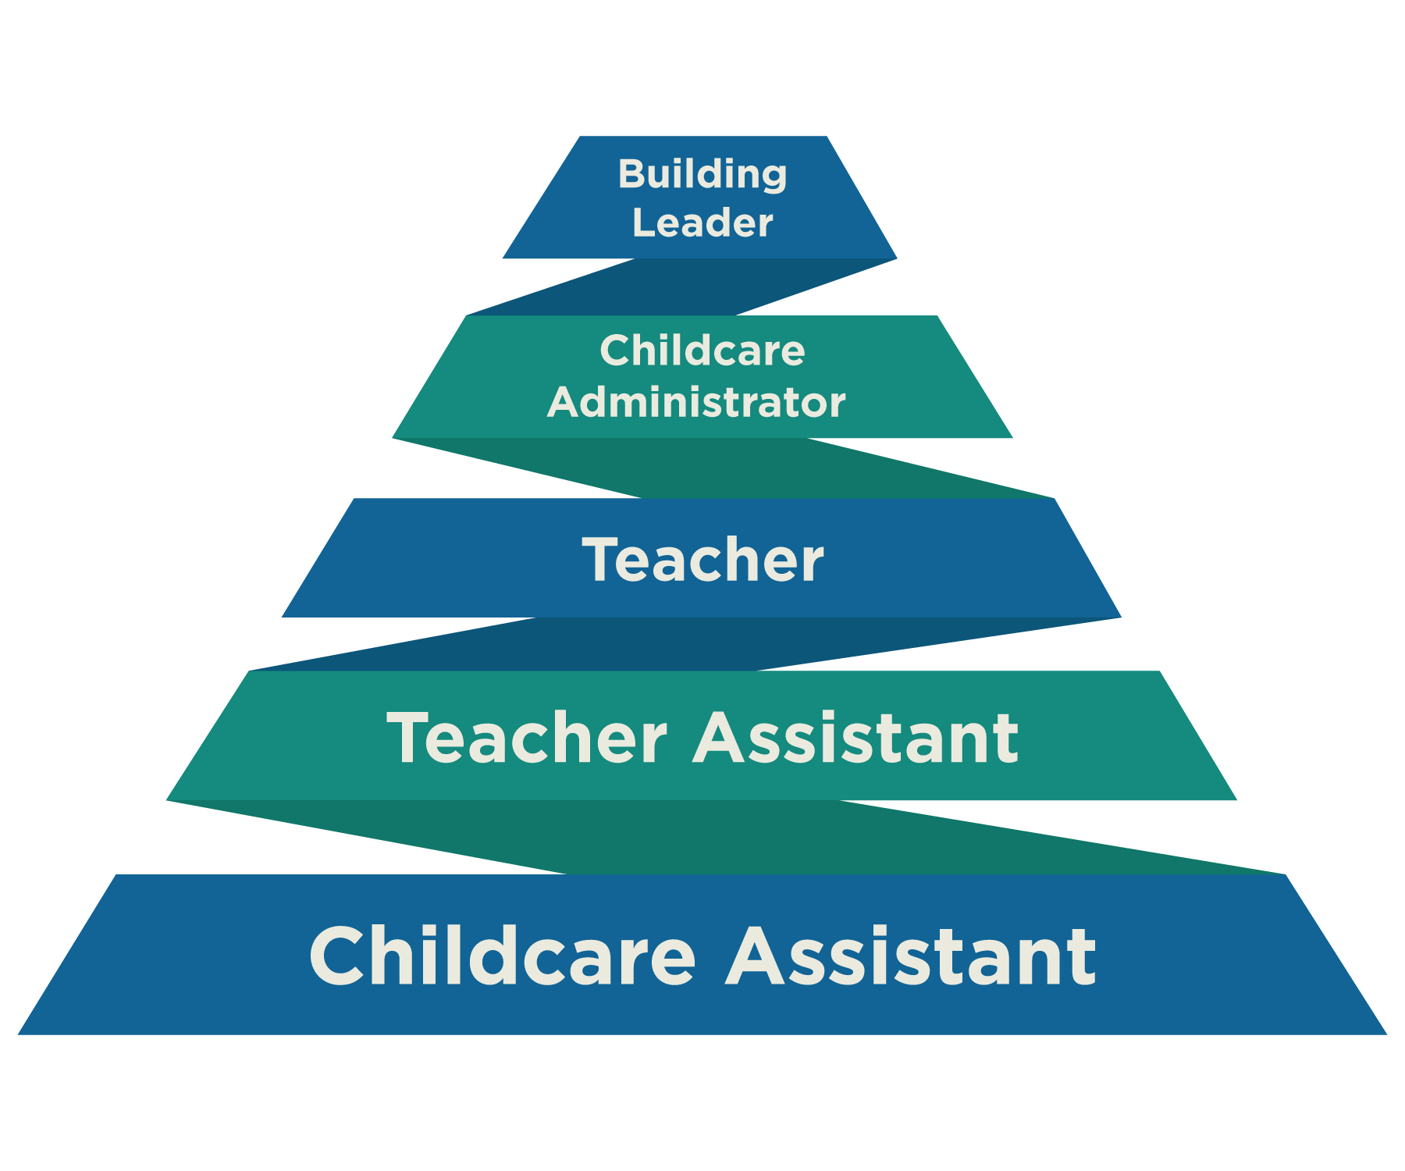
RAPs Provide A Talent Pipeline
Childcare Assistant (competency)
Teacher Assistant (2 year time/skills based)
Teacher (competency)
Childcare Admin/Director (competency)
School Admin/Building Leader (competency)
Notes:
53% decline in educator prep programs over last decade
Interest in high school seniors/college freshmen at 50 year low
10% of all teaching positions nationwide were either unfilled or filled by teachers who were not fully certified (LPI 2023)
Three top reasons new educators leave the field:1) inadequate preparation; 2) lack of support; and 3) challenging work conditions
30%-50% new teacher turnover over first five years
50 year low in teacher satisfaction
19% diverse workforce teaching a 56% diverse student body

Slide 9
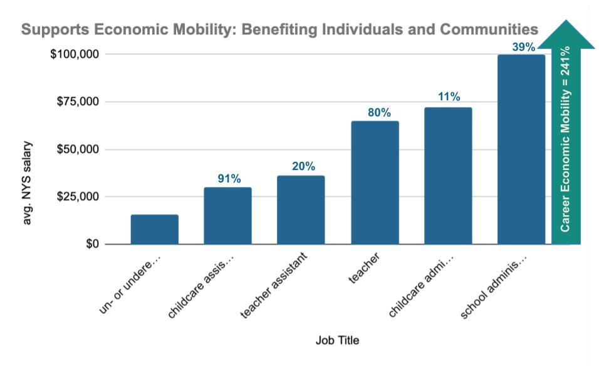
Notes:
Considered significant at 25%, $15,650 single person federal poverty line

Slide 10
RAPs Offer
Direct support to Apprentices; tuition assistance, paid placements, wrap around support, Certification Costs
Employer Wage Support, Individual and Group Programs to reduce administrative work
Established high quality programs with technical assistance; coaching to apprentices
"There is no shortage of people who want to do this work.
There is a shortage of opportunities."
-Carolyn Cleveland, Kennedy Children’s Center

Slide 11
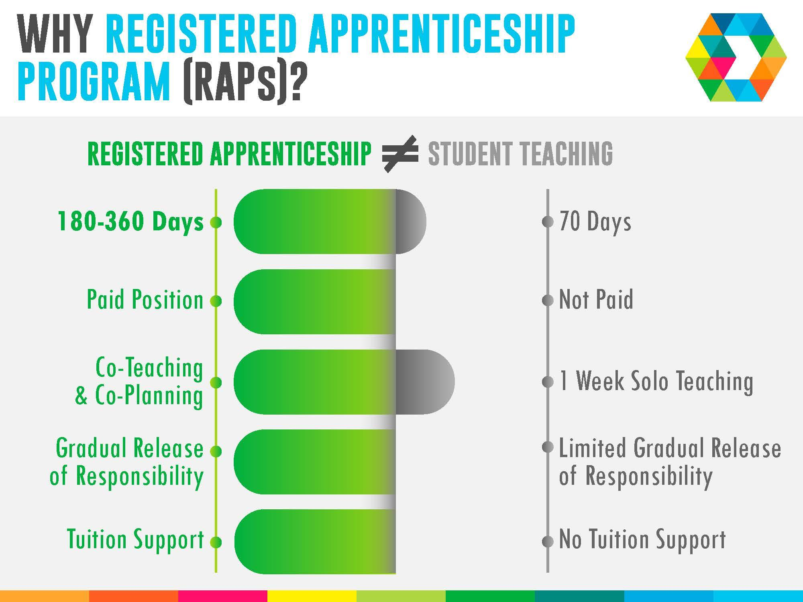
Notes:
70 days in traditional student teaching
vs
180+ days in an apprenticeship model
Graph/statement (2.5 times more days in apprenticeship vs traditional)
A one or two year immersive experience that pairs an experienced educator within the district with a college student enrolled in an educator preparation program. Educator and student (apprentice) work elbow to elbow for the duration of the Apprenticeship, with a gradual release of responsibility passed from the educator to the Apprentice. Apprentices are paid a liveable wage to remove barriers and expand access to a career in education. RAPs are built around gradual release of responsibility from attending teacher to the apprentice, embedding the apprentice into the community. Developing the confidence and ability for long term successful district employment.

Slide 12

Getting Over the Hurdles: Return on Investment
Retention rates are 4x higher
Higher student outcomes than traditional programs
Instructional continuity
CoSER-able, depending on title
Broader access into the profession for current community members
Notes:
How did you get buy in?
What were the challenges and obstacles?
What were the opportunities?
Where are you at now?
Lessons learned?

Slide 13
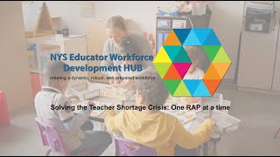

Slide 14
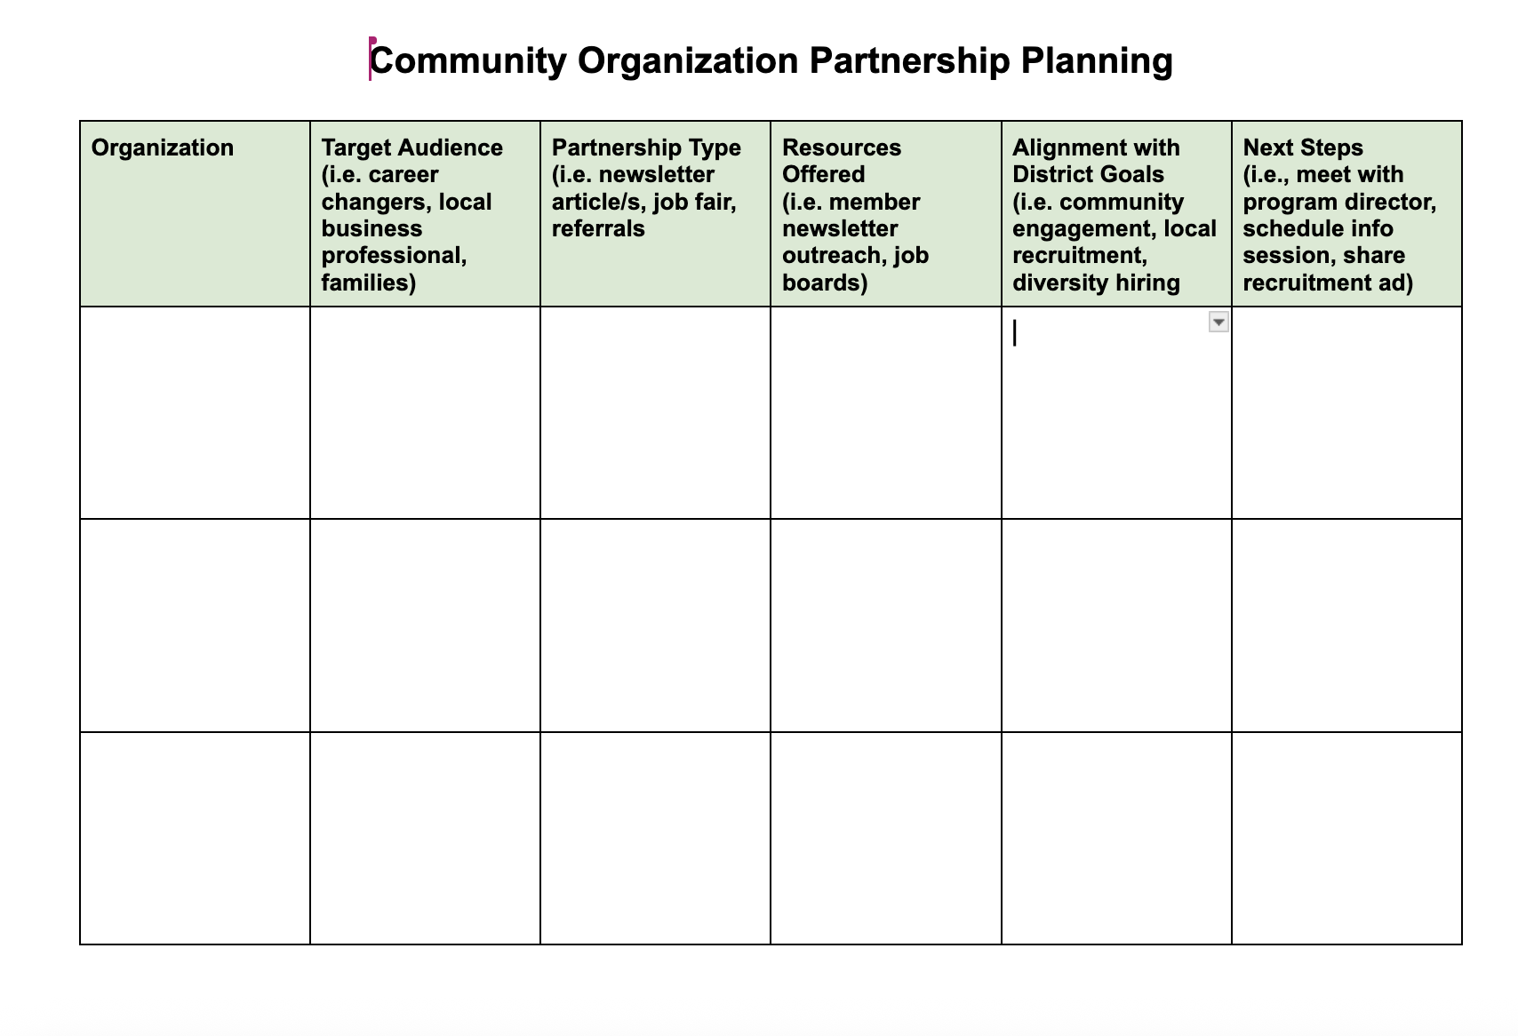
Community Planning Tool
Notes:
53% decline in educator prep programs over last decade
Interest in high school seniors/college freshmen at 50 year low
10% of all teaching positions nationwide were either unfilled or filled by teachers who were not fully certified (LPI 2023)
Three top reasons new educators leave the field:1) inadequate preparation; 2) lack of support; and 3) challenging work conditions
30%-50% new teacher turnover over first five years
50 year low in teacher satisfaction
19% diverse workforce teaching a 56% diverse student body

Slide 15
Recruiting Apprentices
Recruitment Ideas: Link
Recruitment Timeline: Link
Notes:
53% decline in educator prep programs over last decade
Interest in high school seniors/college freshmen at 50 year low
10% of all teaching positions nationwide were either unfilled or filled by teachers who were not fully certified (LPI 2023)
Three top reasons new educators leave the field:1) inadequate preparation; 2) lack of support; and 3) challenging work conditions
30%-50% new teacher turnover over first five years
50 year low in teacher satisfaction
19% diverse workforce teaching a 56% diverse student body

Slide 16




Building Out Resources: Here to Help
From day one, we had someone who already knew our students, our systems, and our community. Unlike my own part-time internship, this full-time role allowed him to be truly present, engaged, and a real part of the [administrative] team.
-K. Conrow, HS Principal
edhubny.org

