Slide 1
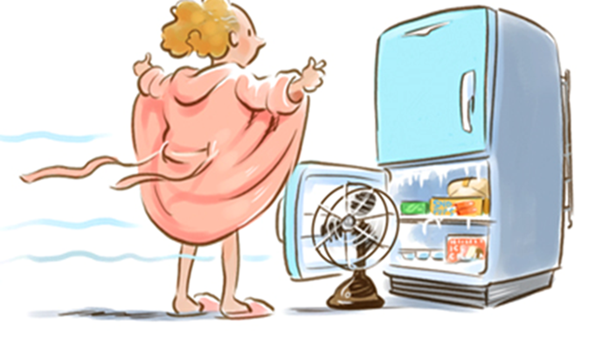
Is It HOT…. OR Is It Just Me? Stephanie Trentacoste McNally, MD, FACOG, FACS, MSCP Medical Director, Katz Institute for Woman's Health Vice President. OB/GYN, Central Region

Slide 2
Redefining tomorrow’s healthcare for women today
The Katz Institute for Women’s Health is dedicated to improving the health of women across their lifespan, bridging the gap between wellness and personalized care delivery.
We are advancing women’s health every day by providing expert, coordinated clinical care, educating our community on prevention and well-being and supporting sex-and-gender-specific research.

Slide 3
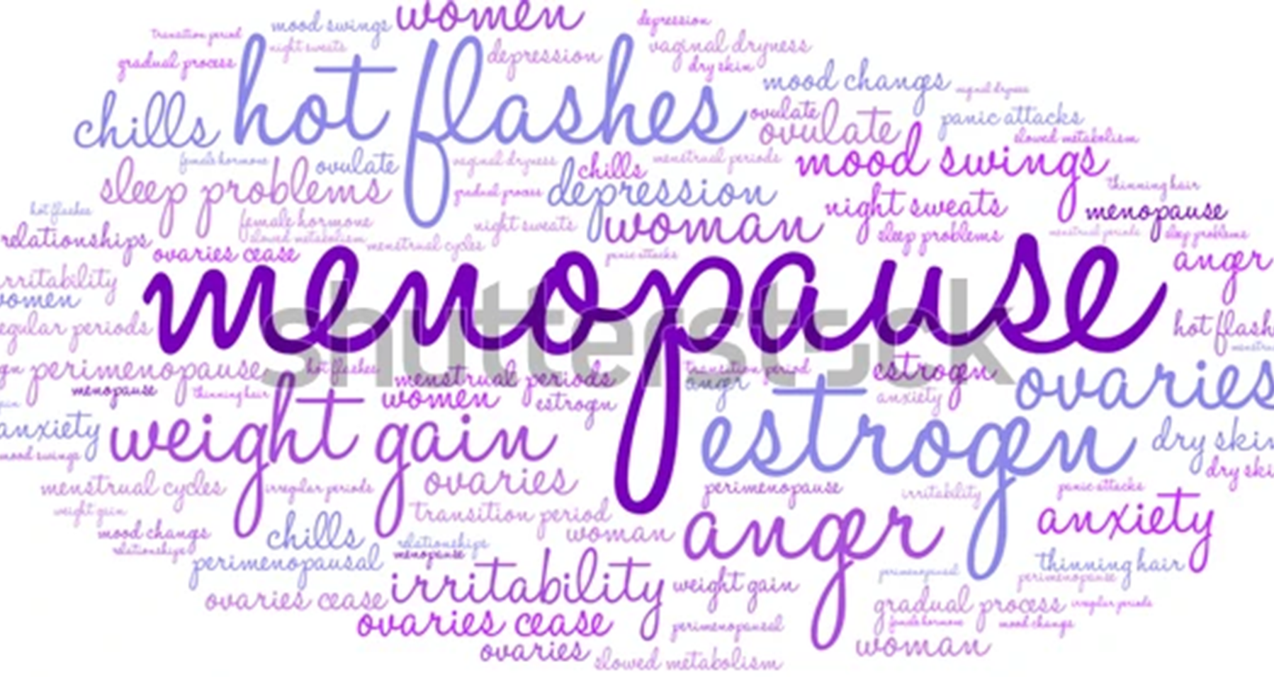

Slide 4
Menopause: An overview
Definition
The role of hormones
Common symptoms
Treatment options
Prescription medications
Complementary, alternative and integrative treatments
Screening Recommendations

Slide 5

MENOPAUSE FACTS
Menopause Transition Is The Time When A Woman Shifts From A Reproductive To A Nonreproductive Phase
Most women can expect to live almost 40% of their life after menopause
According to 2020 population estimates, there were more than 62 million women 50 years or older in the US.
An estimated 6,000 women reach menopause every day.
540,000 lost days of work due to menopausal symptoms.
$237 Million lost in productivity (Canadian data)/ $ 1.8 billion (US data).
10% of women will experience menopause before age 45.
1. North American Menopause Society. Menopause Practice: A Clinician’s Guide 5th Ed 2014. 2. United States Census Bureau. Total U.S. Resident Population by Age, Sex & Series. April 1, 2020. Accessed October 28, 2022. 3. El Khoudary, SA, et. al., Circulation 2020 142 e506-e532. 4. Suzuki, Y. et. al., ObstetGynecol 2022 189(5) 756-763.
Notes:
The mean age of menopause is 51.4years
(SD, 3.3 years), and natural menopause occurs between the ages of
45 years and 56 years in 90% of women.1 Premature hypoestrogenism
(loss of estrogen before the time of natural menopause due
to primary ovarian insufficiency, surgical oophorectomy, or medication-
induced menopause) refers to menopause before the age of
40years. 2 Surgical menopause refers to bilateral oophorectomy that
is performed prior to natural menopause. Hysterectomy, in the absence
of bilateral oophorectomy, does not constitute surgical menopause.
Women typically spend about 40% of their lifespan in the
postmenopausal stage.

Slide 6

MENOPAUSE MYTH #1
Menopause begins at 50

Slide 7
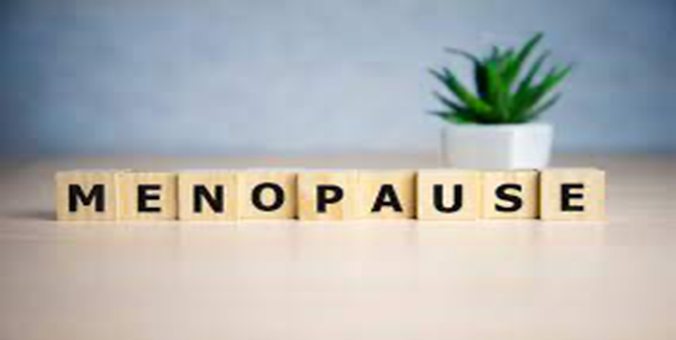
What Is Menopause?
Menopause – 12 consecutive months of NO vaginal bleeding/periods
Average age = 51-52,
Early 40-45 y.o.
Premature <40 y.o.
Pre or Peri Menopause - time leading up to menopause
Usually associated with irregular & skipped periods & bleeding
Black & Latina women:
Earlier perimenopause (49)
More intense effects
Longer transition

Slide 8
Stages of menopause
Time of reproductive fertility
Menstrual cycles are usually regular and hormonal markers are normal
Typically lasts from puberty until early 40s
3 or more months of irregular periods due to naturally waning estrogen
Typically occurs in the mid-40s, averaging about 4-8 years in length
Symptoms are typically most intense during this period
Starts 12 months after last period
Symptoms that began in perimenopause can persist in some cases even after this point
Reproductive Stage or Premenopause
Perimenopause
Menopausal

Slide 9
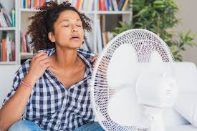
MENOPAUSE MYTH #2
The first sign of menopause is hot flashes

Slide 10

Menopause = Hot Flashes And Night Sweats

Slide 11
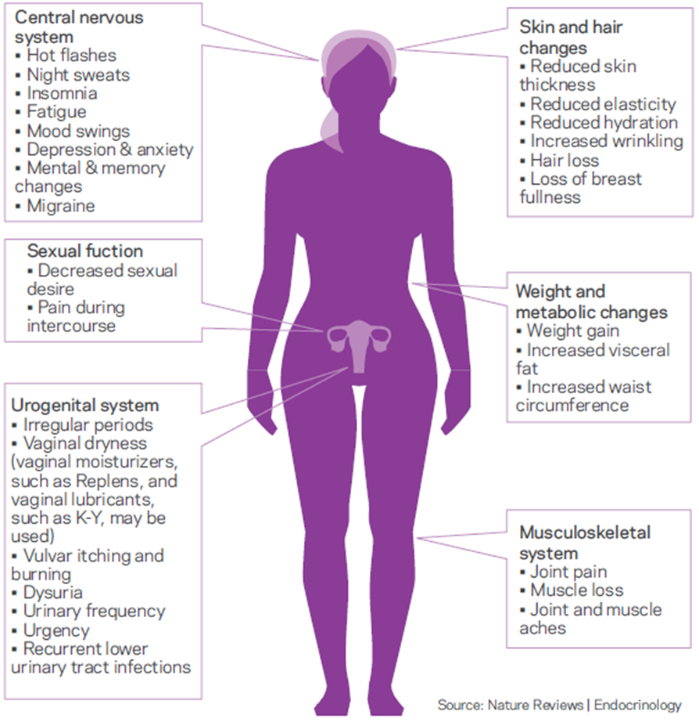
Signs & Symptoms
Menopause is not the same for all.
Symptoms can include:
Vasomotor
Genitourinary and Sexual Function
Neurological and Behavioral
Weight and Metabolic
Skin and Hair
Musculoskeletal

Slide 12
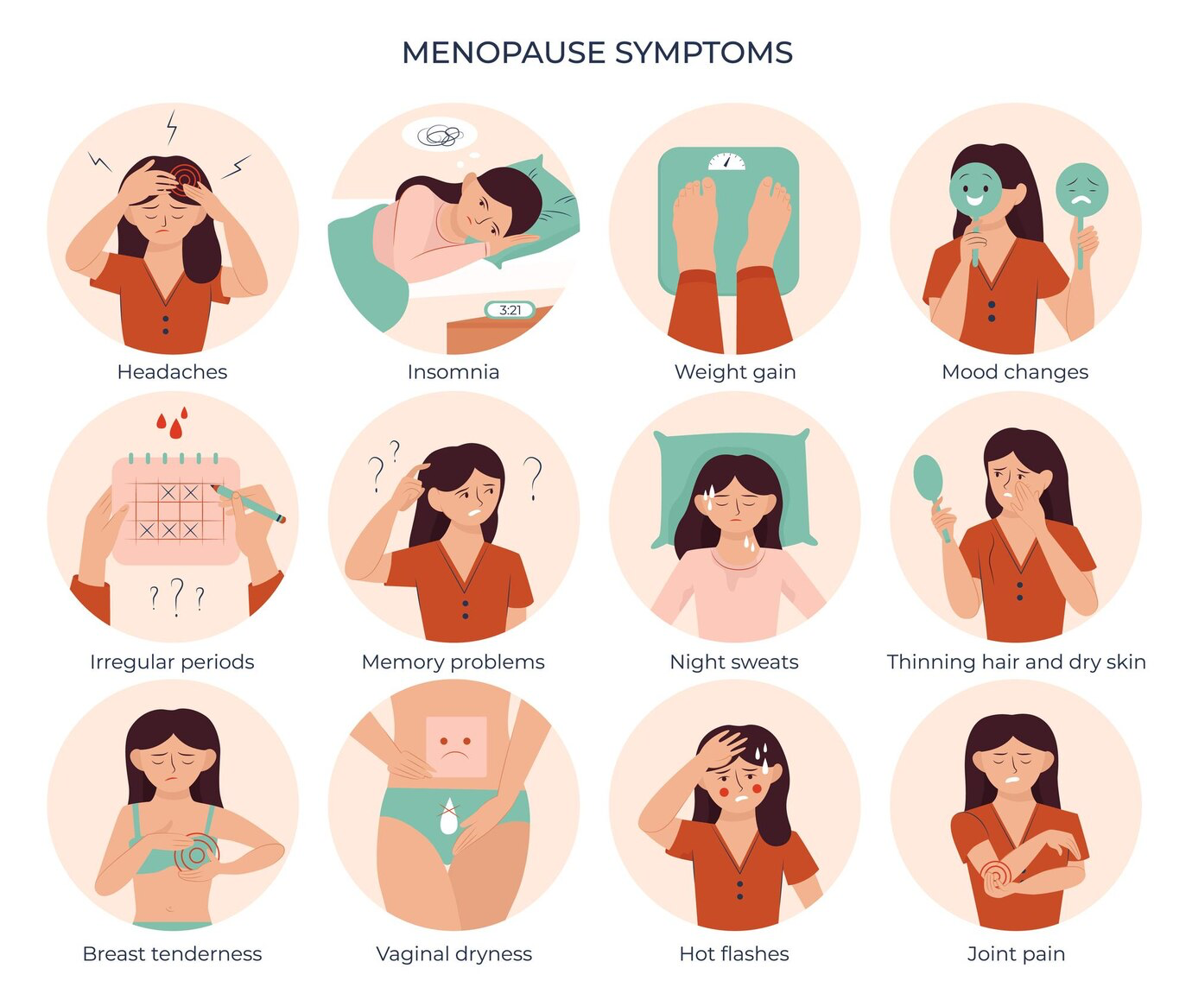
Menopause = Hot Flashes And Night Sweats
45%
30%
90%
45%
80%
20%
80%
50%
Painful sex
60% Diminished libido
https://www.shutterstock.com/image-vector/menopause-symptoms-flat-set-isolated-circle-2277966105
Woods NF, et al. Am J Med. 2005;118:14‐24.

Slide 13
Vasomotor symptoms (VMS): The “hallmark of menopause” Transient episodes of flushing along with a sensation of warmth to intense heat in the face, neck, and/or chest typically lasting 1‐5 minutes
VMS refers to Hot flushes/flashes, night sweats.
Up to 80% of women experience VMS; Variable: Mild, moderate, early severe and late severe
with 34% of women in the US reporting moderate‐to‐severe VMS.
Occur at any time, w/ or w/o trigger
Generally, occur for 5‐7 years; some women may experience for 10‐15 years
Prevalence varies by race/ethnicity
Black>Latina>White>Asian
Worsened by stress, smoking, caffeine, alcohol, and spicy foods
Associated with CVD risk
More common/severe with surgical menopause
May be induced by medication, chemotherapy, or radiation
More severe in women with lower education, socioeconomic status, obesity and smokers
Majority of menopausal women with VMS (~ 70%) remain untreated
5-15% of women have persistent symptoms – we need to stop telling women “they will go away”
Santoro N. J Womens Health (Larchmt). 2016;25:332‐9;Cleveland Clinic. https://my.clevelandclinic.org/health/articles/15223‐hot‐flashes;
Nappi RE, et al. Menopause. 2021;28:875‐82; ACOG Practice Bulletin No 141. Obstet Gynecol. 2014;123:202‐16; NAMS. Menopause. 2015;22:694‐701.
Notes:
Shut up and put up! While many women experience these symptoms, many don’t report them. We still have to ask, be aware that they’re not bringing it up.

Slide 14
MENOPAUSE MYTH #3
The older you are when you get your period, the older you’ll be when you start menopause

Slide 15
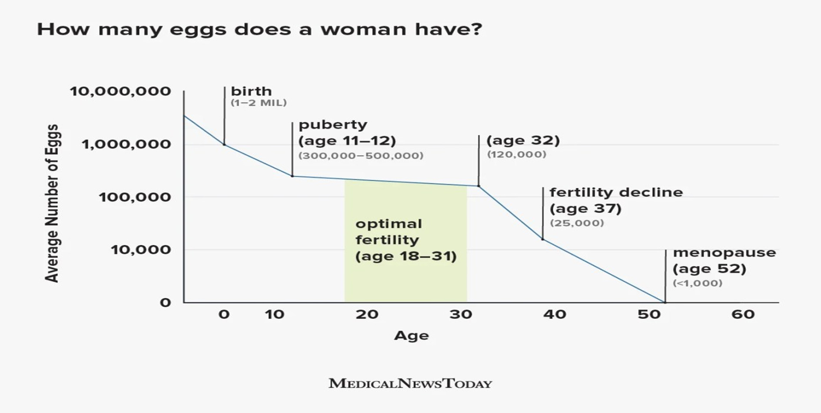

Slide 16
Determinants of menopause
Genetics - family history of age at menopause
Prior Surgery – including removal of ovaries
Lifestyle:
Smoking (associated with earlier menopause)
Obesity
Alcohol Use
Autoimmune
Anxiety and depression associated with worse hot flashes
Medications – Chemotherapy
Early age of first period (associated with earlier menopause)
Not having children (associated with earlier menopause)

Slide 17
MENOPAUSE MYTH #4
After menopause, your body doesn’t produce hormones.

Slide 18
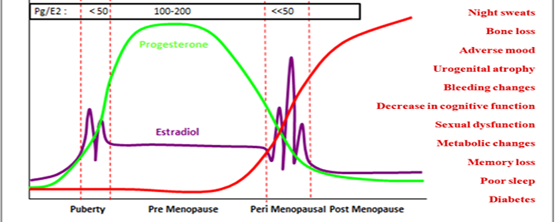
Hormonal changes across the female reproductive

Slide 19
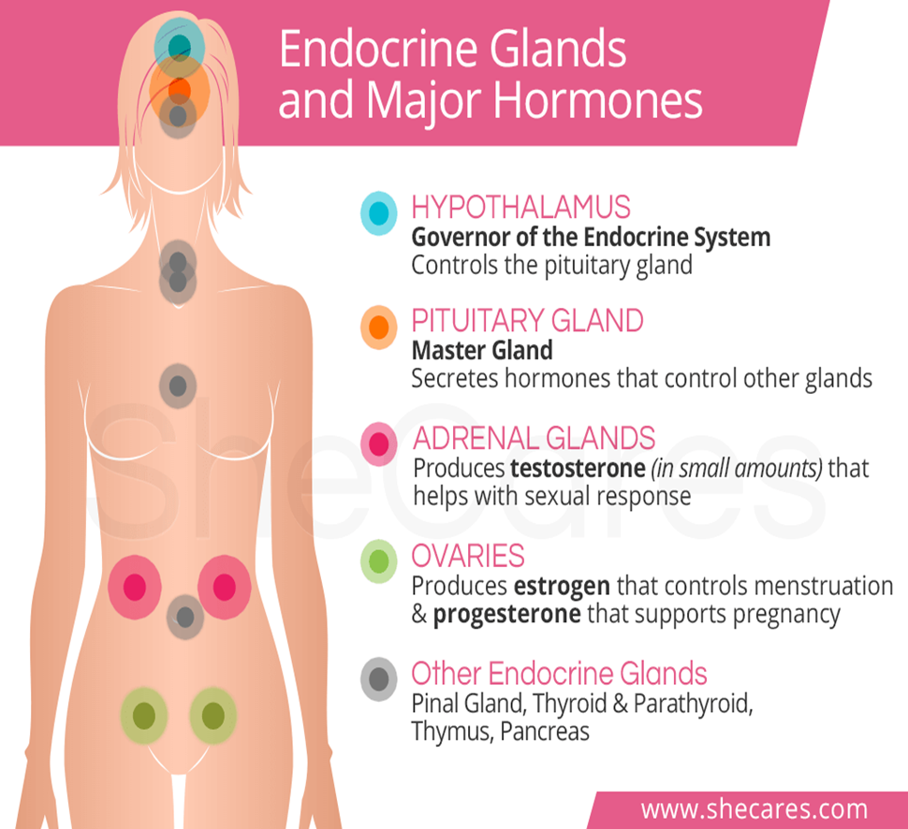
The role of hormones and neurotransmitters
Estrogen
Affects cycle changes/fertility
Affects temperature/tissue quality/ fat distribution
Affects mood, cognition, sleep and libido
Progesterone
Affects mood, cognition, sleep and libido
Progesterone
Affects libido/sexual response
Testosterone
Affects mood, libido and body changes
Dopamine & serotonin
Affects mood, cognition and sleep
Notes:
Vaginal E not associated w/ elevated systemic levels; fewer contraindications and SE (no increased risk of VTE, breast, endometrial CA, CVD); avoid w/ unexplained vaginal bleeding, use cautiously w/ E-dependent tumors

Slide 20
MENOPAUSE MYTH #5
The only way to get through menopause is to take hormones.

Slide 21
VMS Treatment OPTIONS & INDICATIONS
HAS evidence of concurrent mood disorder
SSRI
SNRI
NO mood symptoms, HAS medical contraindications to MHT
Gabapentin
Low-dose SSRI or SNRI
NO mood symptoms, NO contraindications to MHT. Interested in medications.
MHT
NO mood symptoms, NO contraindications to MHT, NOT interested in medications
Alternative treatments
Fezolinetant (Veozah)
Paroxetine (Brisdelle)
Oxybutynin (consider cognition)
Cognitive Behavioral Therapy (CBT)
* Historically, clonidine was a recommendation; now last-line treatment

Slide 22
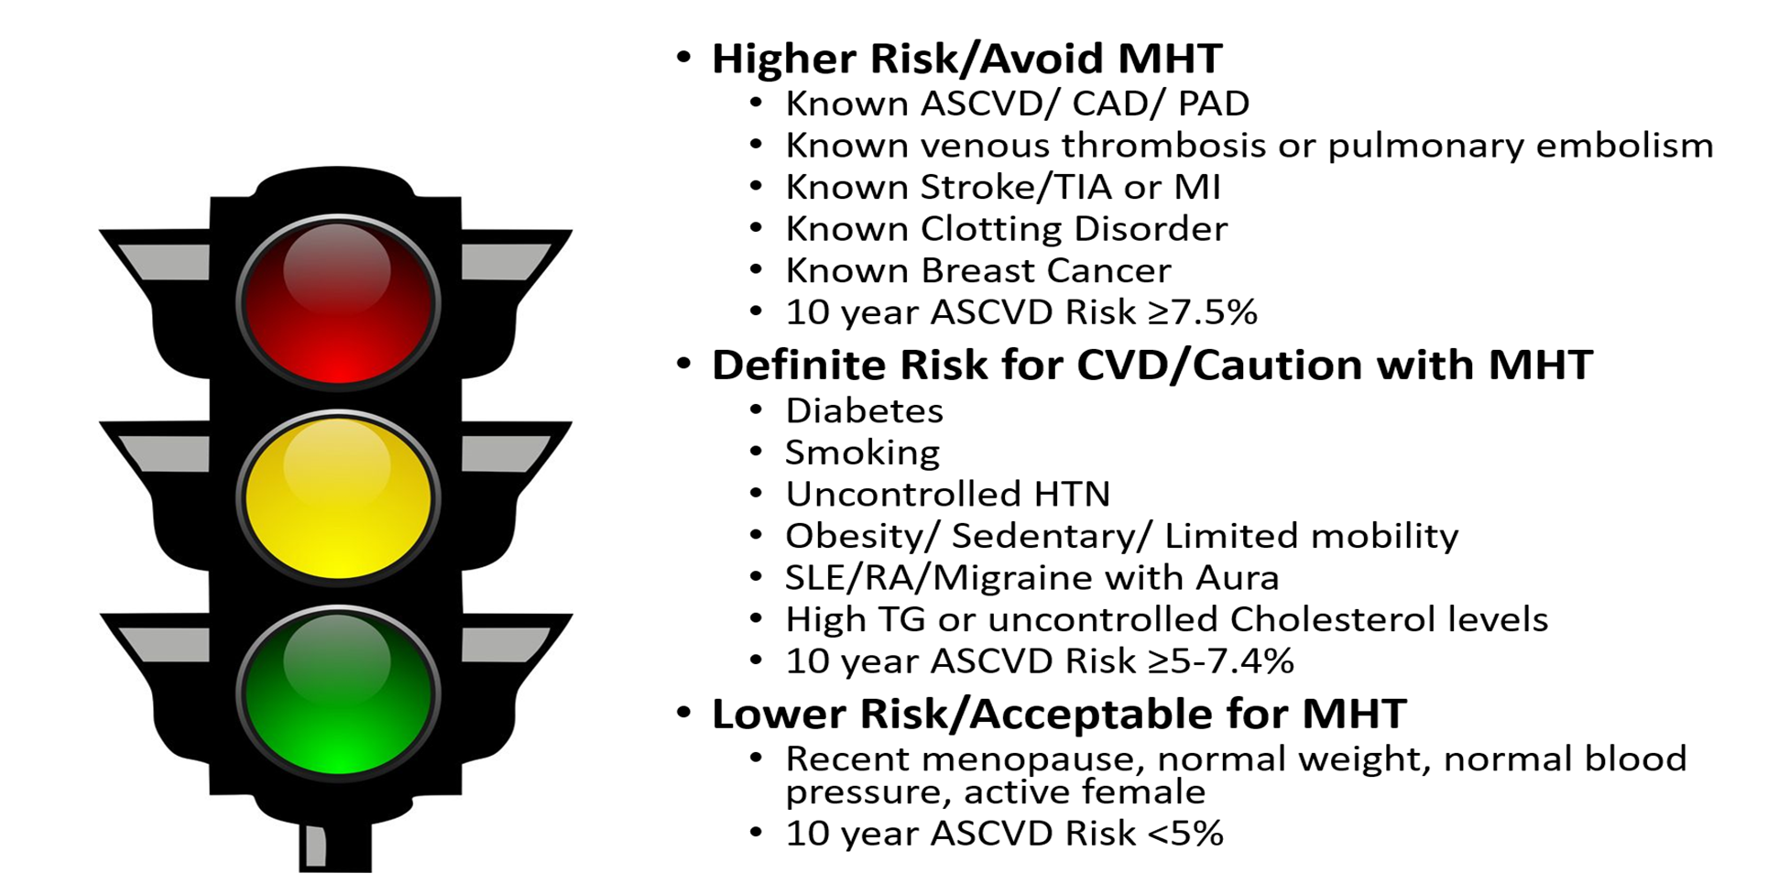
Contradictions for HRT

Slide 23
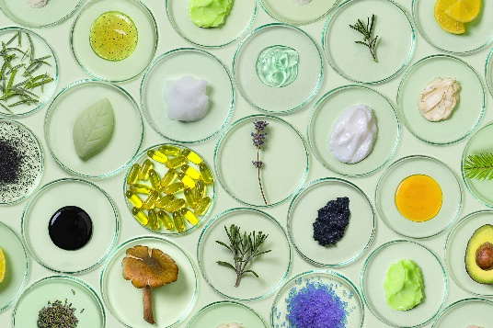
COMPLEMENTARY, ALTERNATIVE AND INTEGRATIVE TREATMENTS FOR VASOMOTOR SYMPTOMS: NO CURRENT EVIDENCE OF EFFICACY
Cooling Techniques
Lifestyle Modifications:
Limit Alcohol intake
Exercise
Nutrition
Sleep
Other health conditions
Isoflavones/phytoestrogens (soy)
Black cohosh (80mg 1-2x per day)
Dong quai
Evening Primrose
Studies done – inconsistent data
Relizen/Hyaluronic Acid
Kava (anxiety)
St. Johns Wort (anxiety/depression)
Reference: the 2015 position statement of the North American Menopause Society, Menopause 2015
Notes:
Some anecdotal data

Slide 24
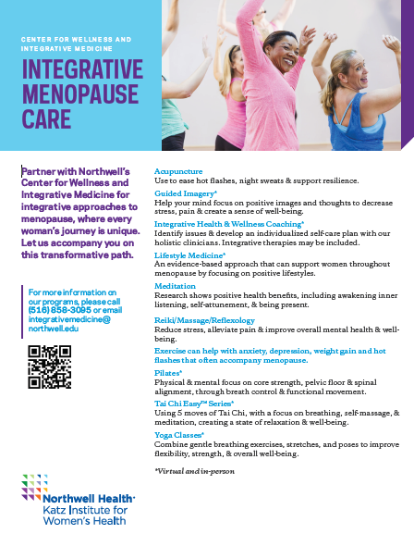
INTEGRATIVE OFFERINGS
Northwell’s Center for Wellness & Integrative Medicine offers the following in-person and virtual programs:
Acupuncture
Guided Imagery
Integrative Health & Wellness Coaching
Lifestyle Medicine
Meditation
Reiki/Massage/Reflexology
Pilates
Tai Chi Easy™
Yoga
Progressive Relaxation

Slide 25
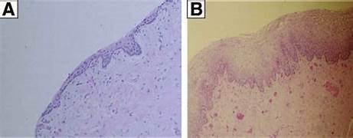
GENITOURINARY SYNDROME OF MENOPAUSE (GSM) TREATMENT- VAGINAL DRYNESS/ ATROPHIC VAGINITIS
Vaginal Lubricants
Vaginal Mostiurizers
Localized Vaginal Estrogen treatment
creams, inserts, ring
Intravaginal DHEA (precursor to testosterone)
Oral ospemifene (SERM)
Pelvic floor evaluation/PT
Dilators
Laser treatment*
* Not consistent in the literature
Notes:
Vaginal E not associated w/ elevated systemic levels; fewer contraindications and SE (no increased risk of VTE, breast, endometrial CA, CVD); avoid w/ unexplained vaginal bleeding, use cautiously w/ E-dependent tumors

Slide 26
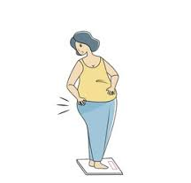
MENOPAUSE MYTH #6
Weight gain is inevitable in menopause

Slide 27

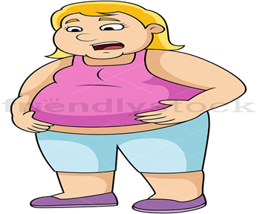
WEIGHT & METABOLIC CHANGES AND THE “MENO-BELLY”
During menopause, decrease in estrogen and progesterone leads to:
Increase in fat mass & waist circumference
Decrease in lean muscle mass fewer calories burned
Based on metabolic changes, elevated BMI and weight gain around the mid-section are common. Post-menopausal women are particularly affected.
Consequences:
Linked to increased morbidity and mortality
Promotes the development and progression of numerous obesity related health conditions

Slide 28
WEIGHT GAIN IS NOT INEVITABLE
Current treatment of obesity in menopausal women mainly centers around lifestyle and diet changes. MHT may help attenuate abdominal adipose accumulation; however, the effect is small. Additional medications may help.
Aerobic Activity:
Aerobic, 150 to 300 minutes a week of moderate-intensity, or 75 to 150 minutes a week of vigorous-intensity aerobic activity (or an equivalent combination.)
Nutrition
Nutrition is a key component of weight management.
Strength Training:
Full-body muscle-strengthening activities on two or more days a week.
Knight MG, Anekwe C, Washington K, Akam EY, Wang E, Stanford FC. Weight regulation in menopause. Menopause. 2021 May 24;28(8):960-965. doi: 10.1097/GME.0000000000001792. PMID: 34033603; PMCID: PMC8373626.
Notes:
Appendix – weight management team flyer

Slide 29
MENOPAUSE MYTH # 7
The only screening I need during menopause is a mammogram.

Slide 30
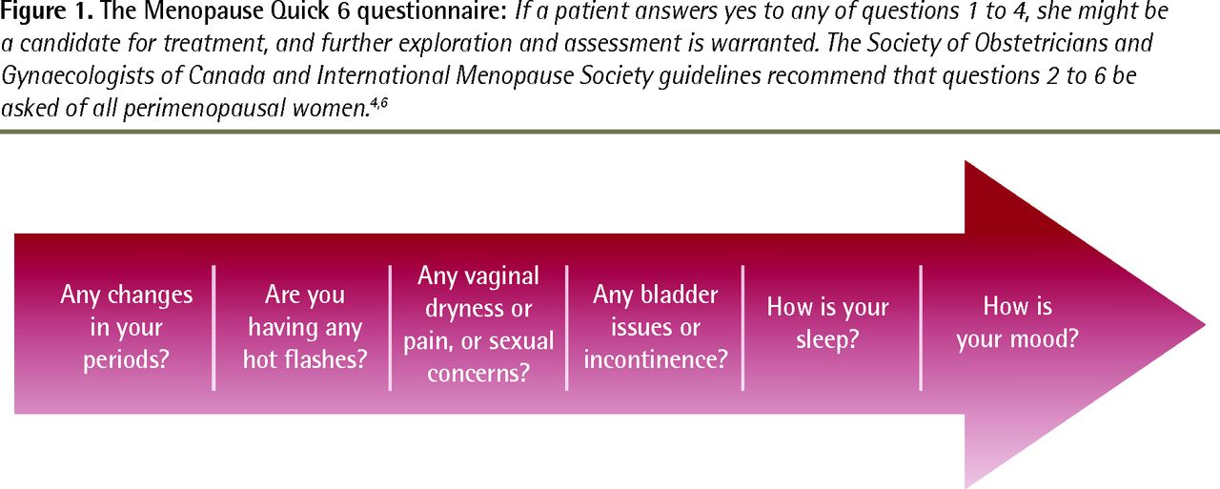
Menopause Quick 6 tool
Menopause Rating Scale – Validated tool designed to measure severity of menopausal symptoms; assesses presence and severity of psychological, physical, and urogenital symptoms
An efficient tool for the primary care management of menopause – Susan Goldstein, Canadian Family Physician Apr 2017, 63(4) 295-298

Slide 31
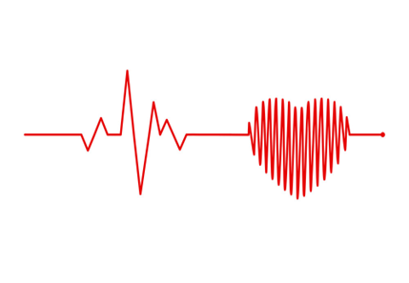
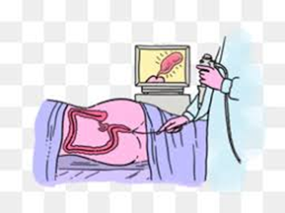
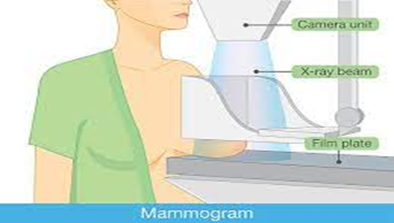
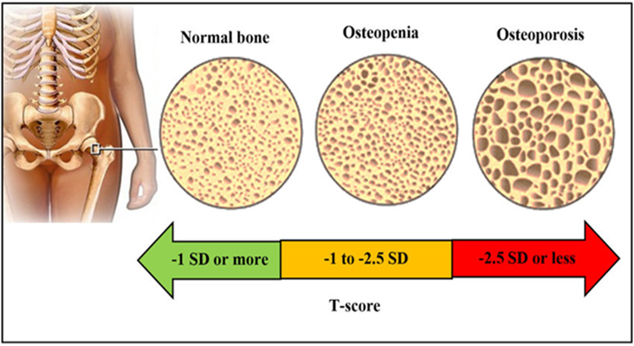
Screening - The 4 B’s
Breast Imaging +/- MRI
Age 40
Colonoscopy
Age 45
Bone Density
Age 65
Primary Care
Dermatology
An efficient tool for the primary care management of menopause – Susan Goldstein, Canadian Family Physician Apr 2017, 63(4) 295-298

Slide 32
KEY TAKEAWAYS
Women of appropriate age may have of a myriad of peri/menopause symptoms
Not all menopausal symptoms are VMS
Menopausal symptoms can adversely affect QOL
There are many treatment approaches for menopausal symptoms
Many women are candidates for hormonal therapy, which is safe if used appropriately
Many non-hormonal options exist, including a new medication w/ specific VMS target
Treatment approaches are personalized for each woman

Slide 33
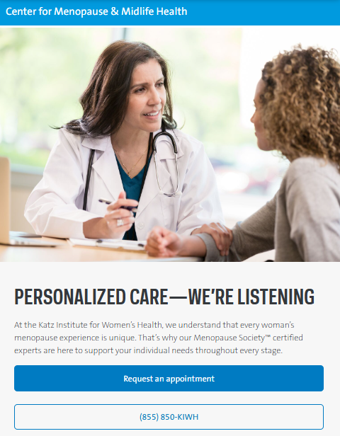
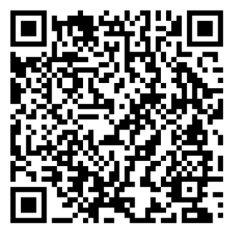
IN SUMMARY
There are many treatment approaches for menopausal symptoms.
Treatment approaches are personalized for each woman.
Visit our Center for Menopause and Midlife Health to find a Menopause Society™ clinician near you.

Slide 34






STAY CONNECTED WITH THE
KATZ INSTITUTE FOR WOMEN’S HEALTH
JOIN THE CONVERSATION...

Slide 35
Thank you!

Slide 36
Addendum

Slide 37
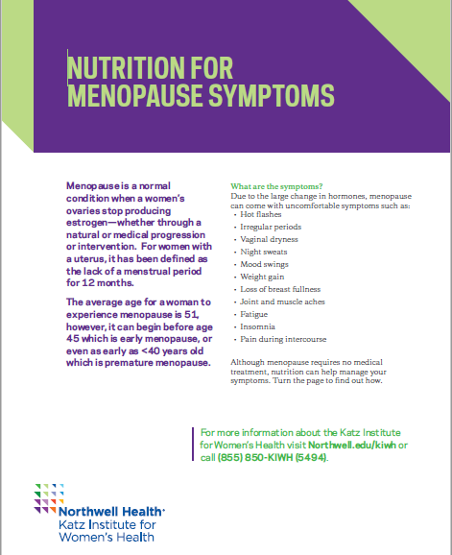
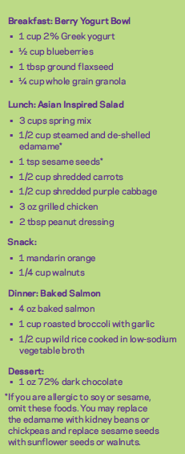
NUTRITION IN MENOPAUSE
Could include minimum 3 servings of isoflavones (whole food soy) and/or lignans (flaxseeds, sesame seed, bran, buckwheat, oats. Smaller but still notable amounts in legumes and nuts) each week
Limit carbohydrates to 35-40% of total calories
Consume 25g of fiber per day
Increase protein to 1.2-1.5g/kg of body weight (or 30% total calories)
Reduce or eliminate alcohol
Avoid spicy foods to prevent hot flash triggers
Limit caffeine to prevent hot flash triggers
Ensure RDA (recommended dietary allowance) is being met of vitamin D 800 IU & calcium 1200 IU

Slide 38

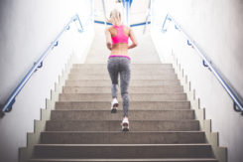


LIFE HACKS FOR HOME
Add HIIT (high-intensity interval training)*
Walk the dog
Have walking meetings
Take the stairs
Switch up your commute – can you walk or bike to work? If you need to drive, consider parking some distance away.
Do a walking tour on vacation
Get your kids and/or friends involved
Bodyweight exercises/Pilates/yoga while watching TV*
Lift groceries*
Track your progress; use a pedometer or an app
Make it fun! Daily exercise won’t become a habit unless it’s something you enjoy.
https://draxe.com/fitness/exercise-hacks/

