Slide 1



Welcome to our PTA Leadership Session:
Getting to Yes - How to Motivate Busy Volunteers to Continue Their Great Work
by Purnima Mohan & Deborah Kassirer
Western Region PTA
Notes:
Welcome to our PTA Leadership Session!
Today, we’ll explore how to inspire more leaders, prevent burnout, and build a stronger PTA community.

Slide 2


AGENDA
Today, we’ll explore how to inspire more to volunteer, keep volunteering, prevent burnout, and build a stronger PTA community:
The volunteer paradox
The impact of officer roles
Tools & The Volunteer Lifecycle
Overcoming barriers
Inspiring engagement
Action steps & discussion
Notes:
Our Agenda: We'll look at common challenges with getting parents, teachers and others to volunteer, and explore practical solutions together.

Slide 3


Slide 4

The Volunteer Paradox
PTAs and small nonprofits face a unique challenge.
The work is vital for our schools and children.
But the workforce is limited—just a handful of dedicated volunteers carry the load.
This imbalance can lead to burnout, frustration, and missed opportunities.
Notes:
Explain how the paradox affects our PTA. Emphasize the importance of recognizing this imbalance and its impact.

Slide 5

Who Are Our Leaders
Our PTA is made up of a mix of new and experienced members:
  Parents
  Teachers
  Nonprofit leaders
Poll: Do you see yourself being here for a couple of years?
Notes:
Highlight the diversity in leadership. Use the poll to engage the audience and understand their commitment.

Slide 6

The Imbalance: Burnout & Missed Opportunities
When a few volunteers carry most of the load:
Burnout and frustration are common.
Opportunities for growth and impact are missed.
Let’s talk about how we can change this pattern.
Notes:
Discuss how burnout affects volunteers and the organization. Encourage reflection on how to distribute responsibilities.

Slide 7
Real Story – The Reluctant Leader
Background: Maria, a busy parent, was asked to be Special Needs PTA Secretary. She hesitated—her job and her own special needs son kept her busy.
After talking with a mentor, Maria realized she could share the role and set boundaries.
She found joy in small wins, built new friendships, and inspired others to step up.
Maria’s story shows that support and flexibility can turn hesitation into leadership.
Notes:
Share Maria’s story to illustrate how mentorship and flexibility can empower hesitant volunteers.

Slide 8

Why Officer Roles Matter
Officer positions like Secretary, Treasurer, and President are the backbone of our PTA.
They shape our direction and impact
Their leadership creates opportunities for all
Stepping into these roles means making a real difference for our school community.
Notes:
Explain the importance of officer roles and how they influence the PTA’s success.

Slide 9

Volunteer level & time commitment
Volunteer at different levels
  Unit
  Council
  Region
  State

Slide 10
Volunteer Involvement Makes a Difference
Research shows a strong, positive correlation between parent involvement and student success.
When families are involved, children do better in school. Report Positive Relationships Between Parent Involvement and Student Success
PTA members including teachers help create a supportive environment that boosts achievement and well-being. Approaching Teacher and Parent volunteers PTA Guide
For example, a study by the National PTA found that schools with active parent organizations see higher student achievement and improved school climate. Study on the effect of Parent Volunteers
Notes:
Be sure to review these informational sources for additional research information and ways to encourage volunteerism.

Slide 11
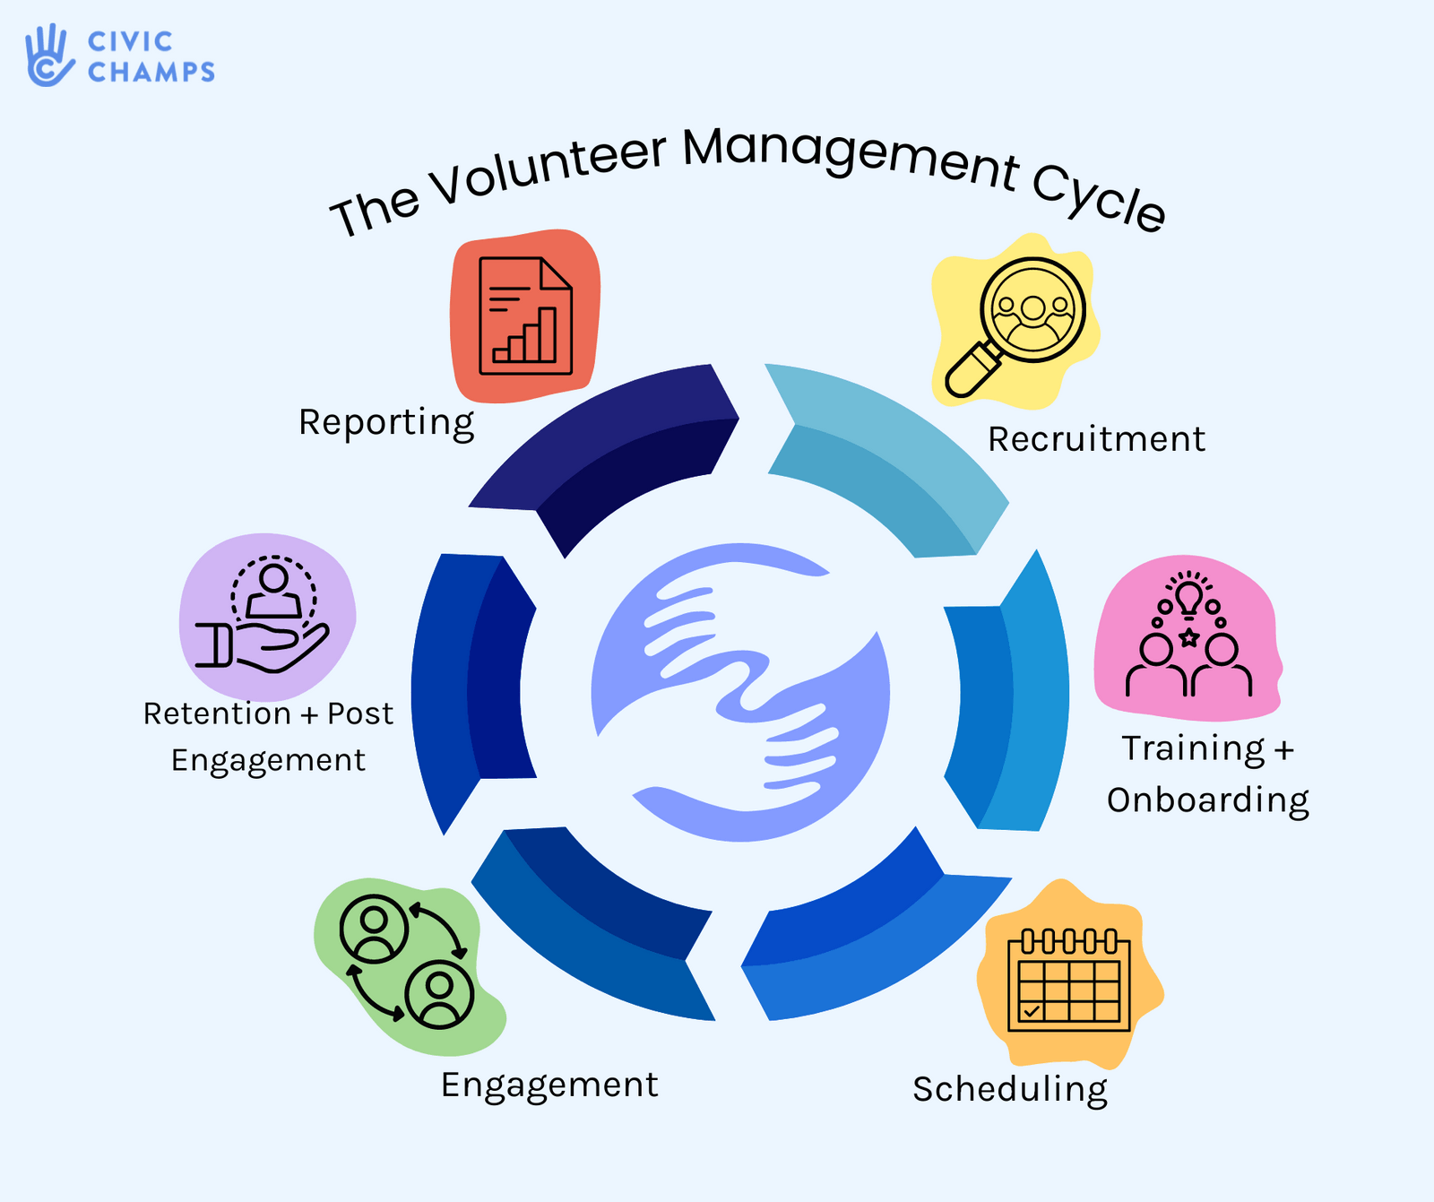
Tools: Volunteer Management Lifecycle
The Volunteer Management Cycle helps PTAs and nonprofits build strong, sustainable teams by focusing on every stage of the volunteer journey.
Notes:
Provide tools and resources to support leadership development.
Understand the Volunteer Management Cycle
Check with other PTAs or volunteer organizations in your region, state, or even nationally for ideas and for those looking to volunteer and expand their skills or experiences.

Slide 12
Volunteer Management Lifecycle breakdown
1. Recruitment: Attract new volunteers with clear roles and personal invitations.
6. Reporting: Track participation and impact to inform future planning.
2. Training & Onboarding: Provide orientation, resources, and mentorship.
5. Retention & Post Engagement: Celebrate achievements, offer feedback, and encourage continued involvement.
3. Scheduling: Offer flexible opportunities and clear expectations.
4. Engagement: Foster community, recognize contributions, and support growth.
Notes:
Speaker Notes:
Explain that effective volunteer management is ongoing. Each stage is important for keeping volunteers engaged and motivated. Encourage leaders to assess which stages need more attention in their PTA and share ideas for improvement.

Slide 13

Barriers to Saying Yes
“I don’t have time.”
Fear of burnout
Unclear expectations
Let’s address these concerns and find
solutions together.
Notes:
Identify common barriers and encourage open discussion on how to overcome them.
If time allows, start with the statement: How might we overcome the above, or , What are all of the ways that I might overcome the barriers?
Post on Sticky notes, or write down etc.

Slide 14

How to Inspire Engagement
Tips for recruiting and retaining officers:
Personal invitations
Clear role descriptions
Tools to Do to Work
Flexible commitments
Recognition and appreciation
Explain the Benefits
Notes:
Make personal invitations:
Let’s talk more in depth about this and a couple of the other tactical suggestions.

Slide 15

Personal Invitation
Approach potential volunteers one-on-one.
Mention specific strengths you’ve noticed.
Explain how their involvement can make a difference.
Notes:
People are much more likely to say yes when asked directly and personally. Avoid mass emails—make it personal!

Slide 16

Tools to Do the Work
Utilize:
Tip and fact sheets, checklists
Givebacks and Shared Drive
Binders - year over year / smooth transition of roles
Notes:
People are much more likely to say yes when they know the work is in organized and manageable.

Slide 17

Role Clarity & Flexibility
Share a simple “job description” for each role.
Offer options for co-chairing or splitting duties.
Allow volunteers to try a role for a short period (“trial run”).
Notes:
Uncertainty is a major barrier. When people know what’s expected and see flexibility, they’re more likely to step up.

Slide 18

Recognition & Support
Publicly thank volunteers at meetings and in newsletters.
Give small tokens of appreciation (certificates, gift cards).
Provide ongoing support and check-ins.
Notes:
Recognition motivates people to stay involved. Support helps prevent burnout and builds loyalty.
Other ideas might include Mentorship programs etc.

Slide 19

Benefits
Find what motivates your potential volunteers and encourage them to join to:
  Make a difference;
  Gain access to administration;
  Gain leadership skills;
  Why do you volunteer?
  What keeps you joining in?
Notes:
Volunteering is wonderful and rewarding work but a commitment too. Benefits must exist to keep people interested and engaged.

Slide 20
Use the NYS PTA Mission and Vision Statement to Inspire!
NYS PTA
Mission Statement:
PTA is a powerful voice for all children, a relevant resource for families and communities, and a strong advocate for the education and well-being of every child.
NYS PTA Vision Statement:
Making every child’s potential a reality by establishing the New York State Congress of Parents and Teachers, Inc. (NYS PTA) as the premier association for parent involvement and advocacy for all children.
Notes:
Volunteering is wonderful and rewarding work but a commitment too. Benefits must exist to keep people interested and engaged.

Slide 21
Getting to YES: Interactive Poll Discussion
How can existing leaders foster up-and-coming members to be long-term leaders?”
?
Notes:
Discussion Prompt:
“How can existing leaders foster up-and-coming members to be long-term leaders?”
Share your own journey: Tell new members how you started and what you’ve gained.
Ask for input: What would make volunteering easier for you?
Encourage shadowing: Invite new members to observe meetings or events before committing.

Slide 22

Success Stories & Small Wins
Brief stories of successful leadership transitions
Celebrate small wins and progress
Resources & Support
Notes:
Share examples of success to inspire and build momentum.

Slide 23

Action Steps
What can you do tomorrow? Invite someone to a meeting
Share your story
Offer to mentor a new member
Notes:
Encourage immediate action and personal involvement.

Slide 24

Notes:
Encourage immediate action and personal involvement.

Slide 25

Notes:
Encourage immediate action and personal involvement.

Slide 26

Q&A /Ideas - Open Forum
Notes:
Open the floor for questions and feedback. Foster a collaborative atmosphere.
Express gratitude and share next steps for continued engagement.

Slide 27
Resources & Support Links
Volunteer management apps
PTA national/local resources
Mentorship and training opportunities
Special Needs PTA training
Notes:
Provide tools and resources to support leadership development.
Understand the Volunteer Management Cycle
Check with other PTAs or volunteer organizations in your region, state, or even nationally for ideas and for those looking to volunteer and expand their skills or experiences.

