Slide 1




From Page to Stage:
The Power of Arts in Education
Presented by:
Jennifer Pollock-Hurst,
NYS PTA Arts Specialist

Slide 2


Introduction

Slide 3


Artsin
Education
WHY?

Slide 4


NATIONAL PTA BELIEVES :
That the arts, music, literature, dance, drama, and visual arts are central to learning.
Infusion of the arts in elementary, secondary, and continuing education curricula is key to the development of students.
NATIONAL PTA SUPPORTS:
Programs that promote public awareness of the arts and arts education.
The integration of the arts in school curriculum.

Slide 5

What is Arts in Education (AIE)?
BOCES’ Arts in Education is a comprehensive support service to assist in the planning, scheduling, booking and evaluation of the full range of arts-related consultant services, including performances, workshops, residencies and class field trips. It provides a cost- effective way for school districts to bring arts programs to their students.
Please note: Your district/BOCES region may use a different process. Please contact your local BOCES for more information:
BOCES https://www.boces.org/contact-a- boces22/

Slide 6

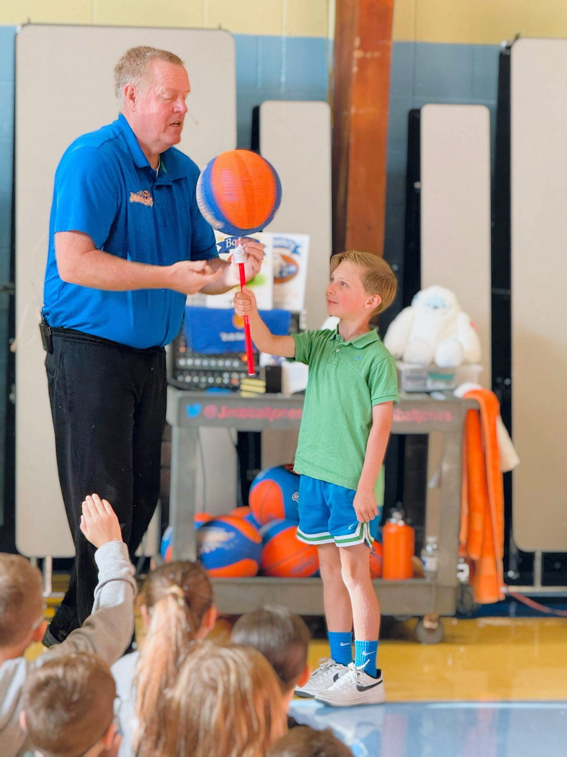
Arts in Education facilitates the infusion of the NYS Learning Standards for the arts into an educational program.
Areas covered include:
🟣 Dance 🟢 Drama 🟠 Literature
🟡 Music 🔵 Media Arts 🟤 Visual Arts

Slide 7

What is BOCES?
In 1948, the New York State legislature created Boards of Cooperative Educational Services (BOCES) to provide shared educational programs and services to school districts within the state. BOCES was created to help school districts share resources and costs to provide high-quality, cost- effective programs that might otherwise be unavailable.
BOCES membership is not available to the “Big Five” city school districts: New York City, Buffalo, Rochester, Yonkers, and Syracuse. This is because they have their own cooperative services within their school districts.

Slide 8

What is BOCES?
Multiple school districts work together to pool resources for services they need, like special education, career and technical training, and administrative support.
By sharing programs and services, school districts can save money through cooperative purchasing and shared expenses.
Each BOCES is governed by a Board of Education made up of representatives from school districts it serves.
There are 37 BOCES across New York State, and they serve nearly all of the state's public school districts.

Slide 9
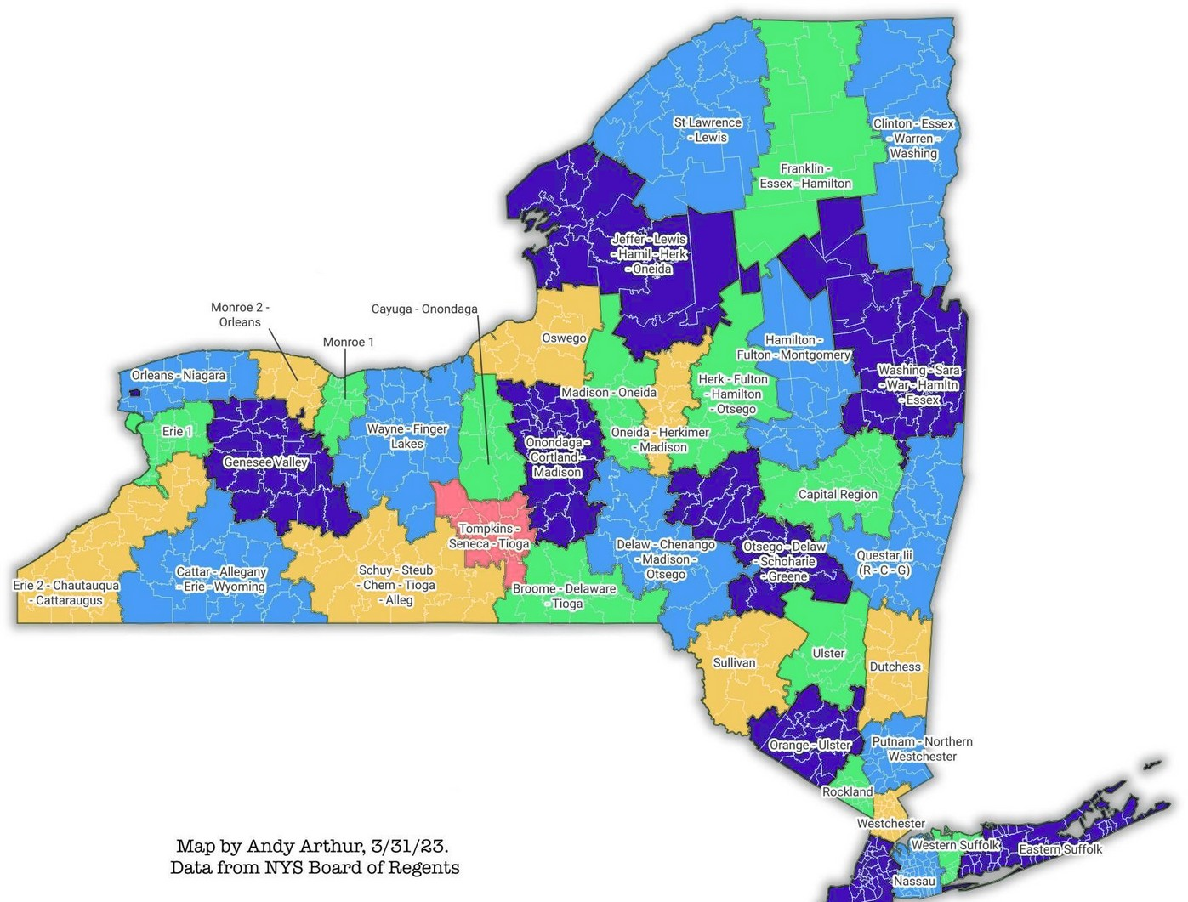

Slide 10



Why is Arts in Education Important?
Arts in Education has been shown to improve both literacy and critical thinking skills resulting in improved performance in other subject areas.
This type of thinking is rarely addressed in other curriculum areas yet is foundational to many of the skills deemed crucial for success in the 21st century - innovation, problem-solving, and creativity among them.
These skills are critical not only in the arts but in a wide variety of subject areas beyond the classroom.

Slide 11

Getting Started with Arts in Education
Has your PTA unit recently participated in AIE?
Yes- Reach out to your building principal and/or district administration to find out what funds are currently available for your unit and the amount.
No- Reach out to your building principal to ask if there is a contact person for AIE within your district.
Most units will need to work alongside their building and district administration to get AIE started for their school.
Meet with your unit executive PTA board to vote on adding a budget line for Arts in Education funding, if possible.
Speak with your local PTA units to find out what sorts of programming they have brought in. (Network!)
Meet with your school(s)’ principal/teachers to find out subject matters they are interested in focusing on.
Speak to teachers within your unit to find out curriculum within the grades and any programs they may have experience with at other schools they have taught at.

Slide 12
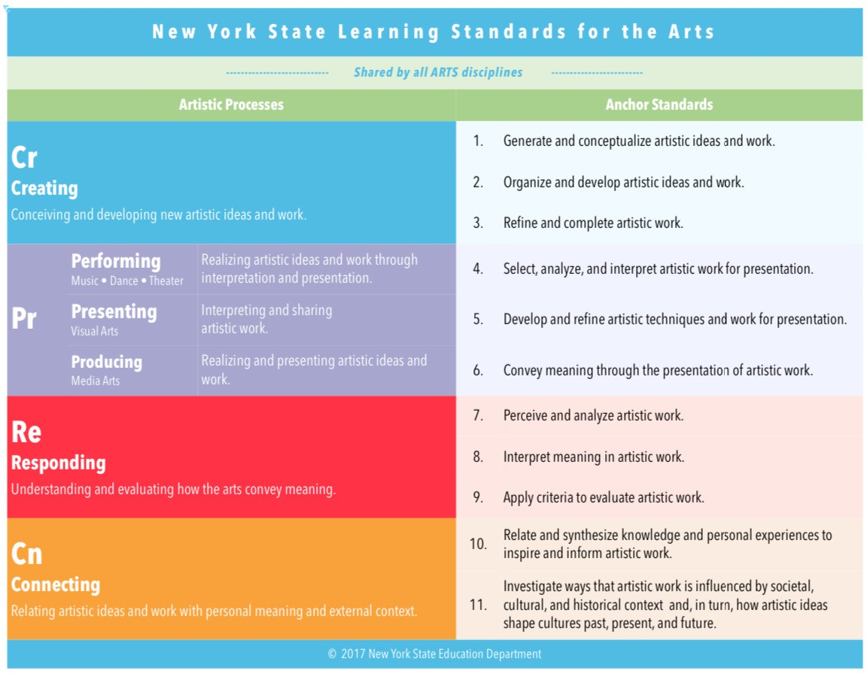






Slide 13
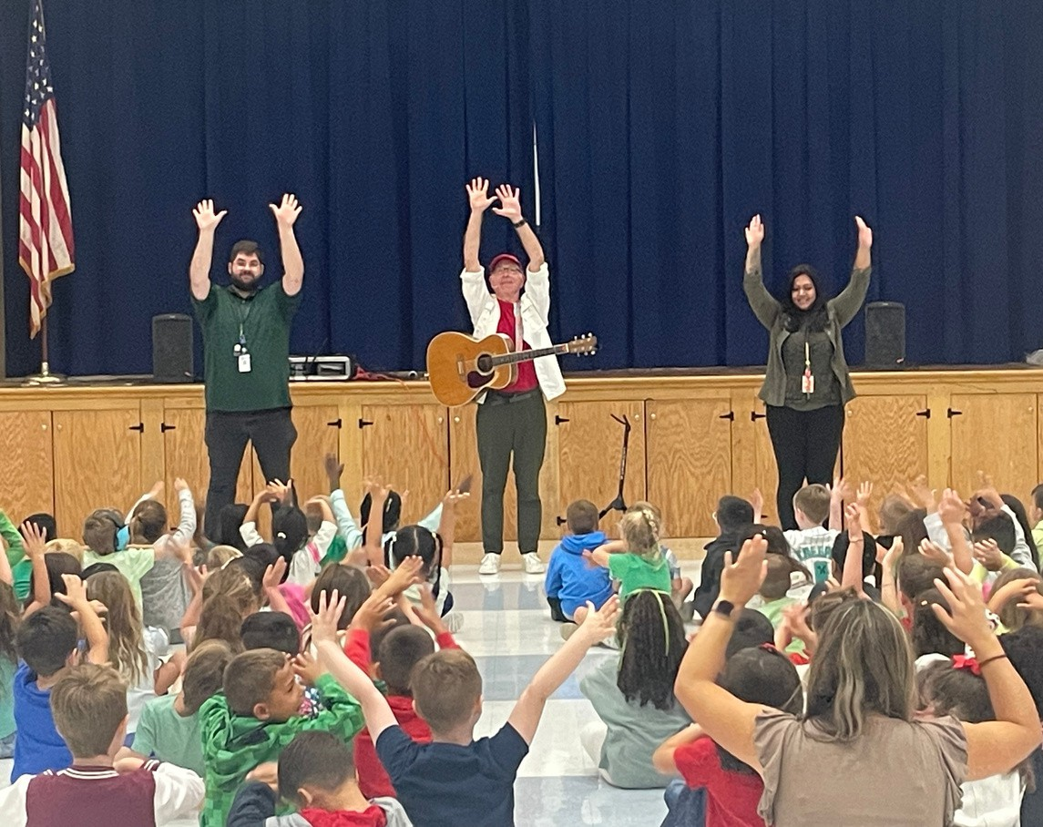
Examples of How Schools Can Use Arts in Education Funding
Field Trips to a theater, historical society, museum, etc. Bringing an assembly presentation into your school
Plan a residency surrounding the arts into your school (ie: dance workshop)
Pay for students to participate in arts-related programs such as NYSSMA (New York State School Music Association)
Purchase arts-related supplies and equipment for visual arts, music, theatre and dance to support arts learning.

Slide 14














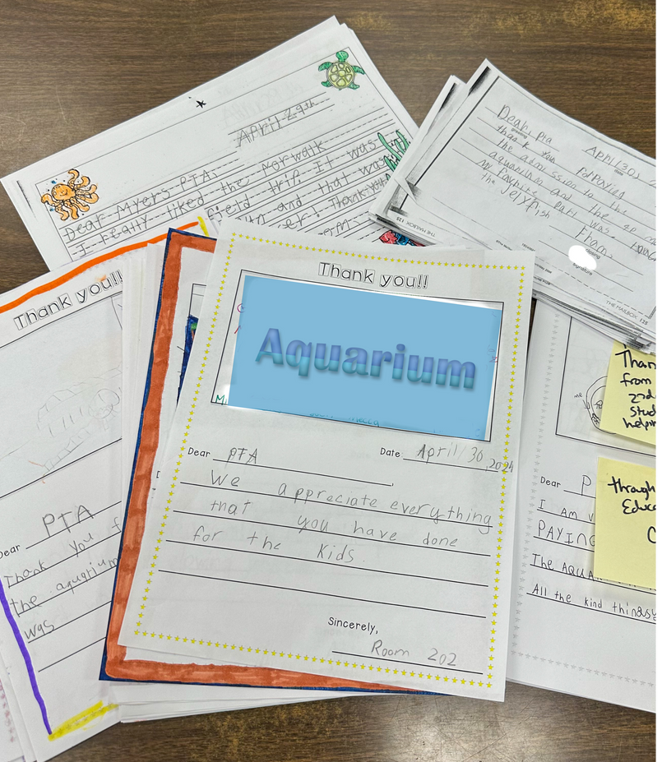


What is Exploratory Enrichment (EE)?
The Exploratory Enrichment program facilitates the integration of curriculum-based activities into instruction supporting the NYS Learning Standards.
Areas covered include:
Mathematics
Science
Technology
Social Studies

Slide 15
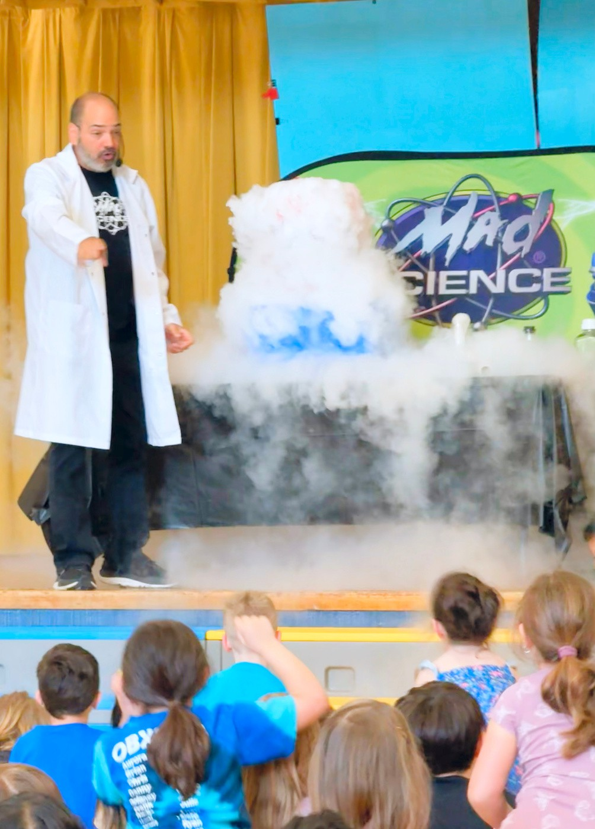


RULES OF EXPLORATORY ENRICHMENT
Can be another type of program, does not have to be directly arts related.
Must be a program that another school in your district has offered within the same school year.

Slide 16


Slide 17
Questions/Comments?

Slide 18


Slide 19
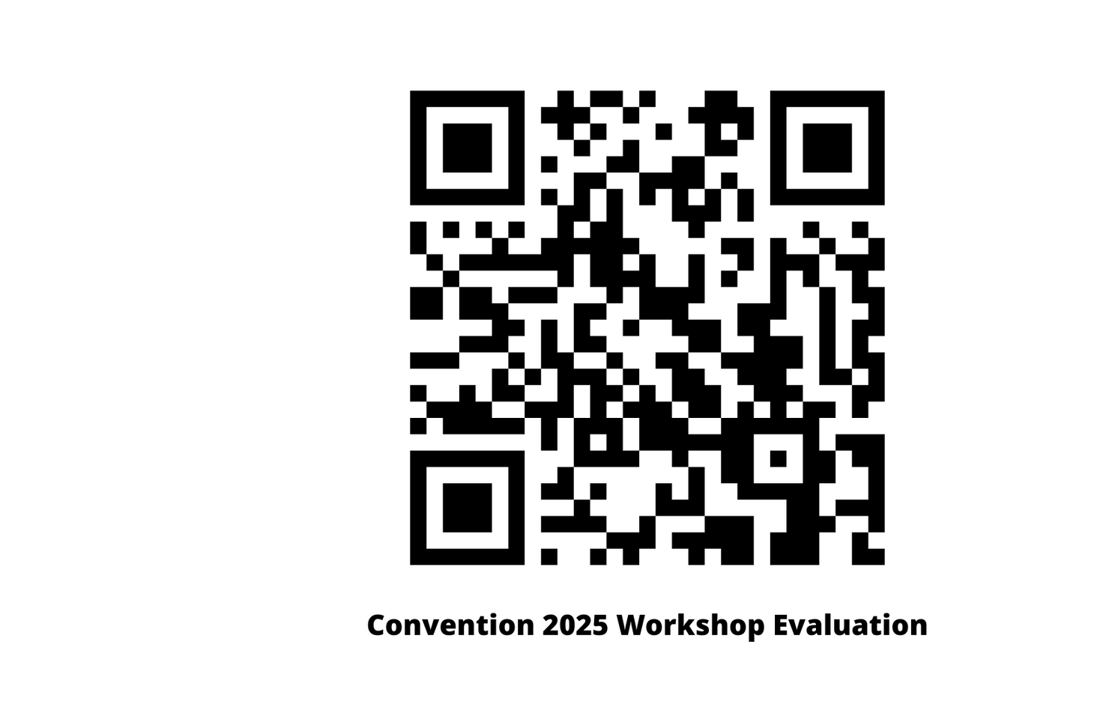

insert review QR code slide here

Slide 20


