Slide 1



31* Point Checklist for Units
Jeanette Rosen
Westchester-East Putnam Region PTA Region Director
Wendy Natalone
NYS PTA Field Support Coordinator

Slide 2

PTA Mission Statement
PTA is a powerful voice for all children, a relevant resource for families and communities, and a strong advocate for the education and well-being of every child.

Slide 3


PTA Basics
We have read our bylaws.
  Our current bylaws expiration date is _________.
    The expiration date is located on the front page of the bylaws.
    If a copy of your bylaws are needed, contact your Region Bylaws Chair https://nyspta.org/bylawsprocedures/
or Region Director https://nyspta.org/home/about/contact/contacts-region-directors/
    Bylaws renewal guidelines are on NYS PTA website (link is above).
We have paid our insurance invoice on_________ and have received our insurance certificate.
    Insurance invoices are emailed to the president by AIM in April.
    Insurance certificates are emailed to the president by AIM in July.
    Contact AIM at (800) 876-4044 if your unit has not received the invoice or has not received the insurance certificate.

Slide 4
PTA Basics (continued)
We have updated our officers’ contact information on Givebacks.
  Units in Good Standing must have a President, Secretary and Treasurer officer contact listed for the current school year.
  Officer contact information includes name, email, phone number and address.
  Officer information must be entered each school year through Givebacks (Compliance → Update Officers)

Slide 5
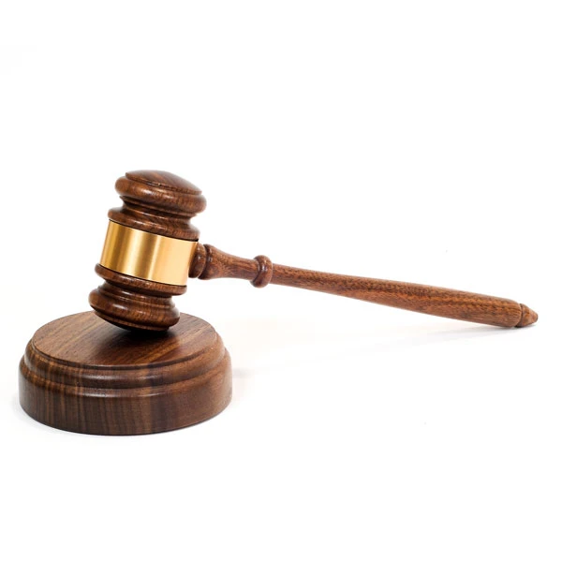
The President’s Guide
We have a calendar of meetings and events.
Our meeting dates are planned and an agenda is prepared and shared.
  A pdf copy of the agenda can be emailed out to members prior to the meeting. Paper copies should be available at the meeting.
We hold our annual meeting as per our bylaws in the month of _________.
Our secretary establishes a quorum of ________members present before voting takes place.
Motions are recorded and seconded before discussion takes place.
  We use Robert's Rules of Order Newly Revised

Slide 6

The PTA Board
Our secretary records the minutes and presents them for approval at the next meeting.
  If the meeting will be held virtually, the secretary shall email a pdf copy of the meeting minutes to each member before the meeting.
Our committees submit a plan of work.
  This is a plan that outlines what is to be done, who will complete the tasks, and what do you expect to be the outcome of the committee work.

Slide 7
Sample Plan of Work Membership Committee
Initiative | Task(s) to complete | Person (s) Responsible | Outcome | Status
First Membership Drive | Print out Membership form and send home in back packs in early September. Have forms available at Meet the Teacher Night, other events | Membership chair | PTA will begin to receive membership dues
Yearlong Membership Drive | Enter member information into Givebacks Have form available at meetings, Events, etc. | Membership Chair, officers | Begin to build membership list to be available to officers
Pay Dues to NYS PTA | Inform officers that members entered in Givebacks Submit dues to NYS PTA via eCheck system- First payment dues by October 31st Make payments monthly as needed Final submission due by April 30th | Membership chair Treasurer or president | Unit will be in Good Standing

Slide 8

Finance and Insurance
We have adopted a balanced budget by vote of our membership.
  Amendments to the budget are approved by a vote of our membership.
Our fundraisers are planned to support our programs, activities and leadership training.
  We follow the 3 to 1 rule of 3 planned programs for every one fundraising activity.
Our checks are signed by 2 authorized PTA signatories.
  Signatories are approved as per our procedures.
  Best practices have 3 authorized PTA signatories to ensure continuity.

Slide 9
Finance and Insurance (continued)
Our treasurer presents an activity report and a budget report at each meeting.
  Monthly bank statements are reconciled and signed by a reviewer who is not an approved account signatory. The review is recorded in the meeting minutes. Statements with reconciliations are retained by the Treasurer. Financial software does not qualify as this requirement.
We have an annual audit with a signed report given at the first meeting of the succeeding school year.
  Insurance claims made to AIM for Embezzlement, Robbery or Theft will be denied if the reconciliations and the audit are not completed.
  Completed financial review should be uploaded into the Compliance section of Givebacks.
We have filed our IRS Form 990 for the fiscal year ending June 30.
  NYS PTA has contracted with File 990 to provide a free, fast, easy, and safe way to e-file your 990-N form or 990 EZ form.
  Reminder emails are sent to President and Treasurer address in Givebacks starting July 1.
  990 confirmations should be uploaded into the Compliance section of Givebacks.

Slide 10

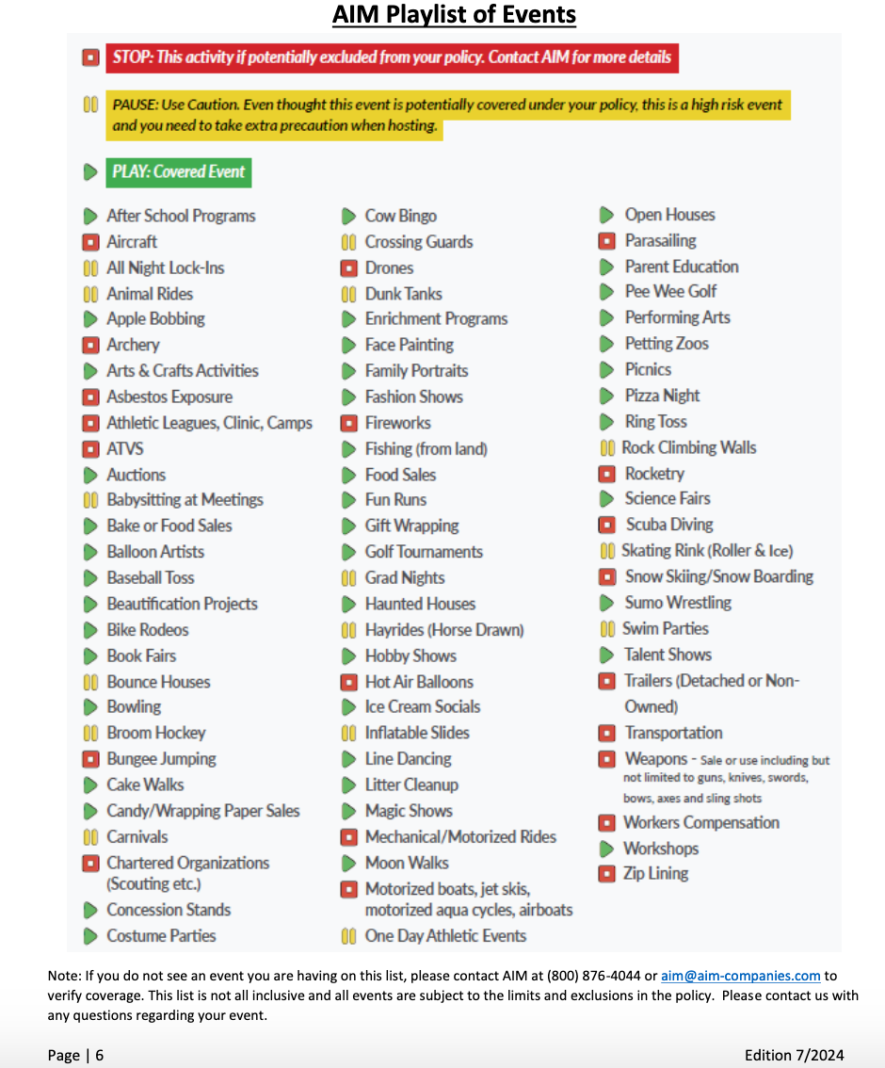
Finance and Insurance (continued)
We refer to the play-pause-stop list for insurance recommendations when planning our activities (the list is on page 6 in the NYS PTA Insurance Resource Guide)
https://nyspta.org/wp-content/uploads/2024/07/NYS-PTA-Insurance-Guide-2024-final.pdf

Slide 11
Financial Accountability
Our President and Treasurer have completed the Financial Accountability Training by October 15.
  Starting with the 2025 - 2026 school year, NYS PTA launched a NEW, hour long, Financial Accountability “class” that is available live on Zoom, or in-person at Region (SLT) and NYS PTA events (SLC).
  While required for all Presidents and Treasurers, we welcome any leader or member to attend!
  Completion certificates should be uploaded in the Compliance section of Givebacks.

Slide 12


Membership
We have a membership goal of _________.
  The membership goal set by NYS PTA is located on Givebacks on the Unit Data link on the Admin Console.
Our dues to become a member are_________.
  The dues amount that each members pays is located in your bylaws. A total of $5 per member is remitted to NYS PTA.
We maintain a roster of our members.
  An Excel spreadsheet with the names of the current year members can be exported from Givebacks.

Slide 13
Bylaws, Procedures, Nominations and Elections
We have approved procedures for officers and committees.
  There are sample procedures in the Resource Guide, Section 7 to assist your PTA in writing your Procedures.
  Examples of items that need to be included in financial procedures:
    Committees need to be aware of their budget.
    Expenses not in the budget or expenses that may go over the budgeted amount will need prior approval from the president AND an amendment to the budget.
    The use of vouchers to accompany invoices and receipts.
    Deadline for submission of receipts for expenses after an event (example, receipts must be received within 30 days of an event).
    Decide whether the PTA will or will not allow expenses to cross over to the next fiscal year
    Use of Tax Exempt Purchase Certificate for PTA purchases and paying for these purchases with a PTA check (some vendors and stores will not accept a personal credit card as the form of payment with the tax exempt form).
    Decide whether the PTA will or will not reimburse a member for sales tax if tax exempt form is not used (there is no NYS PTA regulation that forbids a PTA from reimbursing for sales tax.)

Slide 14
Bylaws, Procedures, Nominations and Elections
We follow our bylaws for the makeup of our elected nominating committee.
  Nominating committee must be elected by the membership. The composition of this committee is always an odd number and mix of Executive Board members and general membership as set out in unit bylaws.
Our vote for new officers takes place in the month of _________.
  We accept nominations from the floor as per our bylaws (Choice of 2-day notice period or no notice period)

Slide 15
PTA Advocacy
We include advocacy efforts in our annual plans.
  Go to the NYS PTA Website, www.nyspta.org, and go to the Advocacy Tab for tools, Resolutions and Position papers. There is also the Advocacy Section of the Resource Guide (Section 8) for more information.
We inform our members of the positions of NYS PTA found in the “Where We Stand” document.
  Go to the NYS PTA website, www.nyspta.org, Advocacy Tab, Advocacy Tools, Where We Stand

Slide 16

School and Community
We support student success by promoting the National Standards for Family School Partnerships.
  The Standards are found on the National PTA website at this link: https://www.pta.org/home/run-your-pta/National-Standards-for-Family-School-Partnerships
We seek to partner with our teachers, principal, school board and community.

Slide 17
Programs, Awards and Recognitions
We follow the 3-to-1 rule of three planned programs for every one fundraising activity.
We have a NYS PTA Pick A Reading Partner Program (PARP).
  Information for PARP: https://nyspta.org/home/programs/literacy/
We participate in the National PTA Reflections Arts Program.
  Information for Reflections: https://nyspta.org/home/programs/reflections/
We recognize our members and partners with NYS PTA and National PTA awards.
  Information for State and National Awards:
    https://nyspta.org/home/pta-leaders/awards-and-recognitions/
    https://www.pta.org/home/run-your-pta/Awards-Grants
Contact your RD for Region awards that are offered.

Slide 18

Questions???
Please contact:
Jeanette Rosen
Westchester East Putnam Region Director
westchestereastputnamrd@nyspta.org
845-222-4770
Wendy Natalone
NYS PTA Field Support Coordinator
fieldsupportnatalone@nyspta.org
516-528-0756

Slide 19
