Slide 1

Screening Women Through the Ages
Dr. Samihah Ahmed, MD, MBA
Endocrinology
Notes:
Good afternoon, everyone. What a wonderful group to be with today.
I am truly honored to be here representing the Katz Institute for Women's Health, and I want to begin by saying something that I mean sincerely: thank you for being here. The fact that you carved time out of your day to sit in this room and think about your health tells me something important about you. You are already taking the first step.
My name is Dr. Samihah Ahmed. I am an endocrinologist, which means I specialize in hormones—and as you'll discover today, hormones have a remarkable amount to say about nearly every aspect of a woman's health throughout her lifetime.
I've spent my career working with women at every life stage: teenagers navigating hormonal changes, young women managing fertility and reproductive health, women in their forties and fifties navigating menopause, and women in their seventies and beyond working to maintain vitality and independence.
What strikes me consistently, regardless of age or background, is this: women are incredibly good at showing up for everyone else—and incredibly reluctant to show up for themselves.
Today, we are going to change that—at least for the next forty-five minutes.
We'll talk about what screening is, why it matters, and what every woman should be thinking about at every stage of life. My goal is not to overwhelm you with guidelines. My goal is to empower you with knowledge—because knowledge leads to action, and action leads to better health outcomes.
So let's begin.

Slide 2
Redefining tomorrow’s healthcare for women today
The Katz Institute for Women’s Health is dedicated to improving the health of women across their lifespan, bridging the gap between wellness and personalized care delivery.
We are advancing women’s health every day by providing expert, coordinated clinical care, educating our community on prevention and well-being and supporting sex- and gender-specific research.

Slide 3
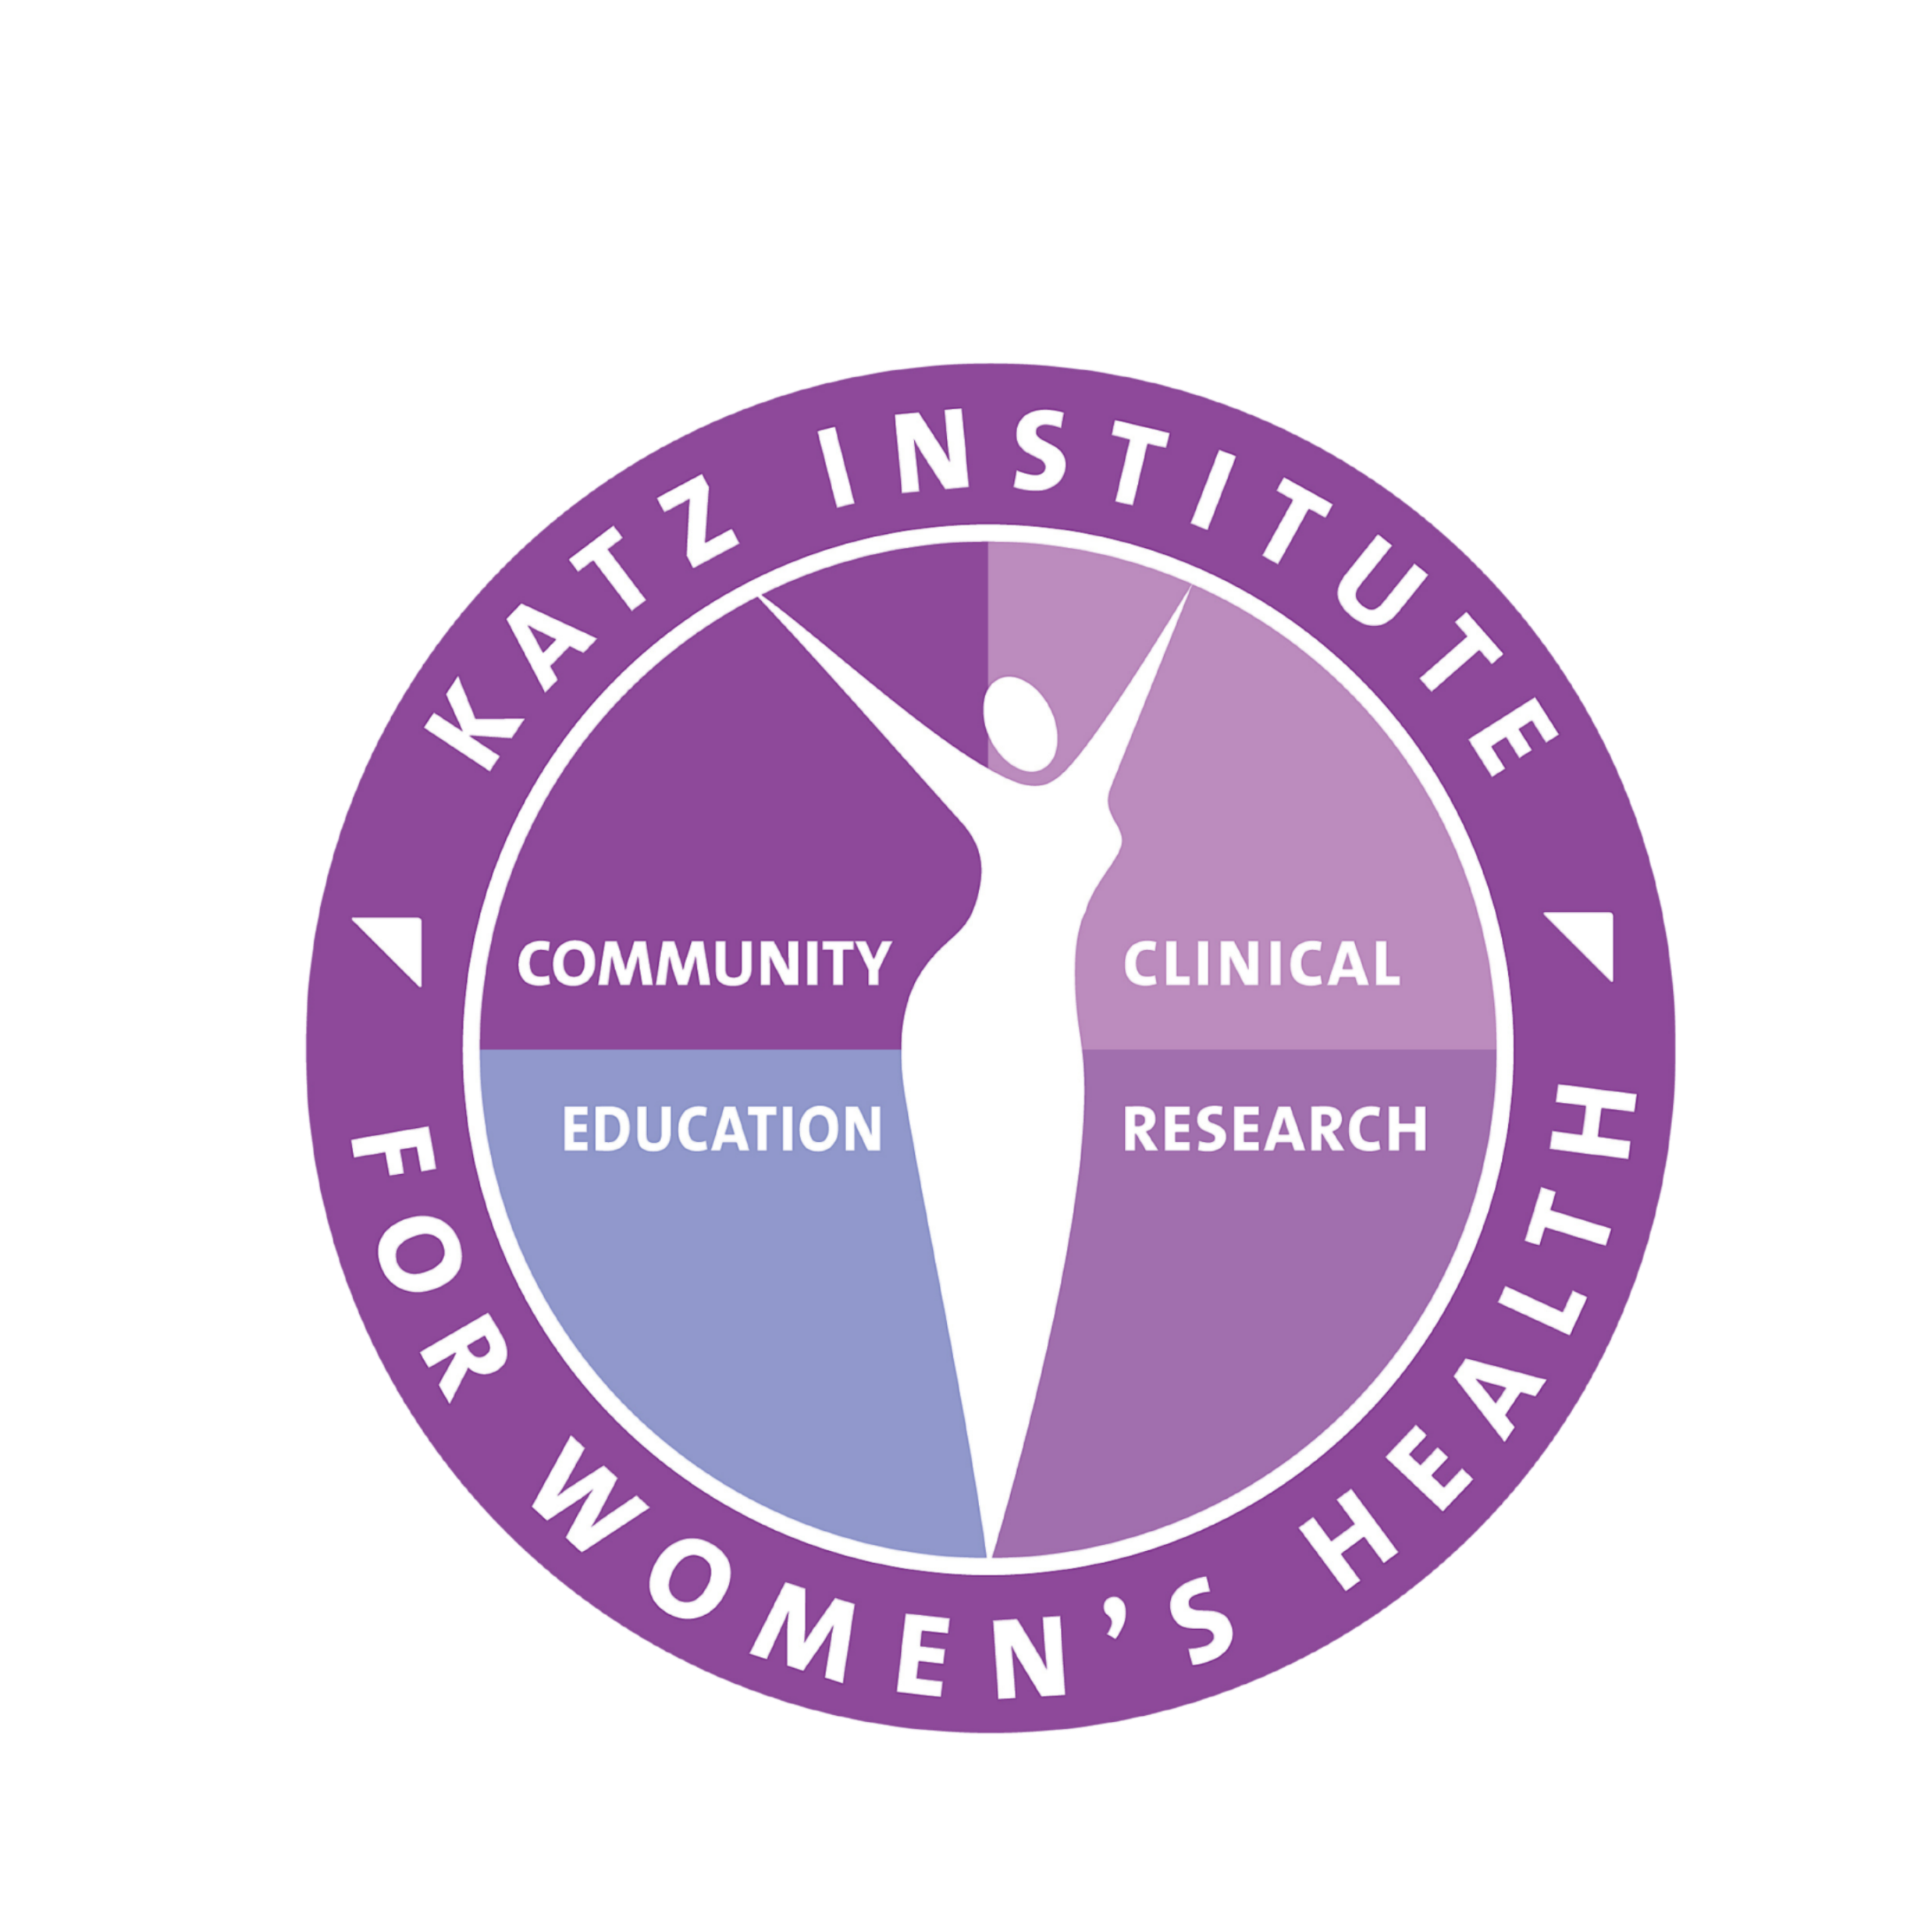

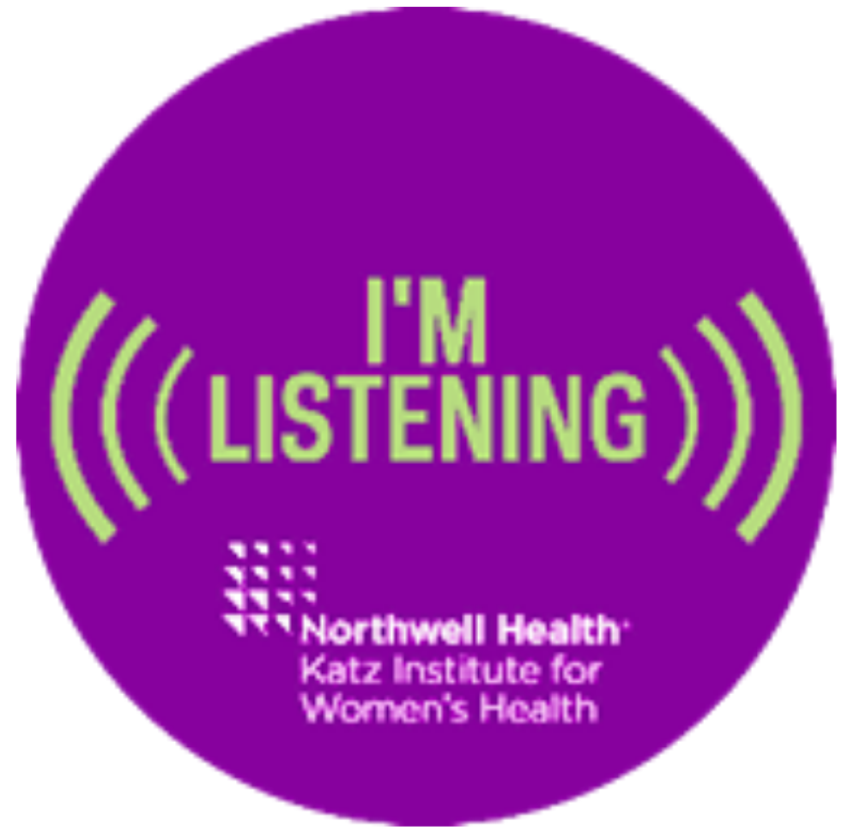


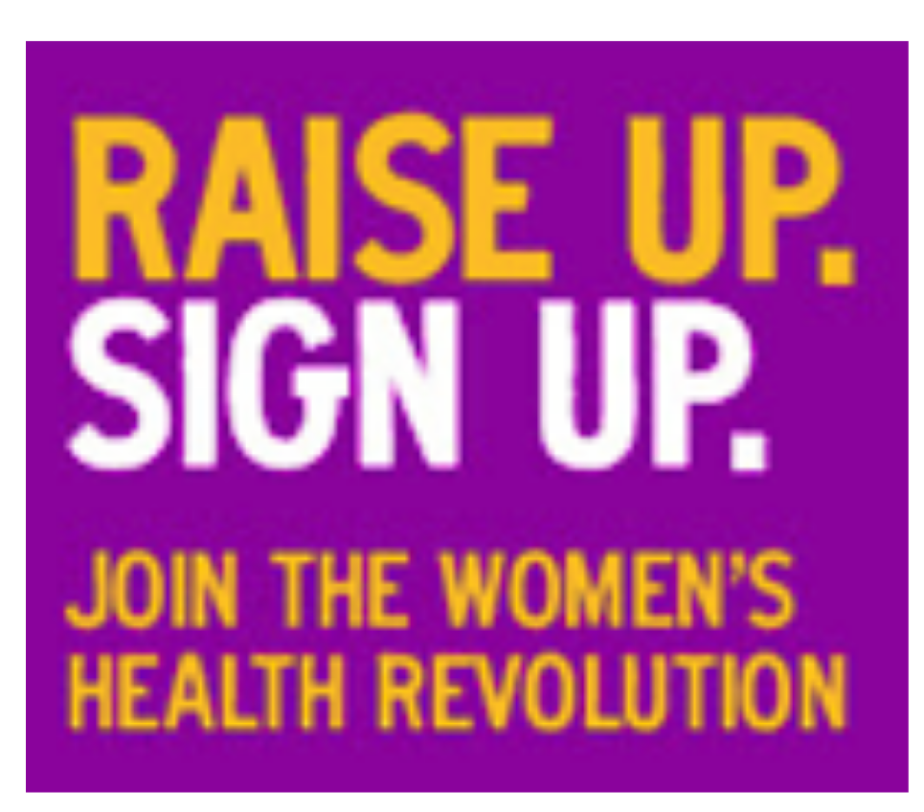
Clinical care
Our network of women’s health experts practice within every specialty and geographic region.
Continuing medical education
We collaborate with clinical departments and service lines to ensure every clinician at Northwell has the tools they need to provide sex- and gender-specific patient care.
katz institute for women’s health
Patient experience
We understand that women’s expectations for care are different than men’s. We are committed to providing extraordinary patient experience for women.
Community outreach
Through community outreach and educational programs, we are empowering women to make informed health care decisions.
Redefining Tomorrow’s Healthcare for Women Today
Medical education and research
We partner with the Zucker School of Medicine and the Feinstein Institutes to ensure that the role of sex and gender in health is included in medical education and research.
Trusted voices
KIWH partners with local, regional and national leaders in industry, media and government to raise awareness and advocate for women’s health issues.

Slide 4
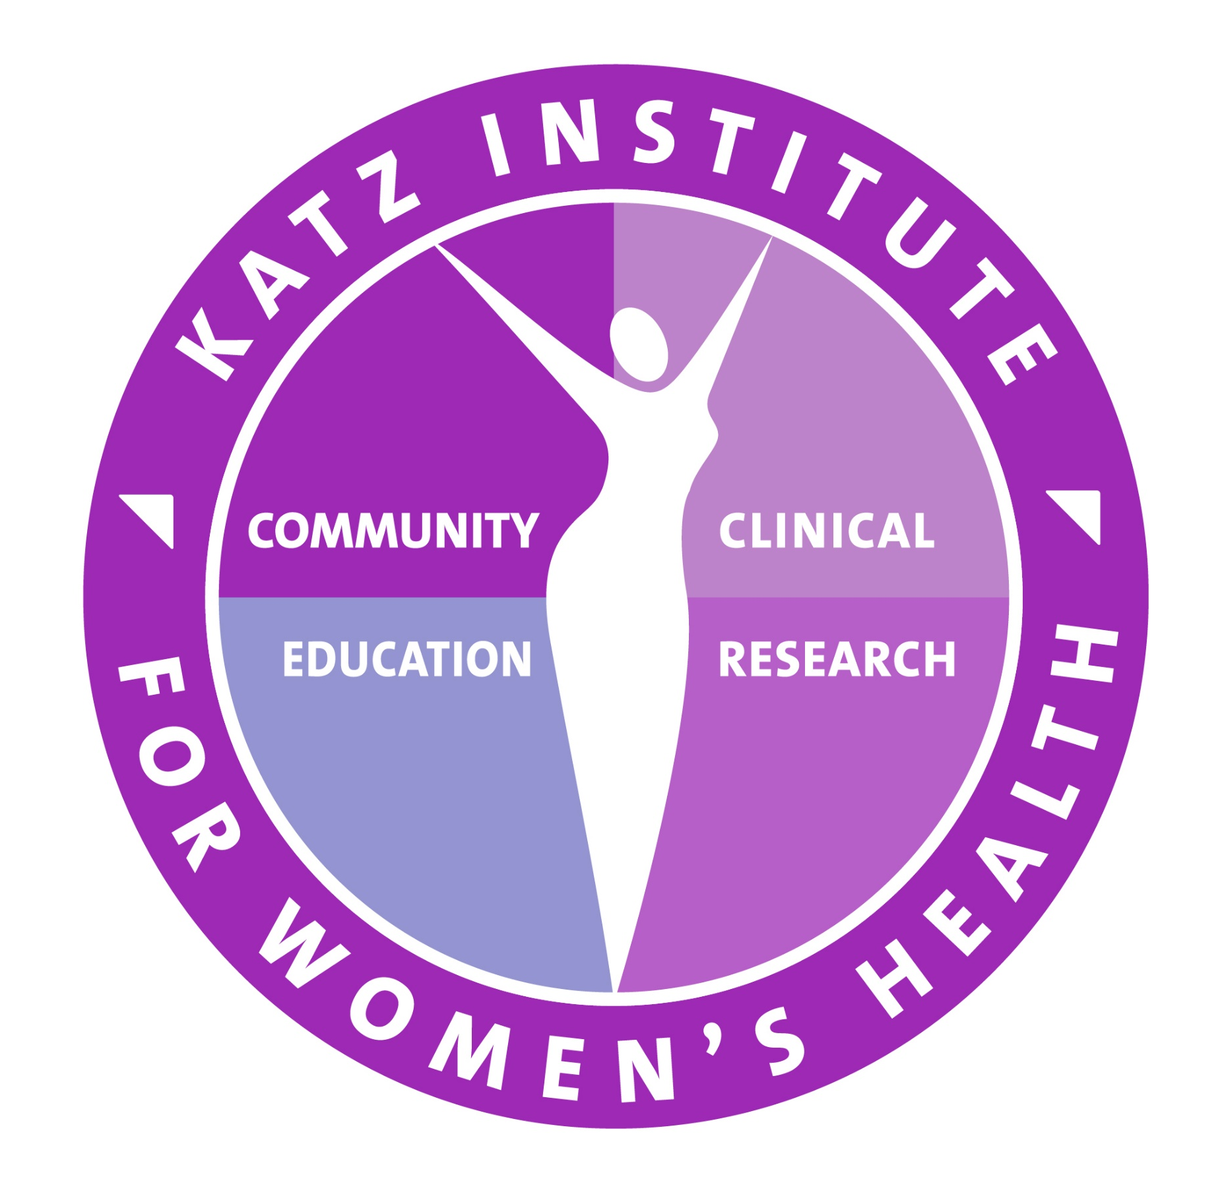





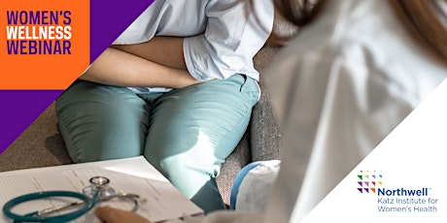

KIWH ECOSYSTEM
KATZ WOMEN’S CIRCLE
Katz Women’s Circle subscribers
receive our monthly newsletter,
attend programs and events,
and are part of the conversation.
1,100+
41,240+
13,000+
WOMEN’s HEALTH
Network of experts
The Katz Institute has a network of clinicians and researchers who
are dedicated to raising every
aspect of women’s health.
SOCIAL MEDIA
FOLLOWERS
KIWH followers interact with KIWH through shares, likes and comments, boosting content and amplifying our messaging on social.
EVENTBRITE
SUBSCRIBERS
Community
members
registered to
receive educational
event notifications.
8,000+
1,265+
KIWH Ambassadors
Northwell team members
serve as women’s health
champions to bring awareness
and knowledge to colleagues,
family members and communities.
64,500+
Notes:
14,885 took the KIWH wellness pledge

Slide 5
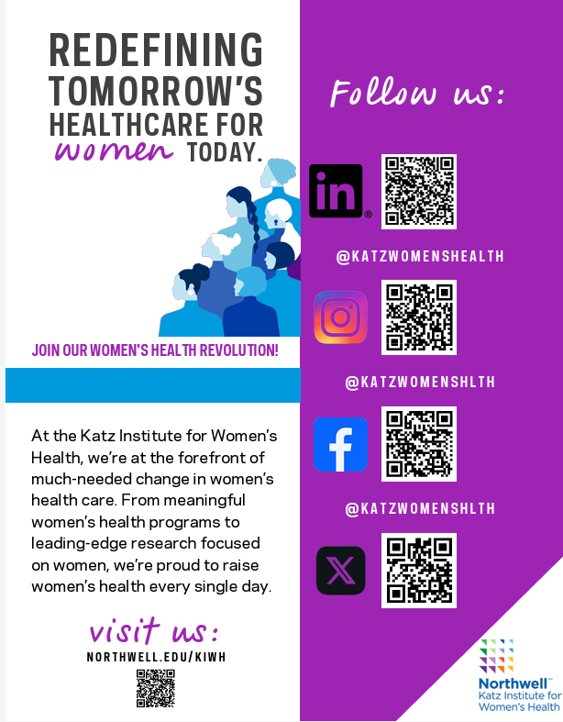
follow us and stay informed!

Slide 6
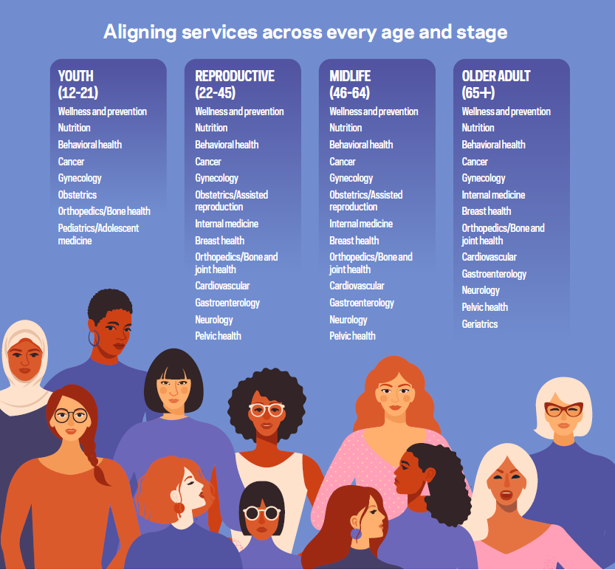
Across the lifespan
The Katz Institute for Women’s Health considers women’s norms, needs and patterns of disease and healing to deliver women-centered care across every age and stage.
6

Slide 7
Raise your hand if:
✓ You’ve delayed your own doctor’s appointment
✓ You schedule everyone else’s appointments first
✓ You’ve ever said:
“I’ll get around to it later.”
Notes:
Let's start with a quick, honest show of hands.
How many of us in this room have postponed a mammogram, an annual physical, or a routine blood draw because something else 'more urgent' came up?
How many of you schedule your children's, your partner's, or even your pet's appointments before you even think about booking your own?
Look around the room. Almost every hand is up.
This is a universal truth: women are the caretakers of everyone else's health, often while completely neglecting their own. Today, we are going to change that narrative.

Slide 8
Women Are the Chief Medical Officers of the Family
  Women influence:
  Children’s healthcare
  Spouse healthcare
  Aging parent healthcare
  Household nutrition
  Preventive health behaviors
80%
80%
of healthcare decisions in families are made by women
of healthcare decisions in families are made by women
Notes:
The data tells a powerful story: women are the Chief Medical Officers of their households. You make roughly 80% of the healthcare decisions for your families.
You choose the doctors, you buy the groceries, you monitor symptoms, and you keep track of who is due for a vaccine or a check-up.
Because of this massive influence, when a woman prioritizes her own preventive care, it creates a powerful, lasting ripple effect. Healthy women build healthy families, which in turn build healthy communities.

Slide 9
Why this matters
♥
✿
HEART DISEASE
BREAST CANCER
#1
1 in 8
Killer of Women
Women Affected
◆
▲
DIABETES
OSTEOPOROSIS
Millions
1 in 2
Women Over Age 50
Notes:
Let's look at the sobering reality of what we are up against.
Many women I speak with fear breast cancer above all else. And while breast cancer affects an incredible 1 in 8 women, heart disease remains the absolute leading cause of death for women globally.
Conditions like cardiovascular disease, Type 2 diabetes, and osteoporosis often progress silently inside our bodies for years—even decades—before the first visible symptom appears. Screening is our window into that silent phase.

Slide 10
Prevention is powerful
Many serious illnesses can be:
🛡
⏰
🔍
PREVENTED
DELAYED
DETECTED EARLY
Before onset through
proactive care
Through structured
lifestyle changes
When treatment outcomes
are most effective
Notes:
I want to clarify a key concept: a mammogram does not prevent breast cancer. A colonoscopy does not prevent colon cancer.
What these screenings do is give us the ultimate clinical advantage: time.
They allow us to intercept disease at its absolute earliest stage—when it is microscopic, highly localized, and when treatment outcomes are dramatically more successful. Prevention is not about living a perfect life; it is about giving yourself the best possible odds.

Slide 11
The women's health timeline
Teen Years
20s & 30s
40s
50s & 60s
70+
Building
Foundations
Reproductive
Health
Cancer &
Heart Screening
Menopause &
Bone Health
Healthy
Aging
Notes:
Think of health screenings as an evolving roadmap. The tests you need in your 20s are fundamentally different from those you need in your 60s.
Today, we're going to walk through this timeline step-by-step.
You do not need to memorize every clinical guideline. Your job is simply to understand the conversations you should be initiating with your primary care provider at every stage of your life.

Slide 12

What is screening?
  Screening = Testing Before Symptoms Occur
Mammogram — Breast health imaging
Pap Test — Cervical cell evaluation
Colonoscopy — Colorectal cancer prevention
Bone Density Scan (DEXA) — Osteoporosis detection
Blood Pressure Check — Cardiovascular risk assessment
Notes:
To get clinical value from screening, you must seek it out while you feel completely fine.
If you wait until you feel a lump, have chronic pain, or experience extreme fatigue, you are no longer in the realm of 'screening'—you are in the realm of 'diagnostic testing.'
Screening is our proactive tool to catch changes early, giving us a head start.

Slide 13
Building healthy foundations
Many serious illnesses can be:
Teen Years Matter — The habits formed now echo through a lifetime
🛡
💉
🧠
🥦
🏃
😴
Vaccinations
Mental Health
Nutrition
Exercise
Sleep
Notes:
Our health story does not begin at age 40. The structural foundations of our adult health are laid down during our teenage years.
For example, peak bone mass is achieved by our late teens and early twenties. The calcium, vitamin D, and resistance exercise we get during this decade dictate our risk of fractures fifty years down the road.
This is also when we must establish proactive routines for mental health and preventative vaccine updates.

Slide 14
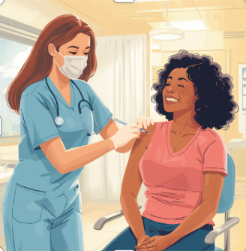
HPV VACCINE SAVES LIVES
  HPV Can Cause:
Cervical cancer
Vaginal cancer
Vulvar cancer
Oropharyngeal cancer
Anal cancer
Vaccination can prevent over 90% of HPV-attributable cancers.
Notes:
Let's talk about a true medical miracle: a vaccine that actually prevents cancer.
The Human Papillomavirus, or HPV, is incredibly common and is the direct cause of almost all cervical cancers, alongside several other cancers of the throat and reproductive tract.
By vaccinating our children—both boys and girls—ideally starting around age 11 or 12, we can virtually erase these cancers for the next generation. If you are a parent or grandparent, this is one of the most vital preventive steps you can discuss with a pediatrician.

Slide 15
Recognizing PMOS Early
Polyendocrine Metabolic Ovarian Syndrome — Affects approximately 1 in 10 women
📅
✨
💇
⚖️
👶
Irregular
Periods
Acne &
Skin Changes
Excess
Facial Hair
Unexplained
Weight Gain
Fertility
Challenges
Notes:
As an endocrinologist, Polyendocrine Metabolic Ovarian Syndrome, or PMOS, formally known as PCOS is one of the most common conditions I diagnose and manage in young women.
Despite affecting 10% of women, it is frequently missed or dismissed as 'normal teen hormone changes.'
PMOS is not just a cosmetic issue or a reproductive issue—it is a profound metabolic condition that increases a woman's lifetime risk of insulin resistance, Type 2 diabetes, and cardiovascular disease. Recognizing it early allows us to protect your long-term health.

Slide 16

You're busy- BUT THIS MATTERS
  Your 20s and 30s: The Transition Decades
  High-demand career building years
  Family building and pregnancy transitions
  Peak chronic stress and competing priorities
Feeling healthy does not guarantee being healthy.
Notes:
In your 20s and 30s, you often feel invincible. You are busy building careers, relationships, and perhaps families. It is easy to think, 'I feel fine, why do I need a doctor?'
But these are the decades where silent risk factors—like elevated blood pressure, subclinical thyroid disease, and metabolic changes—begin to quietly establish themselves.
Do not let preventive care fall completely off your busy schedule.

Slide 17
Cervical cANCER SCREENING
Age 21–29
Age 30–65
Pap Test
HPV Testing
Every 3 Years
or Co-Testing Every 5 Years
Notes:
Cervical cancer screening is one of the greatest success stories in the history of medicine.
Before the Pap smear became routine, cervical cancer was a leading cause of cancer death for women. Today, we can identify abnormal cells before they ever turn into cancer.
Talk to your doctor to see which frequency fits your specific history.

Slide 18
Prevention is powerful
FAMILY PLANNING AND FERTILITY
📅
Pregnancy Planning
❄️
Fertility Preservation
Preconception health optimization
Assessing options & timing
👨‍👩‍👧
Family Building Goals
🩺
Chronic Disease Mgmt
Aligning plans with health
Managing conditions before conception
Notes:
Whether your personal goal is to have children now, delay family building, or not have children at all, family planning is a fundamental part of preventive healthcare.
If you are considering pregnancy later in life, discussing options like egg freezing or assessing your ovarian reserve early in your 30s can be highly empowering.
If you have chronic conditions like diabetes, thyroid disease, or PMOS, optimizing your metabolic health before conception is the single best step you can take for a healthy pregnancy.

Slide 19
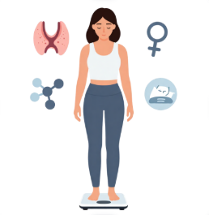
When weight gain is more than weight gain
  Weight is not simply about calories and will power
PMOS and insulin resistance
Thyroid disorders (hypothyroidism)
Cortisol changes from chronic stress
Estrogen fluctuations and perimenopause
Sleep disorders and metabolic disruption
Certain medications
Obesity is a complex chronic disease---not a character flaw.
Notes:
One of the most common, frustrating complaints I hear from women in their 30s and 40s is: 'Dr. Ahmed, I haven't changed my diet, I'm exercising the same, but the weight is suddenly piling on.'
And they feel incredibly guilty about it, assuming it's a personal failure of willpower.
As an endocrinologist, I am here to tell you that weight is a highly regulated, complex hormonal system. Your thyroid, your insulin levels, your sleep, and your stress hormones all dictate how your body stores energy. If you are experiencing unexplained weight changes, we need to look deeper at the underlying biology.

Slide 20
Mental health matters
Mental Health IS Health — Watch for these important signals:
Mental Health IS Health — Watch for these important signals:
Mental Health IS Health — Watch for these important signals:
😰
😰
😰
😔
😔
😔
🔥
🔥
🔥
😴
😴
😴
💙
💙
💙
Anxiety
Anxiety
Anxiety
Depression
Depression
Depression
Burnout
Burnout
Burnout
Sleep
Disturbances
Sleep
Disturbances
Sleep
Disturbances
Caregiver
Stress
Caregiver
Stress
Caregiver
Stress
Notes:
In our society, women are frequently praised for being master multitaskers. But the invisible mental and emotional load of managing careers, households, and families carries a physiological cost.
Chronic stress elevates cortisol, raises blood pressure, disrupts sleep, and causes systemic inflammation.
Screenings for anxiety and depression are just as clinically vital as checkups for high blood pressure. Taking care of your mental well-being is not a luxury or a selfish act; it is a foundational pillar of your physical survival.

Slide 21
Welcome to perimenopause
Mental Health IS Health — Watch for these important signals:
Mental Health IS Health — Watch for these important signals:
The transition begins years before the final menstrual period.
Reproductive Years
Regular hormonal cycles
Late 30s / Early 40s
Hormones begin to fluctuate
Perimenopause
Irregular cycles, symptoms emerge
Menopause
12 months without a period (avg. age 51)
Notes:
There is a common myth that menopause is like a light switch: you have periods, and then one day they stop, and you are in menopause.
In reality, it is a long, often erratic transition called perimenopause, which typically begins in your 40s.
During this phase, estrogen levels don't just drop—they fluctuate wildly. This hormonal roller coaster is what causes changes in your sleep, energy, mood, and cycles. Knowing this transition is underway lets you seek targeted support rather than wondering what is happening to your body.

Slide 22
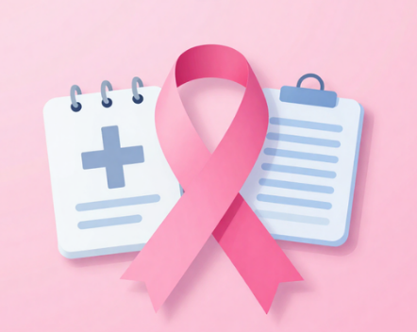
Breast cancer screening
Know Your Risk — Early Detection Saves Lives
Annual mammograms — Typically recommended starting at age 40
Know your family history — Maternal AND paternal
Genetic counseling — If close relatives had breast or ovarian cancer
Breast self-awareness — Know your personal baseline
High-risk screening — MRI may be recommended for elevated risk
Notes:
Mammograms save lives by identifying breast cancer years before a lump can ever be felt during a physical exam.
For the average risk woman, annual screening mammograms should begin at age 40. However, if you have a family history of breast, ovarian, or other cancers, you may need to start screening much earlier or undergo genetic testing.
Have a clear, personalized conversation with your doctor about your unique risk profile.

Slide 23
HEART DISEASE: THE threat most women don't see
#1
Killer of Women
More deaths annually than all cancers combined
Symptoms in women are often atypical
Develops silently over decades
Risk accelerates as estrogen declines
Notes:
This is one of the most critical slides in this deck. Many women fear breast cancer above all, yet cardiovascular disease is the leading cause of death for women.
Heart disease is not just a 'men's health issue.'
In women, heart disease can present without any dramatic chest pain. Instead, you might feel unexplained shortness of breath, unusual fatigue, or nausea. Because of these subtle signs, we must focus on screening the key risk factors early.

Slide 24
KNOW your numbers
These five metrics are your most powerful health indicators:
♥
🩸
🔬
⚖️
📏
BLOOD
PRESSURE
CHOLESTEROL
A1C
WEIGHT / BMI
WAIST
CIRCUMFERENCE
< 120/80 mmHg
Full Lipid Panel
< 5.7% Normal
Body Composition
< 35 inches
Notes:
If you leave here today with just one task, let it be this: know your numbers.
These five numbers give us an incredibly accurate picture of your metabolic and cardiovascular health. They are the early warning indicators of silent chronic disease.
If any of these numbers are out of range, it is not a diagnosis of failure—it is an opportunity to make lifestyle and clinical changes to rewrite your health future.

Slide 25
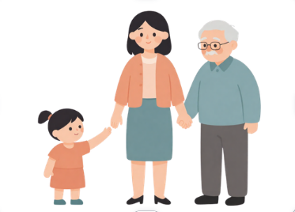
The sandwich generation
Mental Health IS Health — Watch for these important signals:
The transition begins years before the final menstrual period.
Many women are simultaneously caring for multiple generations:
👧 Caring for growing children and their needs
👵 Supporting aging parents with complex care
💼 Managing career and professional demands
❤️ Remembering to care for yourself
You cannot pour from an empty cup.
Notes:
Women in their 40s and 50s often belong to the 'Sandwich Generation.' You are squeezed between the demands of parenting teenagers, caring for elderly parents, and peak career responsibilities.
In this demanding phase, your personal wellness is often the very first thing you sacrifice.
But remember: your family's wellness depends on your health. Taking time to schedule your own screenings is not selfish; it is the absolute foundation of your caregiving.

Slide 26
WHAT ACTUALLY HAPPENS DURING MENOPAUSE
Declining estrogen impacts nearly every organ system:
🦴
🧠
♥
😴
⚡
Bones
Brain
Heart
Sleep
Metabolism
Katz Institute for Women's Health | Northwell Health
Dr. Samihah Ahmed, MD, MBA
Notes:
Menopause is officially defined as going 12 consecutive months without a menstrual period. But clinically, it represents a major metabolic shift.
Estrogen receptors are located throughout your entire body—in your brain, heart, bones, and blood vessels.
When estrogen declines, your risk for cardiovascular changes and bone loss increases. This is why midlife screenings are so essential to help you navigate this transition smoothly.

Slide 27
The symptoms nobody warned you about
Menopause extends far beyond hot flashes:
🔥
🧠
😴
😟
💦
Hot
Flashes
Brain
Fog
Sleep
Problems
Mood
Changes
Night
Sweats
You cannot pour from an empty cup.
Notes:
Everyone knows to expect hot flashes during menopause. But women are often completely blindsided by the cognitive and emotional symptoms.
You might feel a sudden 'brain fog,' struggle to recall words, experience severe insomnia, or feel a new wave of anxiety.
These are not signs that you are losing your mind—they are real physiological responses to changing estrogen levels in your brain. These symptoms are common, and they are highly treatable. You do not have to suffer in silence.

Slide 28
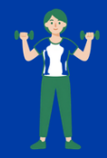
WEIGHT GAIN & mENOPAUSE
Hormonal shifts alter body composition directly:
Visceral fat accumulates in the abdominal region
Lean skeletal muscle mass declines (sarcopenia)
Resting metabolic rate slows with hormonal changes
Visceral fat increases inflammation and insulin resistance
Maintaining muscle mass is the most important counter-strategy.
Notes:
During menopause, many women notice that weight begins to settle around their midsection, even with no changes to their diet or exercise.
This is a direct hormonal effect. Lower estrogen encourages your body to store visceral fat—the deep fat around your organs.
Visceral fat is metabolically active and can increase inflammation and insulin resistance. To counter this shift, we need to focus less on restrictive dieting and more on maintaining our lean muscle mass.

Slide 29
GLP-1 MEDICATIONS: WHAT WOMEN ARE ASKING
Evidence-based answers to the most common questions:
✅
Are They Safe?
✅
Do They Work?
When used under medical supervision
Significant clinical evidence supports effectiveness
✅
Who Qualifies?
✅
What If I Stop?
BMI ≥ 30 or ≥ 27 with related conditions
Weight often returns — ongoing management is key
Notes:
As an endocrinologist, I am frequently asked about GLP-1 medications like Ozempic, Wegovy, and Mounjaro.
These medications have transformed how we treat obesity and metabolic disease. They are not simple 'diet aids'—they are highly effective hormone therapies that address insulin resistance, inflammation, and cardiovascular risk.
However, they are medical treatments that require ongoing clinical guidance, lifestyle support, and a focus on maintaining muscle mass through proper nutrition and strength training.

Slide 30
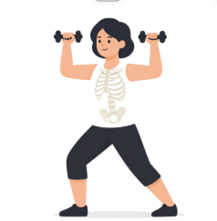
BONE HEALTH
Strong Bones Matter — Osteoporosis is largely silent until fracture occurs
Calcium — 1,000-1,200 mg daily from food and supplements
Vitamin D3 + K2 — Critical for calcium absorption
Strength Training — Stimulates bone growth and density
DEXA Scan — Bone density screening starting at age 65
Earlier screening if risk factors are present
Prevention is always preferable to recovery.
Notes:
Osteoporosis is often called a silent disease because you cannot feel your bones getting weaker. For many women, the very first sign is a painful fracture after a simple fall.
During the first few years of menopause, the drop in estrogen can lead to rapid bone density loss.
To protect your independence, focus on strength training to stimulate bone growth, optimize your bone-supporting nutrients, and ensure you get your baseline DEXA bone density scan as recommended.

Slide 31
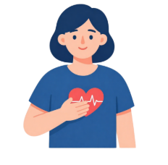
MENOPAUSE AND HEART HEALTH
Cardiovascular risk rises as estrogen's protective effects decline:
  LDL (bad) cholesterol tends to rise after menopause
  HDL (good) cholesterol may decline
  Blood pressure often increases during transition
  Arterial stiffness progresses more rapidly
  Insulin sensitivity may decrease
Monitor: Blood Pressure • Cholesterol • Diabetes Risk
Notes:
Estrogen acts as a natural shield for our blood vessels, helping them stay flexible and healthy. When estrogen levels fall during menopause, that natural protection declines.
This is why women often see their blood pressure, LDL cholesterol, and triglycerides rise during their 50s and 60s.
We must monitor these changes closely so we can protect your long-term heart health.

Slide 32
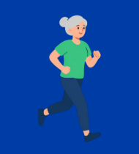
70 is not old
✓ Active
✓ Engaged
✓ Independent
✓ Thriving
"The goal isn't just living longer. It's living better.”
Notes:
Let's redefine what aging looks like. Today's women in their 70s, 80s, and beyond are hiking, traveling, starting new projects, and playing active roles in their families.
Our goal in medicine is no longer just adding years to your life—it is adding life to your years.
We want to maximize your 'healthspan'—the period of your life spent free from chronic disease and functional limitations. Proactive screening in these decades is what keeps you independent and thriving.

Slide 33
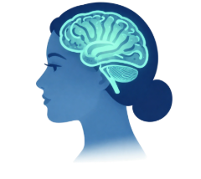
Brain HEALTH
What's Good For The Heart Is Good For The Brain
High blood pressure damages delicate cerebral blood vessels
Diabetes and obesity are major risk factors for cognitive decline
Physical inactivity accelerates brain aging
Social isolation significantly increases dementia risk
Quality sleep is essential for brain waste clearance
Protecting your brain starts decades before symptoms appear
Notes:
One of our biggest concerns as we age is preserving our memory and cognitive function.
Emerging research shows a powerful link between metabolic and brain health. Conditions like high blood pressure, diabetes, and physical inactivity damage the delicate blood vessels in your brain, increasing the risk of dementia.
By keeping your heart and metabolism healthy today, you are protecting your brain health for tomorrow.

Slide 34
Preventing falls & Fractures
Evidence-based answers to the most common questions:
Falls are not inevitable — Most are preventable with proactive strategies:
🏋️
Exercise
👁️
Vision Checks
Balance and strength training
Annual comprehensive eye exams
🏠
Home Safety
🦴
Bone Health
Remove hazards, improve lighting
DEXA screening and treatment
Notes:
In our older decades, a fall is not just an accident—it can be a life-changing event. A hip fracture can lead to a long loss of independence.
Fortunately, falls are highly preventable.
We can protect your stability by maintaining muscle strength, keeping your vision prescription updated, ensuring your home is free of tripping hazards, and proactive bone-density screenings.

Slide 35
Staying strong
✓ Mobility& Joint Protection
✓ Metabolic Rate & Insulin Sensitivity
✓ Balance & Fall Prevention
✓ Functional autonomy & Independence
"Muscle Is Medicine—Resistance training is effective at any age”
Notes:
If we could package the benefits of strength training into a single pill, it would be the most prescribed medicine on earth.
As we age, we naturally lose muscle mass—a process called sarcopenia. Resistance training is our best defense.
Working with resistance bands, light weights, or your own body weight keeps your joints stable, supports your metabolic health, and preserves the strength you need to carry your own groceries, climb stairs, and stand up with ease.

Slide 36
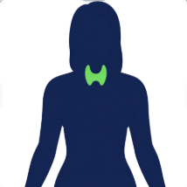
Women's endocrine health
Common conditions affecting women at every life stage
PMOS — Affects 1 in 10 women of reproductive age
Thyroid Disease — Affects women 7-10x more than men
Type 2 Diabetes — Largely preventable with early action
Obesity — A complex chronic disease requiring medical care
Osteoporosis — Silent but highly manageable when detected
Most endocrine conditions are highly manageable when identified early.
Notes:
Our endocrine system regulates almost every aspect of our health, evolving through every stage of our lives.
From managing PCOS in our youth, to tracking thyroid health in midlife, to preserving bone and metabolic strength as we age, hormones are key to our wellness.
The encouraging news is that these endocrine systems are highly manageable when we identify changes early through routine, proactive checks.

Slide 37
Cancer screening checklist
Mental Health IS Health — Watch for these important signals:
The transition begins years before the final menstrual period.
Many women are simultaneously caring for multiple generations:
🩺
Breast Cancer
Mammography — typically annual starting at age 40
🔬
Cervical Cancer
Pap/HPV testing — ages 21 to 65
🩻
Colorectal Cancer
Colonoscopy or stool tests — starting at age 45
☀️
Skin Cancer
Annual full-body skin examination
🫁
Lung Cancer
Low-dose CT — for high-risk individuals
You cannot pour from an empty cup.
Notes:
Let's look at your core cancer screening checklist. These are the key tests that allow us to detect changes early or prevent cancer before it can start.
Please use this checklist to guide your conversations with your primary care provider. Your doctor can help customize this list based on your age, lifestyle, and family medical history.

Slide 38
Heart Health checklist
Mental Health IS Health — Watch for these important signals:
The transition begins years before the final menstrual period.
Heart Health is built through small daily decisions repeated over years:
❤️
Blood Pressure
Target: < 120/80 mmHg — check regularly
❤️
Cholesterol
Know your LDL, HDL, and triglycerides
❤️
Blood Glucose
A1c screening for diabetes risk
❤️
Family History
Early heart disease in close relatives matters
❤️
Activity Level
Aim for 150 min/week moderate exercise
Notes:
Heart health is built through small, consistent daily choices.
Alongside regular medical checks for blood pressure, cholesterol, and A1c, your daily habits are highly protective. Aim for 150 minutes of moderate exercise each week, prioritize quality sleep, and find daily ways to manage stress. These simple steps are powerful shields for your heart.

Slide 39
Menopause checklist
Mental Health IS Health — Watch for these important signals:
The transition begins years before the final menstrual period.
You deserve comprehensive, compassionate care throughout this transition:
😴
Sleep
Quality, duration, and sleep architecture
😊
Mood
Anxiety, depression, and emotional well-being
🔥
Hot Flashes
Frequency, severity, and impact on daily life
🦴
Bone Health
DEXA scan and bone-protective strategies
❤️
Heart Health
Blood pressure, cholesterol, and glucose
💜
Sexual Health
Genitourinary symptoms and quality of life
Notes:
We need to give menopause the same level of medical support, care, and attention that we give to pregnancy or family planning.
If you are experiencing symptoms that impact your daily life—whether it's poor sleep, low energy, mood changes, or intimate discomfort—please speak up.
We have highly effective options, from lifestyle adjustments to hormone replacement therapy, that can help you feel like yourself again. You do not have to just get through it.

Slide 40
Questions to ask your doctor
Come prepared. These three questions can transform any preventive visit:
"What screenings do I need this year?"
"What is my greatest health risk?"
"What can I do today to improve my future health?"
Notes:
Going to the doctor can sometimes feel overwhelming, and it's easy to forget what you wanted to discuss once you are in the clinic.
The best way to advocate for your health is to arrive prepared with clear, direct questions.
Use these three simple questions to guide your next visit. They are designed to shift your appointment from a reactive check-up to a collaborative, proactive planning session.

Slide 41
what should I schedule this year
Mental Health IS Health — Watch for these important signals:
The transition begins years before the final menstrual period.
Your Annual Prevention Action Plan — Start today:
🩺
Annual Physical
Comprehensive exam and metabolic blood panel
🩻
Mammogram
Breast health screening appointment
🔬
Pap / HPV Screening
Cervical health — per your schedule
🧪
Lab Work
Blood pressure, cholesterol, A1c, thyroid
👁️
Eye Exam
Vision and glaucoma screening
🦷
Dental Visit
Oral health and systemic wellness
Notes:
Let's translate this information into action. Here is your practical check-up plan for the year.
If you have delayed any of these appointments over the past year, please take this as your friendly, supportive reminder.
Pull out your phone after this session and schedule the care you've been postponing. It is the single best gift you can give to yourself and to the family that relies on you.

Slide 42
five take-home messages
1
Prevention saves lives.
2
Know your numbers.
3
Menopause is a major health transition.
4
Heart disease remains the #1 threat.
5
Your health matters too.
Notes:
As we conclude, these are the five key points I hope you carry with you.
Please remember that your health is not a secondary priority. Small, consistent choices today—scheduling a screening, knowing your biological numbers, moving your body, and getting support for hormonal transitions—will shape your vitality for decades to come.

Slide 43
Thank you
@drsami_endo
"Taking care of yourself is not selfish—
it is one of the greatest gifts you can give your family."
Notes:
Thank you so much for your time and attention today.
I hope you leave this session with new insights and a clear, actionable plan for your wellness.
When women thrive, their families and communities thrive with them. I would now love to open up the floor to your questions and hear your thoughts.
Because when women thrive, families thrive—and communities thrive.

Slide 44
