Slide 1



BYLAWS WIZARD 101
FOR UNITS & COUNCILS
Presented by:
Geri Lehane, NYS PTA Bylaws Coordinator

Slide 2


WHAT ARE BYLAWS & WHY DO WE NEED THEM
Bylaws are designed to help the group function in an orderly manner.
The bylaws of the association include all the rules that the organization considers so important that they (a) cannot be
changed without previous notice and (b) cannot be suspended.
Every member of the board should have a copy of the bylaws
and be familiar with them.
Bylaws must be updated at least once every three years for a unit or council to remain in good standing.
Up to date bylaws are required per the IRS 501(c)3 regulations.
Notes:
Bylaws are the framework that guides each unit and council

Slide 3
BYLAWS MUST BE RENEWED EVERY 3 YEARS
Bylaws are valid for approximately 3 years from the date of approval by the New York State PTA Bylaws Coordinator. Depending on when they are submitted and approved, they will expire 3 years later on January 1st, April 1st, July 1st or October 1st.
Bylaws can be reviewed at any time and be resubmitted. However, they must be reviewed and adopted every 3 years and new bylaws entered into the Bylaws Wizard, whether revised or not. A Bylaws committee of 3 to 5 members must review the bylaws.
Units & Councils must use the Bylaws Wizard to renew Bylaws.
Only the information that is requested in the Bylaws Wizard can be changed in the bylaws. No other clauses can be added to the bylaws.
Any information specific to running your PTA must be entered into your Procedures.
Notes:
Remind to form a committee

Slide 4

BYLAWS MUST BE RENEWED EVERY 3 YEARS
Bylaws must be adopted by your registered members at a general membership meeting.
  30 day prior notice of the vote must be given
  quorum must be established
  2/3 affirmative vote of the registered members present at
  the meeting is needed to pass the bylaws. No proxy votes are accepted.
  Enter the changes that are made from the previous bylaws
  in the meeting minutes and the result of the adoption vote,
  so there is a record in case there are questions later.
Once adopted, the completed, signed cover page be must
sent via mail or email to the Region Bylaws Chair (RBC).
Notes:
Talk about listing any changes in the minutes.

Slide 5

BYLAWS MUST BE RENEWED EVERY 3 YEARS
Council bylaws must be approved by an instructed vote (must be presented to each member unit at their unit meeting and approved by a 2/3 vote of the unit’s registered members).
At the council meeting after all units have voted, the bylaws must be approved by 2/3 of the member units present and voting. ONE VOTE PER UNIT. No proxy votes are accepted.
Enter the changes made from the previous bylaws and the
result of the vote in the meeting minutes.
Once adopted, the completed, signed cover page must be
sent via mail or email to the Region Bylaws Chair (RBC).
Notes:
The adoption of bylaws for Councils is by an instructed vote. Therefore, the process must be started earlier for councils. Each unit must give 30 days notice of the vote to approve council bylaws and then 30 days notice must be given to the council.
Talk about listing any changes in the minutes.

Slide 6
BYLAWS NEED TO BE UP TO DATE
If Bylaws are expired, it causes the unit or council to become
“Not In Good Standing” with NYS PTA and National PTA
Your unit or council will not be eligible:
For PTA grants, awards or scholarships
To participate in PTA programs (PARP, Reflections, NYS PTA or National PTA grants)
To submit a resolution
To send members as voting delegates at convention
Unit delegates & presidents will not be allowed to vote at council meetings and at Region PTA Annual meetings
All these things do not just negatively impact your organization as a whole, but can directly impact your students, members and staff.

Slide 7

  BYLAWS REVIEW/RENEWAL PROCESS
Check your bylaws expiration date. If they are expiring within the next 3 to 6 months (or already expired), it’s time to get started on the renewal process.
Form a bylaws committee of 3-5 members to review your current bylaws.
Provide the committee members with the tools they need
  a copy of the current bylaws
  Steps to Updating Your Bylaws*
  Bylaws Wizard instructions*
* These can be found on the NYS PTA website home page at www.nyspta.org - Click on Leaders then go to bylaws/procedures
Notes:
Committee - the committee should review the current bylaws within the parameters of what they are allowed to change within the Wizard. Other changes outside those parameters cannot be made. Be sure the committee has a copy of steps to updating bylaws and the Bylaws Wizard instructions,
* Note - both of these are have just been updated and can be found on the NYS PTA website
Once the committee work is done, you are ready to generate your draft Bylaws.
Review pros and cons of submitting before unit vote.

Slide 8

Welcome to Bylaws Wizard
Go to NYS PTA website home page at www.nyspta.org - Click on Leaders then go to bylaws/procedures

Slide 9
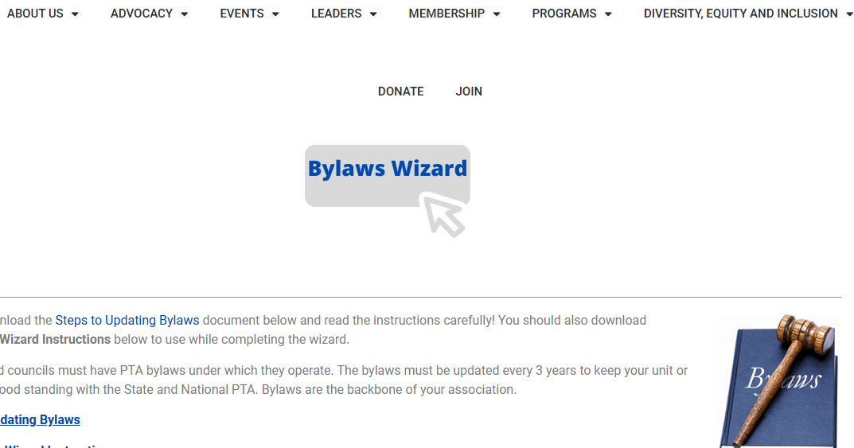

Slide 10
LET’S GET STARTED
The process to enter the bylaws should take
no more than 15 minutes to complete
It is advisable to have a copy of your current bylaws for reference during the process. If you need a copy, please contact your Region Bylaws Chair (RBC) or your Region Director (RD)
You can find a current list of RBC’s and their email addresses here (scroll down to bottom of page):
https://nyspta.org/bylawsprocedures/
The Link to the Bylaws Wizard is located at the top of this page, and here:
Link to Bylaws Wizard
Notes:
We will start with unit bylaws

Slide 11
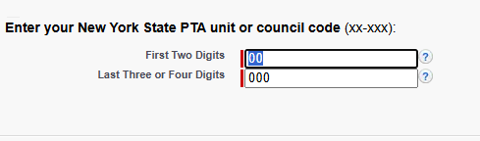
You must enter your unit code to begin - this number is at the top of the first page of your current bylaws
Notes:
This page will be the same for units or councils

Slide 12
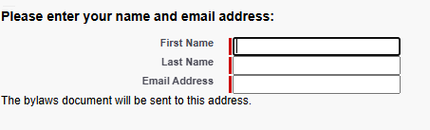
Enter your first and last name and email address – This information is needed to send you a copy of your submitted bylaws. If you want the proposed document sent to another person, enter their name and email address.
Notes:
If you are not the person who should receive the draft and final copies, please be sure to verify who should receive it and enter that person’s name and email address.
Again this page will be the same for units & councils

Slide 13
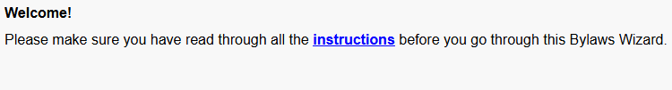
Please be sure to read all instructions before starting the Wizard.
Notes:
Be sure to read all instructions on renewing your Bylaws before starting the Wizard.

Slide 14
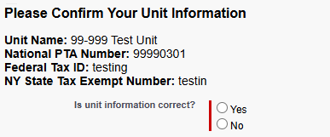
Unit Information – Check if the information provided is correct. If not, check No and make corrections in the box on the next page**
**Unit name changes can only be handled through your region bylaws chair and region director
Notes:
You will see this same page for council

Slide 15
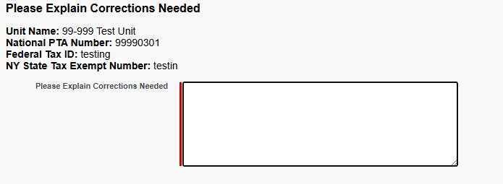
Unit Information – Check if the information provided is correct. If not, check No and make corrections in the box on this page**
**Unit name changes can only be handled through your region bylaws chair and region director
Notes:
You will see this same page for council

Slide 16
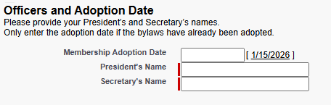
Membership Adoption Date – if your bylaws have not yet been voted on, leave this blank
President and Secretary – put in the names of your current president and secretary. If you have a Recording and Corresponding Secretary, enter the Recording Secretary Information.
Notes:
Also will be the same for council
Be sure that all your Officers are entered correctly on MemberHub as we will cross reference to verify officers.

Slide 17
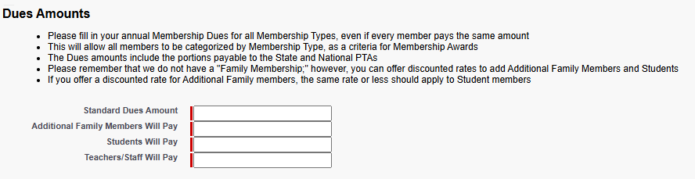
Dues Information –Fill in the annual dues of your association.
*As of 7/1/2025, all dues entered must be at least $5.00*
Notes:
Each member’s dues must be at least $5.00. You must fill in an amount of at least $5.00 for each of the choices (reminder that additional family member is NOT a family membership).
The dues amount is always determined by a vote of the association.
Be aware that new dues do not go into effect until the bylaws have been approved by NYSPTA. The Bylaws coordinator will go into Memberhub and adjust the dues amount as of the date of approval.
As of July 1, 2025, the dues amount remitted to NYS PTA per member will increase to $5 from $4. The dues forwarded to National PTA by NYS PTA will increase to $3.25 from $2.25 per member. This increase was adopted by the delegates that attended the National PTA Convention in June of 2024. The dues to NYS PTA will remain $1.75 per member

Slide 18
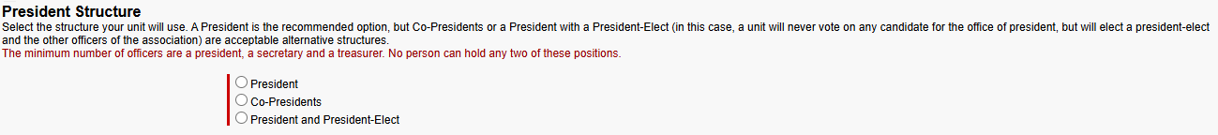
President Structure -Select the type of president structure for your unit
If you choose President/ President Elect Structure, your unit will never vote on any candidate for the office of president but will elect a president-elect and the other officers of the association.
Notes:
Single President is the recommended option, but Co-presidents or a President with a President Elect are acceptable alternative structures.
The officers’ pages are the same for council as well.

Slide 19
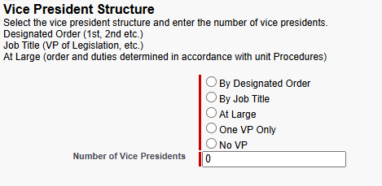
Vice President Structure – Enter number of vice presidents and then the vice president structure:
Designated Order (1st, 2nd etc.)
Job Title (VP of Legislation, VP of Membership, etc.)
At Large (order and duties determined in accordance with unit Procedures)
If 1 VP select One VP Only
If no VP enter 0

Slide 20

Secretary – PTA units can have either a single secretary or a recording and a corresponding secretary.
Notes:
Note: You will not enter the treasurer. That is a required position that has no options for structure. You cannot have co-treasurers - only a single treasurer. It will automatically be added to your final document.

Slide 21
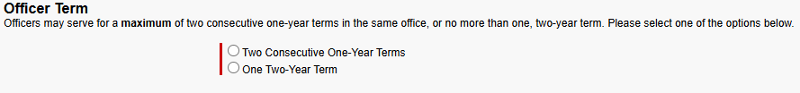
Officer Term – Please select one of these options.
Officers may serve for a maximum of two consecutive one-year terms or one two-year term in the same office.
Notes:
No person may serve more than a total of 2 consecutive years in a position.
Note that when you have chosen the President/President Elect structure, they each may only serve one term in each position. If you choose one year term for your officers, they each would only be in each position for one year. If you wish for each to stay in the position for 2 years, you MUST select the two year term option for all your officers.

Slide 22
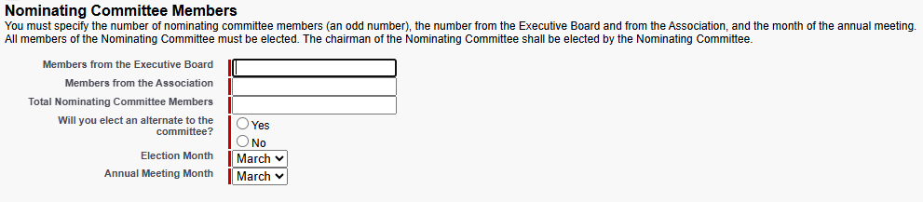
Nominating Committee – You must specify the number of nominating committee members from the Executive Board and the number from the Association (general membership). Total # of members must be an uneven number. Choose whether you wish to have an alternate to the committee. Use the dropdowns to select the month of the election meeting and the annual meeting (choices are March, April, May, or June).
Notes:
The total # of nominating committee members should be an odd #.
The choices for Election and annual meeting months are March, April, May or June.

Slide 23
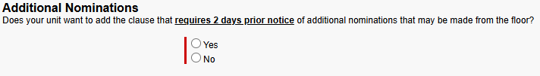
Additional Nominations –
Check Yes for the following selection to be added to your bylaws:
Additional nominations may be made from the floor provided the written consent of the nominee has been secured and the chair of the nominating committee has received notice at least two
business days prior to the election meeting of the candidate’s intention to run.
Check No if you do not wish to require prior notice. If you select no, then any member can be nominated from the floor at the election meeting.
Notes:
Remember, Additional Nominations can always be made from the floor! By choosing prior notice required, it helps the unit to plan for an election knowing there will need to be a ballot vote for an office.
The nominating committee chair should always advise the president & secretary that there is going to be a nomination from the floor ahead of time, so the secretary can prepare the ballots

Slide 24
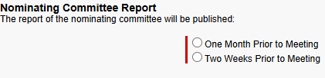
Choose when the nominating committee will publish its report

Slide 25

Executive Committee – consists of the elected officers of the unit and your PTA may include the Immediate Past President if you choose to.
Notes:
The immediate past president can only be added here if not already part of Executive Committee.
Regarding Directors/Building representatives - please note - this is only an option for SEPTAs, SEPTSAs, Central PTSAs and Central PTAs.
Council Delegate(s) – Whether elected at the same time and same manner as the officers, appointed by the president/executive committee or elected by the executive board, the council delegate(s) will be on the executive board and not on the executive committee as they are not officers.

Slide 26
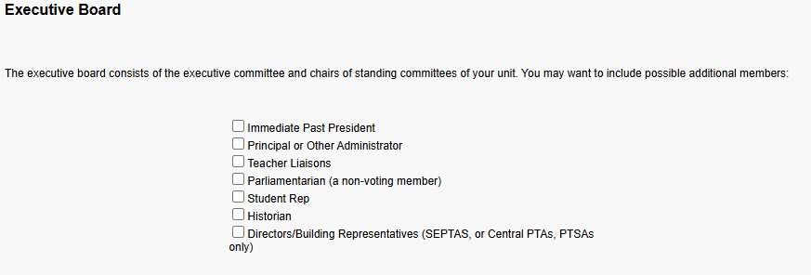
Executive Board – consists of the executive committee, chairs of standing committees of your unit and council delegates (if a part of a council). You may want to include possible additional members:
Notes:
The immediate past president can only be added here if not already part of Executive Committee.
Regarding Directors/Building representatives - please note - this is only an option for SEPTAs, SEPTSAs, Central PTSAs and Central PTAs.
Council Delegate(s) – Whether elected at the same time and same manner as the officers, appointed by the president/executive committee or elected by the executive board, the council delegate(s) will be on the executive board and not on the executive committee as they are not officers.

Slide 27
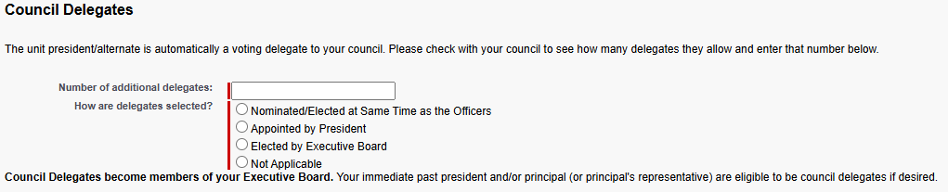
Council – If the PTA unit is a member of a council, key in the number of delegates to the council (as indicated in Council bylaws) and how they are selected. *The number of delegates in a PTA unit’s bylaws must be the same as the number in the Council bylaws.*
Though Delegates may be elected at the same time as officers, they are not officers. All delegates are part of the executive board.
Notes:
Talk about delegates matching in the unit & council bylaws.

Slide 28
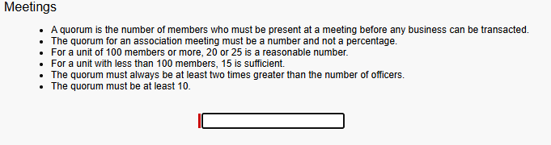
Quorum for Meetings- This is the Minimum number of registered members that must be present at your meeting to conduct PTA business.
Notes:
Talk about delegates matching in the unit & council bylaws.

Slide 29
Please Review your responses- Click on the “previous” button to go back to the beginning to check that you have entered the correct information that the committee has decided to enter.
If all the information is correct, click on Next.
Notes:
Talk about delegates matching in the unit & council bylaws.

Slide 30
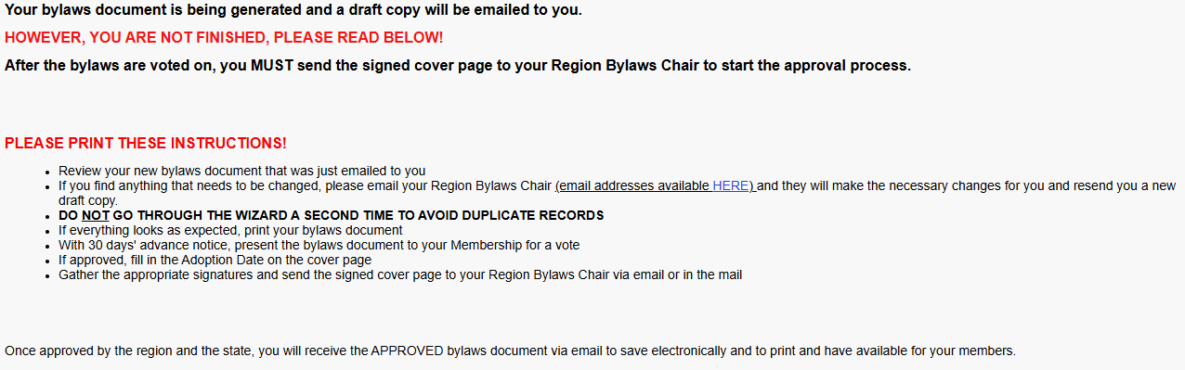
Click on the Finish button to generate the bylaws document.
There is a glitch with the Wizard- when you click on Finish, the system may bring you back to the first screen where you entered your Unit code. Please do not continue- this will enter a duplicate entry. Just exit out of the program at this point.
Notes:
Talk about delegates matching in the unit & council bylaws.

Slide 31
LET’S REVIEW COUNCIL BYLAWS
This starts with the same link to the Bylaws Wizard but when you enter your Council Unit code, you will be taken to screens with some of the same information requested (officer names, officer structure, officer terms) and other screens with specific information for Councils. I will go through the screens that are different than the Unit Bylaws Screens.
It is advisable to have a copy of your current bylaws for reference during the process. If you need a copy, please contact your Region Bylaws Chair (RBC) or your Region Director (RD)
Link to Bylaws Wizard
Notes:
The format is mostly the same with a few exceptions

Slide 32
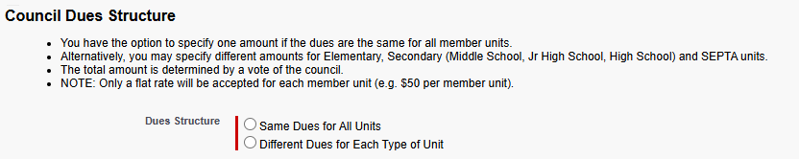
Council Dues structure – you can choose one amount for all units, or different dues for each type of unit
Notes:
The first difference you will see in Council Wizard is the dues structure.

Slide 33

Council Dues structure – Enter the amount that all units will remit to the Council.
Notes:
Same dues amount per unit

Slide 34
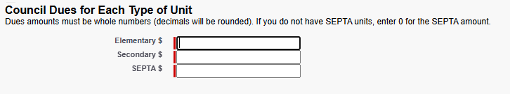
Council Dues structure – Enter different dues amount for each type of unit
Notes:
Different amount of dues per unit type.

Slide 35
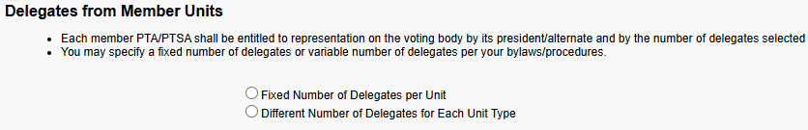
  Delegates – A Council has a choice for the number of delegates- a fixed number of delegates per unit, or a different number of delegates for Elementary, Secondary and SEPTA units
Notes:
The council sets the # of delegates allowed from the units.
There are 2 options - all units having the same # of delegates (shown above)

Slide 36
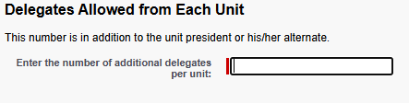
  Delegates – the same for each PTA unit.
Notes:
There are 2 options - all units having the same # of delegates (shown above)

Slide 37
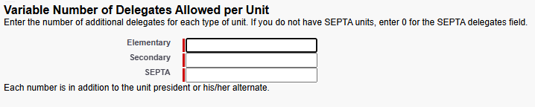
  Delegates – choice of different number of delegates for PTA units
Notes:
OR different # of delegates for each type of unit (shown above)
Talk about delegates matching in the unit & council bylaws.

Slide 38
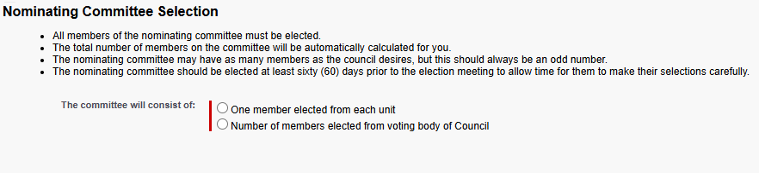
Nominating Committee – A Council will choose the number of members to be elected to the Nominating Committee.
Notes:
The nominating committee structure is also different for a council. You will have 2 choices here as well ….1 member from each unit

Slide 39
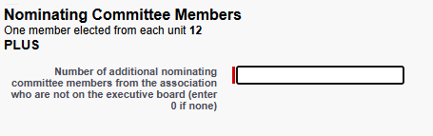
Nominating Committee – Choice #1- 1 member from each unit. You do not need to enter the number of unit representatives as that will be automatically calculated by the system when you make this selection, but you will need to enter the # if you wish to have additional members to make the number uneven. If one member from each unit is an uneven number and you do not wish to add any members, enter “0”.
Notes:
The nominating committee structure is also different for a council. You will have 2 choices here as well ….1 member from each unit

Slide 40
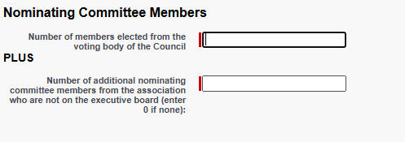
Nominating Committee –Choice #2- from voting body of council (voting body members council officers, chairs of standing committees, Executive Board, President/alternate from each unit, and delegate(s) from each unit- listed in Article VII, Section 1 of Council bylaws). You must specify the number of nominating committee members from the Executive Board and the number of non-board members.
Notes:
OR From the voting body of Council
The total # of nominating committee members should be an odd #.
On the subsequent pages you will Choose whether you wish to have an alternate to the committee and the month of the election meeting and the annual meeting.
The choices for Election and annual meeting months are March, April, May or June.

Slide 41
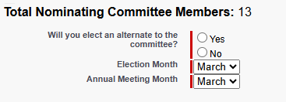
Nominating Committee – The Bylaws Committee will decide whether to elect an alternate member to the committee and use the dropdowns to choose the Election and Annual meeting months (choices are March, April, May or June).
Notes:
OR From the voting body of Council
The total # of nominating committee members should be an odd #.
On the subsequent pages you will Choose whether you wish to have an alternate to the committee and the month of the election meeting and the annual meeting.
The choices for Election and annual meeting months are March, April, May or June.

Slide 42
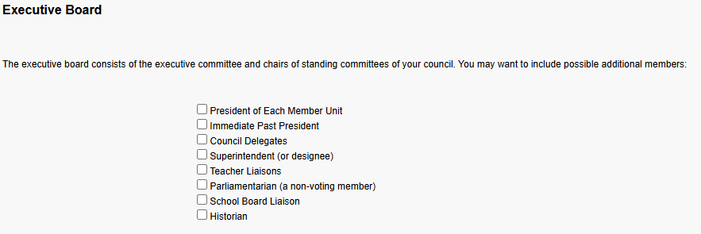
Executive Board – consists of the executive committee and chairs of standing committees of your council. You may want to include possible additional members:
Notes:
The options for the additional board members will be different for a council.
The immediate past president can only be added here if not already part of Executive Committee.

Slide 43
Please review and confirm your responses. When you click 'Next', your bylaws document will be generated and submitted for approval.
Notes:
The next pages will come up for all unit & council submissions. You can use the back button to review and be sure you have entered everything correctly. I highly recommend doing so!! And maybe more than once.

Slide 44
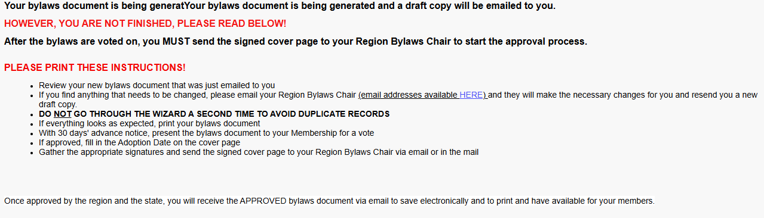
Once you click Finish, a copy of the document will be emailed to the address you provided.
There is a glitch with the Wizard- when you click on Finish, the system may bring you back to the first screen where you entered your Unit code. Please do not continue- this will enter a duplicate entry. Just exit out of the program at this point.

Slide 45
Review your new bylaws document that was emailed to you immediately.
If you find anything that needs to be changed, please email or call your Region Bylaws Chair and they will make the necessary changes for you and resend you a new draft copy.
DO NOT GO THROUGH THE WIZARD A SECOND TIME TO AVOID DUPLICATE RECORDS!
Once approved by the region and the state, you will receive the APPROVED bylaws document via email (to the person who completed the bylaws through the wizard) to save electronically and to print and have available for your members.
VERY IMPORTANT
Your Bylaws cannot be approved until your signed cover sheet is received by your Region Bylaws Chair! If not completed within 6 months, this bylaws record will be deleted, and you will need to start the process over!

Slide 46

The Next Steps
The RBC will receive an email from the Wizard system that notifies them a new document has been entered.
The RBC will contact the PTA or Council officers to verify the changes made from the previous bylaws are correct. The RBC will make any necessary changes.
After your members have adopted the new bylaws at a meeting, the president
and recording secretary must sign the front page, write the date of the
adoption meeting on the front page, and then email a copy of the front
page to the RBC.
The RBC will enter the adoption date and the date they received the front
page and approve.
The State Bylaws Coordinator (SBC) will get an email that the Region has
approved the bylaws, and the SBC will complete a final review and the SBC
will give the final approval and the final document signed by the SBC and the
final copy will be emailed to the person who entered the original document.
The final copy will have the Bylaws Coordinator signature and new expiration
date.

Slide 47
  Region Bylaws Chairs for 2026-27
Central Hudson- Kristyn Weishaar- chrptabylaws@gmail.com
Suffolk- Lori Fontana- bylaws@suffolkpta.org
Leatherstocking- TBD- bylaws@lsrpta.org
Genesee Valley- Jennifer Hryhorenko- bylaws@gvpta.org
Nassau- Andrea Giattini- bylaws@nassaupta.org
Niagara- Evonne Ostrozinski- nrptabylaws@gmail.com
Northeastern- Holly Gregg- northeasternbylaws@gmail.com
South Central- Geri Lehane- southcentralbylaws@gmail.com
Southeastern- Val Ford- serny.bylaws@gmail.com
Taconic- Denise Bermudez- bylaws@taconicpta.org
WEPR- Sophia Wu- weprbylaws@gmail.com
Western- Beth-Anne Diodato- McPhillips- bylaws@westernregionpta.org
Go to https://nyspta.org/bylawsprocedures/ for the most up to date list of Bylaws chairs.

Slide 48
  Bylaws Links
  on NYS PTA website
  NYS PTA Bylaws/Procedures Page
  Link to Bylaws Wizard
  Steps to Revising Bylaws
  Unit Bylaws Wizard Instructions
Council Bylaws Wizard Instructions

Slide 49
Thank You!
Any Questions
Please Contact your RBC or
Geri Lehane
bylaws@nyspta.org

Slide 50
