Slide 1

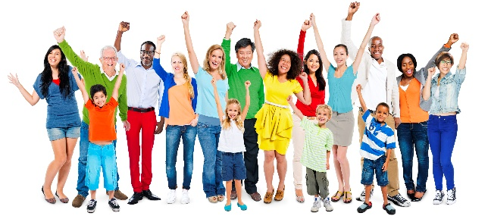
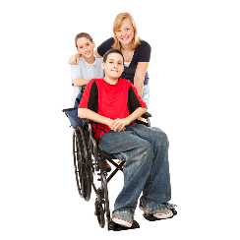
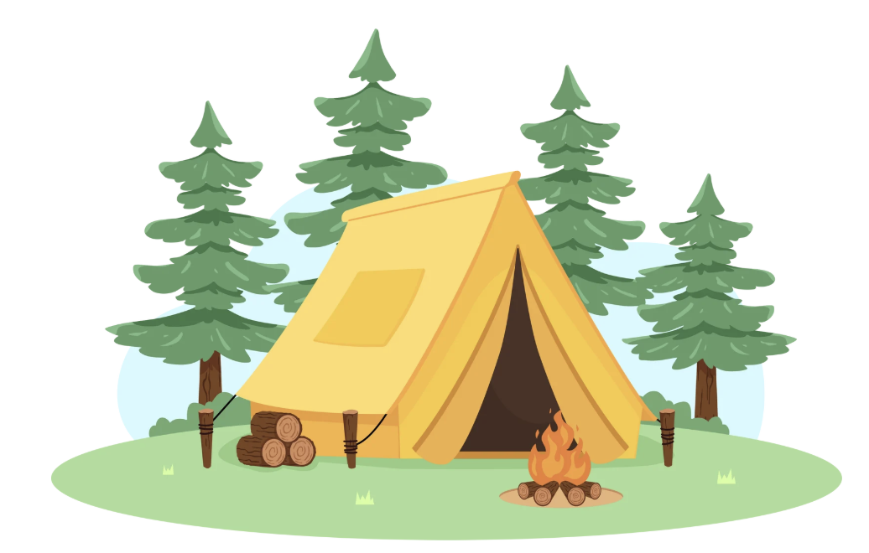
WELCOME TO
Camp Canva

Slide 2

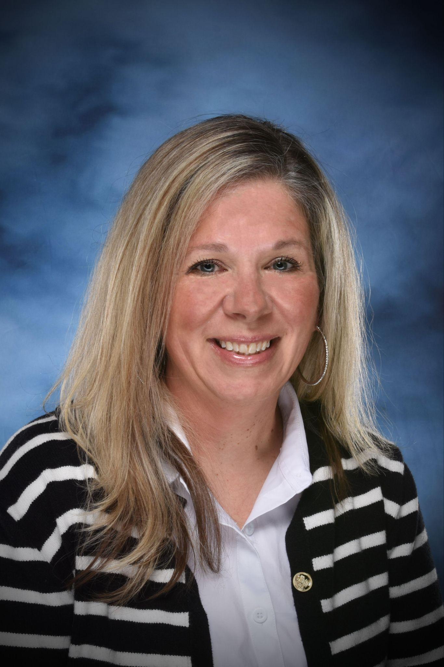
Presented by
Kathleen McEnroe
NYS PTA Digital Engagement Specialist

Slide 3
Camp Canva Agenda
Welcome to Canva
Introduction…What I use Canva for daily…PTA & Professional Life
Why Canva
Canva for nonprofits
Canva Basics
*Flyers, templates, collaboration,
Translation
QR Codes
Beyond Basics…Canva AI, animation, magic layers..etc..
Questions

Slide 4
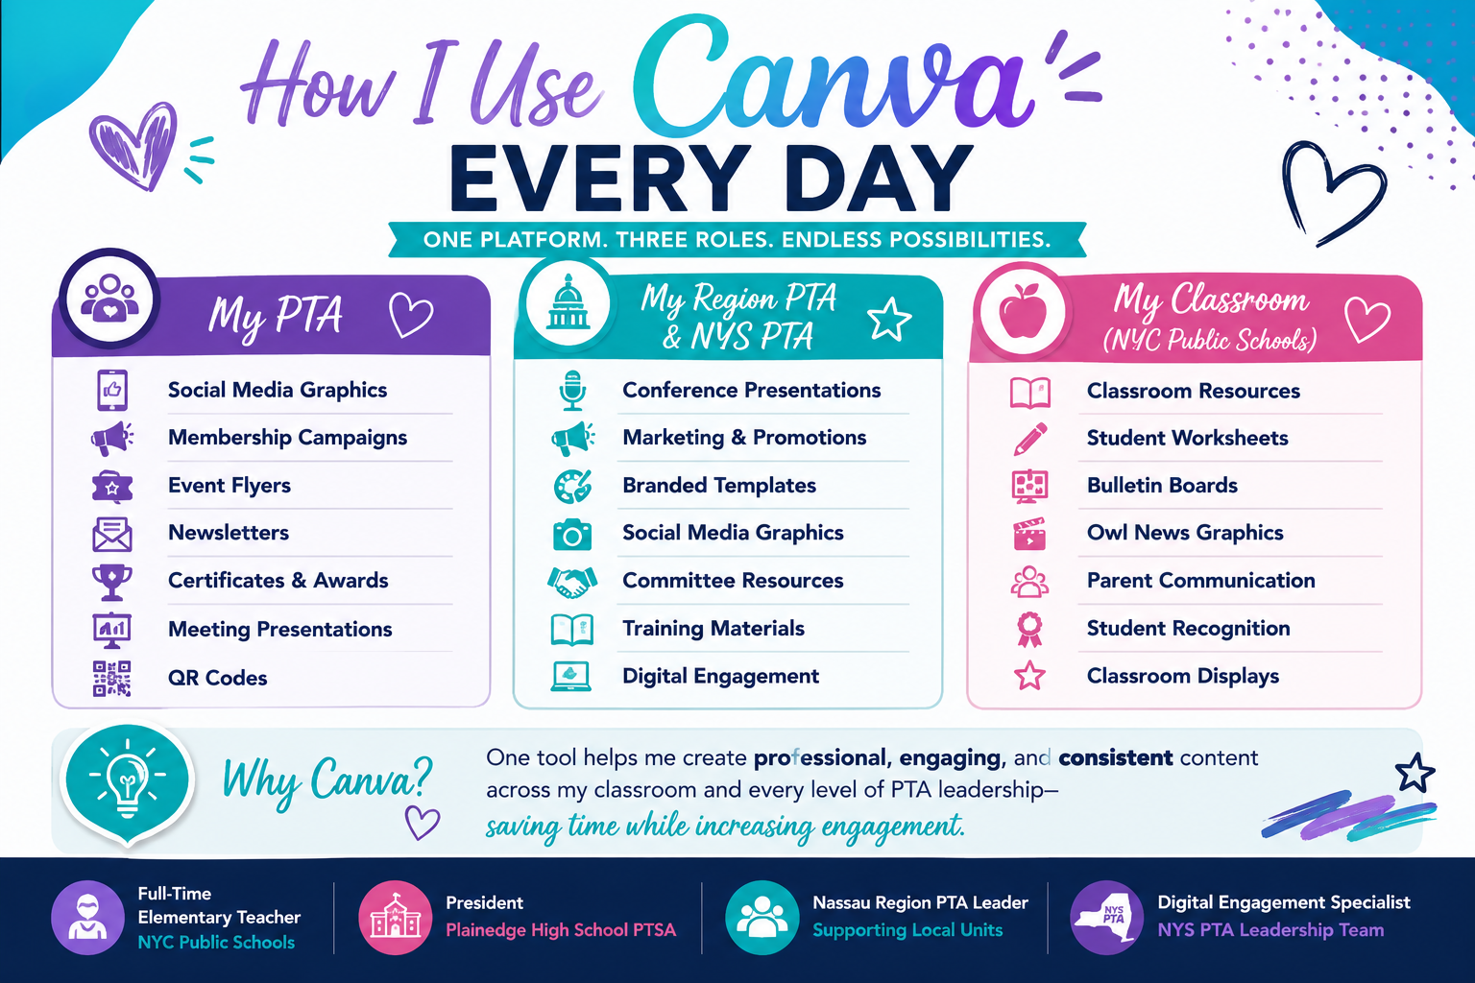

Slide 5

Why Canva?
Canva can me used for so many things
Flyers
Presentations
Instagram posts/videos
Newsletters
Translation of ANYTHING in many many languages
Use ready made NYS PTA Canva flyers and graphics
Make it once have it…always! Can duplicate year after year!

Slide 6
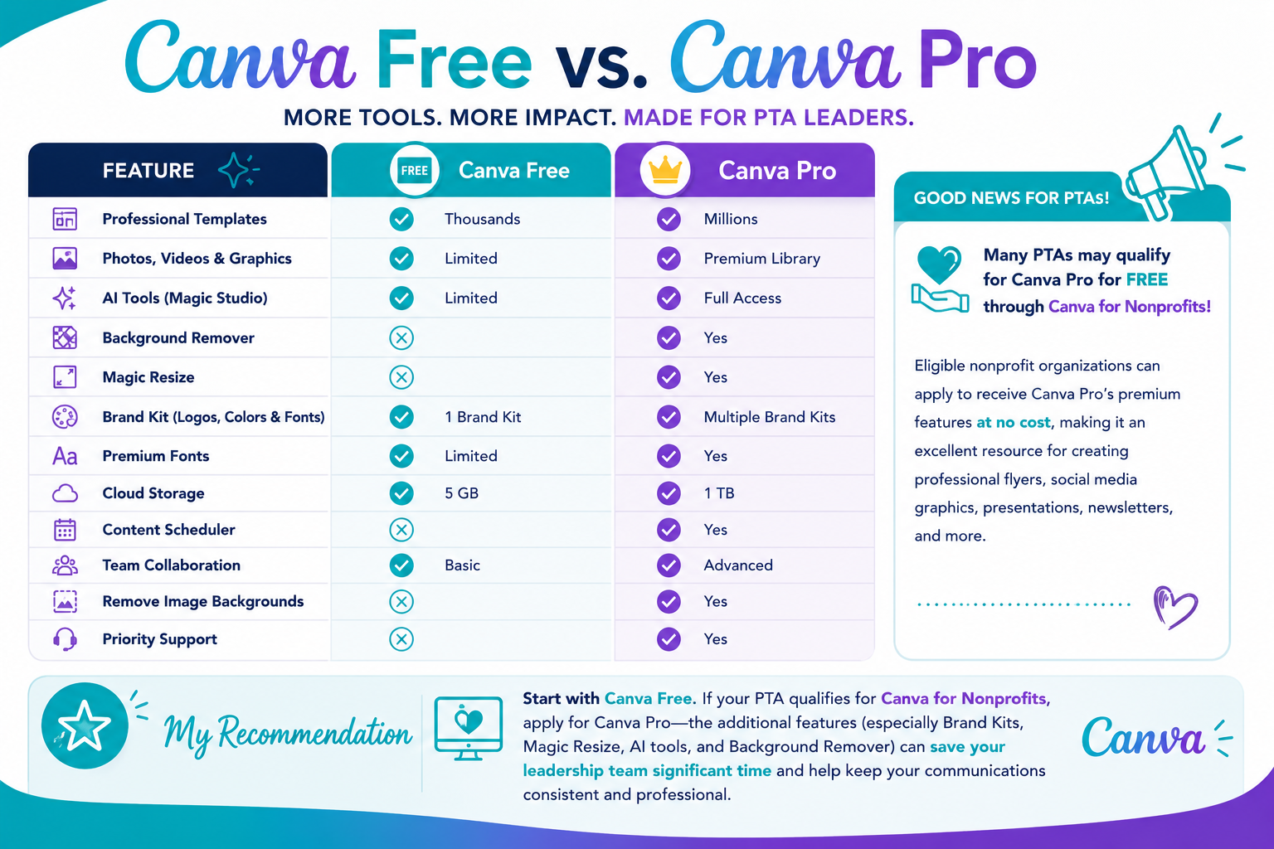

Slide 7
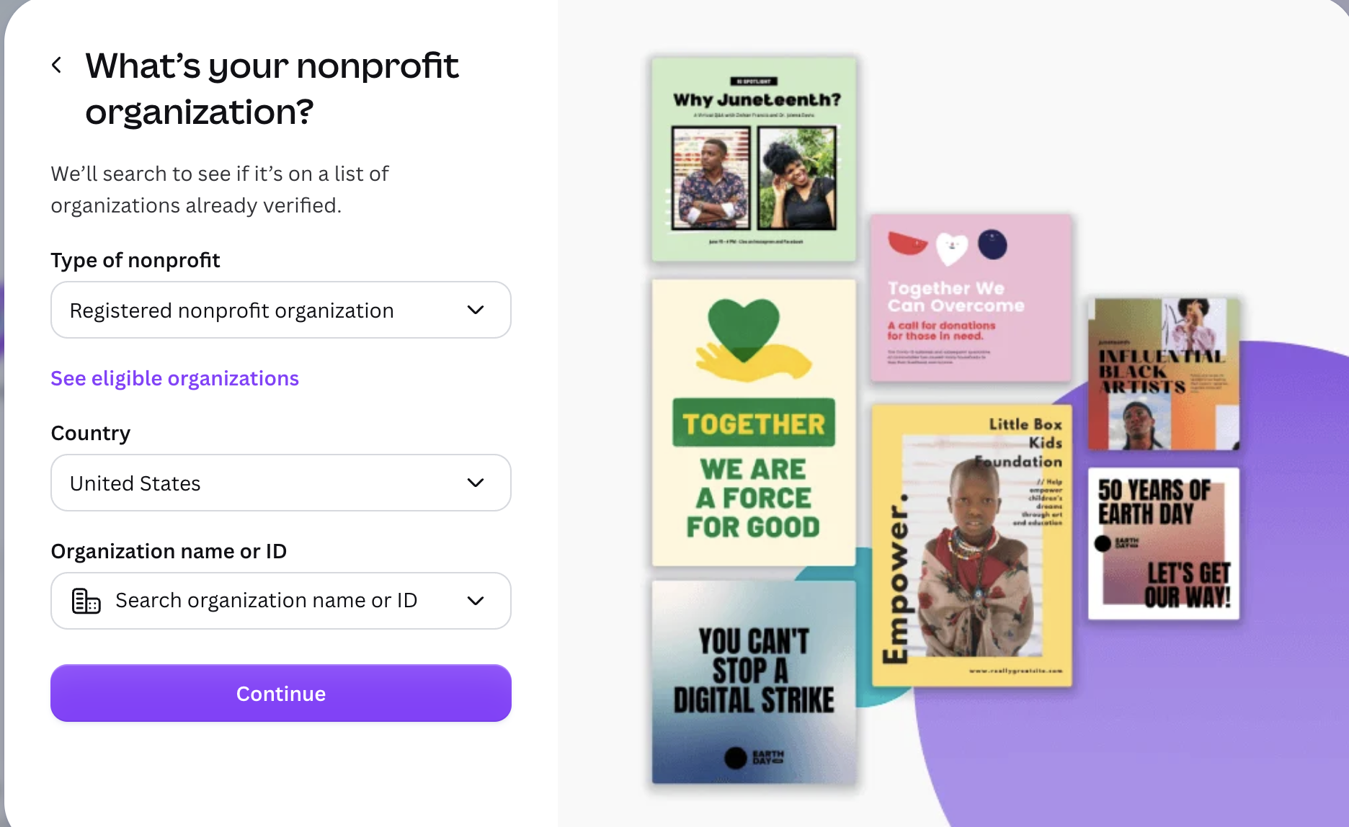
Canva for nonprofits
*Canva pro version for FREE
*Need letter of determination proving non profit status (contact your region)
*Can take some time
*Ability to share across your unit to collaborate
**Helpful to have a Google domain for your unit (as previously discussed in Camp Tech workshop)

Slide 8
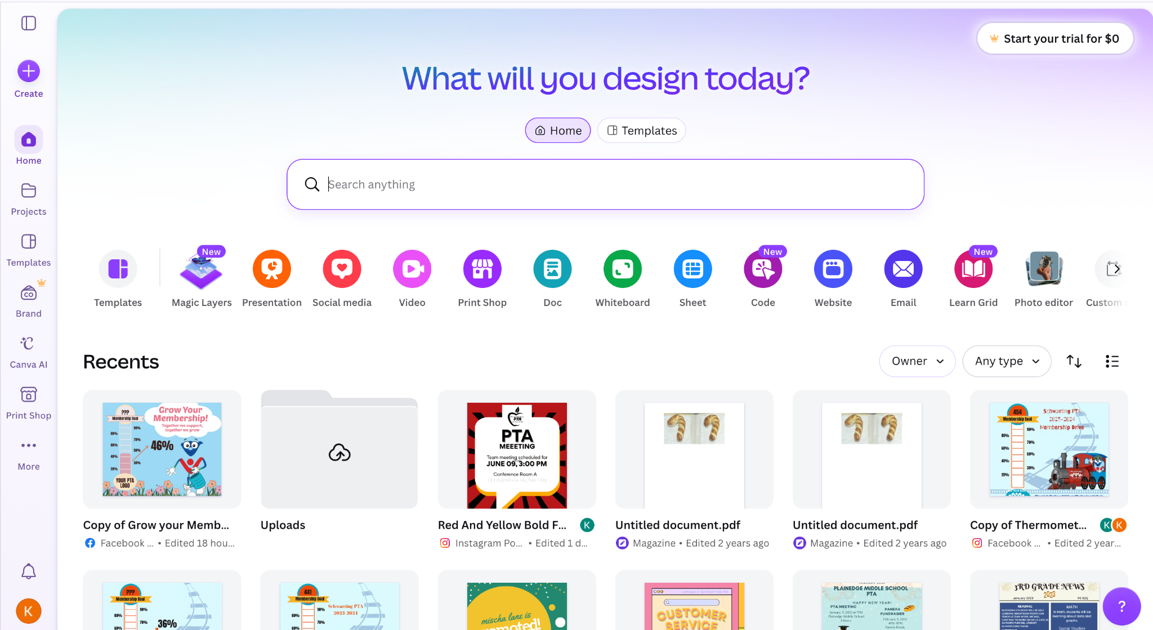
Canva Basics
Home Screen
Free Version

Slide 9
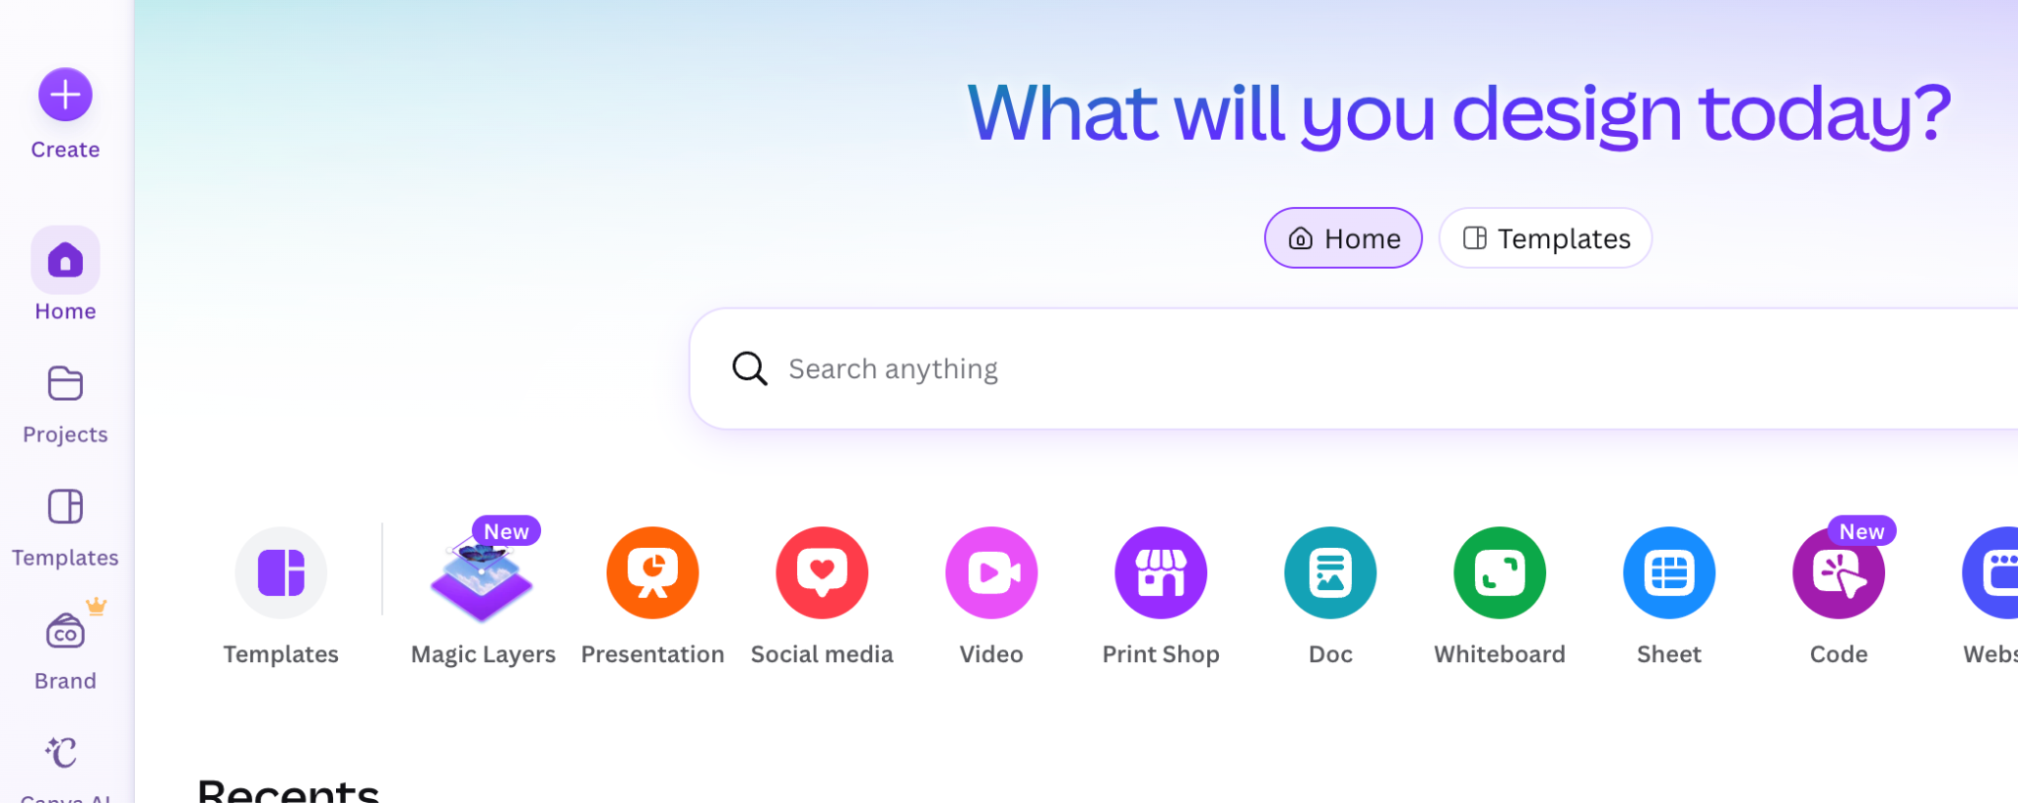
Where to begin…templates always to start
There are many ready made templates that you can customize for your unit’s needs…

Slide 10
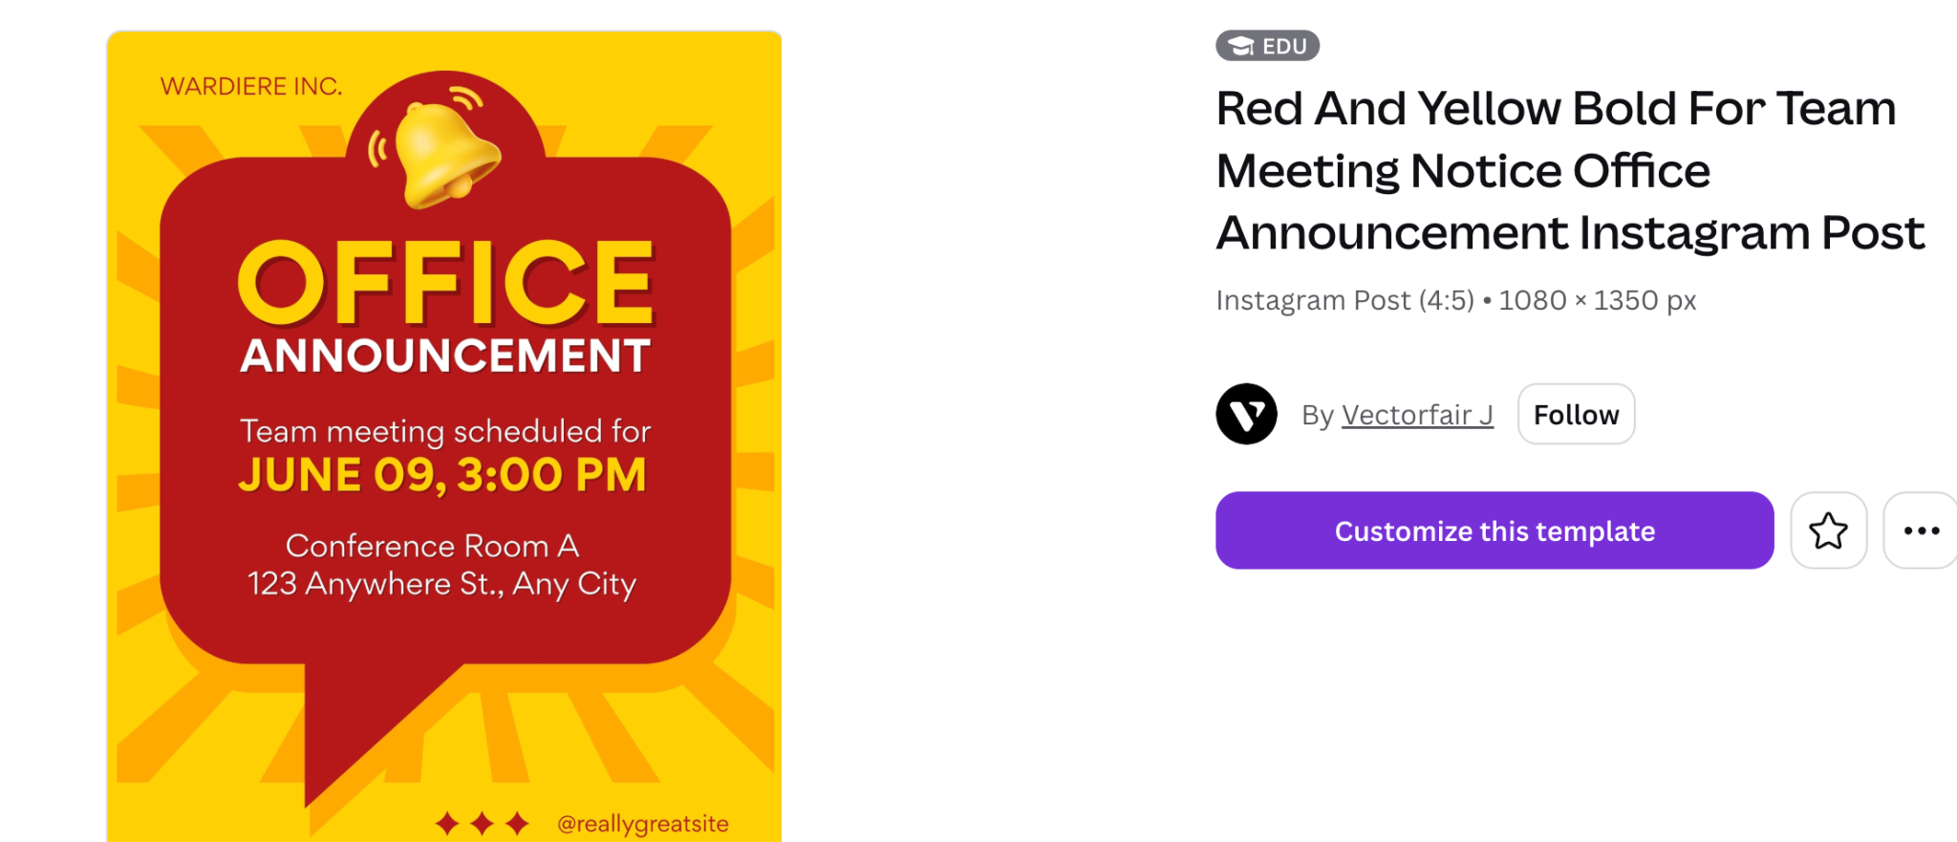
Template(flyer example for a meeting)

Slide 11
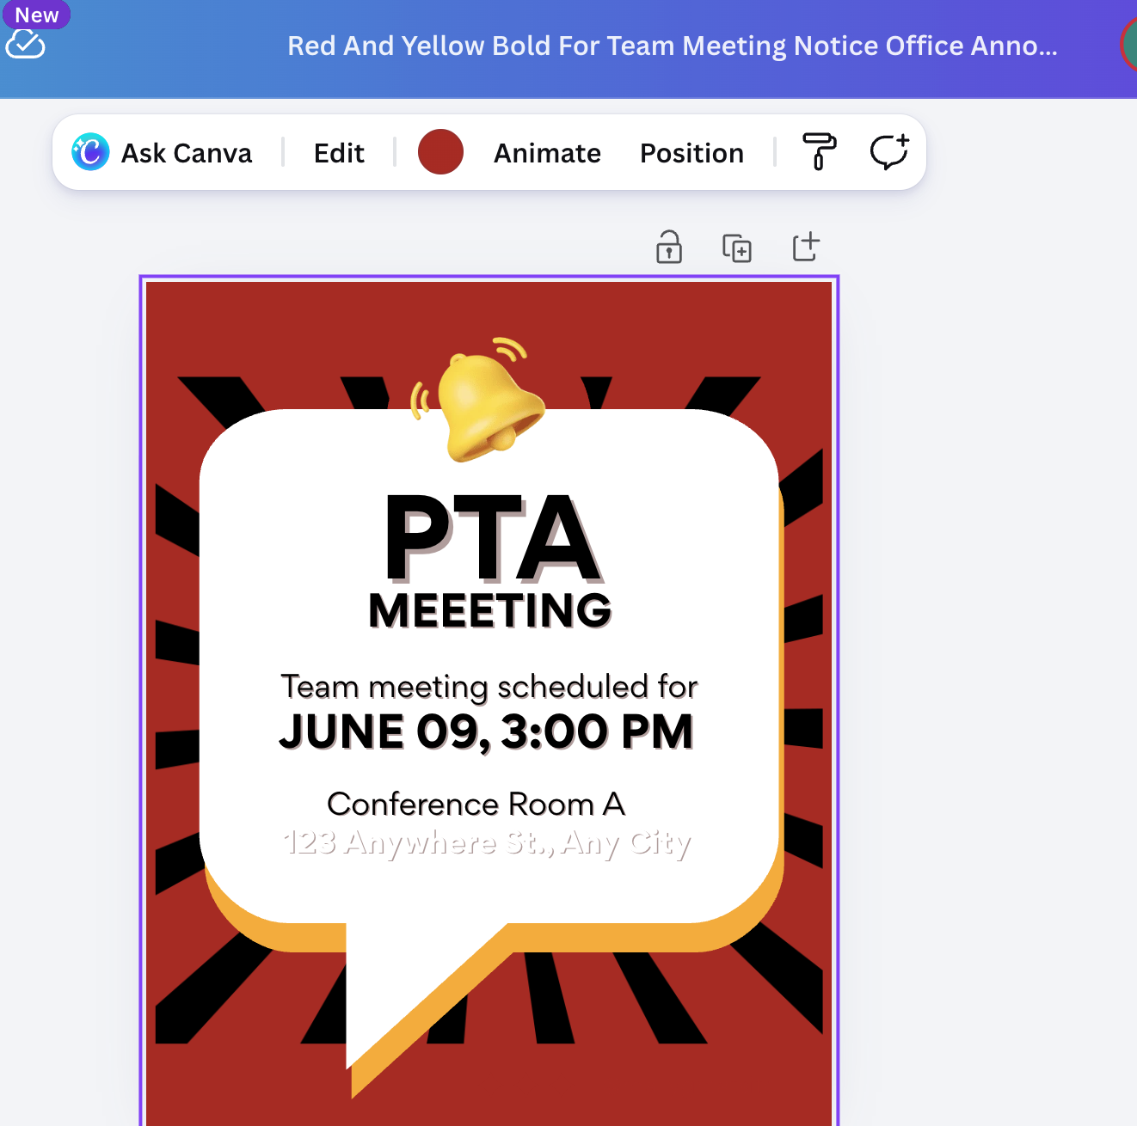
Name the document..
to make it easier to locate
later
(Click to show sample)
Change colors to match your unit/district….
Notes:
Open canva document

Slide 12
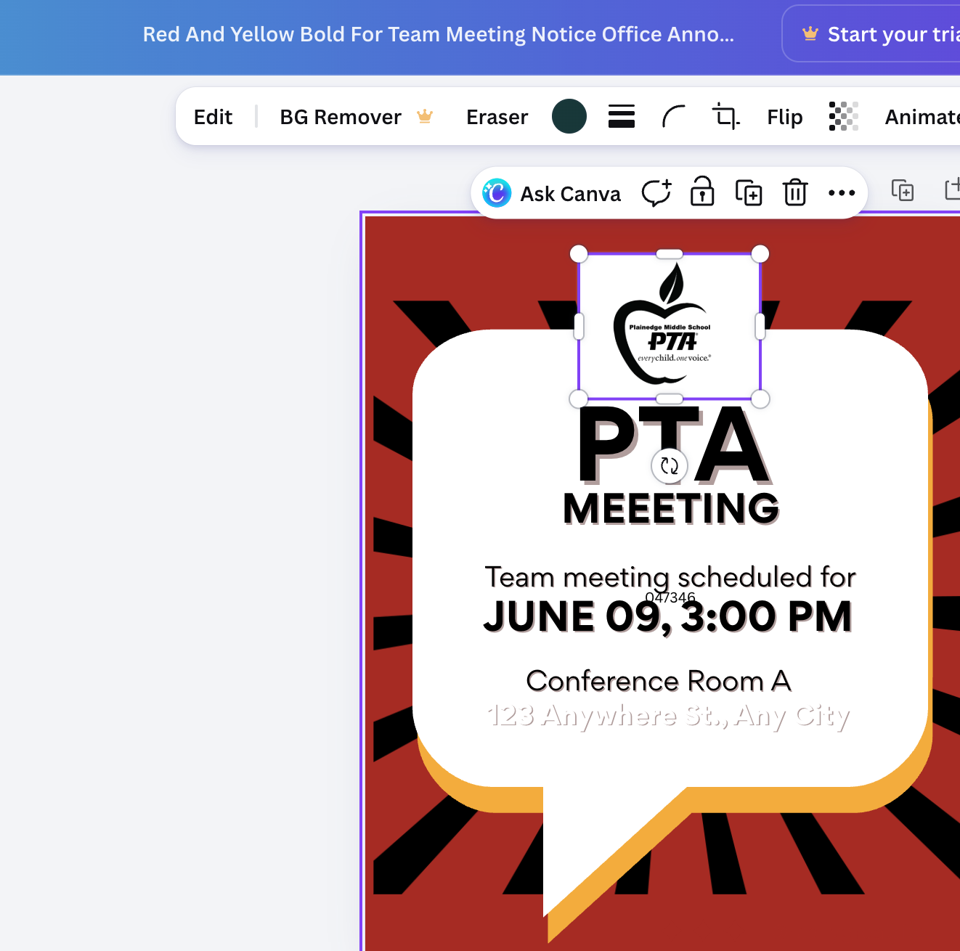
Brand Your Flyers/Documents
*Always have your PTA logo in Canva for quick reference (use logo template from NYS PTA website)NYS PTA Membership Toolkit
*Add to all flyers/documents/communications
*You can remove the background in Canva
(BG remover) to make it transparent,

Slide 13
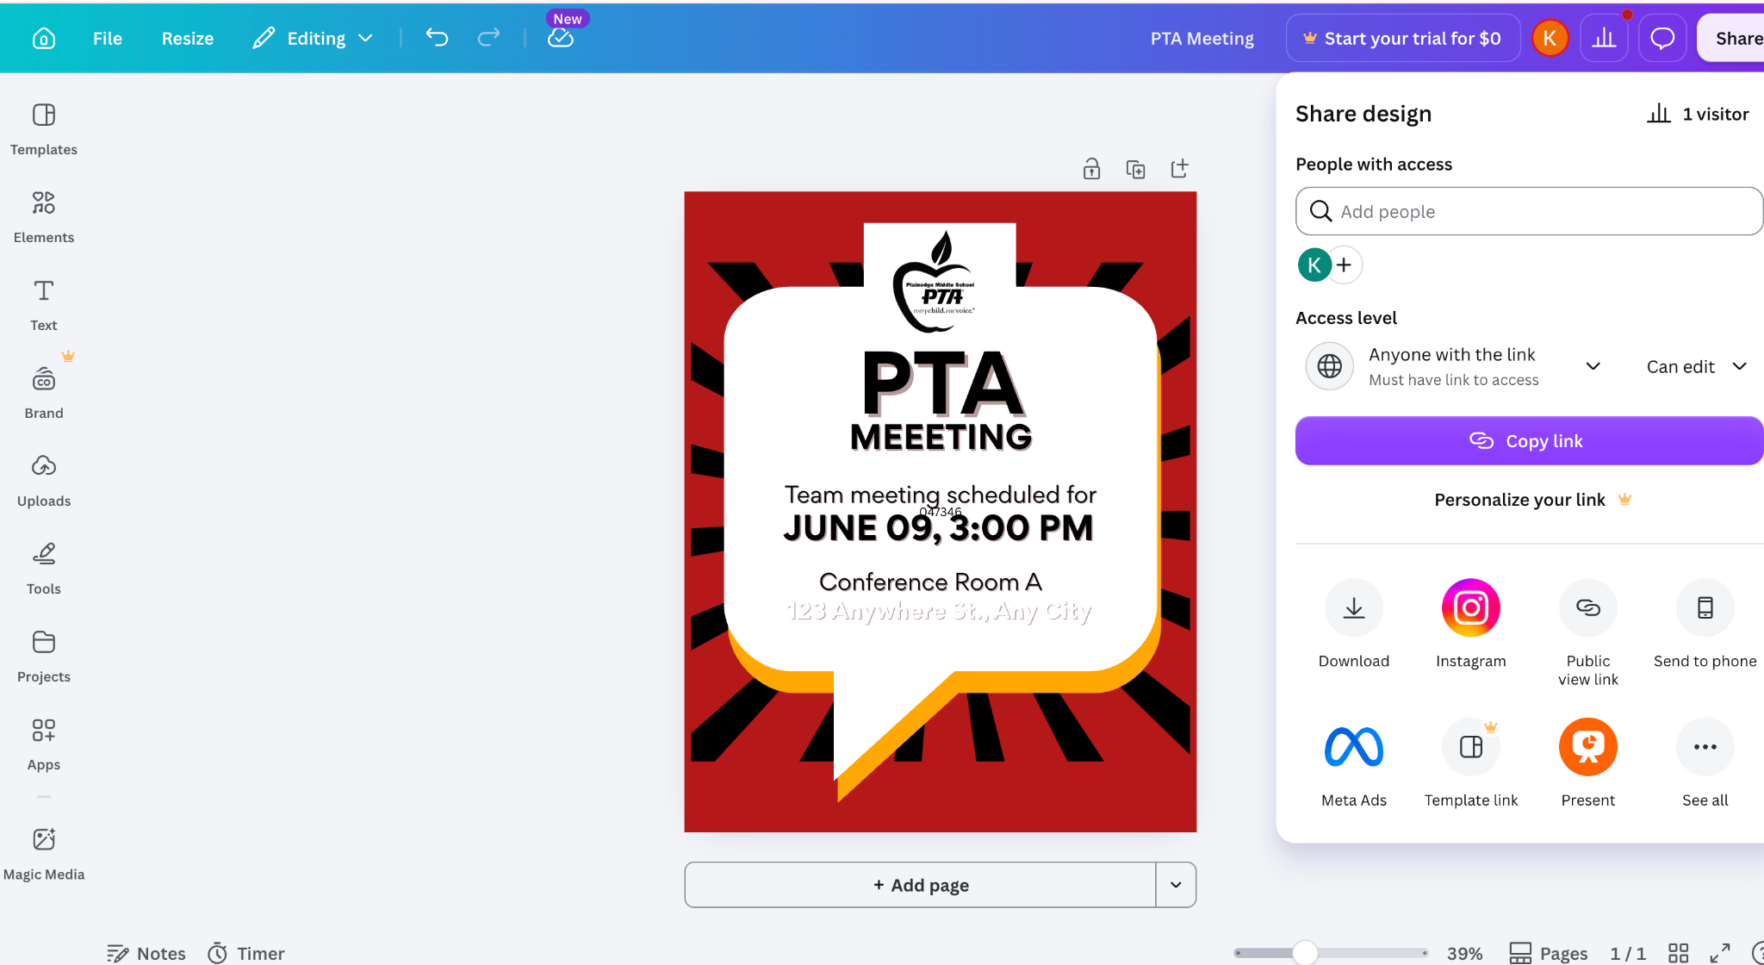
You can share documents with your unit for collaboration

Slide 14
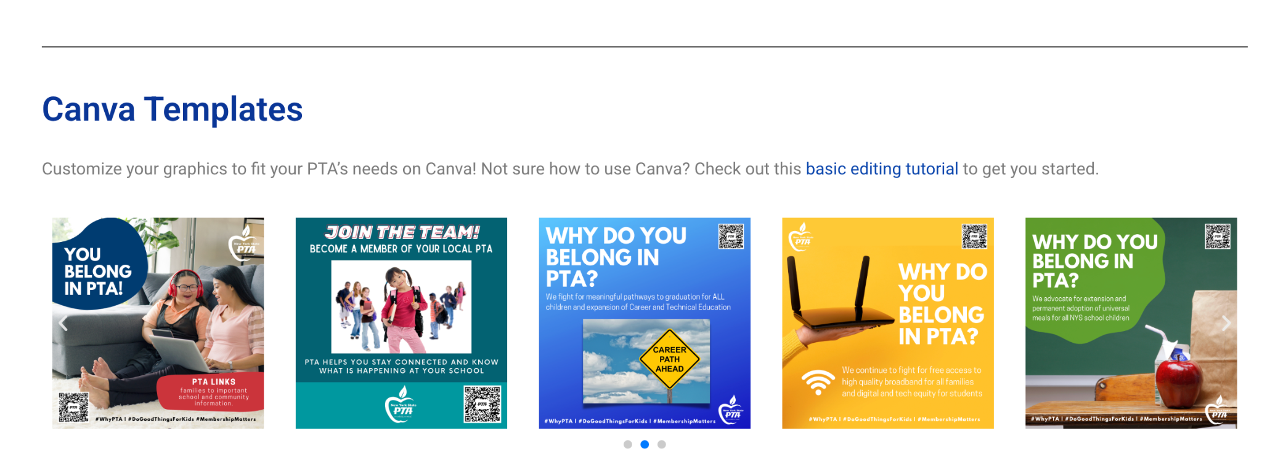
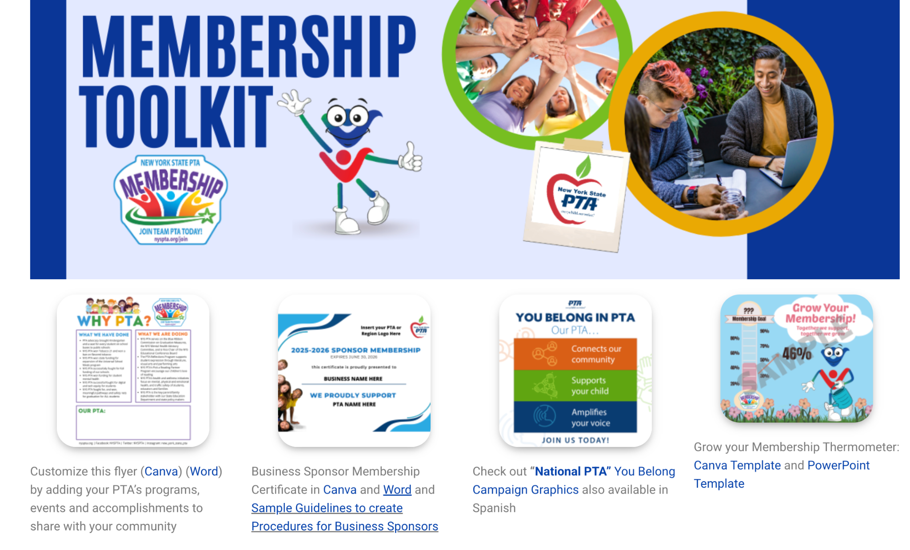
NYS PTA Canva Templates
to kick off your PTA year…
Basic
editing tutorial
NYS PTA Membership Toolkit
Open thermometer

Slide 15
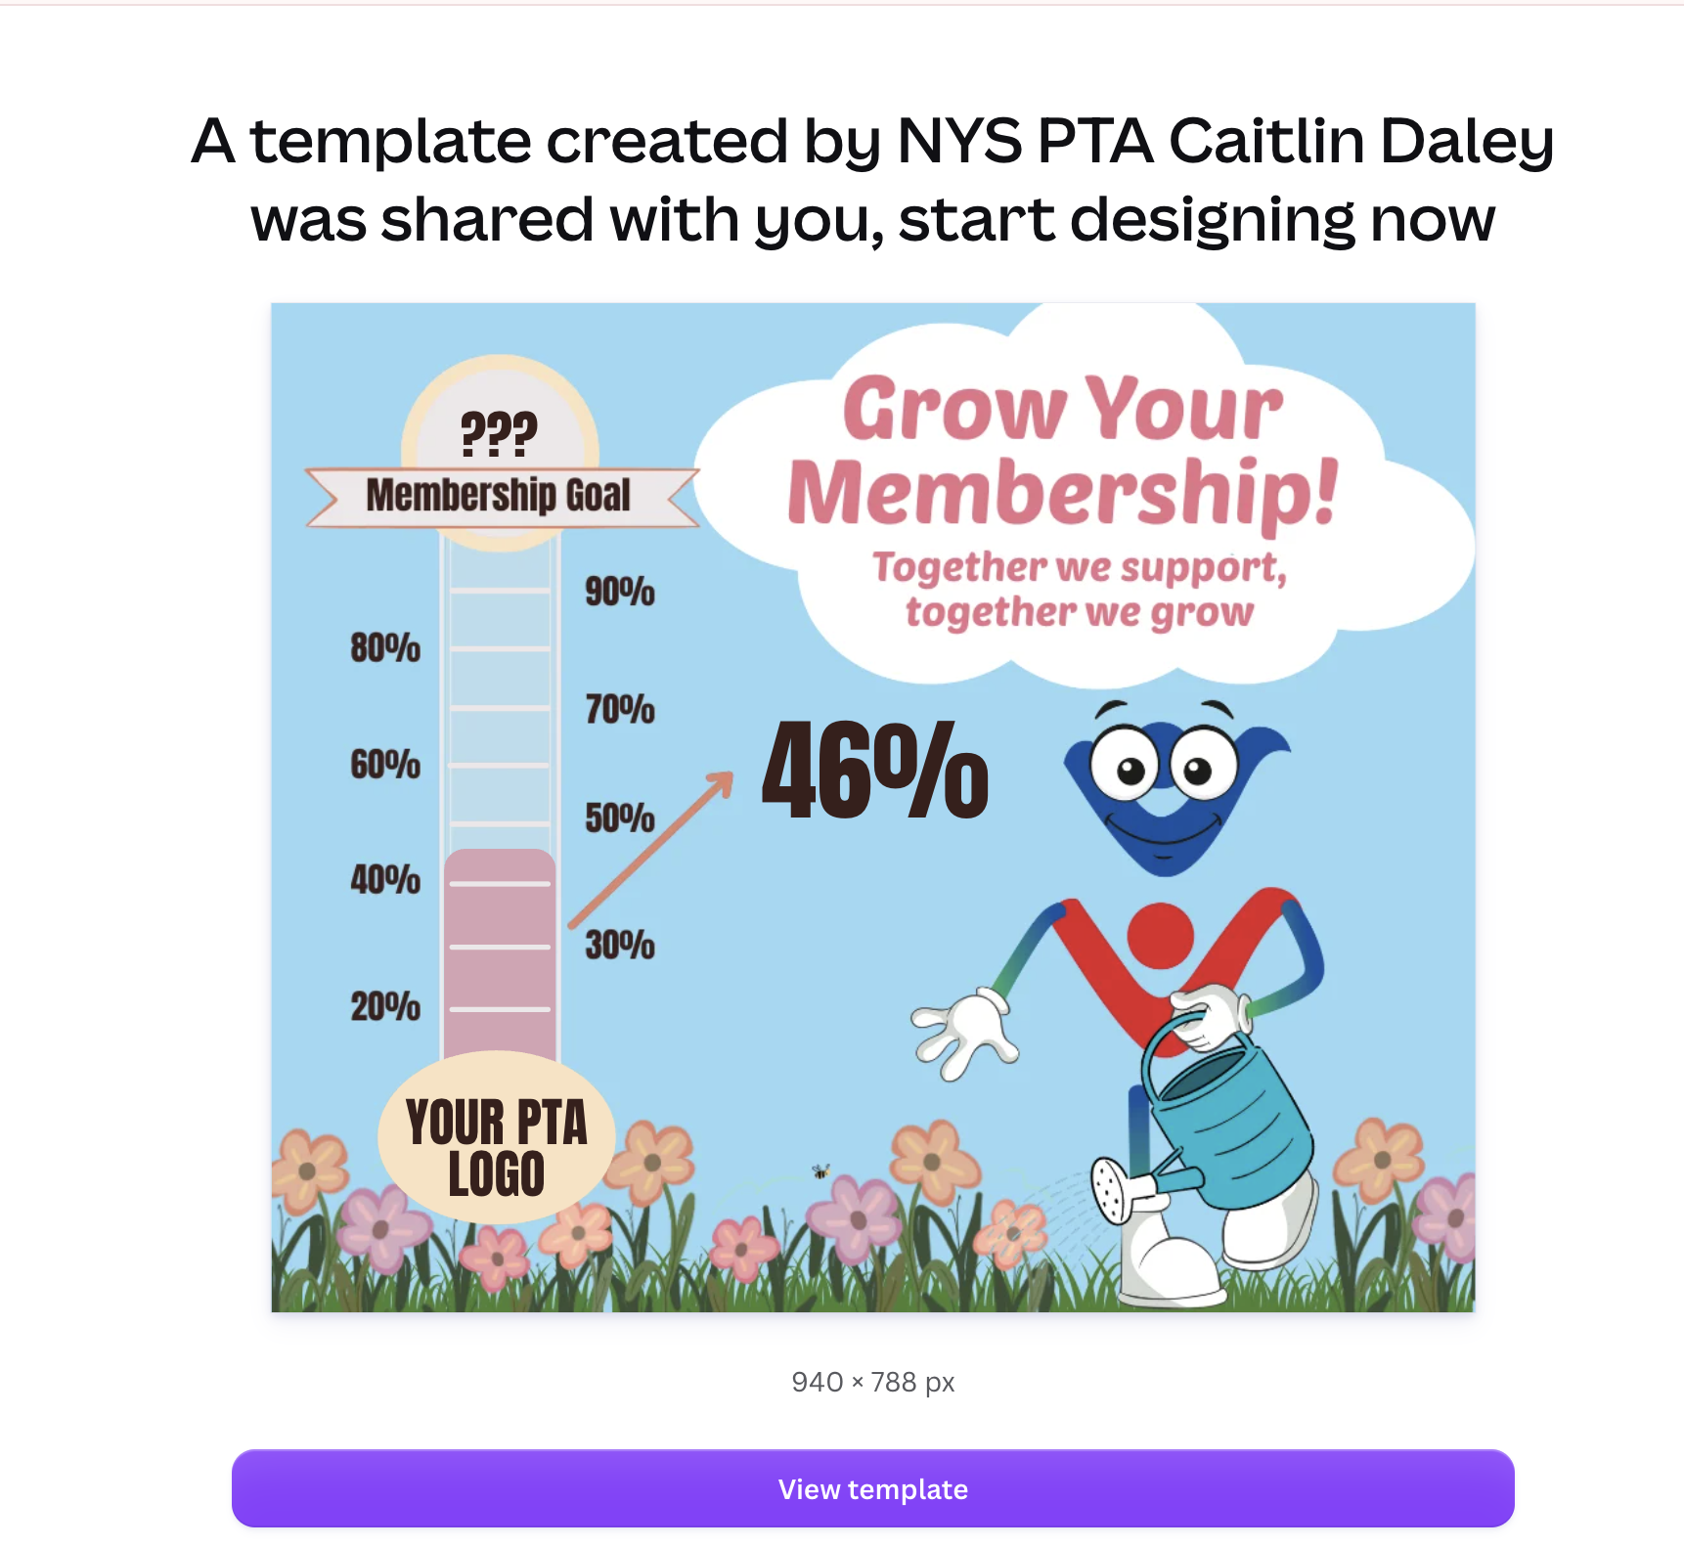
Membership Thermometer

Slide 16
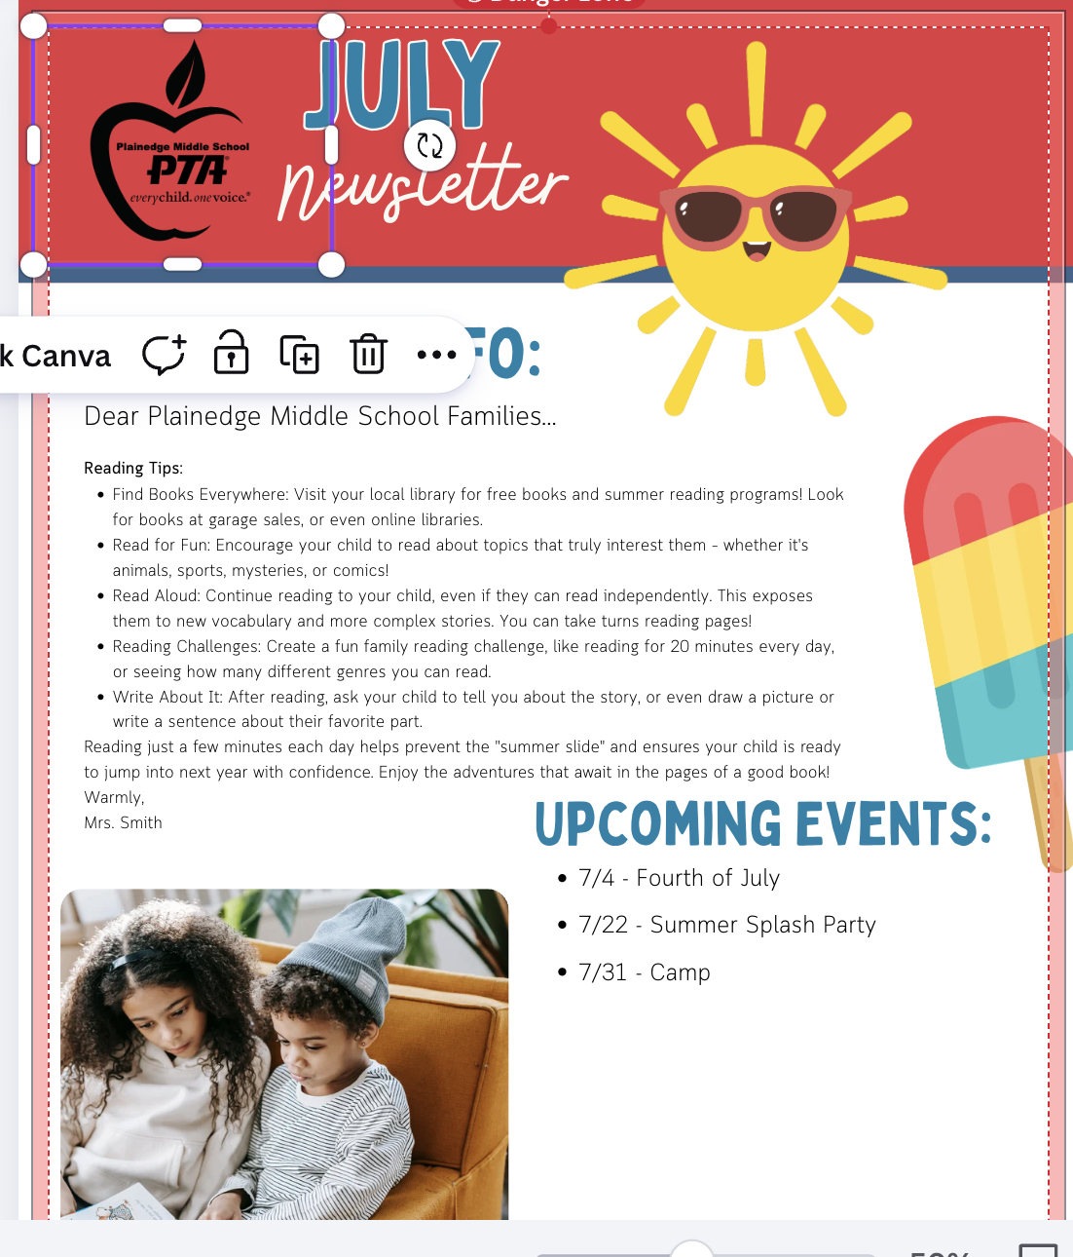
Newsletters
Link to newsletter

Slide 17
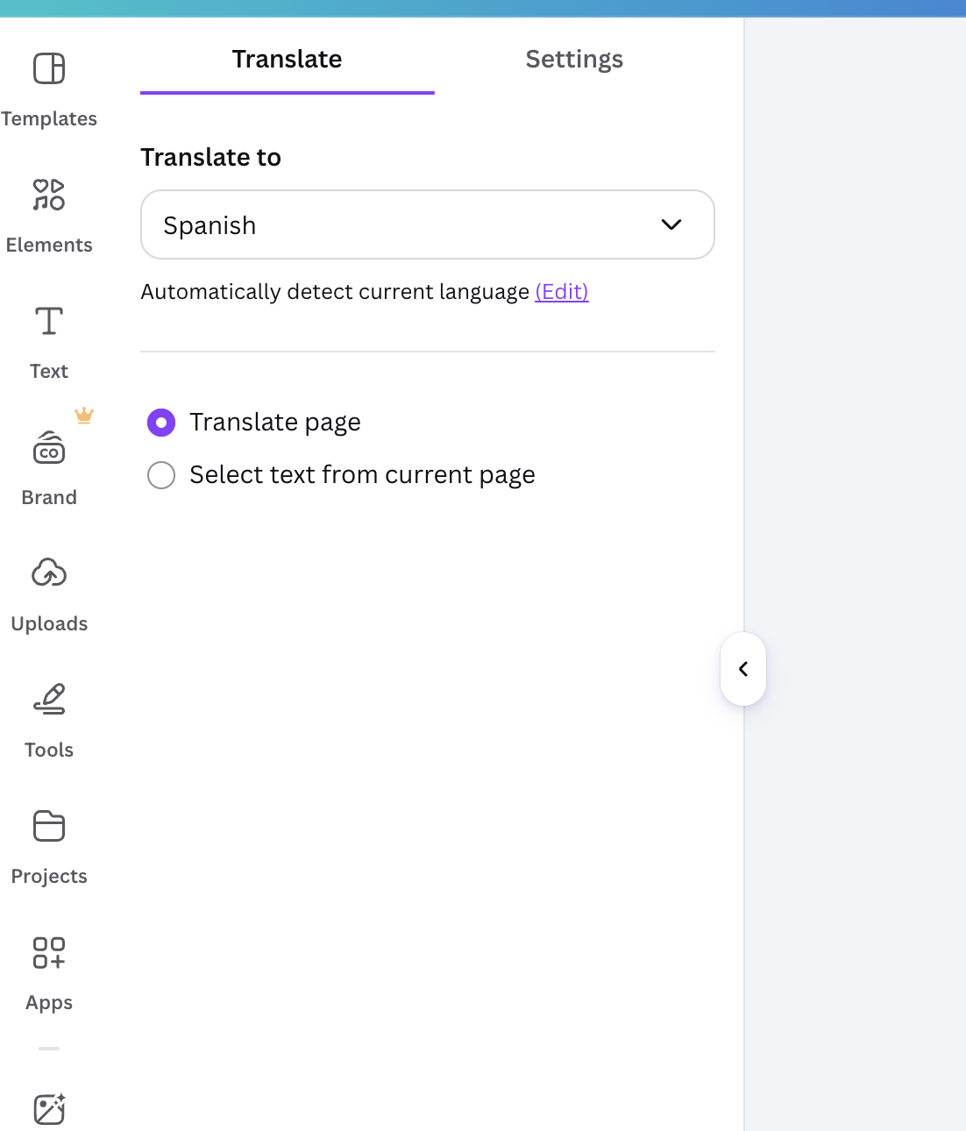
Translation
Link to newsletter
What else can I do?
*Translate
*Insert a QR code

Slide 18
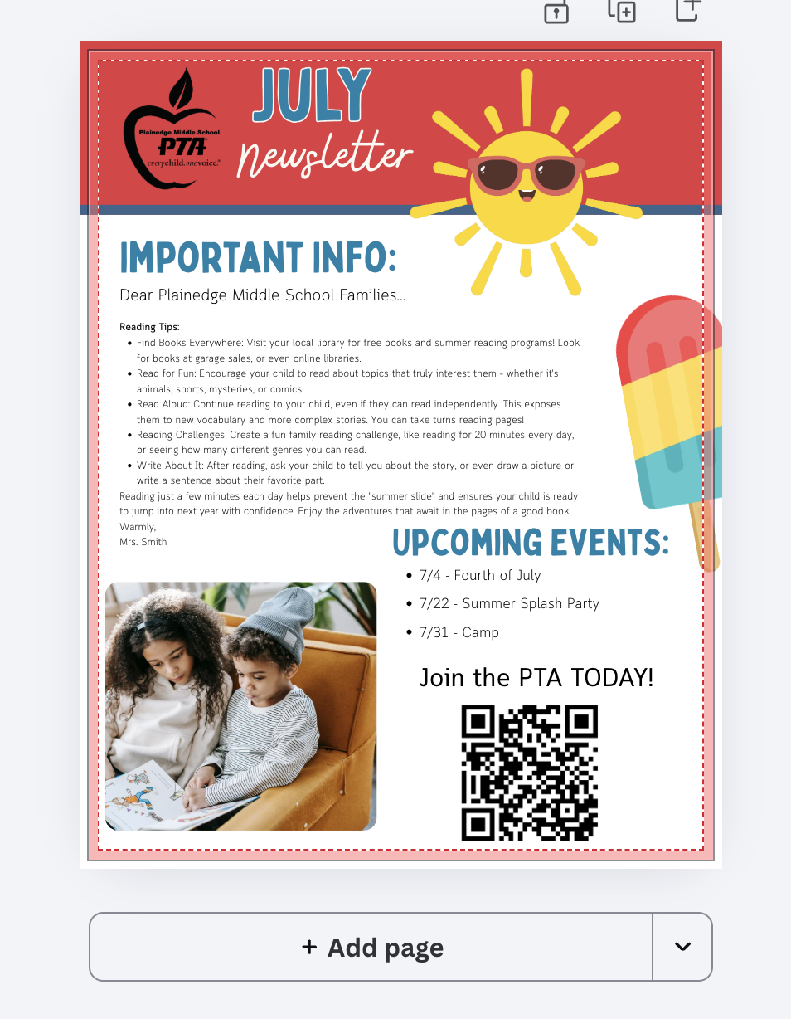
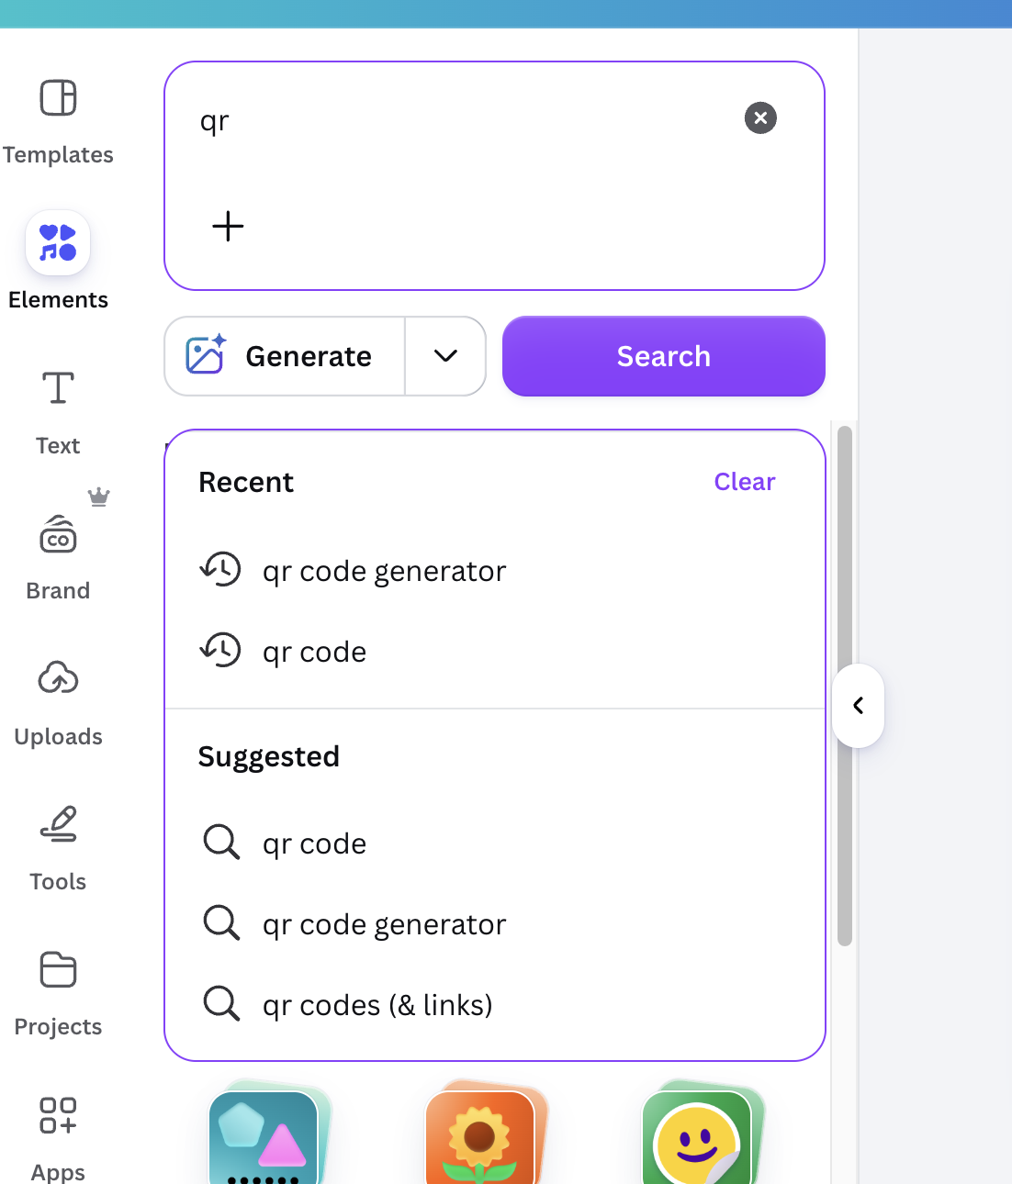
QR Codes
Link to newsletter
Go to elements
QR code generator
Insert website
Generate Code
Code is generated and you can resize as needed.
** Make sure code is open to all**

Slide 19
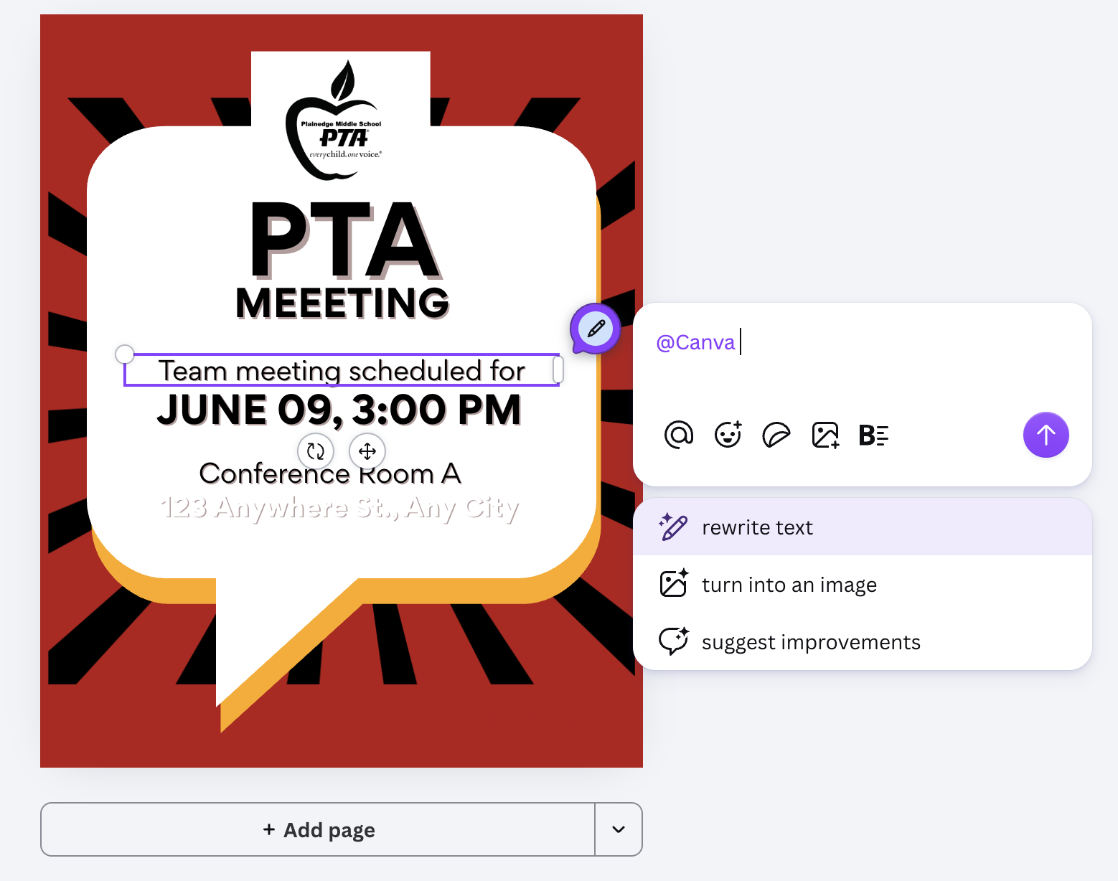
Beyond Basics…Canva AI
Click on text….gives a series of prompts…
Rewrite my text

Slide 20
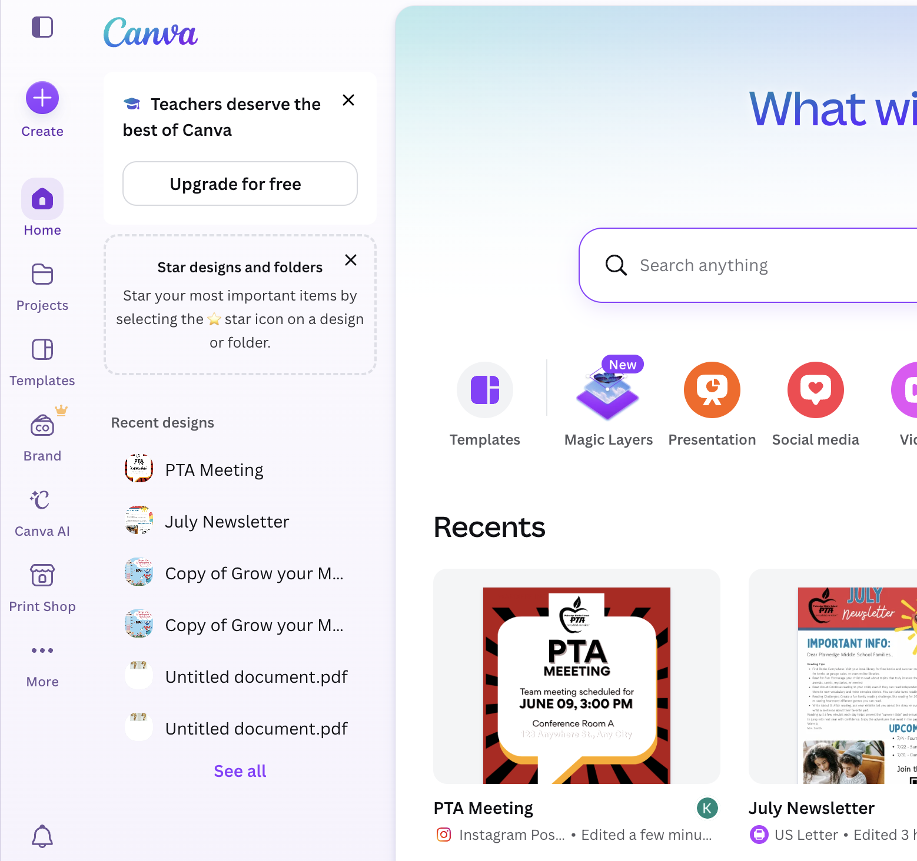
Beyond Basics…Canva AI
Have Canva do they creation for you…
Canva AI Demo

Slide 21
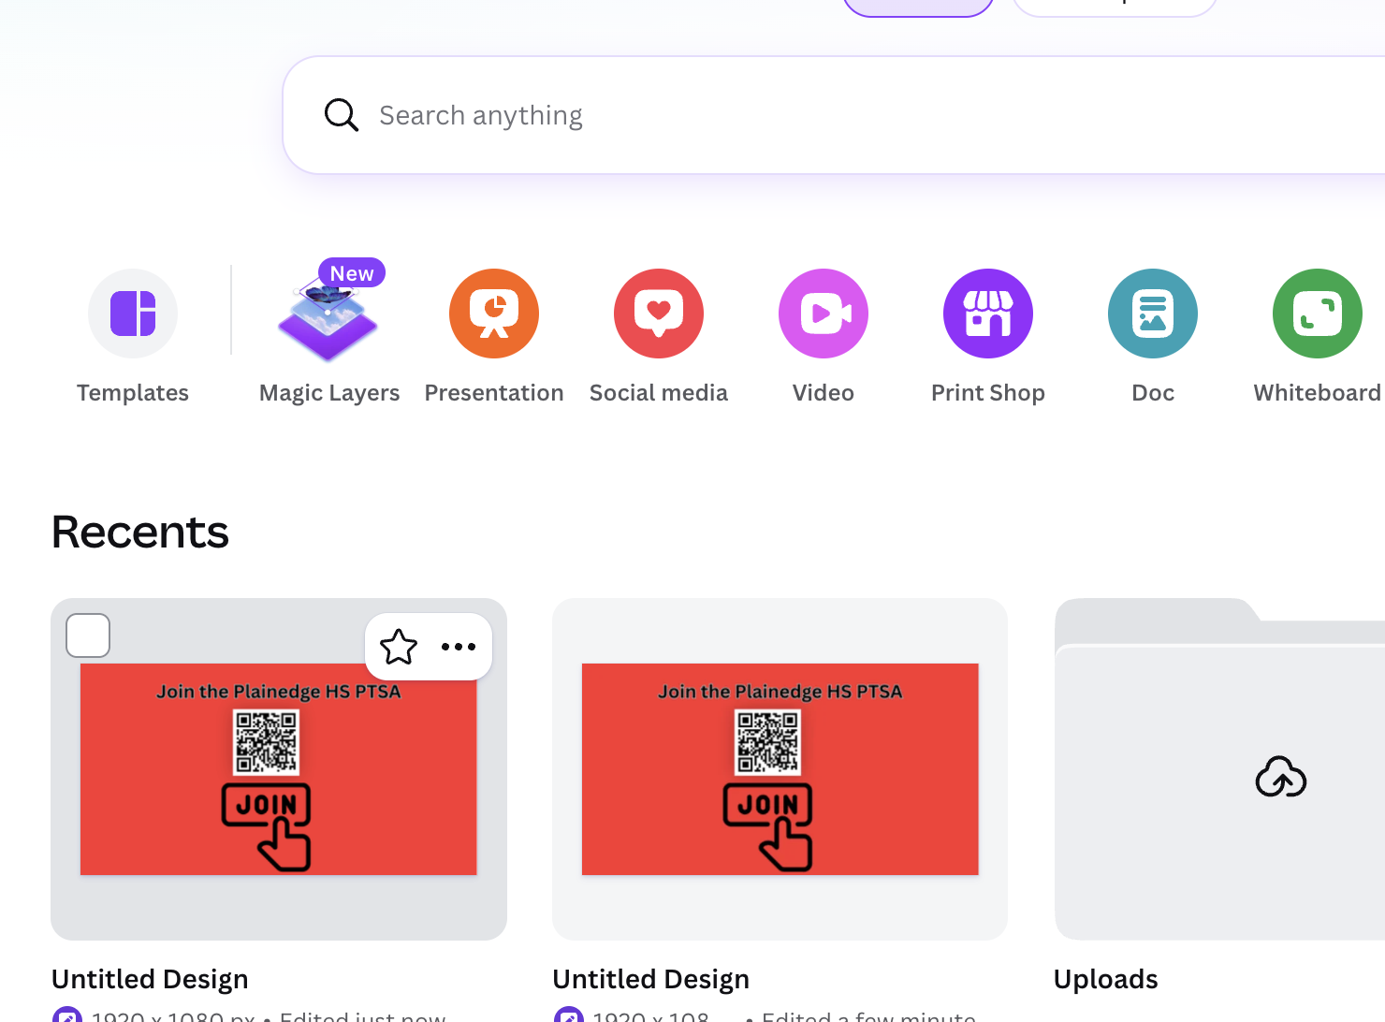
Magic Layers
MAGIC LAYERS DEMO
Free vs. Premium Canva

Slide 22

QUESTIONS?

Slide 23
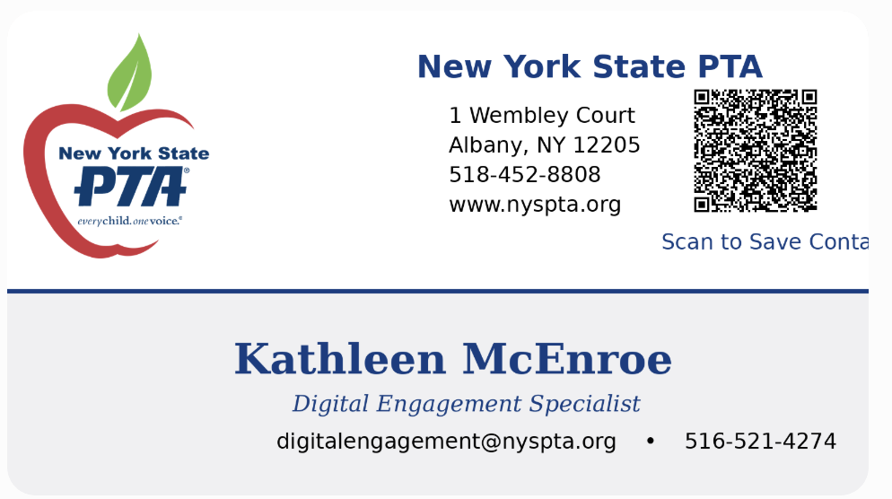

Slide 24
