Slide 1




















Microvolunteering for Modern PTA Families
Small Ways to Make a Big Impact
NYS PTA Membership Engagement Specialist
Danielle Blanchard-St. Louime
New York State
membership
Connecting Hearts
Strengthening Schools
Building Tomorrows
nyspta.org/join

Slide 2




“Uh uh. Get somebody else to do It.”
Common responses from caregivers who can’t (or won’t) volunteer:
I don’t have time.
It’s too much of a commitment.
I don’t know how to help.

Slide 3









What even IS Microvolunteering?
Small, flexible, low‑commitment tasks
Perfect for caregivers with unpredictable schedules
Can be done at home, online, or on-the-go
Requires no special training or background knowledge

Slide 4






PTA Efforts Supported by Microvolunteering
  Events
  Communications
  Fundraising
  Teacher support
  Community outreach
  School environment
  Advocacy
  Family engagement

Slide 5
Why Does This Matter?
  Families are busier than ever
  Traditional roles feel overwhelming
  Many want to help but don’t know how
  Microvolunteering removes barriers and welcomes everyone

Slide 6





Brainstorming Session (15 Mins)
Purpose-Driven, Meaningful Ways to Contribute
Objective: Work in mixed‑unit groups to come up with microvolunteering ideas that can work in any school community. Your group will create:
  2 universal micro‑tasks that any PTA could use
  1 task adaptable to different school sizes (small, medium, large units)
  1 digital‑only task that works regardless of location
  1 culturally inclusive task that welcomes diverse families
  1 “quick win” task that takes under 10 minutes

Slide 7
Brainstorming Session
Purpose-Driven, Meaningful Ways to Contribute
What did we come up with?

Slide 8






Designing Microvolunteering Roles
Use a simple, 3‑part formula:
  One clear task
  One clear time estimate (5–20 minutes)
  One clear way to sign up
Example: “Cut laminated cards for the 2nd grade reading center. Takes 10 minutes. Pick up packet in the office.”

Slide 9


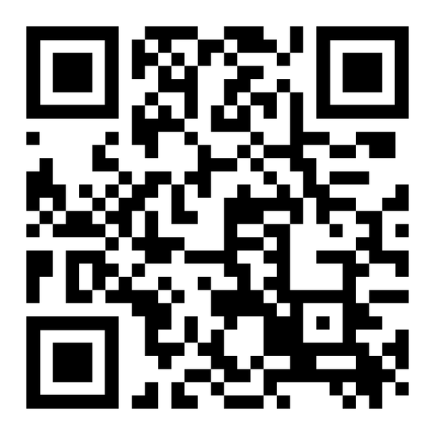


Microvolunteering Toolkit
Scan the code above or click the link below for a short resource guide to help busy families get involved and stay engaged!
Microvolunteering Toolkit Link

Slide 10


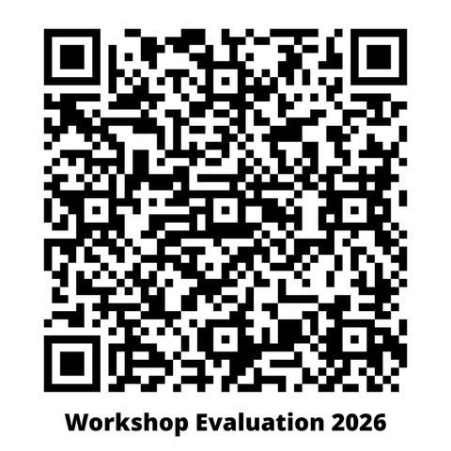



Thank You!
Please submit a workshop evaluation here:
membershipengagement@nyspta.org
https://nyspta.org/home/membership/

