Slide 1



Volunteer Management Best Practices to Strengthen Engagement
Susan Brown
Fieldsupportbrown@nyspta.com

Slide 2

Mission
PTA is a powerful voice for all children, a relevant resource for families and communities, and a strong advocate for the education and well-being of every child.

Slide 3
Why Volunteer Management Matters
Notes:
10 minutes for these 5 slides

Slide 4
My BEST volunteer experience
What made them volunteer?
What kept them engaged?
What made the experience memorable?
Notes:
5 minutes

Slide 5
The same people doing all the work
Difficulty recruiting new volunteers
Volunteer burnout
Lack of leadership succession
Limited family engagement

Slide 6
Why do people volunteer?
Gain
Gain experience
Explore
Explore interests
Become
Become self-confident
Become
Become healthier
Meet
Meet new friends
Strengthen
Strengthen communities
Learn
Learn new skills
Do
Do more good
Become
Become happier
Make
Make the world a better place

Slide 7
People don't volunteer because they have time.
People volunteer because they feel connected, valued, and needed.

Slide 8
Strong volunteer programs:
Increase family engagement
1
Build school-community connections
2
Develop future PTA leaders
3
Improve event success
4
Increase membership retention
5

Slide 9
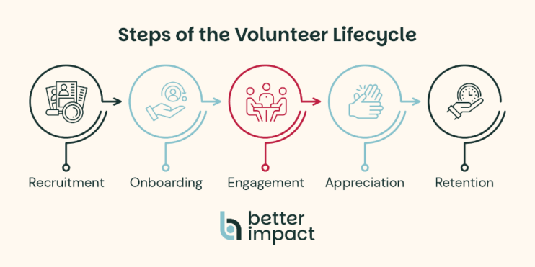
Notes:
10 minutes 2 slides

Slide 10

Which is your strongest stage?
Which stage needs improvement?

Slide 11
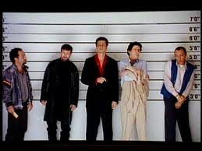
Recruiting Beyond the "Usual Suspects"
Common Recruitment Mistakes
Asking for volunteers only at meetings
Advertising only through one communication channel
Offering only large commitments
Failing to personally invite families
Fail to give a reason why they should join or volunteer
Notes:
10 minutes on recruitment

Slide 12

Hard to reach ←→ hardly reached
“PTA and PTO groups are seen- culturally- as mom spaces. Many dads don’t even consider the possibility that they could (or should) be involved.” (K. Schumacher, After the Donut… p.53)

Slide 13

Dads and Men
Donuts with Dad or Daddy Daughter Dance = starting point
Specific ask and invitations
All Pro Dads https://allprodad.com/
Watch D.O.G.S. https://dadsofgreatstudents.com/

Slide 14

Set tone and expectations
Have opportunities that are:
One-time
Virtual
Family-friendly
Skill-based
Different lengths of time

Slide 15

Use:
Personal invitations
Social media
School communications
Student involvement

Slide 16

How can your PTA reach families and individuals who have never volunteered before?

Slide 17

Onboarding
Code of conduct
  https://nyspta.org/wp-content/uploads/2024/07/Code-of-Conduct-Revised_July-2024.pdf
Screening
  Represent PTA
  Requirements (legal and organizational)
  Set expectations
Description of what is needed
Explain: How will this activity help your PTA meet its mission?
What training is needed?

Slide 18
Volunteer Retention and Recognition
Volunteers stay when they:
Feel welcomed
Know their work matters
Build relationships
Have manageable responsibilities
Receive recognition

Slide 19
Recognition Ideas
Simple gifts
Volunteer spotlights
Recognition at meetings
Student-created thank-you cards
End-of-year appreciation events
April = volunteer appreciation month
Social media shout outs
Formal awards
Personal thank-you notes

Slide 20

List three low-cost ways your PTA can recognize volunteers this year.

Slide 21
Volunteer Feedback & Continuous Improvement
Survey, interview, poll or focus group
Process to identify
Strengths
Weaknesses
Impact- tell the story
“You asked and we changed” summary

Slide 22
Building Your Volunteer Engagement Plan
Communicate your mission and vision
Structured communication
Interactions with leaders
Develop and grow volunteers→ training
Create a team environment
Set a culture of trust
Clear expectations
Recognition
Solicit feedback
Notes:
10 minutes to build a plan

Slide 23
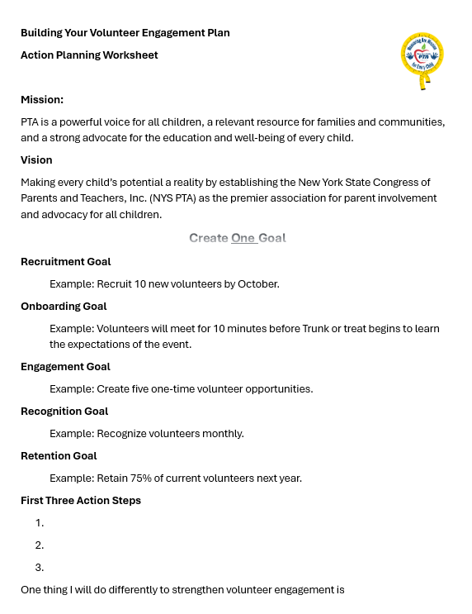

Slide 24

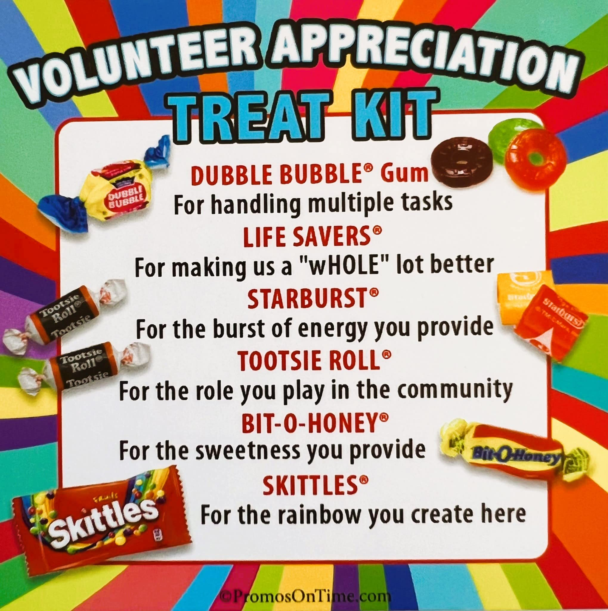


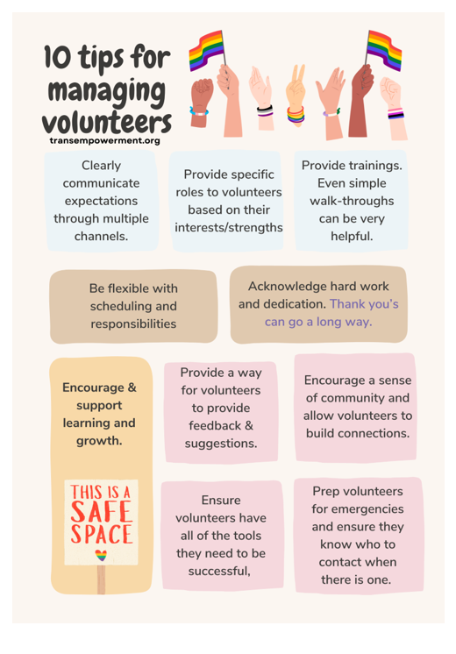
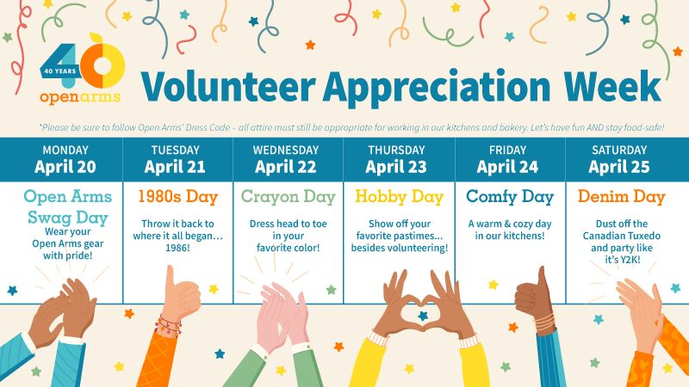

Slide 25

Successful volunteer programs are not built on finding more people willing to help. They are built on creating welcoming opportunities where families feel connected, valued, and empowered to contribute to children’s success.

Slide 26


Slide 27


Slide 28
Resources
Nonprofit learning lab
  https://www.nonprofitlearninglab.org/post/how-to-engage-and-retain-volunteers
Get Connected
  https://www.galaxydigital.com/blog/volunteer-engagement-strategy
  Volunteer Roles with Dana Litwin, CVA
Points of light
  https://www.pointsoflight.org/from-nice-to-necessary-unleashing-the-impact-of-volunteering-through-transformative-investment/

Slide 29
National PTA
  https://www.pta.org/From_S3/Advocacy/CCSSIToolkit/Advocacy%20Training/Volunteer%20Management%20Module.pdf
PTO Today
  https://www.ptotoday.com/pto-today-articles/how-to-be-an-effective-pto-or-pta-volunteer-coordinator
Membership toolkit
  https://membershiptoolkit.com/blogs/post/volunteers-for-your-pta-recruiting-keeping-thanking-them/
After the Donut… K. Schumacher
https://www.strongfathers.com/ strong fathers, strong families
TEP
  https://transempowerment.org/top-10-tips-for-managing-volunteers/

Slide 30
Strategic volunteer engagement
  https://independentsector.org/wp-content/uploads/2024/11/Activating-the-Power-of-Strategic-Volunteer-Engagement.pdf
Volunteer hub
  https://volunteerhub.com/blog/the-ultimate-guide-to-volunteer-management
National Council of Nonprofits
  https://www.councilofnonprofits.org/running-nonprofit/employment-hr/volunteers
United Way
  https://www.youtube.com/watch?v=z7yNwG2Zo44
Do Good Be Kindful
  https://kindful.com/nonprofit-glossary/volunteer-management/

Slide 31

